Slide 1
Consensus or Controversy?
Addressing Practical Clinical Questions Across the Metastatic Lung Cancer Continuum Friday, October 11, 2019
6:15 PM – 7:45 PM Chicago, Illinois
Moderator
Joel W Neal, MD, PhD
Faculty
Nasser H Hanna, MD
Leora Horn, MD, MSc
Lecia V Sequist, MD, MPH

Slide 2
Joel W Neal, MD, PhD
Assistant Professor of Medicine
Division of Oncology
Stanford Cancer Institute
Stanford University
Stanford, California

Slide 3
Disclosures
Advisory Committee | AstraZeneca Pharmaceuticals LP, Exelixis Inc, Genentech, Jounce Therapeutics, Lilly, Roche Laboratories Inc, Takeda Oncology
Contracted Research | Adaptimmune, Boehringer Ingelheim Pharmaceuticals Inc, Exelixis Inc, Genentech, GlaxoSmithKline, Merck, Nektar, Novartis, Roche Laboratories Inc, Takeda Oncology

Slide 4
Nasser H Hanna, MD
Professor of Medicine
Tom and Julie Wood Family Foundation Professor
of Lung Cancer Clinical Research
Indiana University
Indianapolis, Indiana

Slide 5
Disclosures
Contracted Research | AstraZeneca Pharmaceuticals LP, Bristol-Myers Squibb Company, Genentech, Merck
Data and Safety Monitoring Board/Committee | BeyondSpring Inc

Slide 6
Leora Horn, MD, MSc
Ingram Associate Professor of Cancer Research
Director, Thoracic Oncology Research Program
Assistant Vice Chairman for Faculty Development
Vanderbilt University Medical Center
Nashville, Tennessee

Slide 7
Disclosures
Advisory Committee | EMD Serono Inc, Genentech, Xcovery
Consulting Agreements | AbbVie Inc, AstraZeneca Pharmaceuticals LP, EMD Serono Inc, Genentech, Incyte Corporation, Merck, Pfizer Inc, Roche Laboratories Inc, Tesaro, A GSK Company, Xcovery
Contracted Research | AbbVie Inc, AstraZeneca Pharmaceuticals LP, Bayer HealthCare Pharmaceuticals, Boehringer Ingelheim Pharmaceuticals Inc, Bristol-Myers Squibb Company, Genentech, Incyte Corporation, Merck, Takeda Oncology, Xcovery
Paid Travel | Bristol-Myers Squibb Company, Xcovery

Slide 8
Lecia V Sequist, MD, MPH
Director, Center for Innovation in Early Cancer Detection
Massachusetts General Hospital Cancer Center
The Landry Family Professor of Medicine
Harvard Medical School
Boston, Massachusetts

Slide 9
Disclosures
Advisory Committee | AstraZeneca Pharmaceuticals LP, Janssen Biotech Inc
Contracted Research | AstraZeneca Pharmaceuticals LP, Blueprint Medicines, Boehringer Ingelheim Pharmaceuticals Inc, Genentech, Loxo Oncology Inc, a wholly owned subsidiary of Eli Lilly & Company, Novartis

Slide 10
Meeting Agenda
MODULE 1 – Evolving Therapeutic Algorithms in Small Cell Lung Cancer (SCLC)
MODULE 2 – Metastatic NSCLC with EGFR Tumor Mutations
MODULE 3 – Management of NSCLC with ALK Rearrangements
MODULE 4 – Current and Future Role of Existing and Emerging ROS1 Inhibitors
MODULE 5 – Metastatic NSCLC with Other Targetable Tumor Mutations
MODULE 6 – Anti-PD-1/PD-L1 Antibodies Alone or in Combination with Other Therapies for Metastatic NSCLC

Slide 11
In preparation for this meeting, we conducted a survey of 7 medical oncology investigators:
Indiana University
Vanderbilt University Medical Center
Stanford Cancer Institute
Massachusetts General Hospital Cancer Center
University of Pennsylvania
Georgetown University Hospital
Memorial Sloan Kettering Cancer Center

Slide 12
Meeting Agenda
MODULE 1 – Evolving Therapeutic Algorithms in Small Cell Lung Cancer (SCLC)
MODULE 2 – Metastatic NSCLC with EGFR Tumor Mutations
MODULE 3 – Management of NSCLC with ALK Rearrangements
MODULE 4 – Current and Future Role of Existing and Emerging ROS1 Inhibitors
MODULE 5 – Metastatic NSCLC with Other Targetable Tumor Mutations
MODULE 6 – Anti-PD-1/PD-L1 Antibodies Alone or in Combination with Other Therapies for Metastatic NSCLC

Slide 13
Regulatory and reimbursement issues aside, what would be your preferred first-line treatment regimen for a patient with extensive-stage small cell lung cancer (SCLC)?
Age 65
Age 80
Carboplatin/etoposide + atezolizumab
Carboplatin/etoposide + atezolizumab
Carboplatin/etoposide + atezolizumab
Carboplatin/etoposide + atezolizumab
Carboplatin/etoposide + atezolizumab
Carboplatin/etoposide + atezolizumab
Carboplatin/etoposide + atezolizumab
Carboplatin/etoposide + atezolizumab
Carboplatin/etoposide + atezolizumab
Carboplatin/etoposide + atezolizumab
Carboplatin/etoposide + atezolizumab
Carboplatin/etoposide + atezolizumab
Cisplatin/etoposide + durvalumab
Carboplatin/etoposide + atezolizumab

Slide 14
Regulatory and reimbursement issues aside, what would be your preferred first-line treatment regimen for a 65-year-old patient with extensive-stage SCLC and …
Neurologic paraneoplastic syndrome causing moderate to severe proximal myopathy
Symptomatic SIADH (in addition to standard treatment for SIADH)
Carboplatin/etoposide
Carboplatin/etoposide
Carboplatin/etoposide
Carboplatin/etoposide + atezolizumab
Carboplatin/etoposide
Carboplatin/etoposide + atezolizumab
Carboplatin/etoposide
Carboplatin/etoposide + atezolizumab
Carboplatin/etoposide
Carboplatin/etoposide + atezolizumab
Carboplatin/etoposide
Carboplatin/etoposide + atezolizumab
Cisplatin/etoposide
Carboplatin/etoposide + atezolizumab

Slide 15
FDA Approves Atezolizumab for Extensive-Stage SCLC Press Release – March 18, 2019
“The Food and Drug Administration approved atezolizumab in combination with carboplatin and etoposide, for the first-line treatment of adult patients with extensive-stage small cell lung cancer (ES-SCLC).
Approval was based on IMpower133 (NCT02763579), a randomized (1:1), multicenter, double-blind, placebo-controlled trial in 403 patients with ES-SCLC who received no prior chemotherapy for extensive stage disease and had ECOG performance status 0 or 1. Patients were randomized to one of the following:
Atezolizumab 1200 mg and carboplatin AUC 5 mg/mL/min on day 1 and etoposide 100 mg/m² intravenously on days 1, 2 and 3 of each 21-day cycle for a maximum of 4 cycles, followed by atezolizumab 1200 mg once every 3 weeks until disease progression or unacceptable toxicity, or
Placebo and carboplatin AUC 5 mg/mL/min on day 1 and etoposide 100 mg/m² intravenously on days 1, 2, and 3 of each 21-day cycle for a maximum of 4 cycles, followed by placebo once every 3 weeks until disease progression or unacceptable toxicity.”
https://www.fda.gov/drugs/drug-approvals-and-databases/fda-approves-atezolizumab-extensive-stage-small-cell-lung-cancer

Slide 16
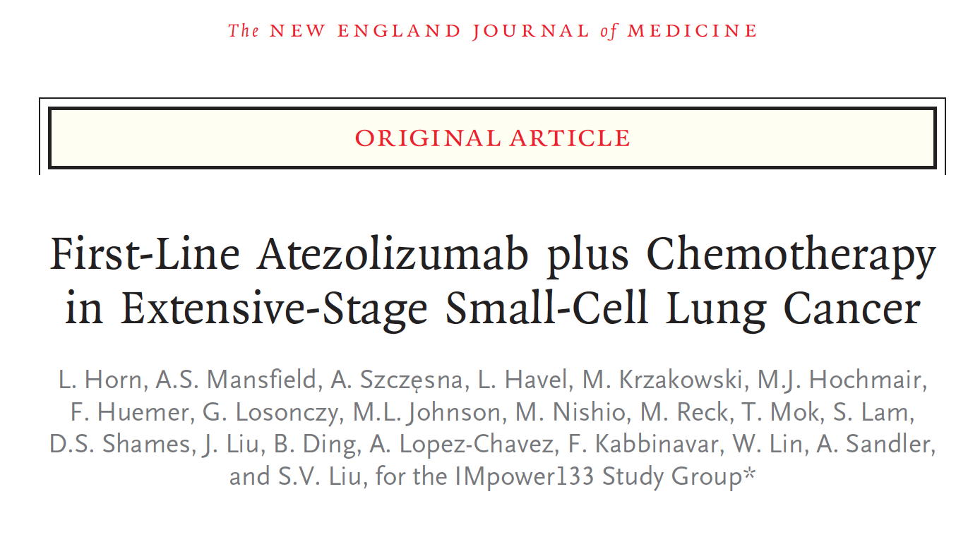
N Engl J Med 2018;379(23):2220-9.

Slide 17
IMpower133: Survival Outcomes with First-Line Atezolizumab and Chemotherapy for Extensive-Stage SCLC
Progression-free survival (PFS)
Overall survival (OS)
Patients who survived (%)
Patients who survived without disease progression (%)
Months
Months
 | Median PFS | 12-mo PFS | HR | p-value
Atezolizumab | 5.2 mo | 12.6% | 0.77 | 0.02
Placebo | 4.3 mo | 5.4%
 | Median OS | 12-mo OS | HR | p-value
Atezolizumab | 12.3 mo | 51.7% | 0.70 | 0.007
Placebo | 10.3 mo | 38.2%
The safety profile of atezolizumab + carboplatin and etoposide was consistent with the previously reported safety profile of the individual agents; no new findings were observed.
Horn L et al. N Engl J Med 2018;379(23):2220-9.

Slide 18
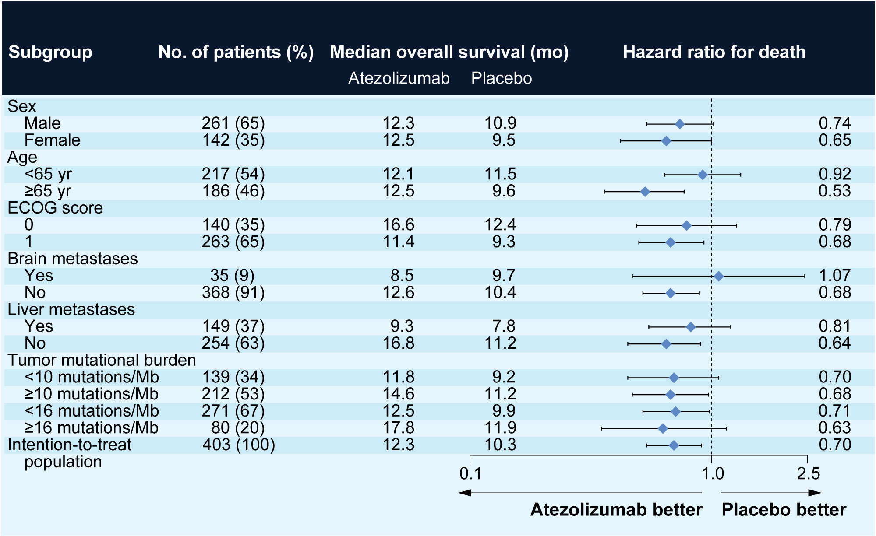
IMpower133: Survival According to Baseline Characteristics
Horn L et al. N Engl J Med 2018;379(23):2220-9.

Slide 19
IMpower133: Select Adverse Events
Adverse event (AE) | Atezolizumab group (N = 198) |  | Placebo group (N = 196)
 | Grade 1-2 | Grade ≥3 | Grade 1-2 | Grade ≥3
Any AE | 36.9% | 58.1% | 34.7% | 57.7%
Neutropenia | 13.1% | 23.2% | 10.2% | 24.5%
Anemia | 24.7% | 14.1% | 20.9% | 12.2%
Decreased neutrophil count | 3.5% | 14.1% | 6.1% | 16.8%
Thrombocytopenia | 6.1% | 10.1% | 7.1% | 7.7%
Leukopenia | 7.6% | 5.1% | 5.1% | 4.1%
Infusion-related reaction | 3.0% | 2.0% | 4.6% | 0.5%
Horn L et al. N Engl J Med 2018;379(23):2220-9.

Slide 20
Overall Survival with Durvalumab plus Platinum-Etoposide in First-Line Extensive-Stage SCLC: Results from the CASPIAN Study
Paz-Ares L et al. Proc WCLC 2019;Abstract PL02.11.

Slide 21
CASPIAN Phase III Trial Design
Durvalumab + EP*
Durvalumab
until disease progression
Randomized (N = 805)
Treatment-naïve ES-SCLC WHO PS 0 or 1 Asymptomatic or treated and stable brain mets permitted
1:1:1
R
EP*
Optional PCI**
Durvalumab + EP + tremelimumab
Durvalumab***
until disease progression
Primary endpoint: OS
Secondary endpoints: PFS, ORR, Safety, Health-related QoL
* EP consists of etoposide 80-100 mg/m² with either carboplatin AUC 5-6 or cisplatin 75-80 mg/m²
** Patients could receive an additional 2 cycles of EP (up to 6 cycles total) and PCI at investigator discretion
*** Patients received an additional dose of tremelimumab post-EP
PCI = prophylactic cranial irradiation; ORR = objective response rate; AUC = area under the curve
Paz-Ares L et al. Proc WCLC 2019;Abstract PL02.11.

Slide 22
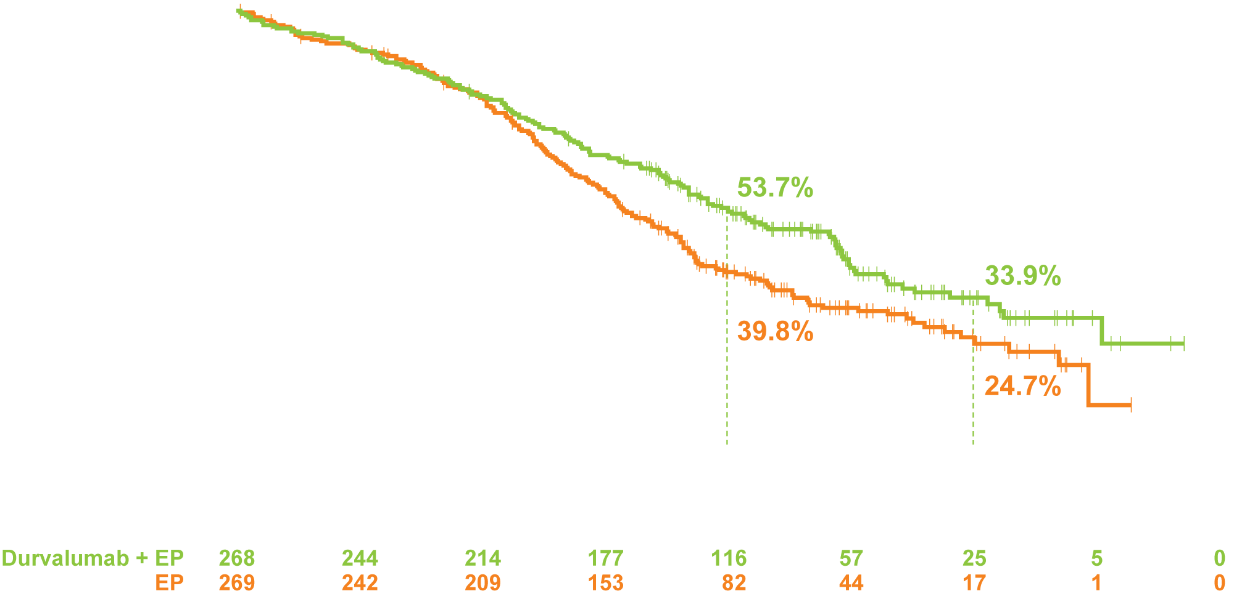
CASPIAN: Overall Survival (Primary Endpoint)
 | Durvalumab + EP | EP
Events, n/N (%) | 155/268 (57.8) | 181/269 (67.3)
mOS, months | 13.0 | 10.3
HR | 0.73
p-value | 0.0047
Probability of PFS
Time from randomization (months)
Grade 3/4 AEs: Durvalumab + EP 61.5%, EP 62.4%
Immune-mediated AEs: Durvalumab + EP 19.6%, EP 2.6%
Paz-Ares L et al. Proc WCLC 2019;Abstract PL02.11.

Slide 23
What would you generally recommend for a 65-year-old patient with metastatic SCLC who experiences a response to first-line treatment with the following agents but then experiences disease progression after 6 months?
Carbo/etoposide
Carbo/etoposide/atezolizumab
Topotecan or irinotecan
Topotecan or irinotecan
Re-treat w/ carbo/etoposide
Re-treat w/ carbo/etoposide
Nivolumab
Topotecan or irinotecan
Re-treat w/ carbo/etoposide
Re-treat w/ carbo/etoposide
Nivolumab/ipilimumab
Carbo/irinotecan
Nivolumab/ipilimumab
Paclitaxel, or re-treat with carbo/etoposide
CAV or re-treat with carbo/etoposide
CAV or re-treat with carbo/etoposide
Carbo = carboplatin

Slide 24
FDA Approves Pembrolizumab for Metastatic SCLC Press Release – June 17, 2019
“The Food and Drug Administration granted accelerated approval to pembrolizumab for patients with metastatic small cell lung cancer (SCLC) with disease progression on or after platinum-based chemotherapy and at least one other prior line of therapy.
Efficacy was investigated in 83 patients with SCLC who had disease progression on or after two or more prior lines of therapy enrolled in one of two multicenter, multi-cohort, non-randomized, open label trials: KEYNOTE-158 (NCT02628067) Cohort G or KEYNOTE-028 (NCT02054806) Cohort C1. Patients received either pembrolizumab 200 mg intravenously every 3 weeks (n = 64) or 10 mg/kg intravenously every 2 weeks (n = 19). Treatment continued until documented disease progression, unacceptable toxicity, or a maximum of 24 months.”
https://www.fda.gov/drugs/resources-information-approved-drugs/fda-approves-pembrolizumab-metastatic-small-cell-lung-cancer

Slide 25
Pembrolizumab After Two or More Lines of Prior Therapy in Patients with Advanced Small-Cell Lung Cancer (SCLC): Results from the KEYNOTE-028 and KEYNOTE-158 Studies
Chung HC et al. Proc AACR 2019;Abstract CT073.

Slide 26
KEYNOTE-028 and KEYNOTE-158: Pembrolizumab After 2 or More Lines of Prior Therapy in Advanced SCLC
Primary and secondary endpoints | Patients eligible for efficacy analyses (n = 83)
ORR | 19.3%
Median PFS | 2.0 mo
Median OS | 7.7 mo
Median DoR | Not reached
Chung HC et al. Proc AACR 2019;Abstract CT073.

Slide 27
FDA Grants Nivolumab Accelerated Approval for Third-Line Treatment of Metastatic SCLC Press Release – August 16, 2018
“The Food and Drug Administration granted accelerated approval to nivolumab for patients with metastatic small cell lung cancer (SCLC) with progression after platinum-based chemotherapy and at least one other line of therapy.
Approval was based on demonstration of a durable overall response rate (ORR) in a subgroup of patients from CheckMate-032 (NCT01928394), a multicenter, open-label trial in patients with metastatic solid tumors. This subgroup comprised 109 patients with metastatic SCLC, with disease progression after platinum-based therapy and at least one other prior line of therapy, regardless of tumor PD-L1 status.”
https://www.fda.gov/drugs/resources-information-approved-drugs/fda-grants-nivolumab-accelerated-approval-third-line-treatment-metastatic-small-cell-lung-cancer

Slide 28
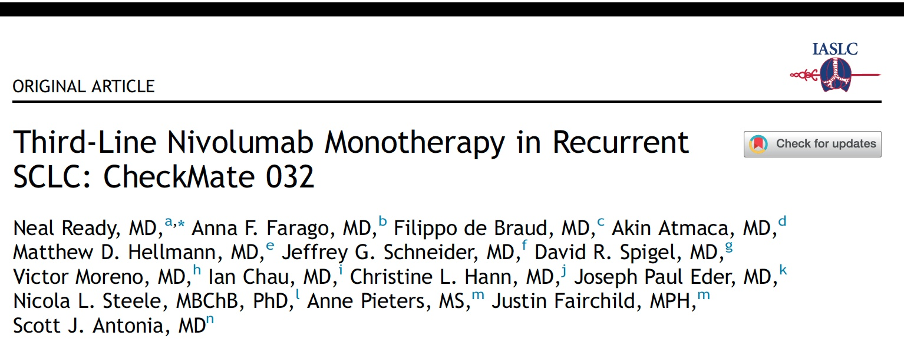
J Thorac Oncol 2019;14(2):237-44.

Slide 29
CheckMate 032: Nivolumab Monotherapy as Third- or Later-Line Therapy in SCLC
Primary and secondary endpoints | (N = 109)
ORR by BICR | 11.9%
DoR ≥6 mo DoR ≥12 mo | 76.9% 61.5%
Median PFS | 1.4 mo
Median OS | 5.6 mo
Ready N et al. J Thorac Oncol 2019;14(2):237-44.

Slide 30
Nivolumab +/- Ipilimumab in Advanced Small Cell Lung Cancer: First Report of a Randomized Cohort from CheckMate 032
Hellmann MD et al. Proc ASCO 2017;Abstract 8503.

Slide 31
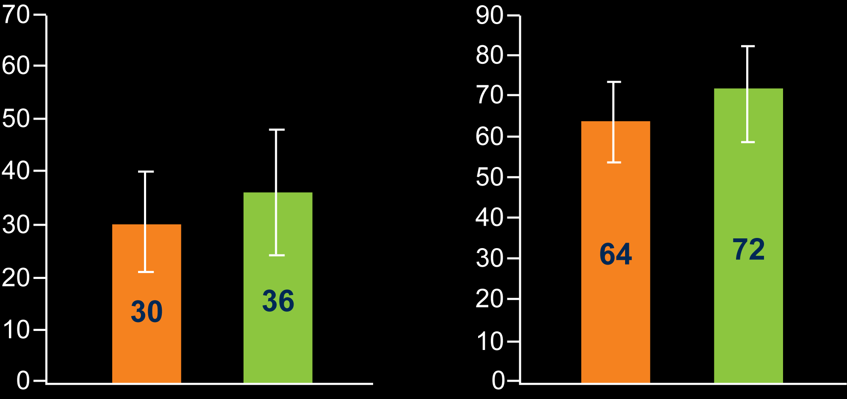
CheckMate 032: Nivolumab + Ipilimumab in Recurrent SCLC
Pooled cohorts – randomized and non-randomized |  | Line of therapy |  | Platinum sensitivity
 | Overall population (N = 156) | Second-line (n = 98) | ≥Third-line (n = 58) | Platinum-sensitive (n = 85) | Platinum-resistant (n = 65)
ORR | 22% | 19% | 26% | 26% | 15%
Nivo + ipi randomized cohort
Nivo + ipi non-randomized cohort
PFS (%)
OS (%)
n
95
61
n
95
61
Hellmann MD et al. Proc ASCO 2017;Abstract 8503.

Slide 32
Meeting Agenda
MODULE 1 – Evolving Therapeutic Algorithms in Small Cell Lung Cancer (SCLC)
MODULE 2 – Metastatic NSCLC with EGFR Tumor Mutations
MODULE 3 – Management of NSCLC with ALK Rearrangements
MODULE 4 – Current and Future Role of Existing and Emerging ROS1 Inhibitors
MODULE 5 – Metastatic NSCLC with Other Targetable Tumor Mutations
MODULE 6 – Anti-PD-1/PD-L1 Antibodies Alone or in Combination with Other Therapies for Metastatic NSCLC

Slide 33
Which first-line therapy would you recommend for an asymptomatic patient with metastatic nonsquamous NSCLC with an EGFR exon 19 deletion and a …
PD-L1 TPS of 60%
PD-L1 TPS of 10%
Osimertinib
Osimertinib
Osimertinib
Osimertinib
Osimertinib
Osimertinib
Osimertinib
Osimertinib
Osimertinib
Osimertinib
Osimertinib
Osimertinib
Osimertinib
Osimertinib
TPS = tumor proportion score

Slide 34
What is your most likely next systemic therapy for a patient with metastatic nonsquamous NSCLC with an EGFR exon 19 deletion and a PD-L1 TPS of 60% who responds to first-line osimertinib and then experiences disease progression with no targetable secondary mutation?
Atezolizumab/carboplatin/paclitaxel + bevacizumab
Chemotherapy + bevacizumab
Pembrolizumab/carboplatin/pemetrexed
Carbo/pemetrexed/osimertinib
Atezolizumab/carboplatin/paclitaxel + bevacizumab
Atezolizumab/carboplatin/paclitaxel + bevacizumab
Chemotherapy + bevacizumab

Slide 35
Osimertinib vs Comparator EGFR-TKI as First-Line Treatment for EGFRm Advanced NSCLC (FLAURA): Final Overall Survival Analysis
Ramalingam SS et al. Proc ESMO 2019;Abstract LBA5_PR.

Slide 36
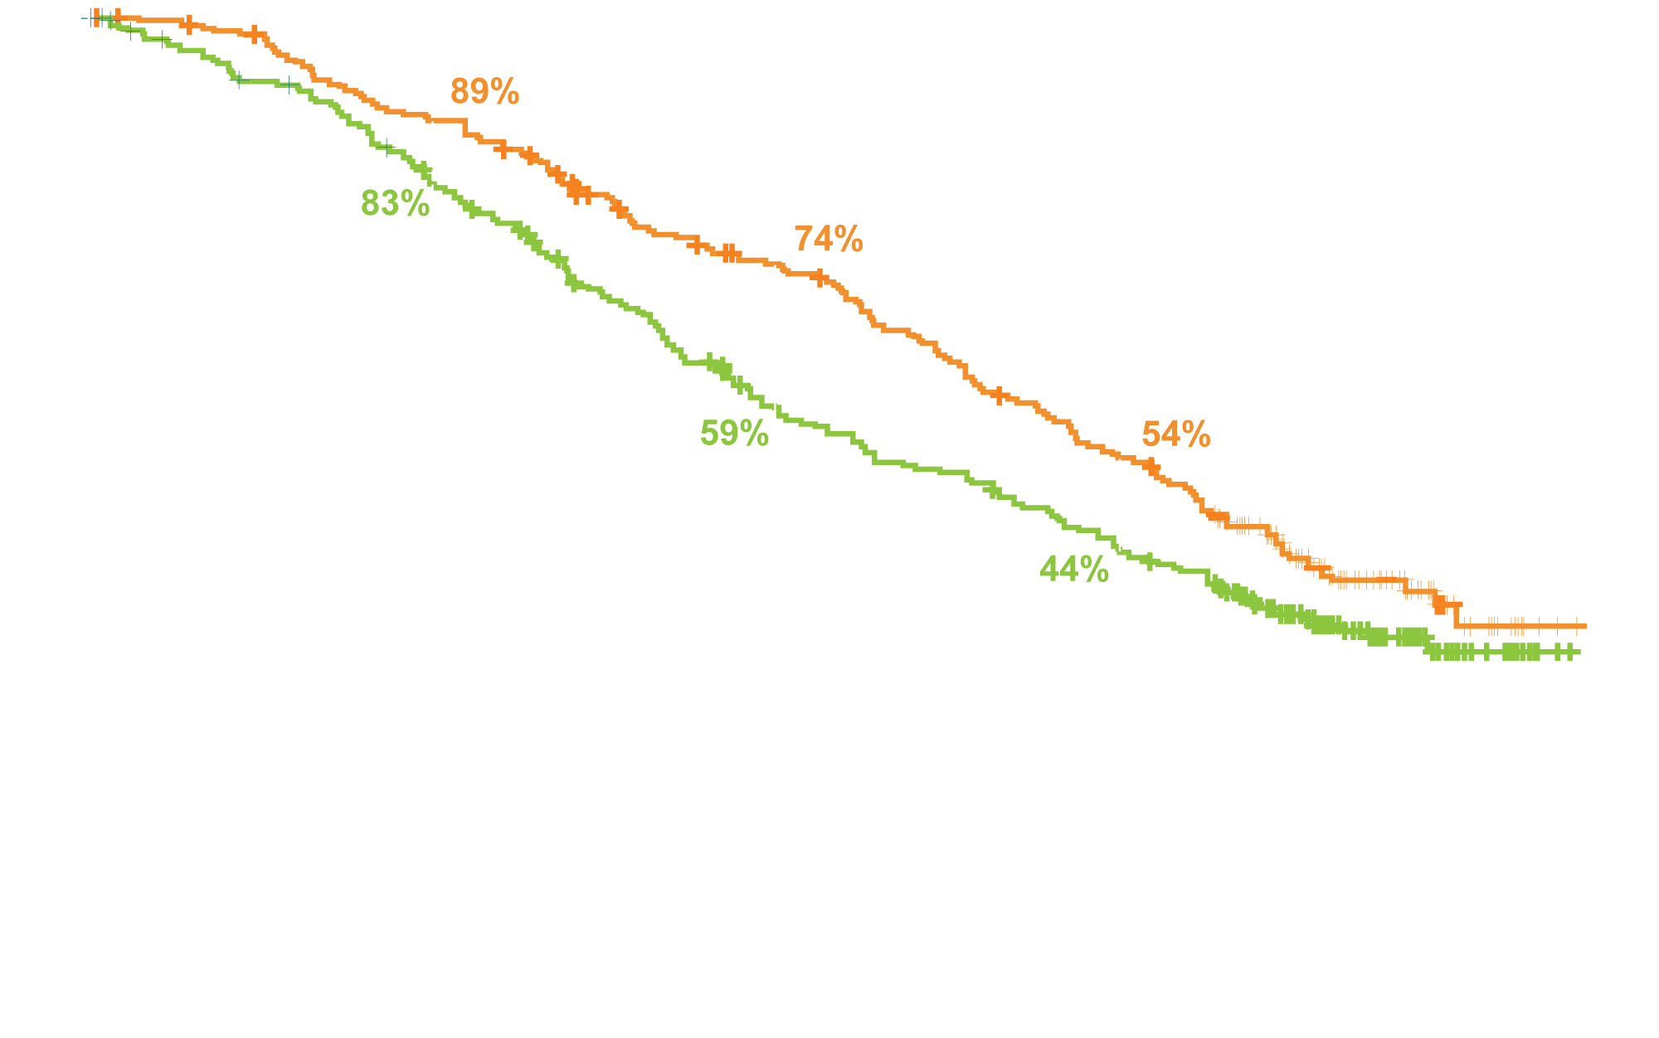
FLAURA: Final Overall Survival Analysis
EGFR TKI | N | Median OS
Osimertinib | 279 | 38.6 mo
Comparator EGFR TKI | 277 | 31.8 mo
Hazard ratio (p-value) | 0.799 (0.0462)
Probability of overall survival
Time from randomisation (months)
Ramalingam SS et al. Proc ESMO 2019;Abstract LBA5_PR.

Slide 37
FLAURA2 Phase III Study Design
Osimertinib +
cisplatin / carboplatin + pemetrexed x 4
Maintenance osimertinib + pemetrexed
PFS
Subsequent treatment
investigator’s choice
PFS2, OS
Randomized (N = 556)
Locally advanced/ metastatic nonsquamous NSCLC EGFRm (exon 19 del, L858R)
1:1
R
Osimertinib
Primary endpoint: Progression-free survival
Secondary endpoints: OS, landmark OS, ORR, DoR, PFS2, QoL, others
Jänne PA et al. Proc IASLC 2019;Abstract OA07.01. www.clinicaltrials.gov (NCT04035486)

Slide 38
Lancet Oncol 2019;[Epub ahead of print].

Slide 39
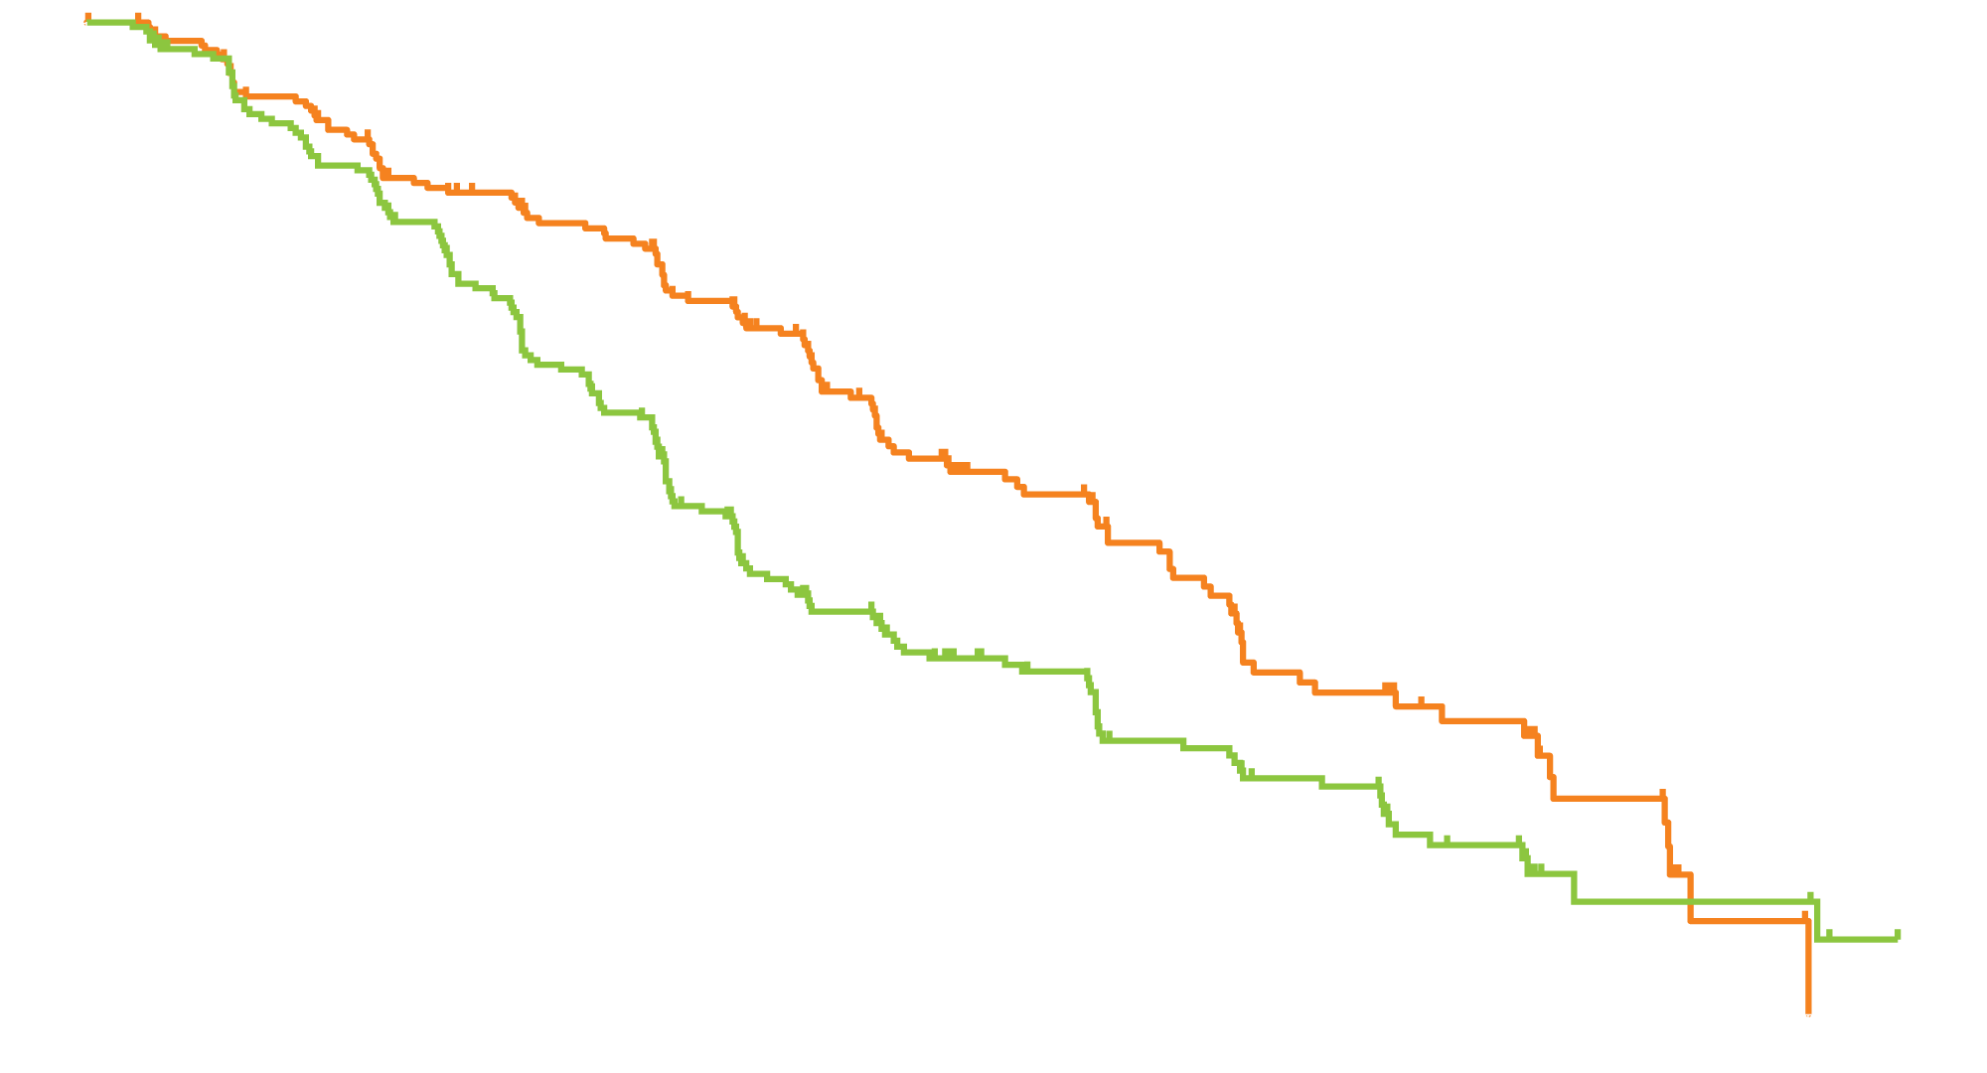
RELAY: Ramucirumab with Erlotinib for Previously Untreated, Advanced NSCLC with EGFR Mutations
PFS
Ramucirumab and erlotinib (median 19.4 months)
Placebo and erlotinib (median 12.4 months)
Progression-free survival (%)
Hazard ratio 0.59; p < 0.0001
Time since randomisation (months)
Nakagawa K et al. Lancet Oncol 2019;[Epub ahead of print].

Slide 40
RELAY: Select Adverse Events
Adverse event | Ramucirumab + erlotinib (N = 221) |  | Placebo + erlotinib (N = 225)
 | Grade 1-2 | Grade ≥3 | Grade 1-2 | Grade ≥3
Diarrhea | 63% | 7% | 70% | 1%
Dermatitis acneiform | 52% | 15% | 59% | 9%
Hypertension | 22% | 24% | 7% | 5%
Alanine aminotransferase increase | 34% | 9% | 24% | 7%
Aspartate aminotransferase increase | 37% | 5% | 21% | 4%
Pyrexia | 21% | 0 | 12% | <1%
Interstitial lung disease or pneumonitis | 1% | <1% | 2% | 1%
Nakagawa K et al. Lancet Oncol 2019;[Epub ahead of print].

Slide 41
Meeting Agenda
MODULE 1 – Evolving Therapeutic Algorithms in Small Cell Lung Cancer (SCLC)
MODULE 2 – Metastatic NSCLC with EGFR Tumor Mutations
MODULE 3 – Management of NSCLC with ALK Rearrangements
MODULE 4 – Current and Future Role of Existing and Emerging ROS1 Inhibitors
MODULE 5 – Metastatic NSCLC with Other Targetable Tumor Mutations
MODULE 6 – Anti-PD-1/PD-L1 Antibodies Alone or in Combination with Other Therapies for Metastatic NSCLC

Slide 42
Which first-line therapy would you generally recommend for an asymptomatic patient with metastatic nonsquamous NSCLC with an ALK rearrangement and a PD-L1 TPS of 60%?
Brigatinib
Alectinib
Alectinib
Alectinib
Alectinib
Alectinib
Alectinib

Slide 43
For a patient with metastatic nonsquamous NSCLC with an ALK rearrangement and a PD-L1 TPS of 60% who receives first-line alectinib with response followed by disease progression, would you recommend repeat biopsy for additional mutation testing?
Yes
Yes
Yes
Yes
Yes
Yes
No

Slide 44
Molecular Targeting, Potency and Indications for ALK Inhibitors
ALK inhibitor | Molecular targets | ALK IC₅₀ | Indication
Crizotinib | ALK, MET, ROS1 | 3-4.5 nM | Metastatic ALK or ROS1-positive NSCLC
Ceritinib | ALK, IGF-1R, ROS1 | 0.15 nM | Metastatic ALK-positive NSCLC
Alectinib | ALK | 1.9 nM | Metastatic ALK-positive NSCLC
Brigatinib | ALK, EGFR, ROS1 | 0.62 nM | Metastatic ALK-positive NSCLC after progression on or intolerance to crizotinib
Lorlatinib | ALK, ROS1 | <0.07-1.3 nM | Metastatic ALK-positive NSCLC with disease progression on Crizotinib and at least 1 other ALK inhibitor for metastatic disease; or Alectinib as the first ALK inhibitor therapy for metastatic disease; or Ceritinib as the first ALK inhibitor therapy for metastatic disease
Mok T et al. Cancer Treat Rev 2017;55:181-9. Zhang I et al. Lancet Oncol 2015;16:e510-21. Crizotinib PI (rev 6/2019); Ceritinib PI (rev 3/2019), Alectinib PI (6/2018), Brigatinib PI (12/2018), Lorlatinib PI (11/2018)

Slide 45
Mutation Coverage for ALK Inhibitors
Mutations | Crizotinib | Alectinib | Ceritinib | Brigatinib | Lorlatinib
EML4-ALK | S | S | S | S | S
L1196M | R | S | S | S | S
L1152P/R | R | S | R | S | S
G1123S | R | S | R | NA | NA
1151Tins | R | S | R | NA | S
C1156Y | R | S | R | S | S
F1174V/C/L | R | S | R | S | S
I1171T/N/S | R | R | S | NA | NA
V1180L | R | R | S | NA | NA
G1202R | R | R | R | S | S
G1269A/S | R | S | S | S | S
F1245C | R | NA | S | NA | NA
S1206C/Y/F | R | S | S | R | S
E1210K | R | S | S | S | S
L1198F | S | R | R | S | R
D1203N | R | S | S | S | S
CMET amp | S | R | R | R | R
The letter “S” denotes mutations that are “sensitive” (clinical and/or preclinical data) to a given compound, and “R” denotes resistance. NA = data not available
Tran PN, Klempner SJ. Front Med 2016;3:65.

Slide 46
CNS Activity of ALK Inhibitors in Advanced NSCLC with ALK Rearrangements
ALK inhibitor | Study | No. of patients | CNS ORR
Crizotinib | ALTA-1L | 21 | 29%
 | ALEX | 11 | 50%
Ceritinib | ASCEND-4 | 54 | 46%
Alectinib | ALEX | 17 | 81%
Brigatinib | ALTA-1L | 18 | 78%
Lorlatinib first-line Phase III study versus crizotinib (CROWN, NCT03052608) is ongoing with estimated primary completion December 31, 2020
Peters S et al. NEJM 2017;377(9):829-38; Camidge DR et al. NEJM 2018;379:2027-39.
Soria JC et al. Lancet 2017;389(10072):917-29; www.clinicaltrials.gov. Accessed October 2019.

Slide 47
Meeting Agenda
MODULE 1 – Evolving Therapeutic Algorithms in Small Cell Lung Cancer (SCLC)
MODULE 2 – Metastatic NSCLC with EGFR Tumor Mutations
MODULE 3 – Management of NSCLC with ALK Rearrangements
MODULE 4 – Current and Future Role of Existing and Emerging ROS1 Inhibitors
MODULE 5 – Metastatic NSCLC with Other Targetable Tumor Mutations
MODULE 6 – Anti-PD-1/PD-L1 Antibodies Alone or in Combination with Other Therapies for Metastatic NSCLC

Slide 48
Which first-line therapy would you generally recommend for an asymptomatic patient with metastatic nonsquamous NSCLC with a ROS1 rearrangement and a PD-L1 TPS of 60%?
Entrectinib
Entrectinib
Crizotinib
Crizotinib
Crizotinib
Entrectinib
Crizotinib

Slide 49
In general, what would be your preferred choice of second-line therapy for a patient with metastatic nonsquamous NSCLC with a ROS1 rearrangement and a TPS of 60% who experienced disease progression on crizotinib? What would be your preferred choice if the patient were asymptomatic and developed a new solitary brain metastasis with no evidence of disease progression elsewhere?
PD on crizotinib
Solitary brain met
Pembro/carbo/pemetrexed
Continue crizotinib; manage brain met with local therapy
Lorlatinib
Continue crizotinib; manage brain met with local therapy
Lorlatinib
Continue crizotinib; manage brain met with local therapy
Entrectinib
Switch to entrectinib
Entrectinib or lorlatinib
Continue crizotinib; manage brain met with local therapy
Lorlatinib
Switch to entrectinib
Lorlatinib
Switch to entrectinib

Slide 50
Mechanism of Action of Entrectinib in ROS1 Disease
Membrane
Entrectinib is a CNS-active, oral, potent and selective ROS1/TRK/ALK tyrosine kinase inhibitor designed to cross the blood–brain barrier and remain within the CNS¹⁻³
TRKA (NTRK1) fusion
TRKB (NTRK2) fusion
TRKC (NTRK3) fusion
ROS1 fusion
Cytoplasm
More potent ROS1 inhibitor than crizotinib in preclinical studies³
Demonstrated clinical activity in multiple tumour histologies including primary brain tumours and secondary CNS metastases⁴
X
X
MARK pathway
PI3K-AKT pathway
X
X
Nucleus
Tumor cell proliferation
Cell survival
¹ Amatu, et al. ESMO Open 2016; ² Menichincheri, et al. J Med Chem 2016 ³ Ardini, et al. Mol Cancer Ther 2016; ⁴ Drilon, et al. Cancer Discov 2017
Barlesi F et al. Proc ELCC 2019;Abstract 109O.

Slide 51
FDA Approves Entrectinib for ROS1 NSCLC Press Release – August 15, 2019
The FDA approved entrectinib for adults with metastatic non-small cell lung cancer (NSCLC) whose tumors are ROS1-positive.
“Efficacy in ROS1-positive metastatic NSCLC was investigated in 51 adult patients who received entrectinib at various doses and schedules in the same three trials; 90% received entrectinib 600 mg orally once daily. The overall response rate was 78% and response duration was 12 months or longer for 55% of patients.
The most serious adverse reactions to entrectinib are congestive heart failure, central nervous system effects, skeletal fractures, hepatotoxicity, hyperuricemia, QT interval prolongation, and vision disorders. The most common adverse reactions in at least 20% of patients were fatigue, constipation, dysgeusia, edema, dizziness, diarrhea, nausea, dysesthesia, dyspnea, myalgia, cognitive impairment, increased weight, cough, vomiting, pyrexia, arthralgia, and vision disorders.”
https://www.fda.gov/drugs/resources-information-approved-drugs/fda-approves-entrectinib-ntrk-solid-tumors-and-ros-1-nsclc

Slide 52
Entrectinib in Locally Advanced or Metastatic ROS1 Fusion-Positive Non-Small Cell Lung Cancer (NSCLC): Integrated Analysis of STARTRK-2, STARTRK-1 and ALKA-372-001¹ Entrectinib in Locally Advanced/Metastatic ROS1 and NTRK Fusion-Positive Non-Small Cell Lung Cancer (NSCLC): Updated Integrated Analysis of STARTRK-2, STARTRK-1 and ALKA-372-001²
¹Barlesi F et al. Proc ELCC 2019;Abstract 109O.
²De Braud FGM et al. Proc ESMO 2019;Abstract 1488PD.

Slide 53
Integrated Analysis Design
Efficacy population
Adult patients with ROS1+ NSCLC, ROS1 inhibitor-naïve n = 53
CNS metastases, n = 23; no CNS metastases, n = 30
Phase I (ALKA-372-001) Phase I dose-escalation study ROS1+ NSCLC patients n = 9
Phase I (STARTRK-1) Phase I dose-escalation study ROS1+ NSCLC patients n = 7
Phase II (STARTRK-2) Phase II, multicenter, global basket study Entrectinib 600 mg once daily, 28-day cycle ROS1+ NSCLC patients n = 37
Safety populations ROS1+ NSCLC patients receiving entrectinib n = 134
Patients receiving entrectinib (all tumor types and gene rearrangements) n = 355
Primary endpoints:
ORR
DoR
Secondary endpoints:
PFS and OS
Intracranial ORR and DoR
Safety and tolerability
Primary data cutoff: 31 May 2018
Updated data cutoff: 30 October 2018
Barlesi F et al. Proc ELCC 2019;Abstract 109O; De Braud FGM et al. Proc ESMO 2019;Abstract 1488PD.

Slide 54
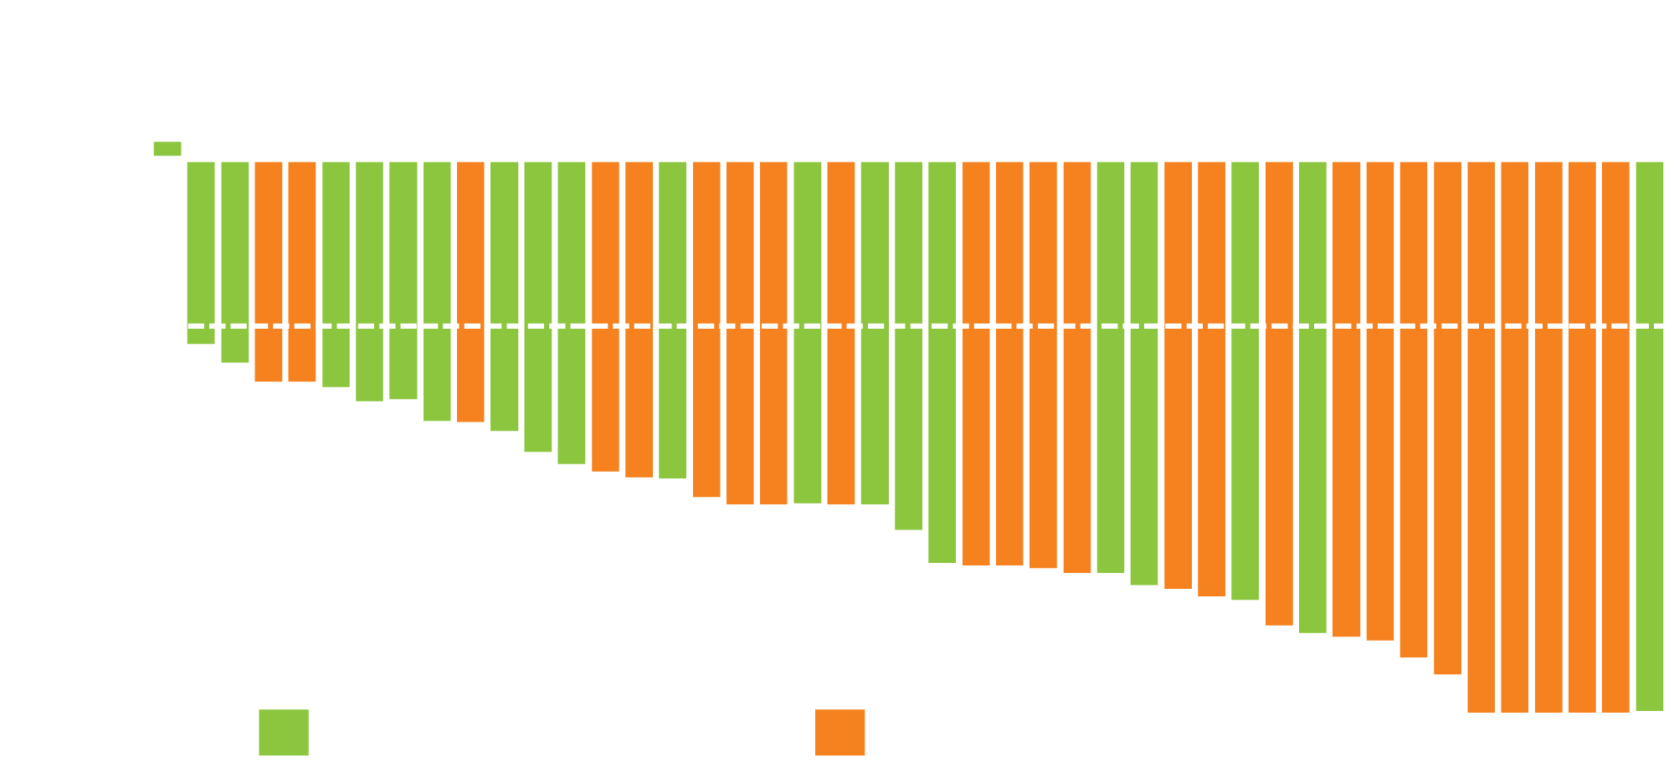
Efficacy of Entrectinib in ROS1-Positive NSCLC
Best percent change from baseline in tumor size
CNS disease at baseline¹
Efficacy | Total (N = 53) | CNS + at baseline (n = 23) | CNS - at baseline (n = 30)
ORR² | 79.2% | 73.9% | 83.3%
Median DoR² | 24.6 mo | 12.9 mo | 24.6 mo
Median PFS¹ | 19.0 mo | 13.6 mo | 26.3 mo
Median OS¹ | NE | — | —
Best % improvement from baseline in SLD
Individual patients
Subjects with missing SLD percent change were excluded from plot
¹Barlesi F et al. Proc ELCC 2019;Abstract 109O; ²De Braud FGM et al. Proc ESMO 2019;Abstract 1488PD.

Slide 55
Select Entrectinib-Related Adverse Events
Adverse event | ROS1+ NSCLC safety-evaluable population (N = 134)
 | All grades | Grade ≥3
Dysgeusia | 43% | 0.7%
Dizziness | 33% | 0.7%
Constipation | 33% | 0
Diarrhea | 28% | 2.2%
Weight increase | 27% | 7.5%
Blood creatinine increase | 13% | 0.7%
Aspartate aminotransferase increase | 12% | 1.5%
AEs leading to dose reduction: 34% AEs leading to discontinuation: 4.5%
Barlesi F et al. Proc ELCC 2019;Abstract 109O.

Slide 56
Efficacy of Lorlatinib in Patients with ROS1-Positive Advanced Non-Small Cell Lung Cancer (NSCLC) and ROS1 Kinase Domain Mutations
Solomon BJ et al. Proc ESMO 2018;Abstract 1380PD.

Slide 57
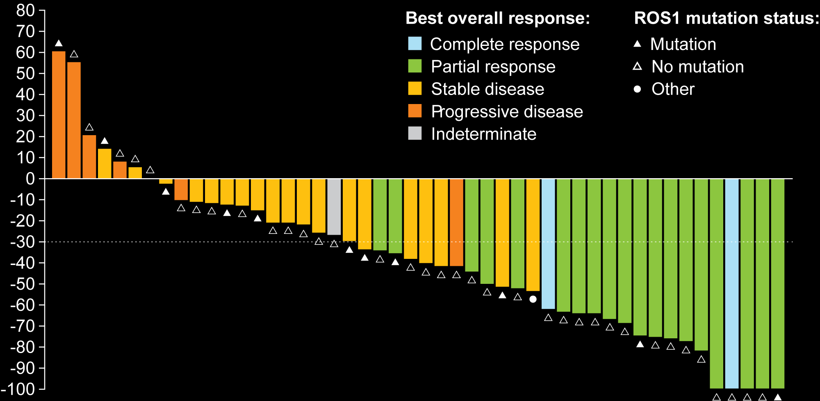
Best Response to Lorlatinib from Baseline in Patients with ROS1-Positive NSCLC by Presence/Absence of ROS1 Mutations in cfDNA and/or Tumor Tissue
Best percent change from baseline
 | TKI-naïve (n = 17) | Prior crizotinib (n = 36) | Prior 1 non-crizotinib TKI or ≥ 2 TKIs (n = 5)
ORR | 11 (64.7%) | 11 (31.4%) | 0
Solomon BJ et al. Proc ESMO 2018;Abstract 1380PD.

Slide 58
Meeting Agenda
MODULE 1 – Evolving Therapeutic Algorithms in Small Cell Lung Cancer (SCLC)
MODULE 2 – Metastatic NSCLC with EGFR Tumor Mutations
MODULE 3 – Management of NSCLC with ALK Rearrangements
MODULE 4 – Current and Future Role of Existing and Emerging ROS1 Inhibitors
MODULE 5 – Metastatic NSCLC with Other Targetable Tumor Mutations
MODULE 6 – Anti-PD-1/PD-L1 Antibodies Alone or in Combination with Other Therapies for Metastatic NSCLC

Slide 59
Do you typically administer targeted therapy to your patients with metastatic NSCLC and an NTRK gene fusion? When you do administer targeted therapy to your patients with metastatic NSCLC and an NTRK gene fusion, what agent/regimen do you generally use?
Targeted therapy?
Agent/regimen
Yes, second-line
Entrectinib
Yes, first-line
Larotrectinib
Next line after detection
Larotrectinib
Yes, first-line
Larotrectinib
Yes, first-line
Larotrectinib
Yes, first-line
Entrectinib
Yes, first-line
Larotrectinib

Slide 60
FDA Approves Entrectinib for NTRK Solid Tumors Press Release – August 15, 2019
“[The Food and Drug Administration] granted accelerated approval to entrectinib for adults and pediatric patients 12 years of age and older with solid tumors that have a neurotrophic tyrosine receptor kinase (NTRK) gene fusion without a known acquired resistance mutation, are metastatic or where surgical resection is likely to result in severe morbidity, and have progressed following treatment or have no satisfactory standard therapy.
Efficacy in NTRK-positive tumors was investigated in 54 adult patients who received entrectinib at various doses and schedules in one of three multicenter, single-arm, clinical trials: ALKA, STARTRK-1 (NCT02097810) and STARTRK-2 (NCT02568267); 94% received entrectinib 600 mg orally once daily. Identification of positive NTRK gene fusion status was determined in local laboratories or a central laboratory using nucleic acid-based tests prior to enrollment.”
https://www.fda.gov/drugs/resources-information-approved-drugs/fda-approves-entrectinib-ntrk-solid-tumors-and-ros-1-nsclc

Slide 61
Entrectinib in NTRK Fusion-Positive NSCLC: Integrated Analysis of Patients Enrolled in STARTRK-2, STARTRK-1 and ALKA-372-001
Doebele R et al. Proc AACR 2019;Abstract CT131.
Paz-Ares L et al. Proc ELCC 2019;Abstract 1130.

Slide 62
Entrectinib for NSCLC with NTRK Fusion: Integrated Analysis of STARTRK-2, STARTRK-1 and ALKA-372-001
Outcome | Patients with advanced/metastatic solid tumors and NTRK fusion (n = 54)
Overall response rate (BICR) | 57.4%, 4 CR (7.4%)
Median DoR (BICR) | 10.4 months
Median PFS (BICR) | 11.2 months
Median OS | 20.9 months
CNS disease at baseline: 22.2%
Grade ≥3 treatment-related adverse events: 35.3%
Conclusion: In this analysis, entrectinib was well tolerated and induced clinically meaningful, durable systemic and intracranial responses in patients with solid tumors and NTRK fusion, including those with NSCLC
BICR = blinded independent central review
Doebele R et al. Proc AACR 2019;Abstract CT131. Paz-Ares L et al. Proc ELCC 2019;Abstract 1130.

Slide 63
FDA Approves Larotrectinib for NTRK Solid Tumors Press Release – November 26, 2018
“The Food and Drug Administration granted accelerated approval to larotrectinib for adult and pediatric patients with solid tumors that have a neurotrophic receptor tyrosine kinase (NTRK) gene fusion without a known acquired resistance mutation, that are either metastatic or where surgical resection is likely to result in severe morbidity, and who have no satisfactory alternative treatments or whose cancer has progressed following treatment.
Approval was based on data from three multicenter, open-label, single-arm clinical trials: LOXO-TRK-14001 (NCT02122913), SCOUT (NCT02637687), and NAVIGATE (NCT02576431). Identification of positive NTRK gene fusion status was prospectively determined in local laboratories using next generation sequencing (NGS) or fluorescence in situ hybridization (FISH).”
https://www.fda.gov/drugs/fda-approves-larotrectinib-solid-tumors-ntrk-gene-fusions-0

Slide 64
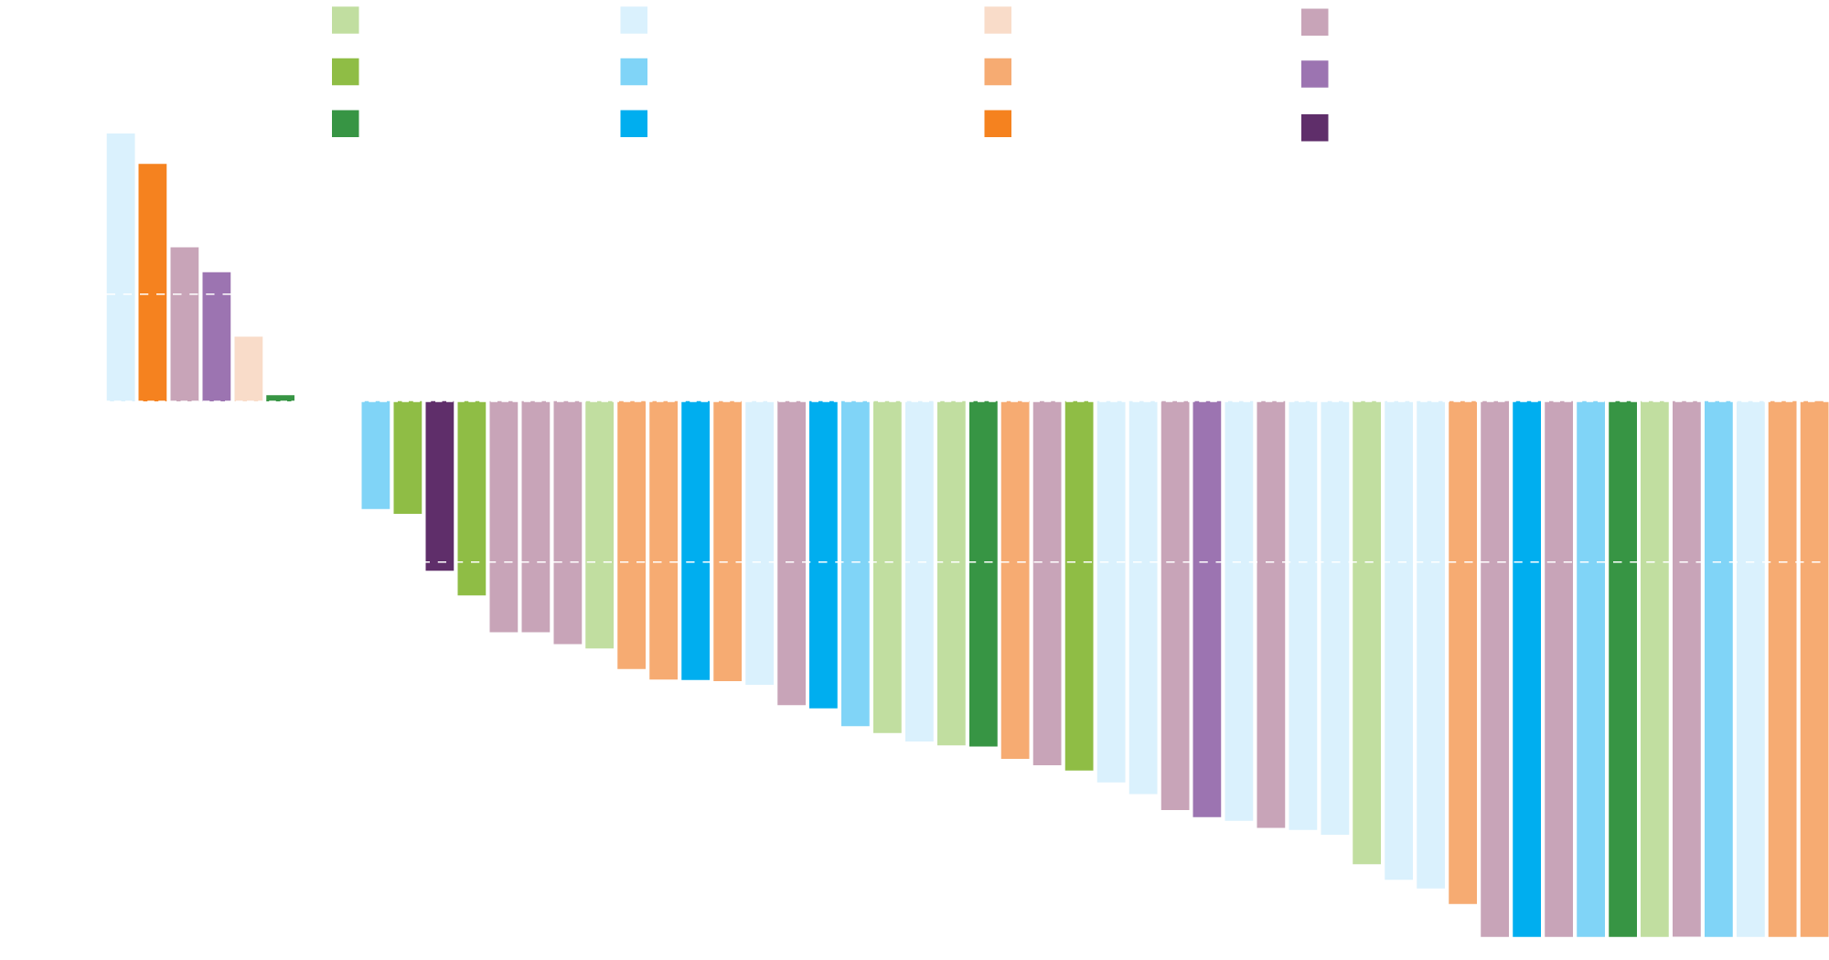
Larotrectinib in NTRK Fusion-Positive Solid Tumors: Integrated Analysis of Patients Enrolled in LOXO-TRK-14001, SCOUT and NAVIGATE
Maximum change in tumor size, according to tumor type
Maximum change in tumor size (%)
 | n = 55
ORR (inv) | 80%
CR | 16%
PR | 64%
SD | 9%
PD | 11%
Drilon A et al. N Engl J Med 2018;378(8):731-739.

Slide 65
Regulatory and reimbursement issues aside and assuming you could access all agents, what would be your first-line treatment recommendation for a patient with metastatic NSCLC, a RET rearrangement and a PD-L1 TPS of 60%?
Pembrolizumab/carboplatin/pemetrexed
Pralsetinib (BLU-667) or selpercatinib (LOXO-292)
Pralsetinib or selpercatinib
Selpercatinib
Selpercatinib
Pralsetinib
Selpercatinib

Slide 66
Registrational Results of LIBRETTO-001: A Phase 1/2 Trial of Selpercatinib (LOXO-292) in Patients with RET Fusion-Positive Lung Cancers
Drilon A et al.
Proc IASLC 2019;Abstract PL02.08.

Slide 67
LIBRETTO-001: Primary Analysis Set (PAS) with Selpercatinib for Lung Cancer with RET Fusion (N = 105 Who Received Prior Platinum Chemotherapy)
Duration of response
Progression-free survival
Patients with response (%)
Patients free from progression (%)
Median DOR: 20.3 months*
Number of events: 16/69
Median follow-up: 8.0 months
Median PFS: 18.4 months*
Number of events: 33/105
Median follow-up: 9.6 months
Months since start of response
Months since start of treatment
ORR = 68%
Intracranial ORR = 91%
Of 28 patients in the PAS that progressed, 23 continued treatment post-progression, for 0.2-16.4+ months
ORR, DOR, PFS similar regardless of prior therapy (eg, anti-PD-1/PD-L1, MKIs)
Data cutoff: June 17th, 2019. Shading in PAS Kaplan-Meier curves indicates the 95% confidence band. * Medians are not statistically stable due to a low number of events.
Drilon A et al. Proc IASLC 2019;Abstract PL02.08.

Slide 68
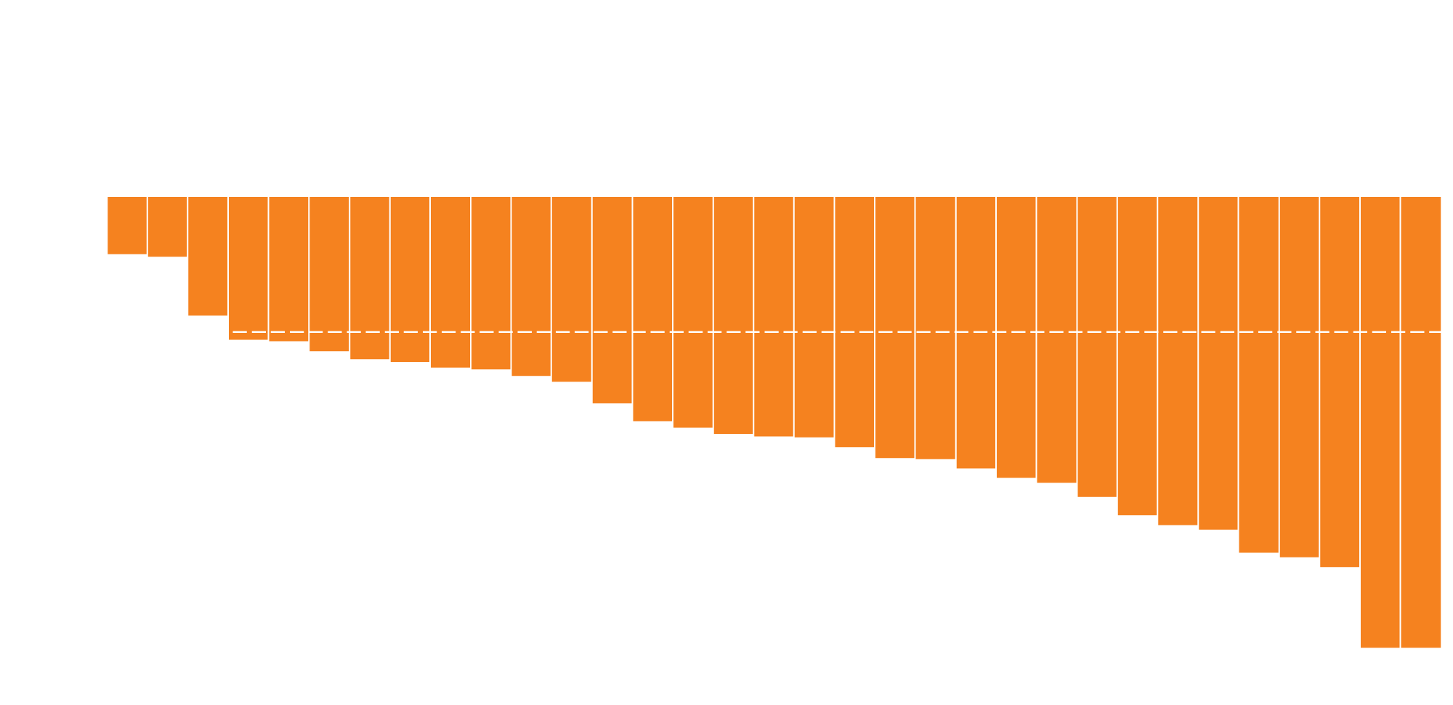
LIBRETTO-001: Efficacy of Selpercatinib for Patients with Treatment-Naïve Lung Cancer and RET Fusion
Best tumor response (%)
ORR | n = 34
 | 85%
CR | 3%
PR | 82%
SD | 9%
PD | 3%
NE | 3%
Drilon A et al. Proc IASLC 2019;Abstract PL02.08.

Slide 69
LIBRETTO-001: Safety Profile
Treatment-related adverse events | Safety database (N = 531)
 | Grade 1-2 | Grade 3-4
Dry mouth | 27% | 0%
Diarrhea | 15% | 1%
Hypertension | 9% | 9%
Increased AST | 17% | 5%
Increased ALT | 14% | 7%
Fatigue | 13% | <1%
Constipation | 10% | <1%
Headache | 6% | <1%
Nausea | 7% | <1%
Peripheral edema | 10% | 0%
Increased creatinine | 10% | 0%
Drilon A et al. Proc IASLC 2019;Abstract PL02.08.

Slide 70
Clinical Activity and Tolerability of BLU-667, a Highly Potent and Selective RET Inhibitor, in Patients (pts) with Advanced RET-Fusion+ Non-Small Cell Lung Cancer (NSCLC)
Gainor JF et al. Proc ASCO 2019;Abstract 9008.

Slide 71
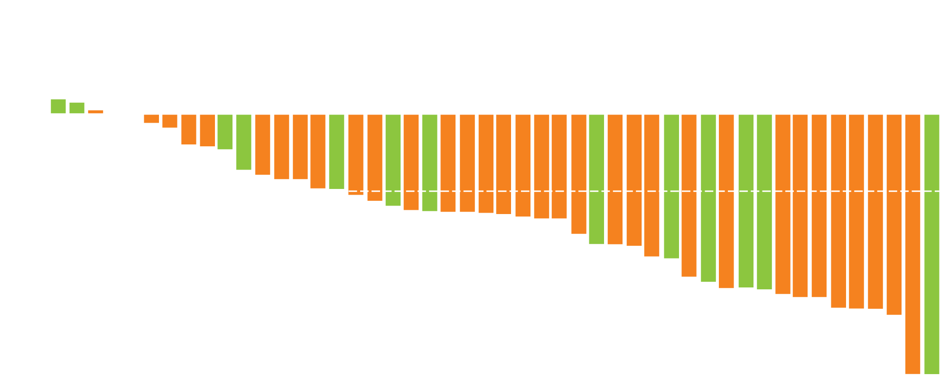
BLU-667 (Pralsetinib) Activity in Advanced NSCLC with RET Fusion
Starting dose 400 mg qd
Platinum-naïve
Prior platinum
Maximum % reduction from baseline sum of diameters of target lesion
Best response | All (N = 48) | Prior platinum (N = 35)
ORR | 58% | 60%
CR* | 1 | 1
PR* | 27 | 20
SD | 18 | 14
PD | 2 | —
DCR | 96% | 100%
5/7 (71%) treatment-naïve patients had confirmed PR
* All responses are confirmed on two consecutive assessments as per RECIST 1.1.
Gainor JF et al. Proc ASCO 2019;Abstract 9008.

Slide 72
Pralsetinib Treatment-Related Adverse Events
Adverse event | Pralsetinib 400 mg qd starting dose (N = 120)
 | All grades | Grade ≥3
Constipation | 17% | 2%
Neutropenia | 26% | 13%
AST increase | 20% | 2%
Fatigue | 13% | 3%
Hypertension | 13% | 10%
Anemia | 11% | 4%
Diarrhea | 9% | 0
ALT increase | 13% | 2%
Treatment discontinuation due to treatment-related AE: 7%
Gainor JF et al. Proc ASCO 2019;Abstract 9008.

Slide 73
Regulatory and reimbursement issues aside and assuming you could access all agents, what would be your first-line treatment recommendation for a patient with metastatic NSCLC, a MET exon 14 mutation and a PD-L1 TPS of 60%?
Pembrolizumab/carboplatin/pemetrexed
Capmatinib or tepotinib
Pembrolizumab/carboplatin/pemetrexed
Capmatinib
Capmatinib or tepotinib
Capmatinib
Tepotinib

Slide 74
MET Exon 14 Skipping Mutations and Potency of MET Inhibitors
MET exon 14 skipping mutations are reported in 3% to 4% of patients with NSCLC:
Associated with poor prognosis
Associated with poor response to standard therapies, including immunotherapy
 | Potency of MET inhibitors
 | Capmatinib | Savolitinib | Tepotinib | Cabozantinib | Crizotinib
IC₅₀ (nM) | 0.6 | 2.1 | 3.0 | 7.8 | 22.5
Wolf J et al. Proc ASCO 2019;Abstract 9004.

Slide 75
Capmatinib (INC280) in METΔex14-Mutated Advanced Non-Small Cell Lung Cancer (NSCLC): Efficacy Data from the Phase II GEOMETRY mono-1 Study
Wolf J et al. Proc ASCO 2019;Abstract 9004.

Slide 76
GEOMETRY mono-1: A Phase II Trial of Capmatinib for Patients with Advanced NSCLC Harboring MET Exon 14 Skipping Mutation
Cohort 4 (Pretreated, second/third line)
N = 69
Capmatinib 400 mg BID
Eligibility
Stage IIIB/IV NSCLC MET exon 14 skipping mutation irrespective of MET GCN by central RT-PCR EGFR wt (for L85R and delE19) and ALK-negative PS 0-1 ≥1 measurable lesion Neurologically stable or asymptomatic brain metastases allowed
Cohort 5b (Treatment naïve)
N = 28
Capmatinib 400 mg BID
Primary endpoint: ORR (BIRC)
Secondary endpoints: DoR, PFS, OS, safety
Cohort 4 overall response rate: 40.6%, median DoR: 9.72 months, median PFS: 5.42 months
Cohort 5b overall response rate: 67.9%, median DoR: 11.14 months, median PFS: 9.69 months
Deep responses observed in a majority of patients across both cohorts
Wolf J et al. Proc ASCO 2019;Abstract 9004.

Slide 77
GEOMETRY mono-1: Efficacy by BIRC of Capmatinib in Advanced NSCLC Harboring MET Exon 14 Skipping Mutation
Cohort 4 (2/3L)
Cohort 5b (1L)
Best % change from baseline (%)
Best % change from baseline (%)
ORR: 67.9%
DCR: 96.4%
Median DoR: 11.1 mo
Median PFS: 9.7 mo
ORR: 40.6%
DCR: 78.3%
Median DoR: 9.7 mo
Median PFS: 5.4 mo
* Patients still on treatment
Wolf J et al. Proc ASCO 2019;Abstract 9004.

Slide 78
GEOMETRY mono-1: Safety Summary
Most common AEs | All patients (N = 334)
 | All grades | Grade 3-4
Any | 84% | 36%
Peripheral edema | 42% | 8%
Nausea | 33% | 2%
Increased blood creatinine | 20% | 0%
Vomiting | 19% | 2%
Fatigue | 14% | 3%
Decreased appetite | 13% | 1%
Diarrhea | 11% | <1%
Discontinuation due to treatment-related AE: 11%
Dose adjustment due to treatment-related AE: 22%
Wolf J et al. Proc ASCO 2019;Abstract 9004.

Slide 79
Phase II Study of Tepotinib in NSCLC Patients with METex14 Mutations
Paik PK et al. Proc ASCO 2019;Abstract 9005.

Slide 80
VISION: Efficacy (IRC) of Tepotinib in NSCLC with MET Exon 14 Skipping Mutations
First line
Second line
≥Third line
Evidence of tumor shrinkage in 92% of patients by both IRC and investigator read
Evidence of tumor shrinkage in ≥75% of patients
IRC
Change in sum of target lesion diameters (%)
Best overall response
PR
SD
PD
NE
Tepotinib 500 mg qd | Overall response rate
 | First line | Second line | ≥Third line
Liquid biopsy+ (n = 48) | 10/17 (58.8%) | 8/15 (53.3%) | 6/16 (37.5%)
Tissue biopsy+ (n = 51) | 8/18 (44.4%) | 9/18 (50.0%) | 6/15 (40.0%)
Paik PK et al. Proc ASCO 2019;Abstract 9005.

Slide 81
VISION: Treatment-Related Adverse Events
Adverse event | Tepotinib 500 mg qd (N = 87)
 | Any grade | Grade 3
Any | 82% | 20%
Peripheral edema | 48% | 8%
Diarrhea | 21% | 1%
Increased blood creatinine | 13% | 0
Asthenia | 9% | 1%
Amylase increase | 8% | 2%
ALT increase | 7% | 2%
AST increase | 6% | 1%
Treatment discontinuation due to treatment-related AEs: 4 patients
No Grade 4 or 5 treatment-related AEs
Paik PK et al. Proc ASCO 2019;Abstract 9005.

Slide 82
Meeting Agenda
MODULE 1 – Evolving Therapeutic Algorithms in Small Cell Lung Cancer (SCLC)
MODULE 2 – Metastatic NSCLC with EGFR Tumor Mutations
MODULE 3 – Management of NSCLC with ALK Rearrangements
MODULE 4 – Current and Future Role of Existing and Emerging ROS1 Inhibitors
MODULE 5 – Metastatic NSCLC with Other Targetable Tumor Mutations
MODULE 6 – Anti-PD-1/PD-L1 Antibodies Alone or in Combination with Other Therapies for Metastatic NSCLC

Slide 83
Which first-line treatment regimen would you recommend for a 65-year-old patient with metastatic nonsquamous lung cancer and no identified targetable mutations and a …
PD-L1 TPS of 60%
PD-L1 TPS of 10%
Pembrolizumab
Carbo/pemetrexed/pembro
Pembrolizumab
Carbo/pemetrexed/pembro
Carbo/pemetrexed/pembro; pembro if not too symptomatic
Carbo/pemetrexed/pembro
Carbo/pemetrexed/pembro
Carbo/pemetrexed/pembro
Pembrolizumab
Carbo/pemetrexed/pembro
Carbo/pemetrexed/pembro
Carbo/pemetrexed/pembro
Pembrolizumab
Carbo/pemetrexed/pembro

Slide 84
A patient presents with metastatic nonsquamous lung cancer with no identified targetable mutations and moderate respiratory distress secondary to extensive tumor in the lung. Which treatment regimen would you generally recommend if they had a …
PD-L1 TPS of 60%
PD-L1 TPS of 10%
Carbo/pemetrexed/pembro
Carbo/pemetrexed/pembro
Carbo/pemetrexed/pembro
or RT followed by pembro
Carbo/pemetrexed/pembro
Carbo/pemetrexed/pembro
Carbo/pemetrexed/pembro
Carbo/pemetrexed/pembro
Carbo/pemetrexed/pembro
Carbo/pemetrexed/pembro
Carbo/pemetrexed/pembro
Carbo/pemetrexed/pembro
Carbo/pemetrexed/pembro
Carbo/pemetrexed/pembro
Carbo/pemetrexed/pembro

Slide 85
For how long would you continue treatment with an anti-PD-1/PD-L1 antibody for a patient with metastatic NSCLC who is tolerating treatment well and at first evaluation is found to have a …
Complete clinical response
Partial clinical response
Indefinitely until progression/toxicity
Indefinitely until progression/toxicity
2 years
2 years
Indefinitely until progression/toxicity
Indefinitely until progression/toxicity
2 years
Indefinitely until progression/toxicity
2 years
2 years
2 years
Indefinitely until progression/toxicity
Indefinitely until progression/toxicity
Indefinitely until progression/toxicity

Slide 86
FDA Approves Atezolizumab with Chemotherapy and Bevacizumab for First-Line Treatment of Metastatic Non-Squamous NSCLC Press Release – December 6, 2018
“The Food and Drug Administration approved atezolizumab in combination with bevacizumab, paclitaxel, and carboplatin for the first-line treatment of patients with metastatic non-squamous, non-small cell lung cancer (NSq NSCLC) with no EGFR or ALK genomic tumor aberrations.
Approval was based on the IMpower150 trial (NCT02366143), an open-label, randomized (1:1:1), three-arm trial enrolling 1202 patients receiving first-line treatment for metastatic NSq NSCLC. Eighty-seven percent (1045 patients) were identified as not having EGFR or ALK tumor mutations. The trial was designed to conduct comparisons between each of the atezolizumab-containing arms with the control arm. Patients were randomized to receive the following:
Atezolizumab, carboplatin, paclitaxel, and bevacizumab (4-drug regimen);
Atezolizumab, carboplatin, and paclitaxel (3-drug regimen); or
Carboplatin, paclitaxel, and bevacizumab (control arm).”
https://www.fda.gov/drugs/fda-approves-atezolizumab-chemotherapy-and-bevacizumab-first-line-treatment-metastatic-non-squamous

Slide 87
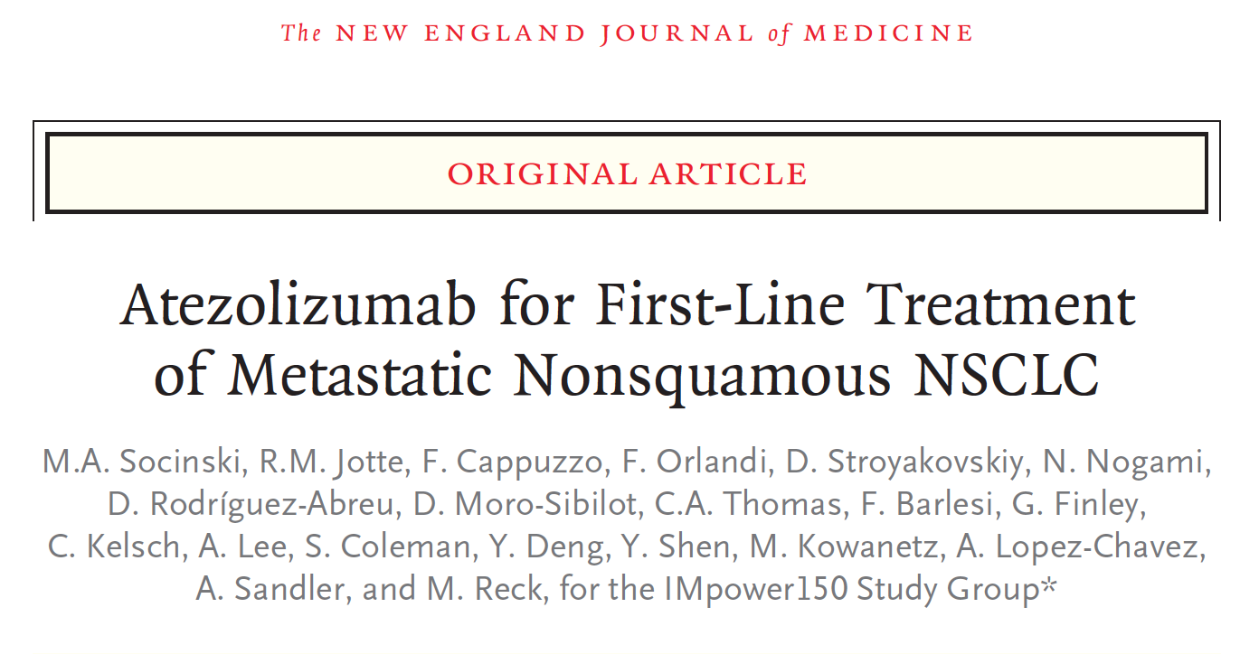
N Engl J Med 2018;378(24):2288-301.

Slide 88
IMpower150: PFS Results of First-Line Atezolizumab with Bevacizumab/Chemotherapy in Metastatic Nonsquamous NSCLC
PFS in WT ITT Population
Rate of Progression-Free Survival
 | At 6 mo | At 12 mo
ABCP | 66.9% | 36.5%
BCP | 56.1% | 18.0%
Median in the ABCP group, 8.3 mo
Progression-free survival (%)
Stratified hazard ratio, 0.62 P < 0.001
Median in the BCP group,
6.8 mo
Months
WT = wild type; ABCP = atezolizumab + BCP; BCP = bevacizumab/carboplatin/paclitaxel
Median PFS was significantly longer in the ABCP vs BCP group in the effector T-cell (Teff)-high WT population:
11.3 mo vs 6.8 mo (HR 0.51, p < 0.001)
PFS was also higher in the ABCP arm for the entire ITT population, patients with low or negative PD-L1 expression and patients with low Teff gene signatures
Socinski MA et al. N Engl J Med 2018;378(24):2288-301.

Slide 89
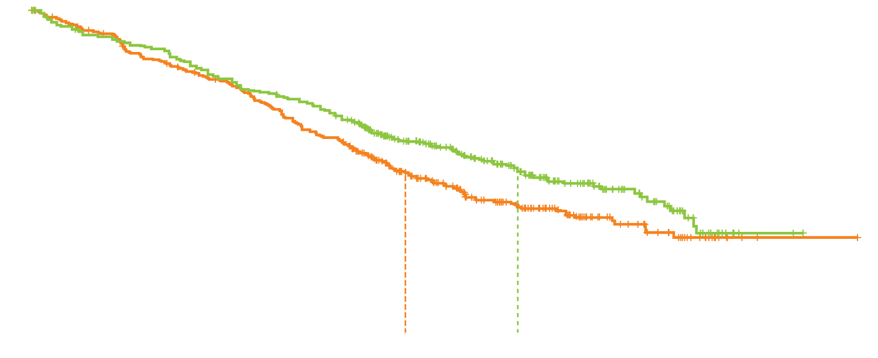
IMpower150: Interim Analysis of Overall Survival
OS in WT ITT Population
Rate of Overall Survival
 | At 12 mo | At 24 mo
ABCP | 67.3% | 43.4%
BCP | 60.6% | 33.7%
Stratified hazard ratio, 0.78 p = 0.02
Overall survival (%)
ABCP
BCP
Median in the BCP group,
14.7 mo (95% CI, 13.3-16.9)
Median in the ABCP group, 19.2 mo (95% CI, 17.0-23.8)
Months
WT = wild type; ABCP = atezolizumab + BCP; BCP = bevacizumab/carboplatin/paclitaxel
Socinski MA et al. N Engl J Med 2018;378(24):2288-301.

Slide 90
IMpower150: An Exploratory Analysis of Efficacy Outcomes in Patients with EGFR Mutations
Median OS, mo | ABCP | BCP | ABCP vs BCP HR
EGFR mutation (n = 79) | NE | 18.7 | 0.61
Sensitizing EGFR mutationª (n = 58) | NE | 17.5 | 0.31
Received prior TKI therapy (n = 50) | NE | 17.5 | 0.39
Median PFS, mo | ABCP | BCP | HR
EGFR mutation (n = 78) | 10.2 | 6.9 | 0.61
Sensitizing EGFR mutationª (n = 58) | 10.3 | 6.1 | 0.41
Received prior TKI therapy (n = 50) | 9.7 | 6.1 | 0.42
ª Defined as exon 19 deletions or L858R mutations. A = atezolizumab; B = bevacizumab; C = carboplatin; P = paclitaxel; NE = not estimable
IMpower150 is the first randomized Phase III trial of a checkpoint inhibitor to show a benefit for patients with pretreated disease with EGFR mutations.
Overall survival was improved with ABCP vs BCP in patients with EGFR mutations and sensitizing EGFR mutations.
Reck M et al. Proc ELCC 2019;Abstract 104O.

Slide 91
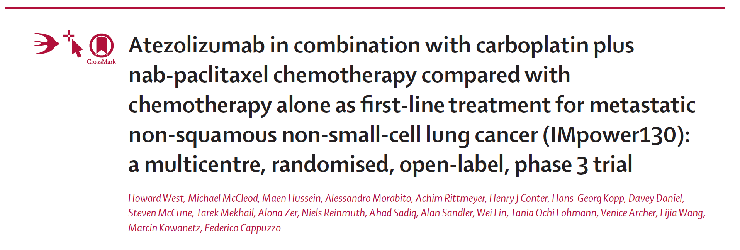
Lancet Oncol 2019;20(7):924-37.

Slide 92
IMpower130: PFS and OS with Carboplatin/Nab Paclitaxel (CnP) with or without Atezolizumab in the ITT-WT Population
Atezo + CnP
CnP
PFS (%)
OS (%)
Median: 5.5 mo
Median: 7.0 mo
Median: 13.9 mo
Median: 18.5 mo
Months after randomization
Months after randomization
PFS (ITT-WT) | 6-month | 1-year | HR | p-value
Atezo + CnP | 56.1% | 29.1% | 0.64 | p < 0.0001
CnP | 42.5% | 14.1%
OS (ITT-WT) | 1-year | 2-year | HR | p-value
Atezo + CnP | 63.1% | 39.6% | 0.79 | p = 0.033
CnP | 55.5% | 30.0%
Outcomes in patients with EGFR or ALK genomic alterations suggest treatment benefit was mostly driven by the ITT-WT population
Atezo with chemotherapy had a safety profile consistent with the AEs associated with single-agent therapy; no new safety signals were identified
West H et al. Lancet Oncol 2019;20(7):924-37; Cappuzzo F et al. Proc ESMO 2018;Abstract LBA53.

Slide 93
IMpower110: Interim Overall Survival (OS) Analysis of a Phase III Study of Atezolizumab (atezo) vs Platinum-Based Chemotherapy (chemo) as First-Line (1L) Treatment (tx) in PD-L1-Selected NSCLC
Spigel D et al. Proc ESMO 2019;Abstract LBA78.

Slide 94
IMpower110 Interim OS Analysis (Squamous and Nonsquamous)
 | TC3 or IC3 WT (≥50% TC or ≥10% IC) |  | TC2/3 or IC2/3 WT (≥5% TC or IC ) |  | TC1/2/3 or IC 1/2/3 WT (≥1% TC or IC)
 | Atezo (n = 107) | Chemo (n = 98) | Atezo (n = 166) | Chemo (n = 162) | Atezo (n = 277) | Chemo (n = 277)
Overall survival | 20.2 mo | 13.1 mo | 18.2 mo | 14.9 mo | 17.5 mo | 14.1 mo
Hazard ratio (p-value) | 0.59 (0.0106) |  | 0.72 (0.0416) |  | 0.83 (0.1481)
Spigel DR et al. Proc ESMO 2019;Abstract LBA78.

Slide 95
Which first-line treatment regimen would you recommend for a 65-year-old patient with metastatic squamous cell lung cancer and a …
PD-L1 TPS of 60%
PD-L1 TPS of 10%
Pembrolizumab
Pembro/carbo/paclitaxel
Pembrolizumab
Pembro/carbo/nab paclitaxel or pembro/carbo/paclitaxel
Pembrolizumab, unless symptomatic
Pembro/carbo/paclitaxel
Pembro/carbo/nab paclitaxel
Pembro/carbo/nab paclitaxel
Pembrolizumab
Pembro/carbo/nab paclitaxel
Pembro/carbo/nab paclitaxel
Pembro/carbo/nab paclitaxel
Pembrolizumab
Pembro/carbo/paclitaxel

Slide 96
FDA Approves Pembrolizumab in Combination with Chemotherapy as First-Line Treatment of Metastatic Squamous NSCLC Press Release – October 30, 2018
“The Food and Drug Administration approved pembrolizumab in combination with carboplatin and either paclitaxel or nab-paclitaxel as first-line treatment of metastatic squamous non-small cell lung cancer (NSCLC).
Approval was based on KEYNOTE-407 (NCT02775435), a randomized, multi-center, double-blind, placebo-controlled trial in 559 patients with metastatic squamous NSCLC, regardless of PD-L1 tumor expression status, who had not previously received systemic therapy for metastatic disease. Patients were randomized (1:1) to pembrolizumab 200 mg or placebo in combination with carboplatin, and investigator’s choice of either paclitaxel every 3 weeks or nab-paclitaxel weekly on a 3-week cycle for 4 cycles followed by pembrolizumab or placebo. Patients continued pembrolizumab or placebo until disease progression, unacceptable toxicity, or a maximum of 24 months.”
https://www.fda.gov/Drugs/InformationOnDrugs/ApprovedDrugs/ucm624659.htm

Slide 97
Pembrolizumab + Chemotherapy in Metastatic Squamous NSCLC: Final Analysis and Progression After the Next Line of Therapy (PFS2) in KEYNOTE-407
Paz-Ares L et al. Proc ESMO 2019;Abstract LBA82.

Slide 98
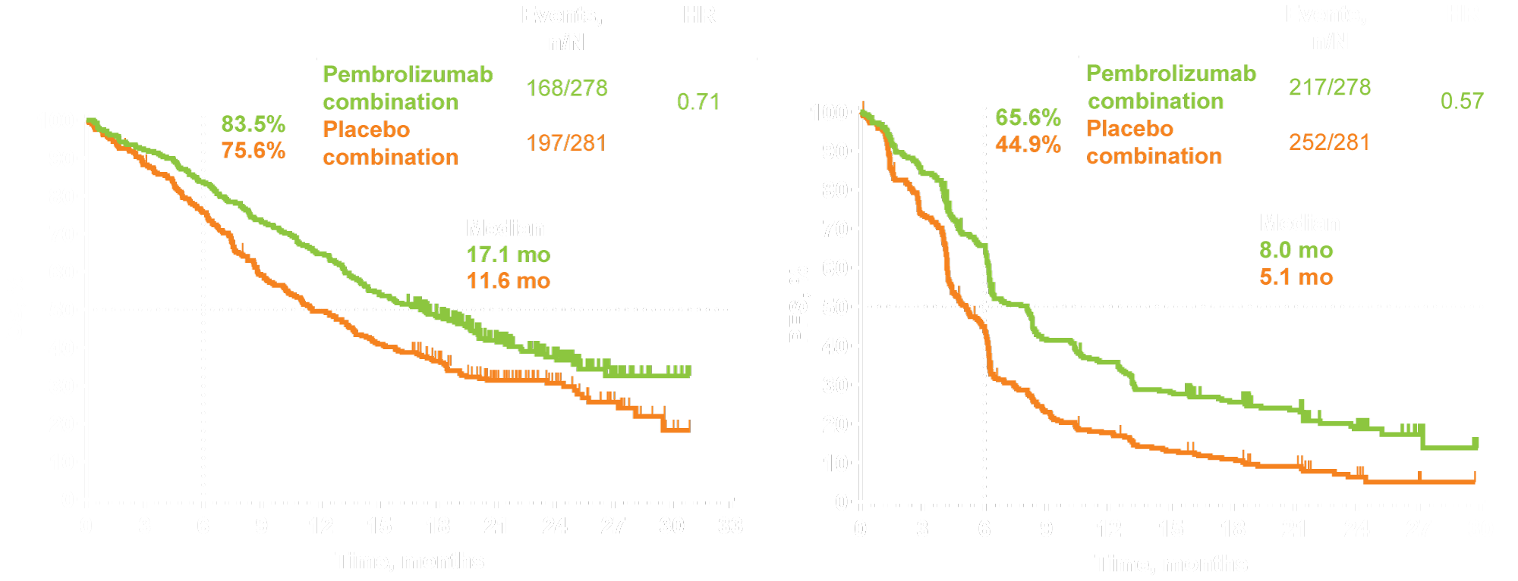
KEYNOTE-407: Final Survival Analyses Median follow-up: 14.3 months
Overall survival
Progression-free survival
Paz-Ares L et al. Proc ESMO 2019;Abstract LBA82.

Slide 99
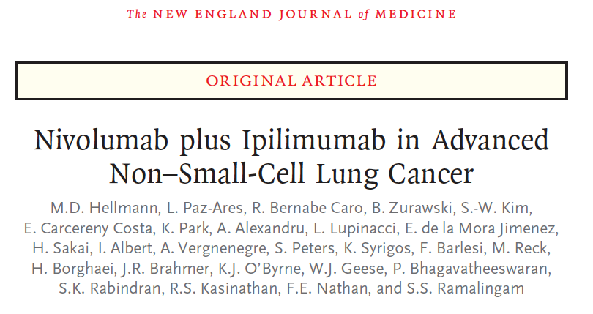
N Engl J Med 2019;[Epub ahead of print].

Slide 100
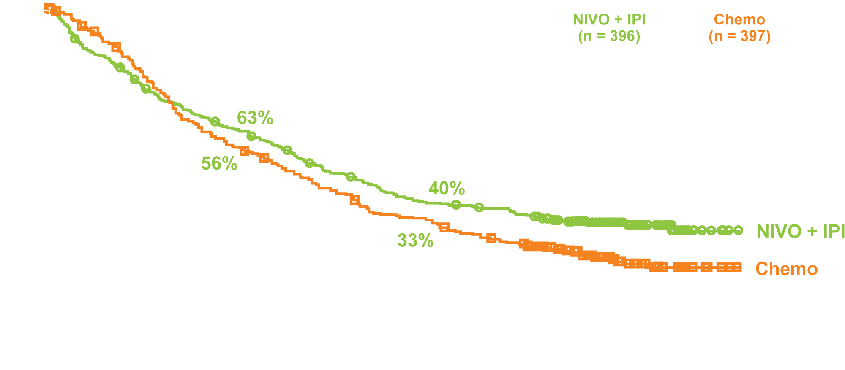
CheckMate 227 Part 1 Primary Endpoint: Overall Survival with NIVO + IPI vs Chemo (PD-L1 Expression ≥1%) (Squamous and Nonsquamous)
Minimum follow-up: 29.3 mo
OS (%)
Months
Hellmann MD et al. N Engl J Med 2019;[Epub ahead of print]; Peters S et al. Proc ESMO 2019;Abstract LBA4.

Slide 101
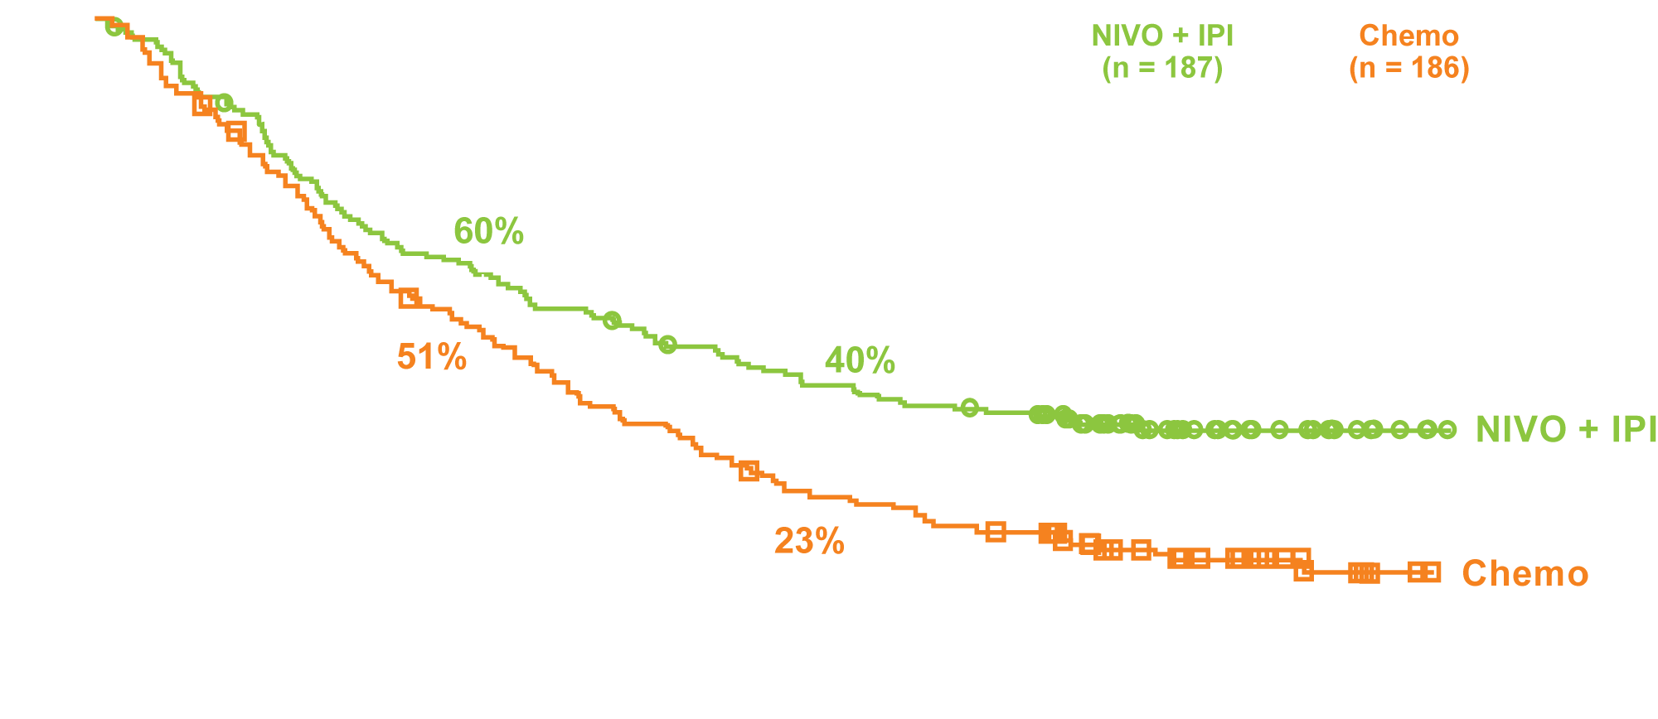
CheckMate 227: Overall Survival with NIVO + IPI vs Chemo (PD-L1 Expression < 1%)
OS (%)
Months
Hellmann MD et al. N Engl J Med 2019;[Epub ahead of print]; Peters S et al. Proc ESMO 2019;Abstract LBA4.

