Slide 1
Saturday, November 9, 2019
Moderator
Neil Love, MD
Faculty
Johanna Bendell, MD
Jamie Carroll, APRN, MSN, CNP
Matthew S Davids, MD, MMSc
Morie A Gertz, MD, MACP
Amy Goodrich, CRNP
Sara Hurvitz, MD
Ann S LaCasce, MD, MMSc
Jessica Mitchell, APRN, CNP, MPH
Josie Montegaard, MSN, AGPCNP-BC
Eileen M O’Reilly, MD
Elizabeth O’Reilly, MSN, MPH, ANP-BC
Daniel P Petrylak, MD
David I Quinn, MBBS, PhD
Tiffany A Richards, PhD, ANP-BC, AOCNP
Susan K Roethke, CRNP, MSN, ANP-BC, AOCNP
Hope S Rugo, MD
Victoria Sinibaldi, RN, MS, CS, CANP, BC
Amanda Wagner, APRN-CNP, AOCNP
Notes:
1
1

Slide 2
Session Overview – Saturday
Module 1: Colorectal and Gastric Cancer — Dr Bendell and Ms Wagner
Module 2: Hepatocellular Carcinoma and Pancreatic Cancer — Ms Mitchell and Dr O’Reilly
Module 3: Chronic Lymphocytic Leukemia — Dr Davids and Ms Montegaard
Module 4: Hodgkin and Non-Hodgkin Lymphomas — Ms Goodrich and Dr LaCasce
Module 5: Multiple Myeloma — Dr Gertz and Ms Richards
Lunch

Slide 3
Session Overview – Saturday (cont)
Module 6: Prostate Cancer — Dr Petrylak and Ms Sinibaldi
Module 7: Renal Cell Carcinoma and Bladder Cancer — Dr Quinn and Ms Roethke
Module 8: ER-Positive Breast Cancer — Dr Hurvitz and Ms O’Reilly
Module 9: HER2-Positive and Triple-Negative Breast Cancer — Ms Carroll and Dr Rugo
Adjourn

Slide 5
HR-positive, HER2-positive
2 positive nodes
70 people cancer free: no further treatment
15 people cancer free: chemotherapy/ trastuzumab
2 more people cancer free by adding pertuzumab
2 more people cancer free by adding postadjuvant neratinib
11 people: cancer recurrence
Estimates provided to patients by 30 breast cancer clinical investigators

Slide 6
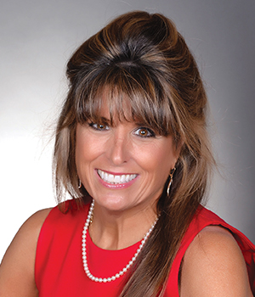
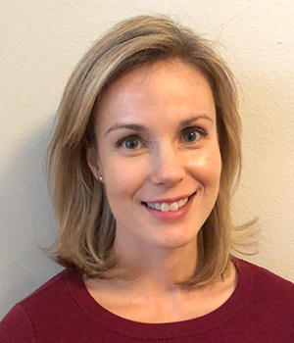
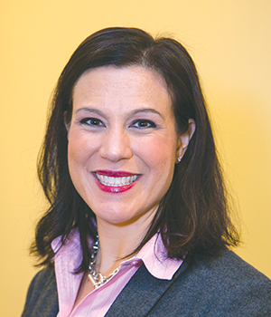
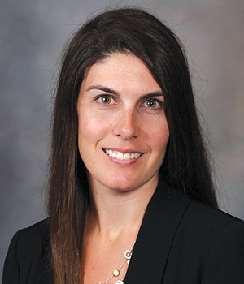
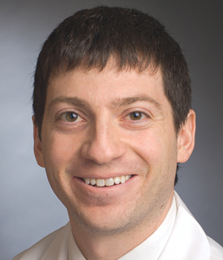
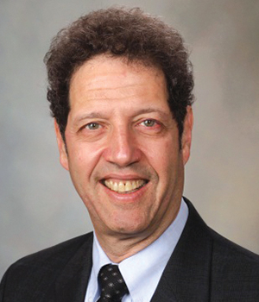
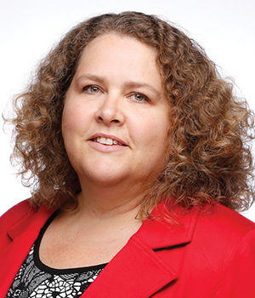
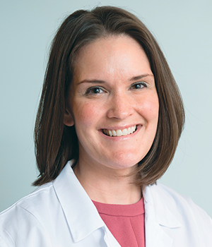
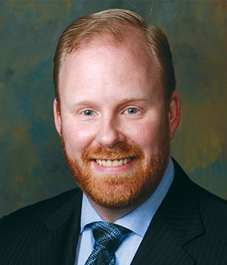
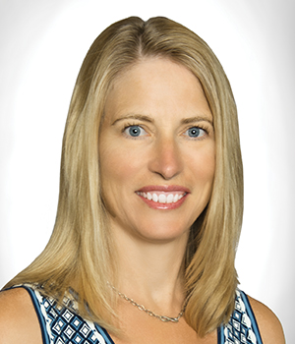
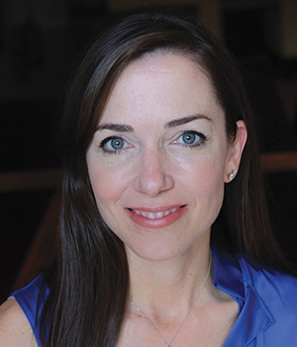
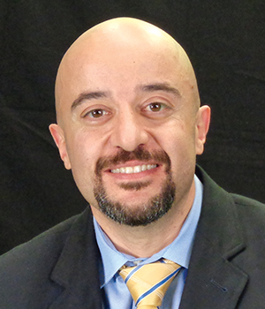
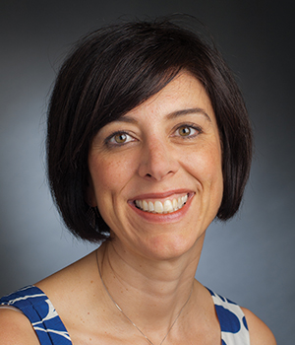
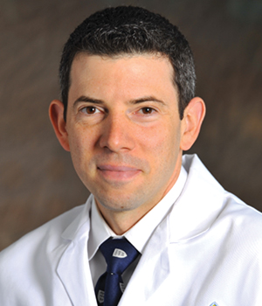
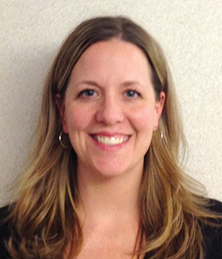
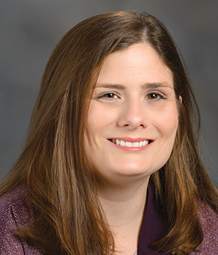
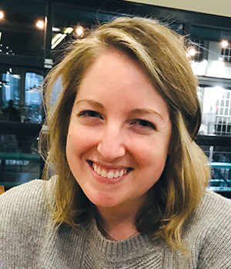
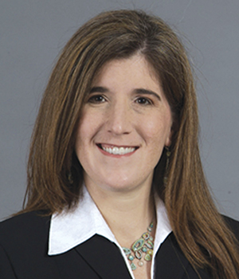
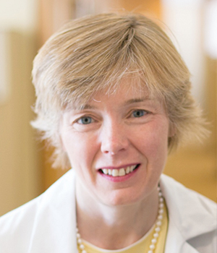
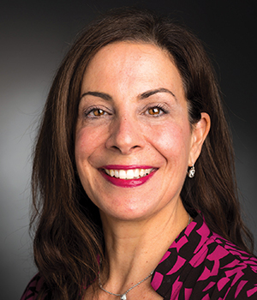
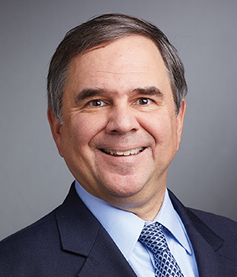
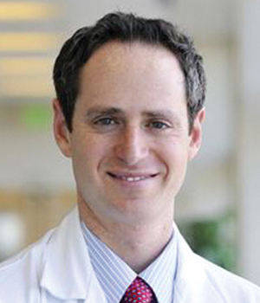
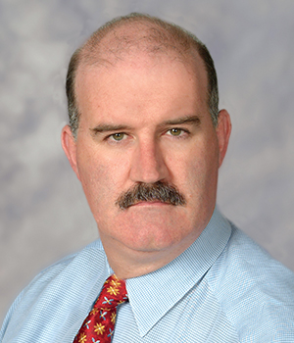
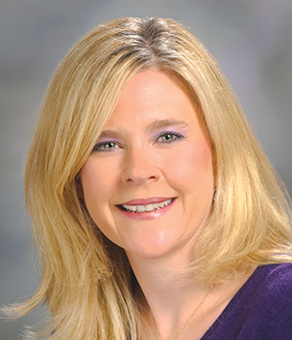
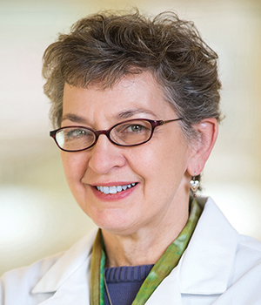
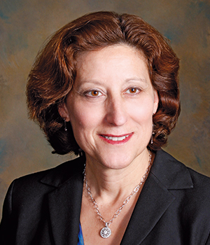
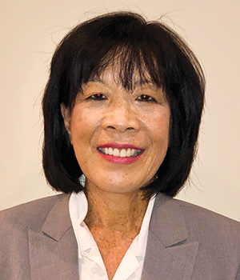
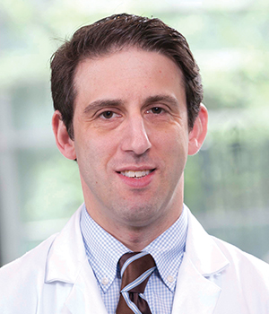
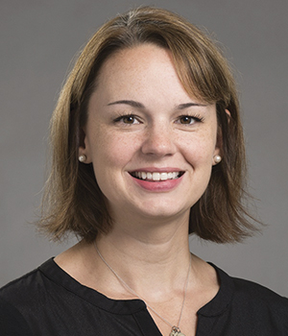
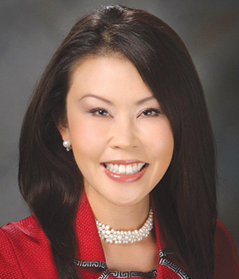
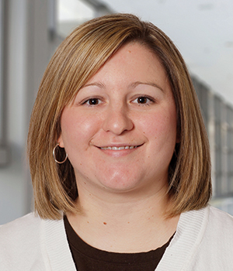
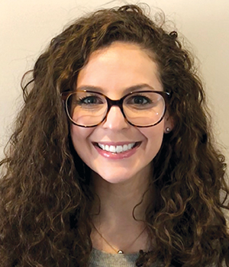
Oncology Nursing Retreat Faculty

Slide 7
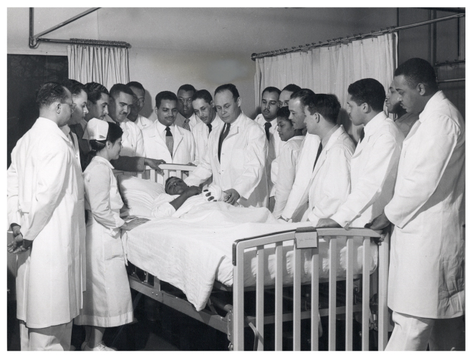
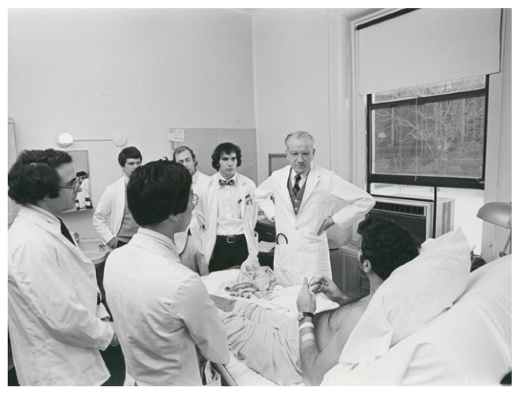
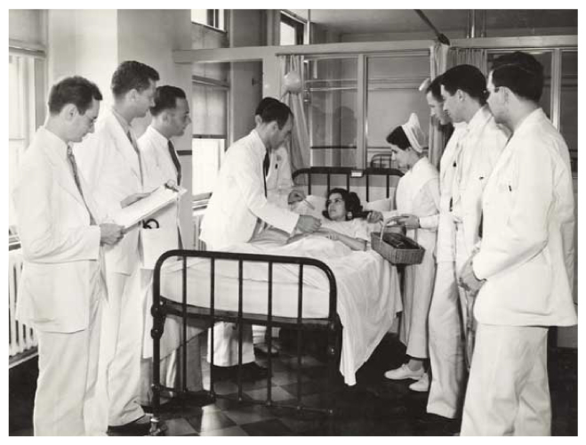
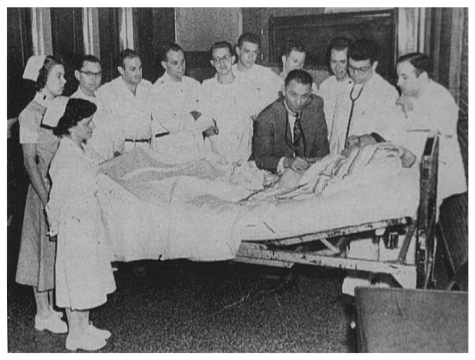

Slide 8
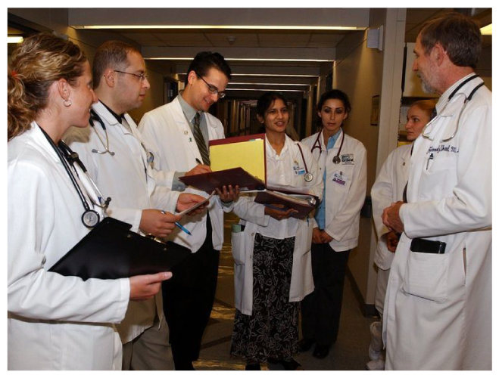
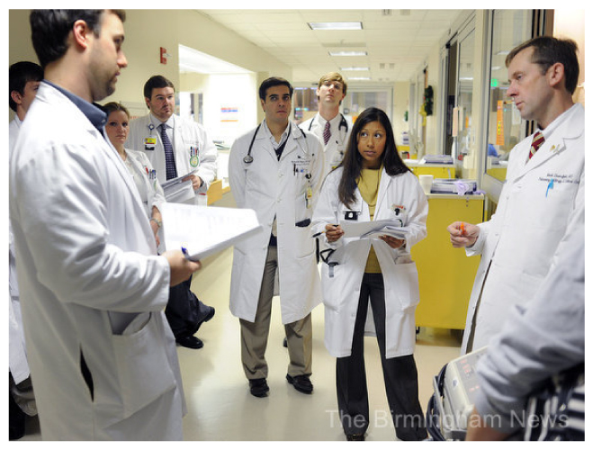
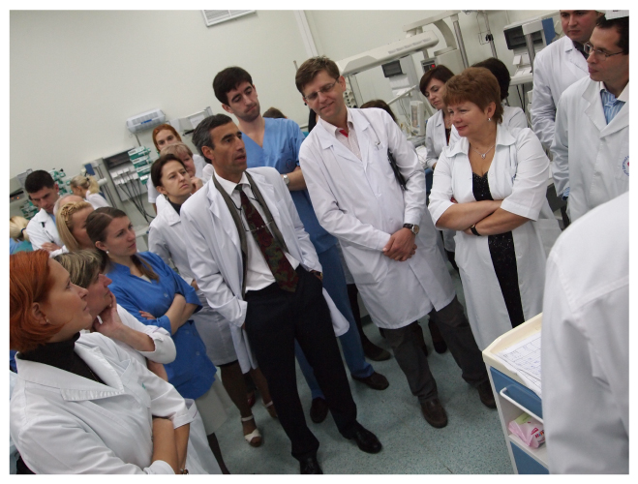

Slide 9
Symposium Themes
Personalized oncology: Implementing an individualized oncologic strategy
Tumor factors (eg, biomarkers, numeracy)
Biopsychosocial factors (eg, adherence, available family support, comorbidities, mood)
Novel agents and treatment strategies
The new-agents revolution (beginning of the end?)
The bond that heals (both ways)

Slide 10
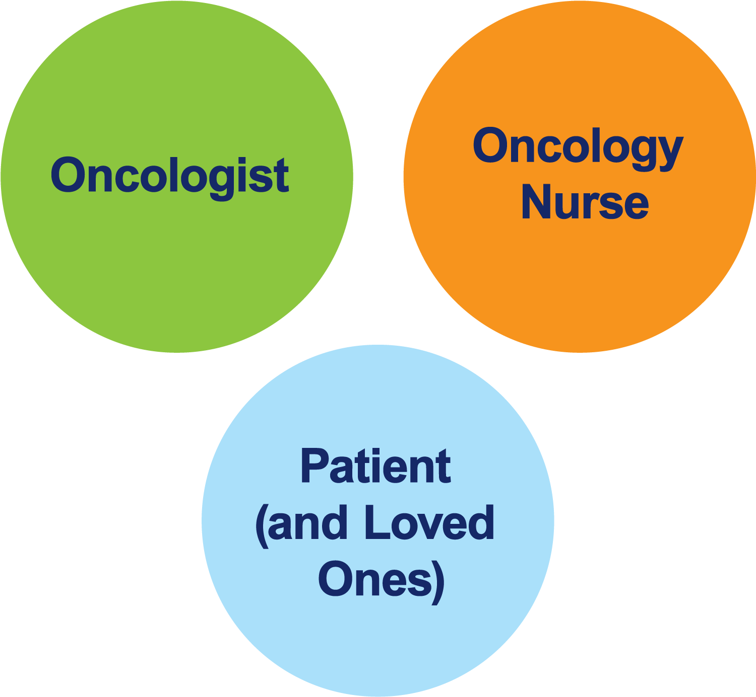
The Core Oncology Triad Developing an Individualized Oncology Strategy

Slide 11
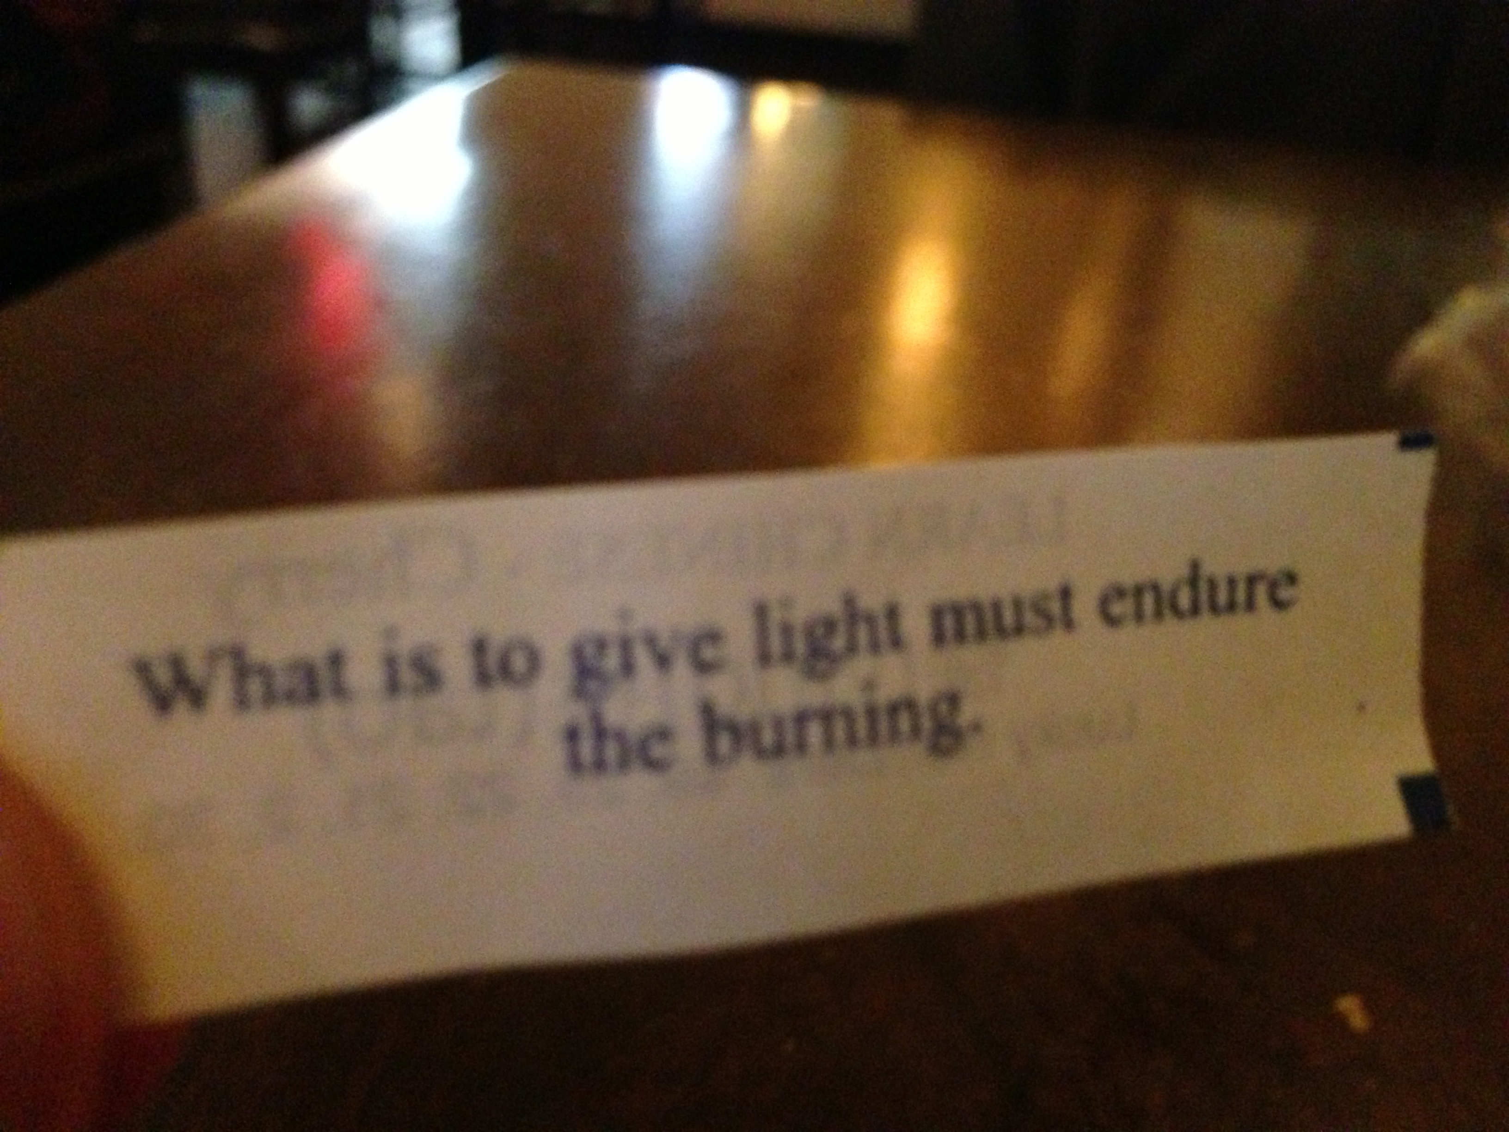

Slide 12
Approximately how many patients with the following types of cancer have you interacted with over the past year?
Type of cancer | Median
Breast cancer | 40
Lung cancer | 35
Colorectal cancer | 30
Myelodysplastic syndromes | 20
Multiple myeloma | 20
Chronic lymphocytic leukemia | 15
Pancreatic cancer | 10
Diffuse large B-cell lymphoma | 10
Prostate cancer | 10
Follicular lymphoma | 7
Melanoma | 6
Type of cancer | Median
Ovarian cancer | 6
Renal cell carcinoma | 6
Hepatocellular carcinoma | 5
Gastric cancer | 5
Acute myeloid leukemia | 4
Hodgkin lymphoma | 4
Urothelial bladder cancer | 4
Endometrial cancer | 3
Cervical cancer | 2
Mantle cell lymphoma | 2

Slide 13
Day in the Life: NURSE 8
72 M, Lung cancer, Pemetrexed, carboplatin, Socioeconomic status
31 F, Benign hematology, transfusion exchange, Depression
72 F, AML and HCC, Pembrolizumab, Acceptance of disease
73 F, Mantle Cell Lymphoma, Study drug, Acceptance of disease
30 F, Breast cancer, AC, Young age
61 F, Colorectal cancer, completed FOLFOX, Language barrier
63 F, Multiple myeloma, Daratumumab, Language barrier
56 F, Head and neck cancer, Pembrolizumab, Socioeconomic status
79 F, Multiple myeloma, Surveillance, Culture
58 M, Multiple myeloma, Zoledronic acid, poor attitude
85 F, Ovarian cancer, will receive study drug, had multiple lines of therapy

Slide 14
Day in the Life: NURSE 8
80 F, AML and Lung cancer, Pembrolizumab, venetoclax, azacitidine, family support
70 F, Lung cancer, Pemetrexed/carbo/pembrolizumab, Acceptance of disease
37 F, Benign hematology, Opioid addiction
26 F, Hodgkin lymphoma, Nivolumab, Family support
63 M, Colorectal cancer, Surveillance, Socioeconomic status
91 M, Myeloproliferative neoplasm, Surveillance, ETOH use
31 M, Testicular cancer, Surveillance, Anxiety/depression
67 F, Multiple myeloma, Bortezomib, Positive outlook
50 F, Breast cancer, AC, Family support

