Slide 1
Keynote Session:
Acute Myeloid Leukemia
Rhonda Hewitt, MSN, RN, ANP-BC, AOCNP
Daniel A Pollyea, MD, MS
Eytan M Stein, MD
Lauren Ziskind, APN, NP-C, OCN

Slide 2
Disclosures for Rhonda Hewitt, MSN, RN, ANP-BC, AOCNP
No financial interests or affiliations to disclose

Slide 3
Disclosures for Daniel A Pollyea, MD
Advisory Committee | AbbVie Inc, Agios Pharmaceuticals Inc, argenx, Celgene Corporation, Celyad, Forty Seven Inc, Gilead Sciences Inc, Janssen Biotech Inc, Pfizer Inc
Consulting Agreements | AbbVie Inc, Astellas, Daiichi Sankyo Inc, Genentech, Takeda Oncology
Contracted Research | AbbVie Inc, Agios Pharmaceuticals Inc
Data and Safety Monitoring Board/Committee | GlycoMimetics Inc, Tolero Pharmaceuticals

Slide 4
Disclosures for Eytan M Stein, MD
Advisory Board Participation: AbbVie Inc, Agios Pharmaceuticals Inc, Astellas, Celgene Corporation, Bayer HealthCare Pharmaceuticals, Pfizer Inc, PTC Therapeutics, Daiichi Sankyo Inc, Novartis and Syros
Equity (Founder): Auron Therapeutics
Research Funding: Agios Pharmaceuticals Inc, Celgene Corporation, Bayer HealthCare Pharmaceuticals and Syros

Slide 5
Disclosures for Lauren Ziskind,
APN, NP-C, OCN
No financial interests or affiliations to disclose

Slide 6
Approximately how many patients with the following types of cancer have you interacted with over the past year?
Type of cancer | Median
Breast cancer | 40
Lung cancer | 35
Colorectal cancer | 30
Myelodysplastic syndromes | 20
Multiple myeloma | 20
Chronic lymphocytic leukemia | 15
Pancreatic cancer | 10
Diffuse large B-cell lymphoma | 10
Prostate cancer | 10
Follicular lymphoma | 7
Melanoma | 6
Type of cancer | Median
Ovarian cancer | 6
Renal cell carcinoma | 6
Hepatocellular carcinoma | 5
Gastric cancer | 5
Acute myeloid leukemia | 4
Hodgkin lymphoma | 4
Urothelial bladder cancer | 4
Endometrial cancer | 3
Cervical cancer | 2
Mantle cell lymphoma | 2

Slide 7
Day in the Life: AML
80 F, AML and lung cancer, pembrolizumab, venetoclax/azacitidine, family support
47 M, azacitidine/venetoclax, Jehovas' Witness, must keep dosing low so he doesn't become pancytopenic
45 M, post BMT, azacitidine/venetoclax, patient with colostomy that he doesn't routinely care for/high risk for infection
40 M, AML and DLBCL, gilteritinib, solid neck mass responded to azacitidine/venetoclax but bone marrow did not respond
70 F, azacitidine/venetoclax, relapse after 10 yr post BMT transplant
82 F, azacitidine/venetoclax, dressed up in full make up and fashion every day for chemotherapy
89 M, palliative transfusions, has 38 grandchildren

Slide 8
Day in the Life: AML
20, M,post BMT relapse; azacitidine/venetoclax, noncompliance and usage of holistic medicines
83 M, venetoclax/decitabine, constipation
24 F, Post-BMT patient, relapsed after one year, decided to go holistic therapy after relapse
22 M, Pre BMT conditioning, homeless/extensive illicit drug use
54 F, azacitidine, pain control
76 M, Ruxolitinib and azacitidine, positive and always comes prepared to engage
82 M, azacitidine, sweetest patient and wife
62, F, nivolumab, amazing attitude

Slide 9
Keynote Session:
Acute Myeloid Leukemia
Venetoclax Combinations

Slide 10
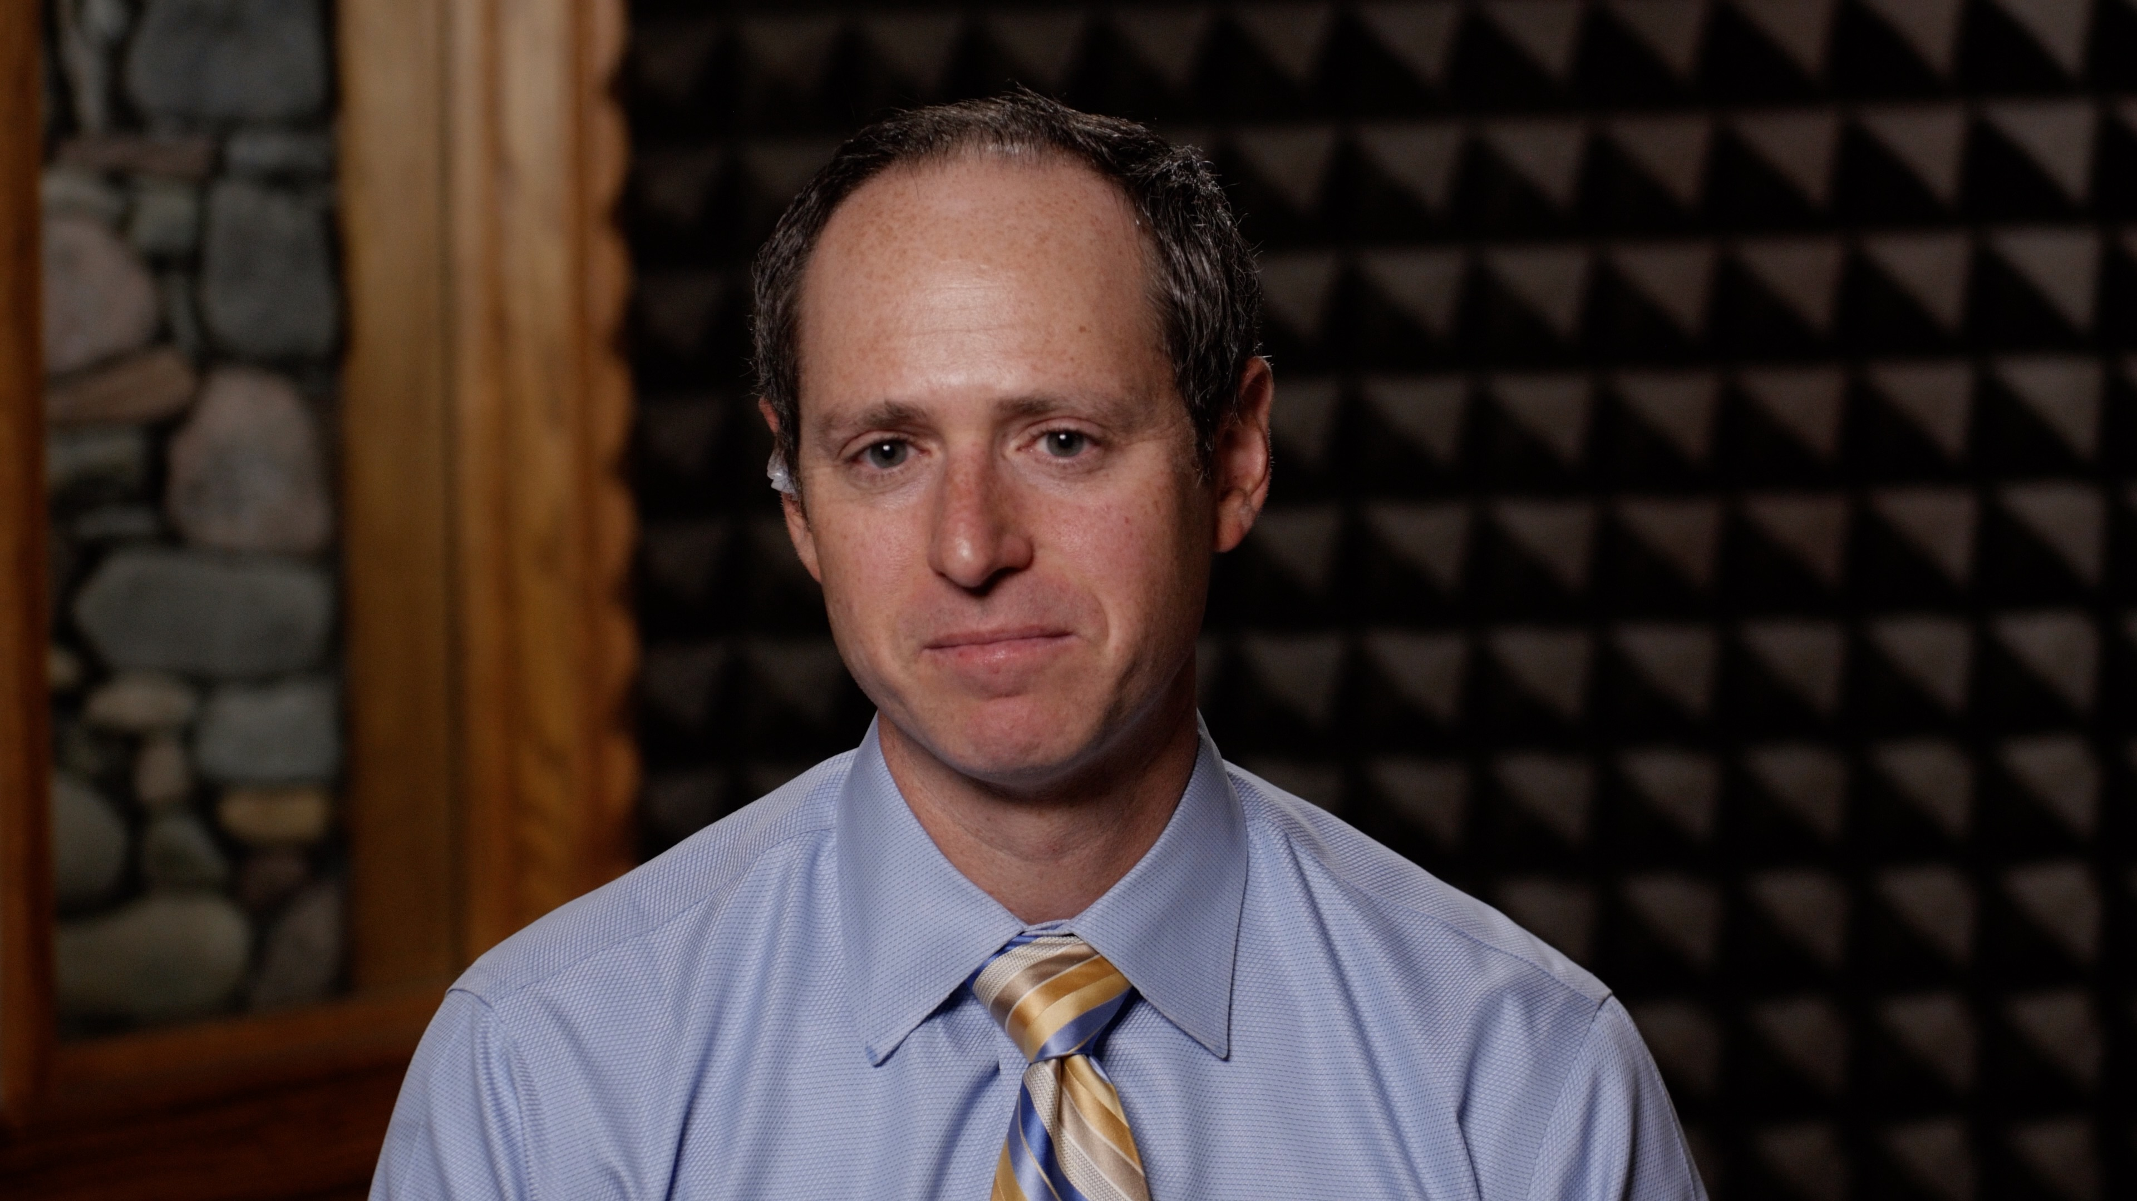

Slide 11
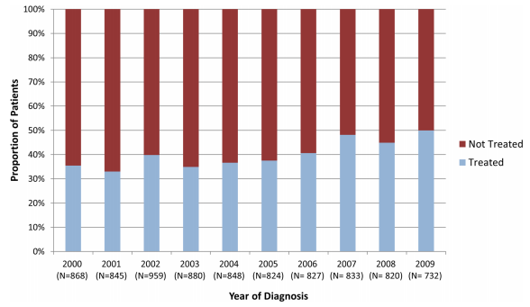
The Reality for Older AML Patients
Medeiros et al, Ann Hematol, 2015

Slide 12


Ms Hewitt Case #1
81 yo man with poor-risk AML (complex karyotype & p53/TET2 mutations) presents with his wife & 2 adult children to Hematology Clinic to discuss options for his newly diagnosed AML
HPI Summary
  5.5 yr h/o mild thrombocytopenia
  Increasing fatigue & SOBOE over past month
  PCP orders fatigue w/u with CBCD, thyroid studies, iron studies
  CBCD with pancytopenia
  BMBx reveals AML evolving from MDS

Slide 13
Ms Hewitt Case #1
Impression/Plan
  Poor-risk AML (complex karyotype & p53/TET2 mutations)
  We discussed the diagnosis, natural history, prognosis, & treatment of AML
  We discussed that AML is an incurable, life threatening, aggressive disease
  We explained that our goal would be to control the disease as best as possible
  We explained that high-dose chemotherapy would not be an option given his age & comorbidities
  Treatment options included low-intensity therapy with HMA/venetoclax, clinical trial, supportive care

Slide 14
Ms Hewitt Case #1
Important to patient & his family
  Patient feels he is still contributing to society
  Wants to continue to work as CPA
  Not ready for/interested in supportive care only option
  Not interested in clinical trial as it would necessitate he receive therapy at a different medical center which is farther from home
  Prefers the “known” expected responses & SEs with SOC decitabine + venetoclax
  Hoping to maintain his active lifestyle including hobby of bridge photography for which he has an upcoming trip planned

Slide 15
Venetoclax Combinations in Older Patients
Daniel A. Pollyea, MD
Associate Professor of Medicine, University of Colorado Division of Hematology
Research To Practice
First Annual Oncology Nursing Retreat
November 8, 2019
Notes:
Appropriate that I go last; in real life, my job is to follow your work and then think about how to translate it into clinically applicable therapies. Have though a lot about this and this has become my niche…

Slide 16
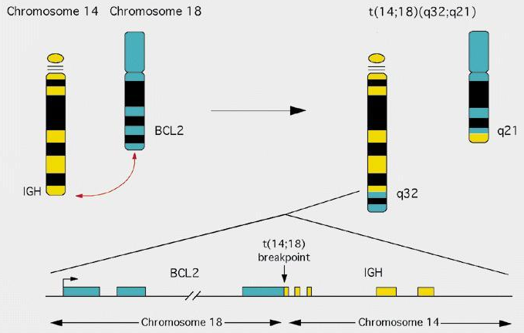
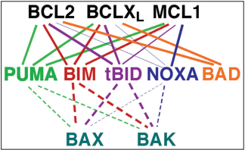
BCL-2 Family Proteins Mediate Apoptosis
BCL-2 gene discovered at the t(14;18) breakpoint in follicular lymphoma
  Results in overexpression
BCL-2 overexpression did not cause proliferation; it impaired cell death
  Nearly universally overexpressed in many B-cell lymphomas
Multiple BCL-2 family proteins, of which BCL-2 is a member
  Critical function to control apoptosis
Tsujimoto et al. Science 1985
Cleary et al. Cell 1986
Dai et al. Cancer Transl Med 2016.
Notes:
Anti apoptotic proteins (TOP, include BCL2) and pro apoptotic proteins (bottom); so called BH3 proteins in the middle mediate their interaction.
Either inhibit anti-apoptotic proteins (solid lines) or directly activated BAX and BAK (dashed lines)

Slide 17
Cells Use the BCL-2 Family of Proteins to Decide Whether to Die or to Survive
BCL2
BCLX_{L}
BCLW
MCL1
BAX
BAK
BIM
BID
BAX
BAK
BIM
BID
BCL2
BCLX_{L}
BCLW
MCL1
Survival
Steady State
Apoptosis
BCL2
BCLX_{L}
BCLW
MCL1
BAX
BAK
BIM
BID
Apoptosis
Survival
Favor Survival
Favor Apoptosis
Survival
Apoptosis
Anti-apoptotic proteins bind and sequester pro-apoptotic proteins
BH3 proteins bind anti-apoptotic proteins, resulting
in the release and activation of pro-apoptotic proteins

Slide 18
Rationale for BCL-2 Inhibition in AML
Targeting BCL-2 may allow for apoptosis to be restored
BCL-2 overexpression associated with worse outcomes in AML, and higher resistance to conventional therapy
But BCL-2 overexpression not universal in AML
Additional rationale for targeting BCL-2 in AML?
Karakas et al. Annals of Oncology 1998
Lauria et al. Leukemia 1997
Campos et al. Blood 1993
Certo, Letai et al. Cancer Cell 2006

Slide 19
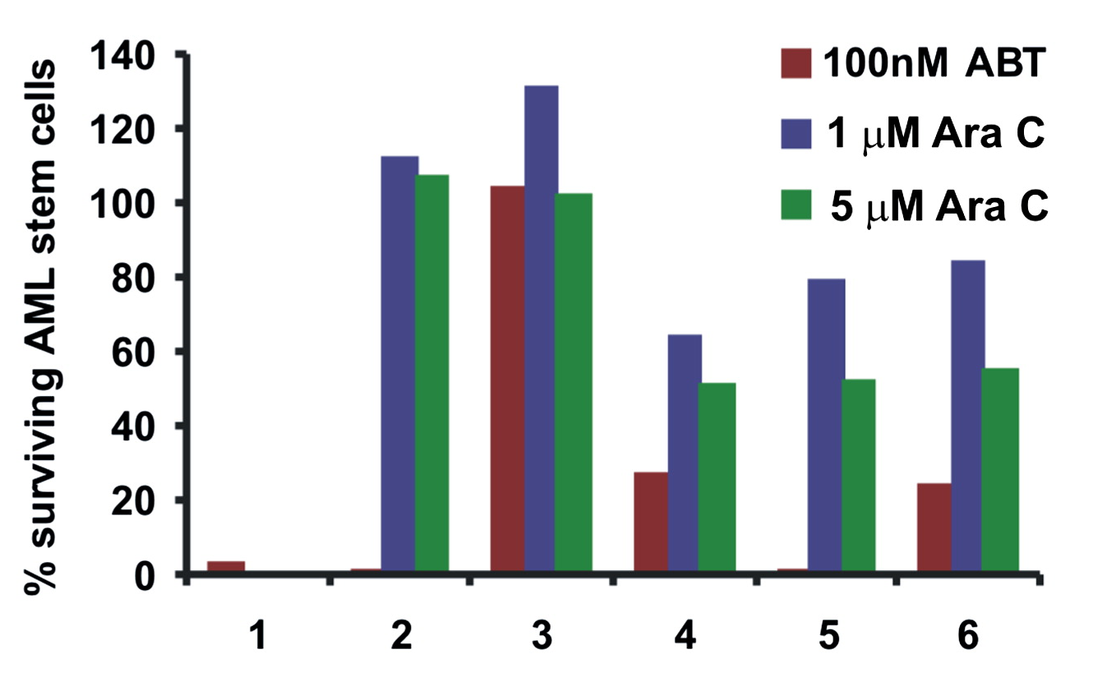
BCL-2 Inhibition Impacts
Leukemia Stem Cells (LSCs)
Konopleva et al. Cancer Res 2008
Konopleva et al. Cancer Cell 2006
Notes:
Using obatoclax and BT-737, BH3 mimetcis
This shows ABT737 impacts LSCs, as defined as CD34+, CD38-, CD123+, in most of the primary samples, favorably compared with ara-c

Slide 20
Venetoclax + Azacitidine Specifically Targets Untreated LSCs by Altering Metabolism
Glutathione
ETC Complex II
OXPHOS
Venetoclax
+
Azacitidine
Selective LSC Targeting
Amino Acid Uptake
ETC = electron transport chain; OXPHOS = oxidative phosphorylation
Pollyea, Stevens, Jones et al. Nature Medicine 2018.
Jones et al. Cancer Cell 2018.

Slide 21
Pre-Venetoclax BCL-2 Inhibitor Clinical Trials in AML
Drug | Mechanism | Clinical Setting | Response | Reference
Oblimersen | Antisense oligonucleotide | Phase 1: Relapsed/refractory AML combined with FLAG | 7/17 CR+CRi+MLFS | Marcucci et al, Blood 2003
 |  | Phase 1: Older untreated AML combined with 7+3 | 14/29 CR | Marcucci et al, JCO 2005
 |  | Phase 2: Older relapsed AML combined with gemtuzumab | 12/48 CR+CRp | Moore et al, Leukemia Research 2006
 |  | Phase 3: Randomized study of chemotherapy +/- oblimersen for untreated elderly AML | No difference in CR or OS for experimental arm | Marcucci et al, ASCO presentation, 2007
Obatoclax | BH3 mimetic; pan BCL-2 inhibitor | Phase 1: Single agent; refractory AML/MDS | 1/25 AML (CR) 3/14 MDS (HI) | Schimmer et al. Clin Cancer Res 2008
 |  | Phase 2: Single agent; untreated MDS | 2/24 (HI) | Arellano et al. Clin Lymph Myel Leuk 2014
 |  | Phase 1/2: Single agent; older untreated AML | 0/18 responses | Schimmer et al. PLOS ONE 2014

Slide 22
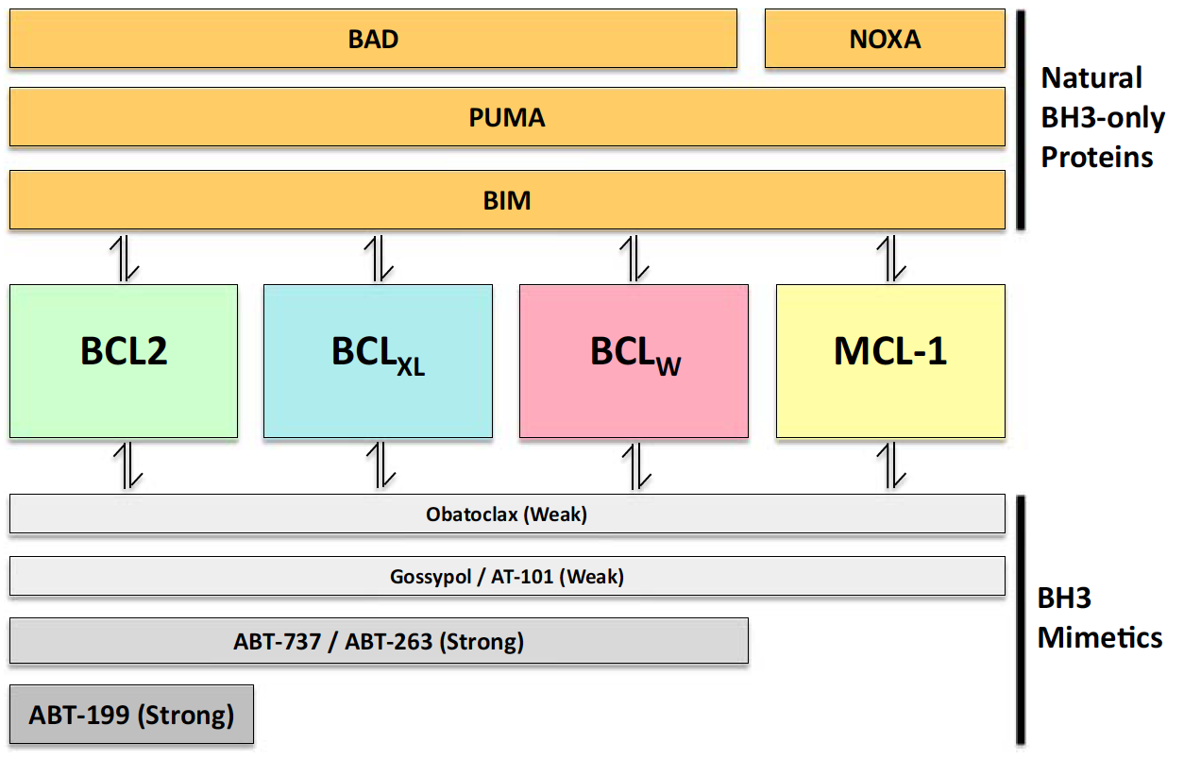
Venetoclax (ABT-199) Is a Potent,
Selective Inhibitor of BCL-2
Tam et al. Seminars in Oncology 2016
Notes:
Effective strategy for CLL, in which BCL-2 overexpression is universal, and venetoclax is now an exciting approved therapy
But what about AML?? Why would this strategy work in this disease, in which BCL2 overexpression is NOT universal??

Slide 23
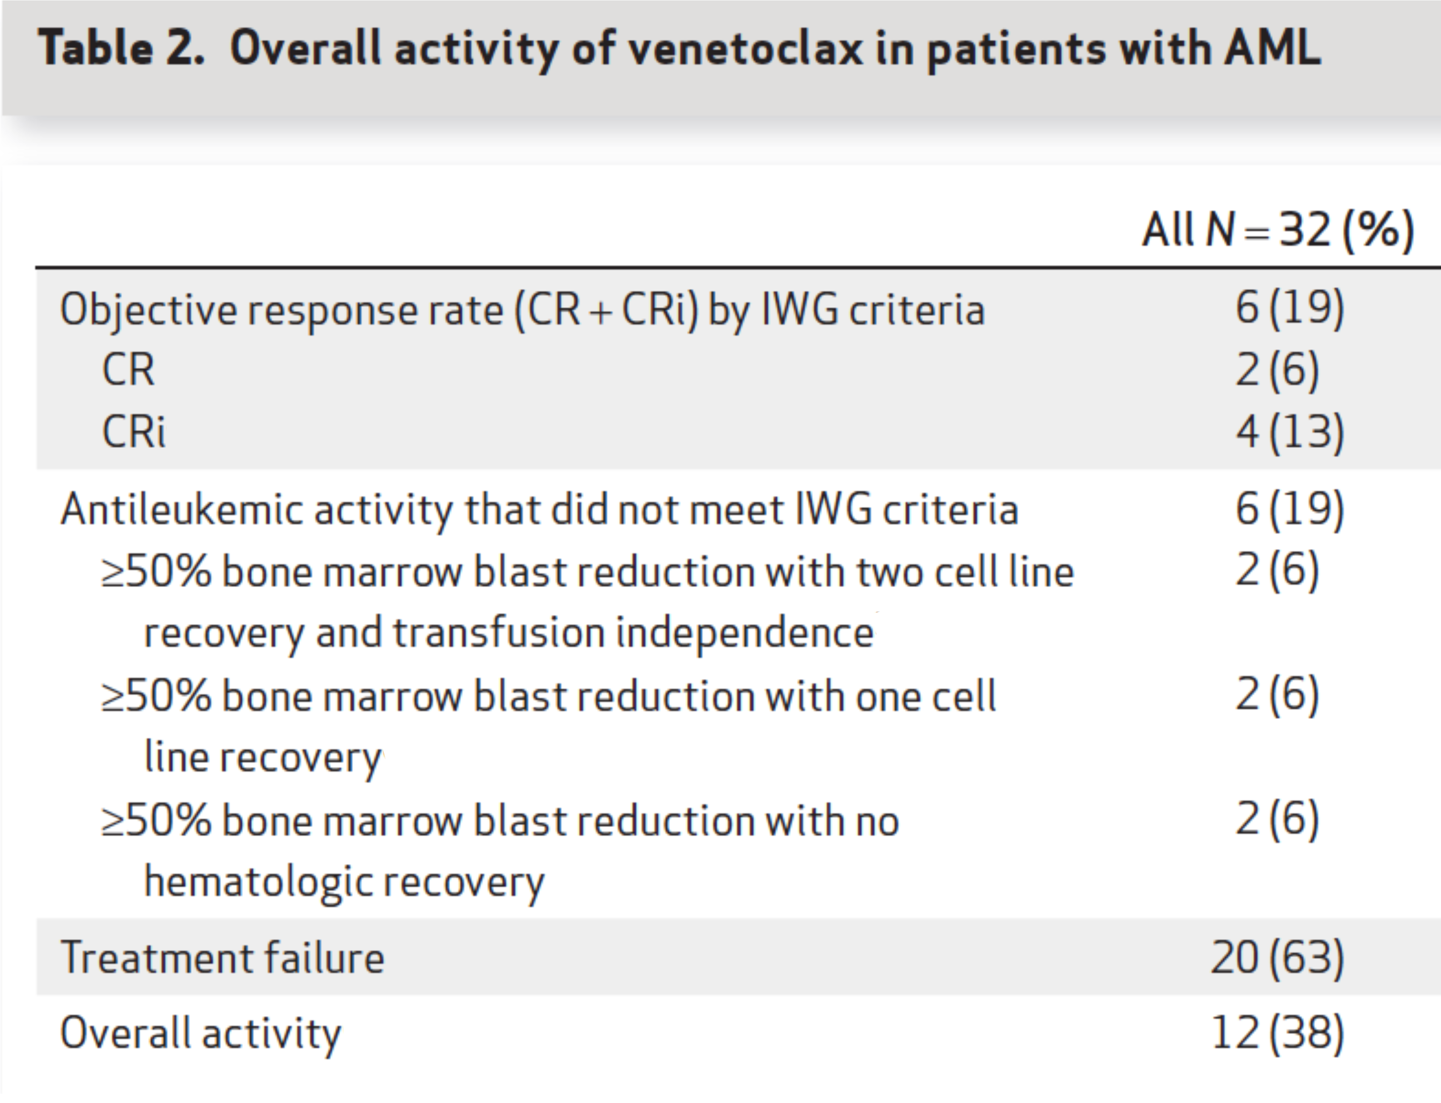
Single Agent Venetoclax in R/R AML
Konopleva et al, Cancer Discovery 2016

Slide 24
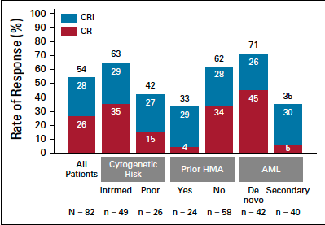
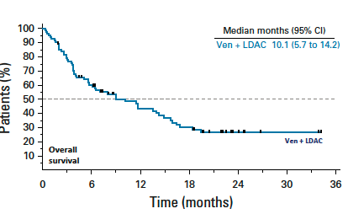
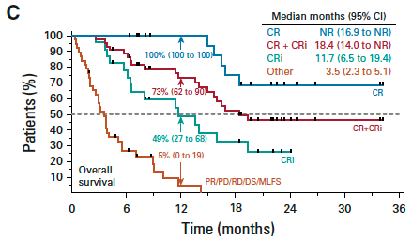
Venetoclax Plus LDAC in Newly Diagnosed Elderly AML Patients
Wei et al, JCO 2019

Slide 25
Venetoclax Plus a Hypomethylator in Newly Diagnosed Elderly AML Patients
Pollyea et al, ASH 2018
DiNardo et al, Blood 2019

Slide 26
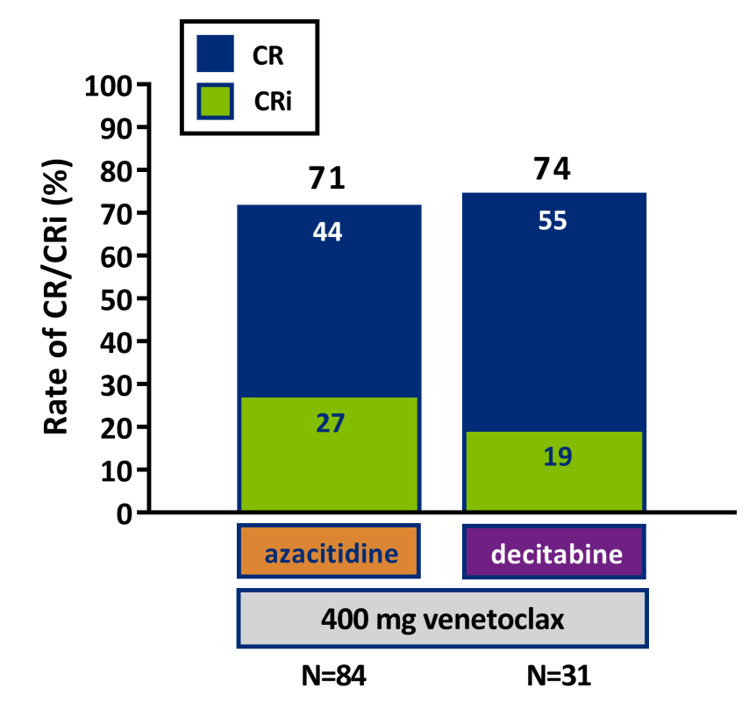
High Response Rates That Occur Rapidly
 | Ven + Aza | Ven + Dec
Time to CR median (range) | 1.2 (0.7–5.5) | 1.9 (0.9–4.6)
No. of treatment cycles for these patients median (range) | 6.0 (1–32) | 6.0 (1–29)
Pollyea et al, ASH 2018

Slide 27
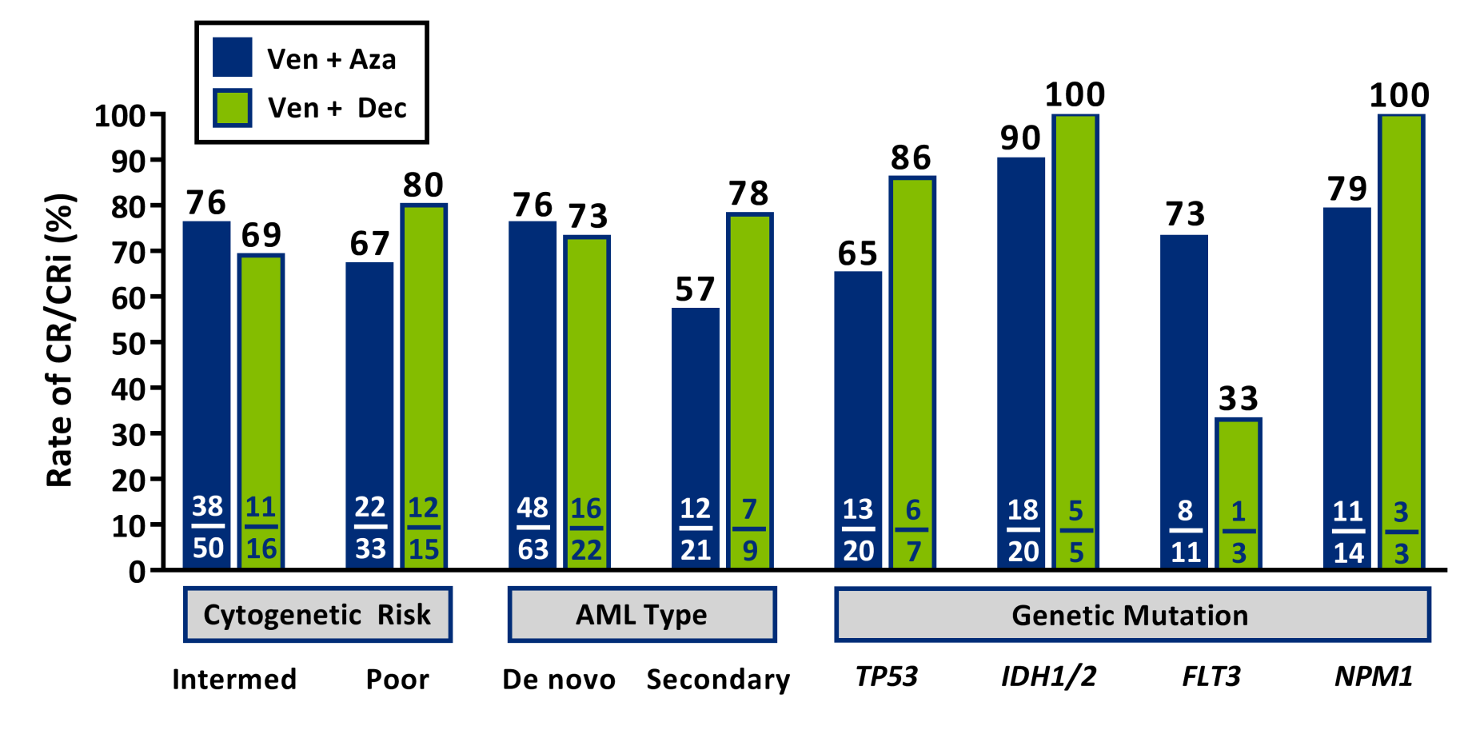
Responses Occur Across the AML Landscape
Pollyea et al, ASH 2018

Slide 28
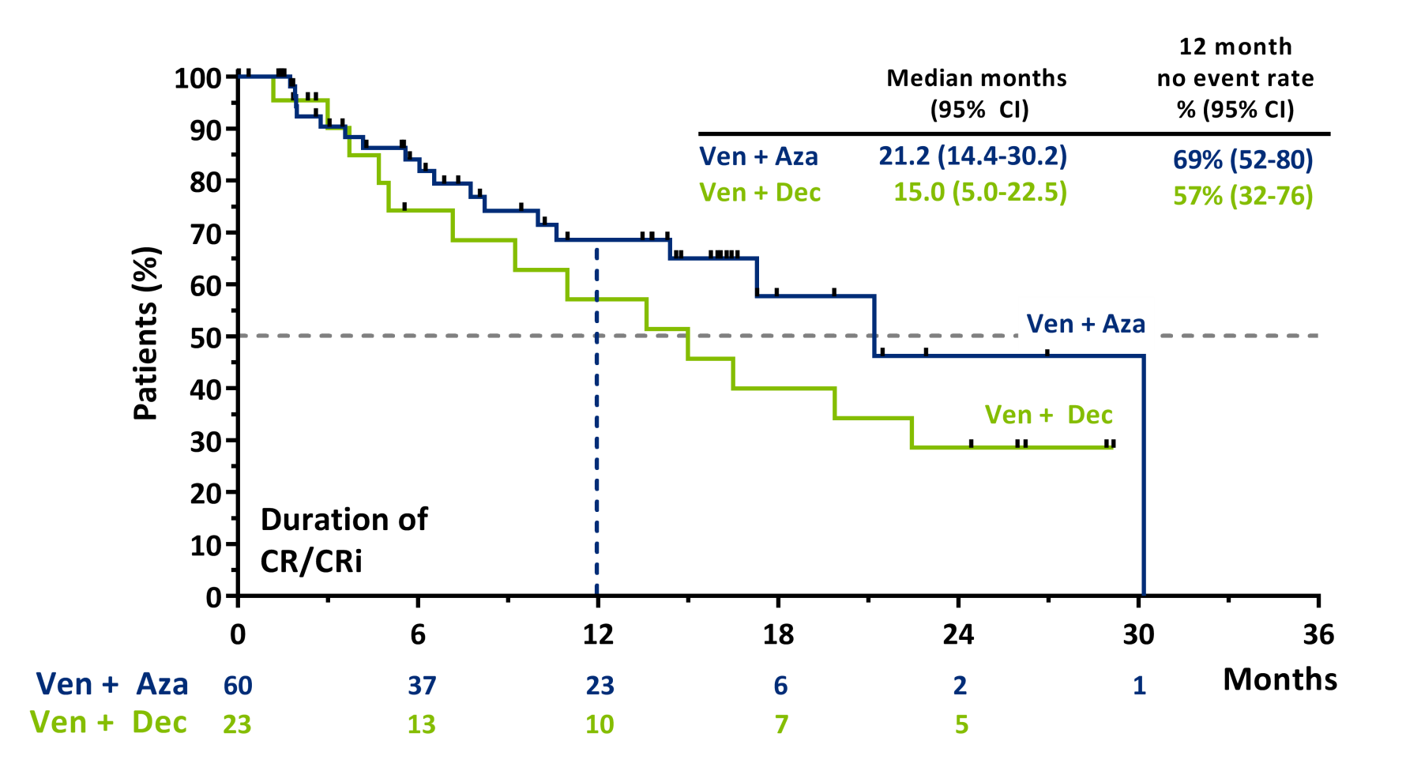
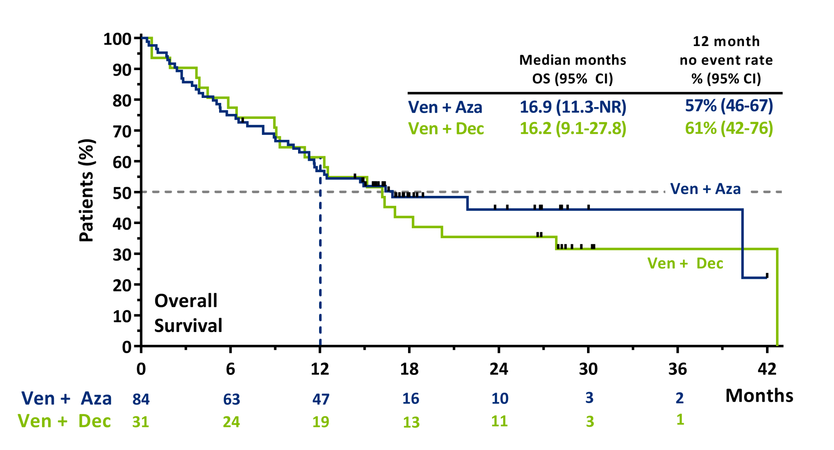
Pollyea et al, ASH 2018
Notes:
Duration of response and OS

Slide 29
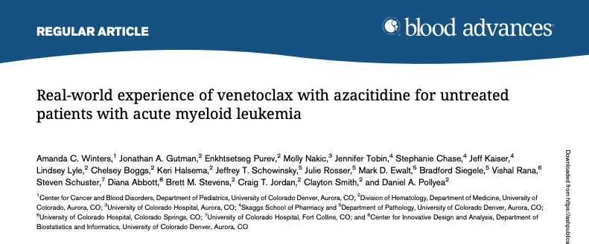
Responses in Various Settings

Slide 30
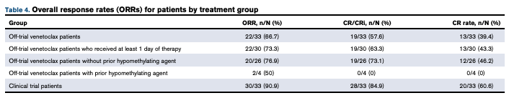
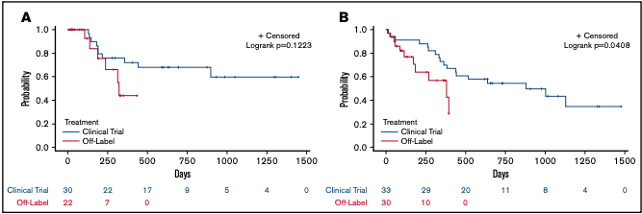
Real World vs Ideal World
Winters et al, Blood Advances, 2019

Slide 31
Fantasy World
If compared to a theoretical scenario where all the patients had been induced:
  No difference in actual vs predicted response rate
  Significant improvement in early death rate with venetoclax vs induction
Winters et al, Blood Advances, 2019

Slide 32
Future Directions: Combination Therapies
Low Intensity Triplets
  With other genomically defined targeted therapies
  With other BCL-2 family members
With intensive chemotherapy
  Up front
  Salvage

Slide 33
Future Directions: New Settings
Older “fit” patients
Younger “fit” patients
Relapsed AML
Maintenance strategies

Slide 34
Ms Hewitt Case #1
He decides to proceed with decitabine + venetoclax
When starting a patient on therapy we educate about potential SE’s
  Cytopenias requiring transfusion support & dose adjustments/interruptions
  Risk of life threatening infections +/- bleeding complications
  Fatigue from therapy
  GI toxicities
  Need to protect & monitor for TLS, AKI, other organ toxicities
  Medication adherence with oral therapies
Patients generally get a little sicker before they get better→ unique to our area of medicine
I also like to stress the importance of communication, open dialogue so we can help get patients through therapy

Slide 35
Ms Hewitt Case #1
6/6/19 C1D1 5 day Decitabine + venetoclax. Complicated by prolonged neutropenia
7/1/19 BMBx no morphologic evidence of leukemia, 0.2% abnormal blasts by MRD flow consistent with morphologic leukemia-free state
7/3/19 C2D1 Dec/Ven with 25% dose reduction due to cytopenias & MLFS
  → received only 3 days due to neutropenic fever hospitalization
8/1/19 C3D1 dose reduced Dec+Ven
9/5/19 C4D1 with further dose reduction due to recurrent neutropenia → Dec 5 to 4 days & Ven 28 to 14 days

Slide 36

Ms Hewitt Case #1
Key management points with patient & family:
Balancing disease control and toxicities of therapy
  Fatigue, nausea, myelosuppression, RLE cellulitis
Much support through necessary dose reductions
  Ongoing discussions re cause of myelosuppression → therapy vs disease progression
    Possible BMBx if persists/worsens
  Education/scheduling of labs & transfusion support
Education on neutropenia & reportable symptoms/problems
Maintaining roles while undergoing therapy → very important to patient to continue to work part time
Ongoing participation in important life events → patient has upcoming vacation plans to go on a photography trip. C5D1 delayed to accommodate this important event

Slide 37
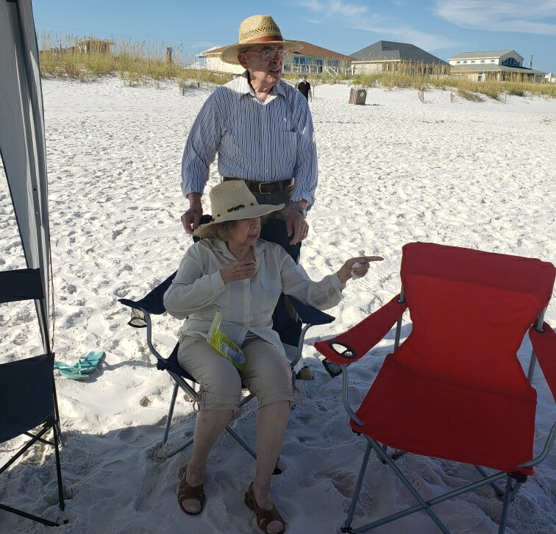
Ms Ziskind Case
An 80 year old gentleman
PMH: HTN
Married with 4 children, 20 grandchildren; retired foreman
Enjoys gardening, being outdoors, vacationing in Florida with his family

Slide 38
Diagnosis
BMBX showed hypercellular bone marrow (~60%) with reduced myelopoiesis, multilineage dysplasia, increased myelofibrosis, and markedly increased myeloblasts (~37%, CD34+)
NGS panel: ASXL1, SRSF2, STAG2
AML evolved from MDS

Slide 39
Treatment
BEAT AML trial vs CPX-351 vs single agent hypomethylating agent (HMA)
August 2018: Began Azacitidine 75 mg/m² SQ x 7 days
November 2018: Introduced Venetoclax 50 mg daily x 28 days, in combination with Azacitidine 75 mg/m² SQ x 7 days
Notes:
We reviewed each possible treatment option with Mr. V.
not interested in clinical trial
Not interested in transplant
Wanted an outpatient regimen with follow up
Minimal toxicities
Ven- s/p 3 cycles of Aza with persistent circulating blasts
cycle 4 with venetoclax (11/27/2018). Bone marrow 12/20/2018 showed 60% cellularity with <5% blasts
Allowed for recovery of cytopenias, reduced dose to 20 mg daily x 14 days (1/2019) then 20 mg daily x 7 days (4/2019).

Slide 40
counseling/education
Neutropenia precautions
Thrombocytopenia precautions
Maintaining proper nutrition
Maintaining physical activity
Notes:
As with any of our leukemia patients, neutropenia and thrombocytopenia precautions are two of our biggest concerns because they can be sentinel for our patients.

Slide 41
Side effects/toxicities
Prolonged neutropenia
Increased nausea
Decreased appetite
Peripheral edema

Slide 42
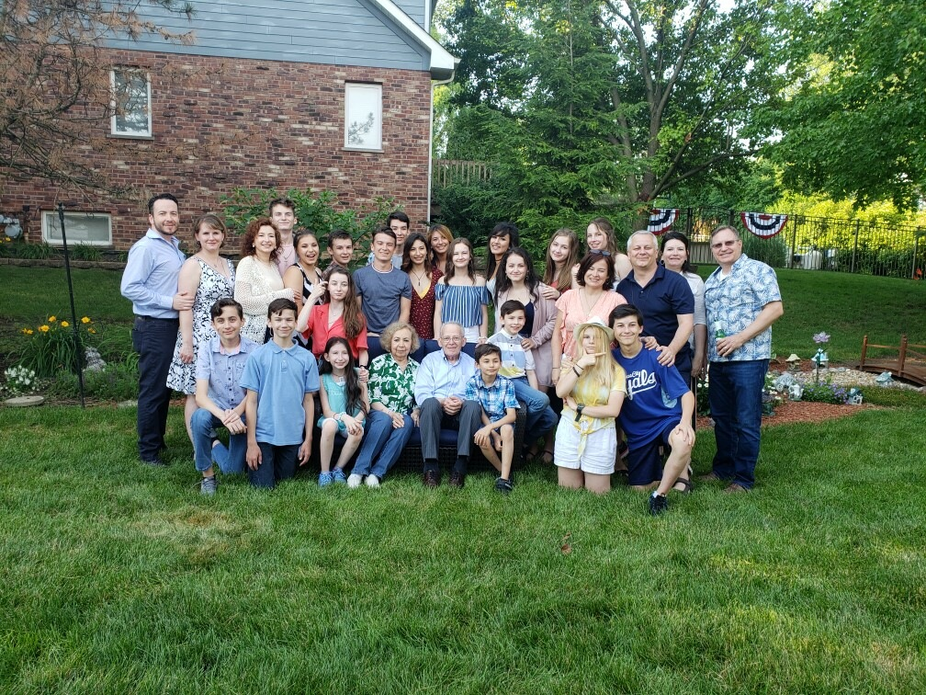
Follow-up
Labs/transfusions twice weekly; weekly clinic visits
Dose reduced to Venetoclax 20 mg x 7 days + Azacitidine 75 mg/m² SQ x 7 days
Continue treatment every 28-35 days
Last BMBX (April 2019) showed variable cellularity around 30% without any increase in blasts

Slide 43
Keynote Session:
Acute Myeloid Leukemia
Management of AML with FLT3 and IDH Mutations

Slide 44

MS ziskind Case
An 81 year old woman
PMH: Breast CA, PV, HTN
Widowed, with 4 grown sons; former office secretary
Enjoys singing in a German women’s choir, hosting Sunday brunch with friends
Notes:
Stock photo

Slide 45
Diagnosis
February 2017: Repeat BMBX showed hypercellular bone marrow (80-90%) with 50-60% blasts
NGS Panel notable for JAK2, IDH2, STAG2
Secondary AML arising from prior history of PV

Slide 46
Treatment
February 2017: Phase 1B study: AG-221 50 mg + Azacitidine 37.5 mg/m² x 7 days for 16 cycles
September 2018: Continued with single agent AG-221
April 2019: NGS Panel notable for IDH1, FLT3, JAK2, STAG2, ATRX, NRAS
May 2019: Single agent Ivosidenib 250 mg while on Posaconazole, then increased to Ivosidenib 500 mg daily
September 2019: Gilteritinib 120 mg daily
Notes:
In February 2017, Ms. K started the trial at full doses of each drug (Aza 75 mg/m2 and AG-221 100 mg daily), but became very ill with a neutropenic fever. We then reduced each dose by 50% moving forward
Based on remission status and difficulty continuing Aza, we stopped Azacitidine after 16 cycles (September 2018) and continued single agent enasidenib (AG-221) until April 2019.
In April 2019, we recognized disease progression in the blood. Repeated NGS and found the following mutations: IDH1, FLT3, JAK2, STAG2, ATRX, NRAS
Between May and August, Ms. K was monitored on Ivosidenib until signs of disease progression in August 2019
August 2019: repeat NGS shows similar mutations with FLT3 showing a higher variant allele fraction

Slide 47
counseling/education
Tumor Lysis Syndrome
Differentiation Syndrome
Neutropenic Fever
Thrombocytopenia precautions
Notes:
Allergies to allopurinol and febuxostat; admitted for hydration and rasburicase
Multiple admissions for neutropenic fevers requiring intravenous antibiotics
- component of ITP; requiring eltrombopag. She also had significant antibiodies, making transfusions difficult and required HLA matched platelets

Slide 48
Side effects/toxicities
Leg swelling
Rash
Diarrhea (history of refractory C. diff)
Hair loss

Slide 49
Follow-up
She continues to take Gilteritinib 120 mg daily, but has been experiencing many of the known side effects
She is being managed for an ongoing rash of unknown etiology; taking prednisone daily
Blood product transfusion independent!

Slide 50
Inhibitors of Mutant FLT3 and Mutant IDH
Eytan M Stein, MD
Director, Center for Drug Development in Leukemia
Assistant Attending Physician
Leukemia Service, Department of Medicine
Memorial Sloan Kettering Cancer Center
New York, New York
Notes:
Thank you to the organizers of this meeting for inviting me to talk about how we target mutations in mutated isocitrate dehydrogenase, a topic I spend a lot of time thinkging about.

Slide 51
Patient Case
50 year old woman with no prior medical history who developed a severe headache while playing tennis.
The next day the headache persists. She presents to a local emergency room for evaluation.
She reports the headache as bifrontal, throbbing, and relentless. Pain is 8 out of 10. No fevers, chills, neck stiffness, history of prior migraines or other headache syndromes.
She has no family history of serious medical issues. She and her husband have three children ages 14, 16 and 18. She works as an executive coach and does not smoke. She has a glass of wine each night with dinner.
Physical examination is normal. A detailed neurological exam shows normal cranial nerves, gait, strength and sensation.
CT brain is performed and shows no abnormalities.

Slide 52
Patient Case (continued)
CBC results show a white blood count of 83, hemoglobin of 5.9 and platelet count of 42.
Differential shows 80% blasts.
Bone marrow biopsy done later in the day confirms a diagnosis of acute myeloid leukemia with 90% myeloblasts, a normal karyotype and the presence of a FLT3 mutation.
The patient is transferred to a comprehensive cancer center, where she begins induction chemotherapy with daunorubicin, cytarabine and the multikinase/FLT3 inhibitor Midostaurin.

Slide 53
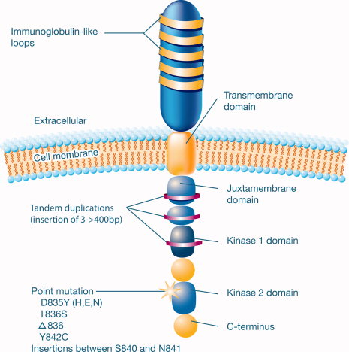
FLT3
FLT-3 ITD found in 30% of cytogenetically normal AML
Constitutive activation of FLT-3 receptor
Confers a poor prognosis
Patients typically present with a high white count
Cancer; pages 3293-3304, 11 FEB 2011 DOI: 10.1002/cncr.25908
Notes:
This is a schematic depiction of the Fms‐like tyrosine kinase 3 (FLT3) receptor. The most common sites of mutations or alterations are indicated (see Thiede et al, 200221; Litzow et al, 200555; Breitenbuecher et al, 200963; and Kayser et al, 2009107). D835Y (H,E,N) indicates substitution of tyrosine, histidine, glutamic acid, or asparagine for aspartic acid at codon 835; I836S, substitution of serine for isoleucine at codon 836; Δ836, delta 836 mutation of 3 base pairs (bp) affecting codon I836; Y842C, substitution of cysteine for tyrosine at codon 842.
© IF THIS IMAGE HAS BEEN PROVIDED BY OR IS OWNED BY A THIRD PARTY, AS INDICATED IN THE CAPTION LINE, THEN FURTHER PERMISSION MAY BE NEEDED BEFORE ANY FURTHER USE. PLEASE CONTACT WILEY'S PERMISSIONS DEPARTMENT ON PERMISSIONS@WILEY.COM OR USE THE RIGHTSLINK SERVICE BY CLICKING ON THE 'REQUEST PERMISSION' LINK ACCOMPANYING THIS ARTICLE. WILEY OR AUTHOR OWNED IMAGES MAY BE USED FOR NON-COMMERCIAL PURPOSES, SUBJECT TO PROPER CITATION OF THE ARTICLE, AUTHOR, AND PUBLISHER.

Slide 54
Phase 3 RATIFY Study: Chemotherapy ±
Midostaurin in Newly Diagnosed AML¹
Cytarabine
(200 mg/m²/d, d 1-7) +
Daunorubicin
(60 mg/m²/d, d 1-3) +
Midostaurin
(50 mg twice daily, d 8-21)
High-dose cytarabine
(3 g/m²/d twice daily,
d 1, 3, 5) +
Midostaurin
(50 mg twice daily,
d 8-21)
CR
CR
Midostaurin
(50 mg twice daily, d 1-28)
Treatment-naïve patients with AML with activating FLT3 mutations
(N = 717)
Primary endpoint: OS
Key secondary endpoints: EFS, OS,
CR, DFS
Induction
(1-2 cycles)
Consolidation
(4 cycles)
Continuation
(12 cycles)
R
Cytarabine
(200 mg/m²/d, d 1-7) +
Daunorubicin
(60 mg/m²/d, d 1-3) +
Placebo
(twice daily, d 8-21)
High-dose cytarabine
(3 g/m²/d twice daily,
d 1, 3, 5) +
Placebo
(twice daily, d 8-21)
CR
CR
Placebo
(twice daily,
d 1-28)
Stone RM et al. N Engl J Med. 2017;377:454-464.

Slide 55
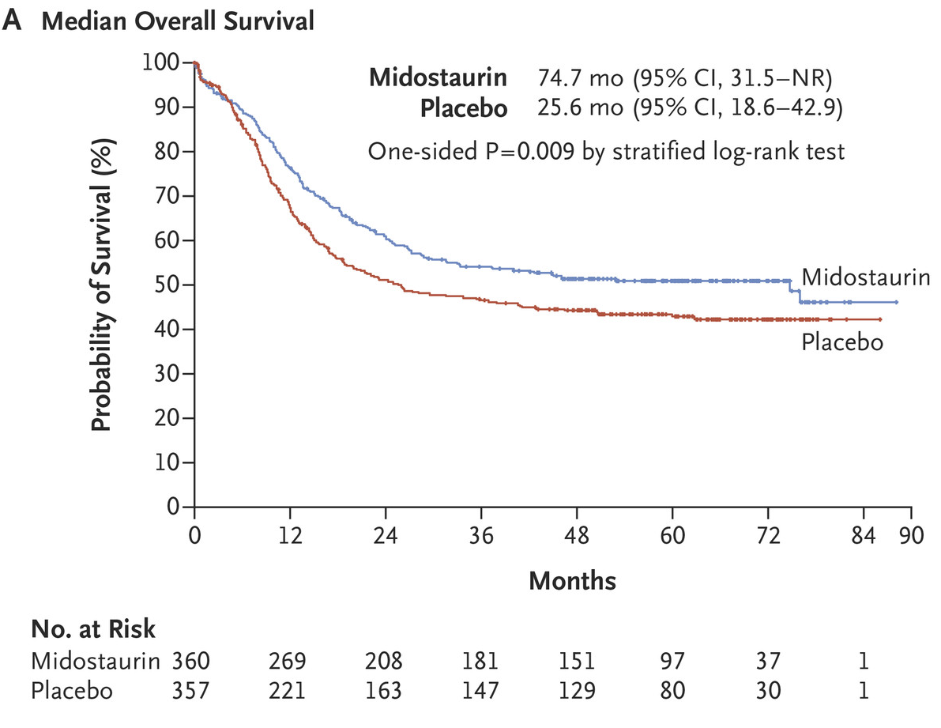

Overall RATIFY – Overall Survival
HR = 0.78
Stone RM et al. N Engl J Med. 2017;377:454-464.
Notes:
Figure 2. Overall Survival. Panel A shows Kaplan–Meier curves for median overall survival in the midostaurin group and the placebo group. Tick marks indicate censoring of data. Panel B shows the between-group comparison of overall survival with stratification according to subtype of FLT3 mutation: point mutation in the tyrosine kinase domain (TKD) or internal tandem duplication (ITD) mutation with either a high ratio (>0.7) or a low ratio (0.05 to 0.7) of mutant to wild-type alleles (ITD [high] and ITD [low], respectively). NR denotes not reached.

Slide 56
Patient Case (continued)
The patient has a bone marrow biopsy on day 21 of induction chemotherapy that shows persistent disease with 60% blasts in a cellular marrow.
The patient is started on the targeted FLT3 inhibitor Gilteritinib.
  Oral medication, taken once a day in continuous 28 day cycles
  Favorable side effect profile. Major toxicities are transaminitis and CK elevation
  Leads to complete remission (CR) or complete remission with partial hematologic recovery (CRh) in 34% of patients

Slide 57
Gilteritinib – Phase III ADMIRAL Study
Monotherapy vs salvage chemotherapy (ADMIRAL; NCT02421939)
Patients (N=371)
FLT3-ITD or D835/I836 mutation
Aged ≥18 years
R/R after first-line AML therapy (±HSCT)
No prior FLT3 inhibitor except midostaurin or sorafenib
Suitable for one of the high- or low-intensity control salvage chemotherapy options
Primary endpoints:
OS; CR/CRh rate
Secondary endpoints include:
EFS, LFS, duration of remission, CR, CRc, CRh
HSCT
Gilteritinib
continuous
28-day cycles until lack of clinical benefit
or unacceptable toxicity
Follow-up
R
2:1
LoDAC or azacitidine
Continuous 28-day cycles until lack of clinical benefit or unacceptable toxicity
Salvage chemotherapy
Follow-up
HSCT
MEC or FLAG-IDA
For a maximum of 2 cycles or until NR or PD
ADMIRAL addresses gilteritinib efficacy in the R/R disease setting compared with salvage chemotherapy; the study includes patients who are and are not fit for high intensity chemotherapy
Based on data from the ongoing ADMIRAL study, gilteritinib is approved in Japan and US for treatment of adults with FLT3-mutated R/R AML

Slide 58
ADMIRAL: Overall Survival (ITT Population: N=371)
Perl A, et al, NEJM, Oct 31, 2019
Notes:
Source data:
CL-301 manuscript
Figure 2A

Slide 59
Patient Case, Continued
The patient achieves a complete remission with the absence of measurable residual disease by flow cytometry and molecular testing. She is scheduled to be admitted in two weeks for an allogeneic bone marrow transplant.

Slide 60
Patient Case – IDH Mutation
58 year old man diagnosed in January, 2017 with AML associated with an isolated mutation in IDH2 (R140Q). Receives induction chemotherapy with 7+3 → no remission → FLAG-IDA → no remission.
The patient feels well. Physical examination is normal. Labs are notable for a WBC of 2.4 with 90% peripheral blasts, an ANC of 0.2, hgb of 7.1 and platelets of 13.
Repeat bone marrow biopsy shows 80% myeloblasts and confirms the continued presence of an IDH2 mutation. What should you do?

Slide 61
IDH2m and IDH1m: Distinct Genetically Defined Populations
IDH Mutations Seen in Multiple Cancer Types
Target | Indication | IDHm (%)
 | AML | 15%
 | MDS/MPN | 5%
 | Angio-immunoblastic NHL | 25%
 | Others (melanoma, glioma, chondro)² | 3-5%
 | Type II D-2HG Aciduria (inborn error of metabolism) | 100%
 | Low-grade glioma & 2^{ary} GBM¹ | 70%
 | Chondrosarcoma | >50%
 | AML | 7.5%
 | MDS/MPN | 5%
 | Intrahepatic cholangiocarcinoma | 20%
 | Others (colon, melanoma, lung)² | 1-2%
IDH2m
IDH1m
¹Includes 8.5% of Primary GBM
²Includes “basket” of emerging unconfirmed indications
Notes:
Mutations in IDH1 and IDH2 can be seen across cancer types. Mutations in IDH-2 predominate in hematologic malignancies and are found commonly in 25% of angioimmunoblastic non-hodgkins lymphoma, 10-15% of Acute Myeloid Leukemia and 5% of Myelodysplastic syndromes and myeloproliferative neoplasms. Mutations in the IDH-1 gene are most commonly found in solid tumors and are present in 70% of gliomas, and over 50% of chondrosarcomas. IDH-1 mutations are also found in 7.5% of AML and 5% of patients with MDS/MPN.

Slide 62
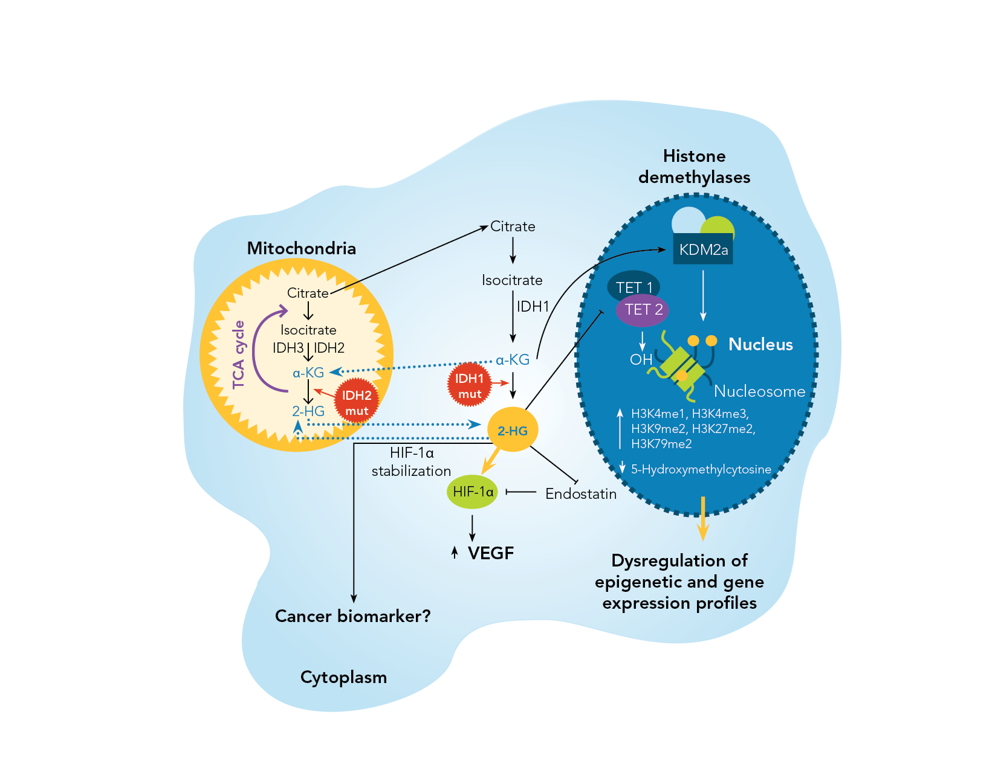
IDH in AML
IDH1 in cytoplasm and IDH2
in mitochondria
Cancer-associated IDHm produces 2-hydroxyglutarate
(R-2-HG)
IDH1/IDH2 mutations induce
BCL-2 dependence (Majeti, Nature Medicine, 2015)
R-2HG suppresses homologous recombination (Bindra, Science Translational Medicine, 2017)
Prensner and Chinnaiyan Nature, 2011
Notes:
Many of you in this room know that Isocitrate dehydrogenase occurs in three isoforms, IDH1, IDH2 and IDH3. IDH1 is found in the cytoplasm and peroxisomes and IDH2 is located in the mitochondria. In their wild type state, both IDH1 and IDH2 catalyze the oxidative decarobxylation of isocitrate to alpha ketoglutarate. Mutations in IDH1 and IDH2 confer neomorphic activity onto the mutant IDH enzyme; instead of catalyzing the conversion of isocitrate to alpha ketoglutatrate, the mutant proteins act to reduce alpha ketoglutarate to beta hydroxyglutarate or 2-HG. Increased levels in 2-HG lead to an inability of cells to demethylate target genes. This hypermethylation, in pre-clinical models, leads to a block in differentiation at the myeloblast stage of hematopeoisis and clinically apparent AML. Small molecule inhibition of mutant IDH blocks the production of 2-HG, allowing demethyation of target genes, cellular differentiation and the resumption of normal hematopoiesis.

Slide 63
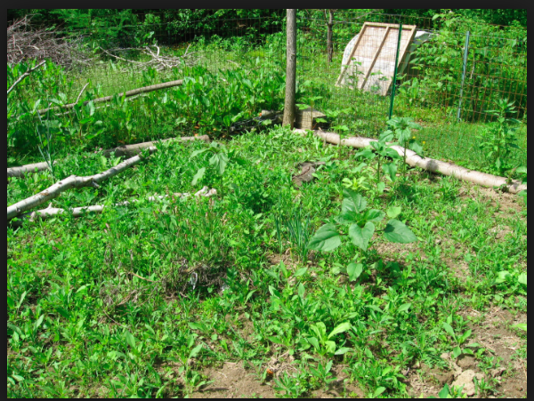
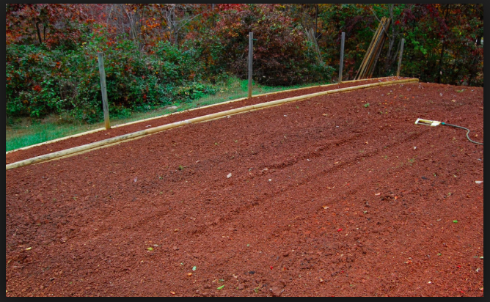
Chemotherapy

Slide 64

Differentiation Therapy

Slide 65
Approved IDH Inhibitors in AML
Enasidenib – IDH2 inhibitor. Approved for relapsed and refractory IDH2 mutant AML.
  Oral, given once daily, continuous 28 day cycles
  Indirect hyperbilirubinemia
Ivosidenib – IDH1 inhibitor. Approved for relapsed and refractory and newly diagnosed IDH1 mutant AML.
  Oral, once daily, continuous 28 day cycles
  QT prolongation
In R/R AML, complete remission rates with IDH inhibitors is about 21%

Slide 66
Enasidenib – Response Over Time
Responding Patients (n=79)
Median time to first response = 1.9 mo
Median time to best response = 3.7 mo
NA
Relapse/PD
SD
PR
MLFS
CRi/CRp
CR
Data cutoff: 14 October 2016
CR, complete remission; CRp, CR with incomplete platelet recovery; CRi, CR with incomplete hematologic recovery; MLFS, morphologic leukemia-free state; PR, partial remission; SD, stable disease; PD, progressive disease
Notes:
Evolution of response at each cycle among responding patients (n=79 total) with R/R AML

Slide 67
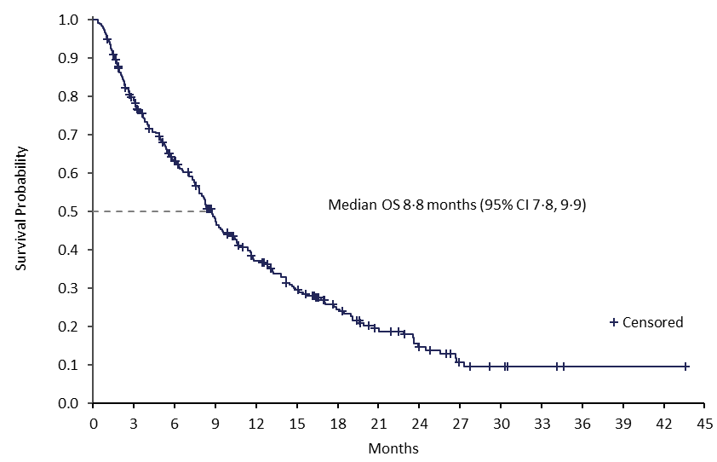
Overall Survival – All R/R Patients
Stein EM, Dinardo CD, et al, Blood 2017

Slide 68
Case Continued
At cycle 5 day 1, the patient is noted to have a decrease in his peripheral blasts and a rise in the absolute neutrophil count to 1.1/ul.
At cycle 5 day 15, the patient calls the office reporting new dyspnea on exertion and leg swelling.
You ask him to come in to your office. Physical exam is notable for bilateral rales in all lung fields. Chest X-ray shows bilateral fluffy infiltrates.

Slide 69
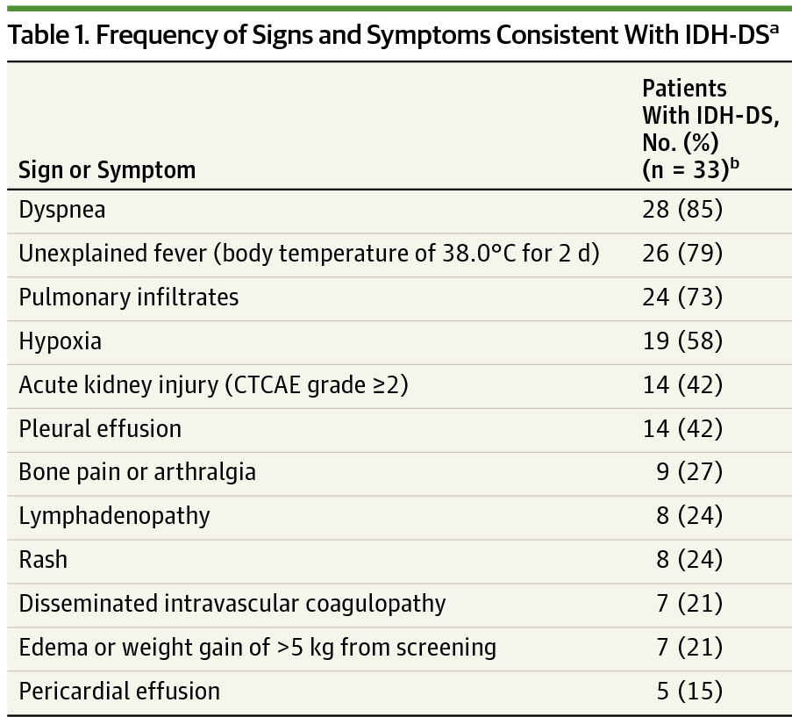
Differentiation Syndrome
ª Signs and symptoms are based on retrospective differentiation syndrome review committee review of clinical records.
^{b} Patients may have had multiple symptoms.
Fathi A et al, JAMA Oncology 2018

Slide 70
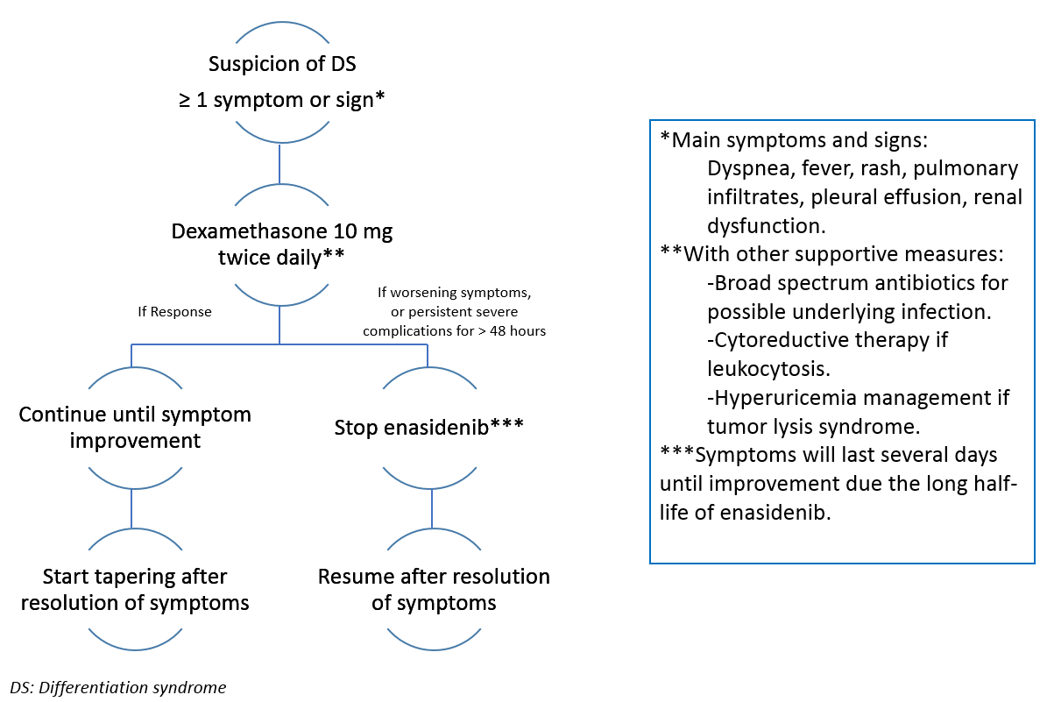
Management of IDH-DS
Abou Dalle I et al, Ther Adv Heme 2018

Slide 71
Case Continued
At cycle 6 day 1, a bone marrow biopsy confirms a morphologic CR, with the presence of 2% abnormal myeloblasts by flow cytometry and the persistence of the IDH2 mutation by next generation sequencing.
You recommend to the patient that he proceed to an allogeneic bone marrow transplant from his matched sibling donor.
The patient declines and says, “Doctor, I feel great, I have no side effects from this oral pill and I don’t want to be admitted to the hospital for another month. I’m going to take my chances with Enasidenib.”
At cycle 9 day 1, the patient relapses with 40% blasts in the peripheral blood. Bone marrow biopsy shows 75% blasts, persistence of the IDH2 mutation and a new FLT3-ITD.

Slide 72
Improving Survival with FLT3 and IDH Inhibitors
Combining these drugs with standard of care chemotherapy and hypomethylating agents.
  Phase III study of IDH1/IDH2 inhibitors in combination with chemotherapy
  Phase III studies of FLT3 inhibitors (Gilteritinib/Quizartinib/Crenolanib) in combination with chemotherapy versus Midostaurin or Placebo in combination with chemotherapy
  Studies of IDH inhibitors and FLT3 inhibitors in combination with hypomethylating agents

Slide 73
Keynote Session:
Acute Myeloid Leukemia
Induction Treatment for Younger, Fit Patients;
Secondary AML

Slide 74
Ms Hewitt Case #3
Patient is a 64 yo man with h/o provoked bilateral PE after international flights/p 6 months of warfarin in 2015 and provoked DVT/PE after gastrectomy in 2016 s/p tPA and now on lifelong rivaroxaban who is followed in the VA Hematology clinic
1/8/19 noted to have cytopenias → referred for BMBx
1/9/19 BMBx with 65% blasts; erythroid cells and megakaryocytes were normal in appearance, flow with 64% blasts, NPM1 mutation present, FLT3-ITD wild-type, normal karyotype

Slide 75
Ms Hewitt Case #3
PMH
  HTN, PEs, DVT
Meds
  Rivaroxaban 20 mg (for past 3 yrs)
  Multivitamin
SH
  Lives 1 hr away with his wife of 37yrs. 5 grown sons who all live locally. Retired marine who served in many places including Camp Lejeune, Vietnam, and Japan. Exposed to water contamination & agent orange. Has worked as a pastor for 36yrs & does overseas missionary work. Also works in state prisons. Two half sibs, no full sibs

Slide 76
Ms Hewitt Case #3
We discussed that his AML is favorable prognosis given NPM1+ mutation
  40-60% chance of cure with chemotherapy→ 7+3 with gemtuzumab ozogamicin
  Needs to be admitted to hospital for ~1 month for induction
  Needs PICC placed prior to admission
  Needs ECHO prior to anthracycline
  HLA typing immediately in case needs BMT in future
  Given h/o extensive travel abroad to endemic regions, he needs tuberculosis test, Hep B/C, and strongyloides antibody testing

Slide 77
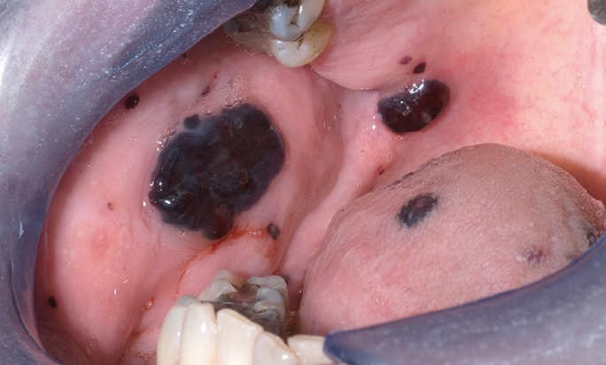
Ms Hewitt Case #3
1/27-2/17/19 admitted for induction with 7+3+GO.
  Course c/b ESBL bacteremia and diffuse skin rash
3/3/19 C1D1 IDAC + GO
  Course c/b grade 1 mucositis, multiple oral blood blisters, epistaxis, fatigue, and toothache (occurred with count recovery) in tooth with pre-existing cavity in base of tooth (seen on x-ray only)

Slide 78
Ms Hewitt Case #3
Management considerations
  Reviewed neutropenic precautions and reportable symptoms
  TIW infusion appts for labs, transfusion support
  Low threshold to add antibx for toothache =/- imaging given concern for possible development of abscess
  Hold rivaroxaban when PLT <50k, restart at recovery → cancer is in hypercoagulable state
  Send MRD testing at end of C3 consolidation

Slide 79
Ms Hewitt Case #3
During 3rd cycle of consolidation patient presented as a sick call with c/o 10/10 tooth/jaw pain & fevers to 39C
Found to have a dental abscess requiring tooth extraction & antibx
  Coordination with oral surgery → antibx, PLT transfusions with increased transfusion threshold x3 days
  Pain management
6/17/19 BMBx shows CR, MRD-

Slide 80
Special Issues in Oncology Care
Clinical research opportunities offering
important new options for patients

