Slide 1
Module 1: Colorectal and Gastric Cancers
Amanda Wagner, APRN-CNP, AOCNP
Johanna Bendell, MD

Slide 2
Disclosures for Ms Wagner
No financial interests or affiliations to disclose

Slide 3
Disclosures Dr Bendell
Consulting Agreements | Agios Pharmaceuticals Inc, Amgen Inc, Apexigen, Arch Oncology, ARMO BioSciences, Array BioPharma Inc, AstraZeneca Pharmaceuticals LP, Bayer HealthCare Pharmaceuticals, BeiGene, Boehringer Ingelheim Pharmaceuticals Inc, Bristol-Myers Squibb Company, Celgene Corporation, Continuum Clinical, Cyteir Therapeutics, Daiichi Sankyo Inc, Five Prime Therapeutics Inc, FORMA Therapeutics, Genentech, Gilead Sciences Inc, GlaxoSmithKline, Incyte Corporation, Innate Pharma, Ipsen Biopharmaceuticals Inc, Janssen Biotech Inc, Leap Therapeutics Inc, Lilly, MacroGenics Inc, Merck, Merrimack Pharmaceuticals Inc, Moderna Inc, Molecular Partners, Novartis, OncoGenex Pharmaceuticals Inc, OncoMed Pharmaceuticals Inc, Pfizer Inc, PhoenixBio, Prelude Therapeutics, Roche Laboratories Inc, Sanofi Genzyme, Seattle Genetics, Taiho Oncology Inc, Tanabe Research Laboratories, TG Therapeutics Inc, Tizona Therapeutics Inc, Tolero Pharmaceuticals, Torque Therapeutics, Translational Drug Development
Contracted Research | AbbVie Inc, Acerta Pharma — A member of the AstraZeneca Group, ADC Therapeutics SA, Agios Pharmaceuticals Inc, Amgen Inc, Apexigen, Arch Oncology, Arcus Biosciences, ARMO BioSciences, Array BioPharma Inc, Arrys Therapeutics, a wholly owned subsidiary of Kyn Therapeutics, AstraZeneca Pharmaceuticals LP, Bayer HealthCare Pharmaceuticals, Bellicum Pharmaceuticals Inc, Blueprint Medicines, Boehringer Ingelheim Pharmaceuticals Inc, Boston Biomedical Inc, Bristol-Myers Squibb Company, Calithera Biosciences, Celgene Corporation, Celldex Therapeutics, CytomX Therapeutics, Daiichi Sankyo Inc, eFFECTOR Therapeutics Inc, Eisai Inc, EMD Serono Inc, Evelo Biosciences Inc, Five Prime Therapeutics Inc, FORMA Therapeutics, Forty Seven Inc, Genentech, Gilead Sciences Inc, GlaxoSmithKline, Gossamer Bio, Harpoon Therapeutics, ImClone Systems, a wholly owned subsidiary of Eli Lilly and Company, Incyte Corporation, Innate Pharma, Ipsen Biopharmaceuticals Inc, Jacobio Pharmaceuticals Co Ltd, Kolltan Pharmaceuticals Inc, Leap Therapeutics Inc, Lilly, MacroGenics Inc, MEI Pharma, Merck, Merrimack Pharmaceuticals Inc, Mersana Therapeutics, Merus BV, Nektar, Novartis, Novocure, OncoGenex Pharmaceuticals Inc, OncoMed Pharmaceuticals Inc, Onyx Pharmaceuticals, an Amgen subsidiary, Pfizer Inc, Pieris Pharmaceuticals Inc, Prelude Therapeutics, Rgenix, Roche Laboratories Inc, Sanofi Genzyme, Seattle Genetics, Shattuck Labs, Sierra Oncology, SynDevRx Inc, Taiho Oncology Inc, Takeda Oncology, Tarveda Therapeutics, Tempest Therapeutics Inc, TG Therapeutics Inc, TRACON Pharmaceuticals Inc, Tyrogenex Inc, Unum Therapeutics, Vyriad
Data and Safety Monitoring Board/Committee | Five Prime Therapeutics Inc

Slide 4
Approximately how many patients with the following types of cancer have you interacted with over the past year?
Type of cancer | Median
Breast cancer | 40
Lung cancer | 35
Colorectal cancer | 30
Myelodysplastic syndromes | 20
Multiple myeloma | 20
Chronic lymphocytic leukemia | 15
Pancreatic cancer | 10
Diffuse large B-cell lymphoma | 10
Prostate cancer | 10
Follicular lymphoma | 7
Melanoma | 6
Type of cancer | Median
Ovarian cancer | 6
Renal cell carcinoma | 6
Hepatocellular carcinoma | 5
Gastric cancer | 5
Acute myeloid leukemia | 4
Hodgkin lymphoma | 4
Urothelial bladder cancer | 4
Endometrial cancer | 3
Cervical cancer | 2
Mantle cell lymphoma | 2

Slide 5
Day in the Life: Colorectal
45 F, C3D1 FOLFOX, She had a hypersensitivity reaction to 3rd dose of Oxaliplatin! We were able to administer corticosteroids, Diphenhydramine and Famotidine and then rechallenge her at half the rate, titrating up. Completed treatment.
38 M, bevacizumab and FOLFIRI, Not understanding the reality of stage 4 disease
61 M, FOLFOX, Calmness
56 M, FOLFOX, He is surprised how well he tolerates his chemotherapy
66 F, bevacizumab and 5 FU, Extremely gentle soul always with a huge smile and genuine care for those around her
48 M, FOLFOX, Caring for other patients
65 F, Radiation and chemo, Positive outlook

Slide 6
Day in the Life: Colorectal
55 F, Oral chemo and radiation, Perseverance
54 F, Clinical trial, Doing well
49 M, FOLFOX, Smart, realistic and funny
46 M, FOLFIRI, His attitude
93 M, FOLFOX, His age/ performance status
60 F, FOLFOX, Complaints of fatigue, metastatic

Slide 7
Day in the Life: Gastric
81 M, Ramucirumab, progression of disease in patient who really wants to live
85 M, surveillance, too debilitated for adjuvant treatment; doing well 5 yrs later
55 M, chemotherapy, Parkinson's, bipolar disorder
81 F, palliative radiation therapy, poor performance status - family had difficulty not treating curatively
68 M, FOLFOX, neuropathy
68 M, none, Profound weakness (elevated CK) as toxicity to immunotherapy
65 F, Pembrolizumab, Compassionate use

Slide 8
Day in the Life: Gastric
60 M, Chemotherapy, FLOT, He continues to work and works night shift and then comes for his chemo
64 M, s/p surgery, will get chemo, had esophageal leak, esophageal stent migration, wound dehiscence, milky JP drainage + for Staph aureus

Slide 9
Colorectal Cancer

Slide 10
Case #1
60 yo female with a past medical history of HTN/HLD/GERD
Presented to local ED with worsening fatigue and shortness of breath
Labs revealed: hemoglobin 8.8, MCV 66, chest x-ray with pulmonary nodules
CT C/A/P with contrast showed multiple pulmonary nodules, liver lesions, and enlarged mesenteric lymph nodes in the L abdomen.
Colonoscopy showed a high-grade obstructing lesion in the transverse colon, +adenocarcinoma
Liver biopsy--+adenocarcinoma consistent with colorectal primary (pMMR, RAS/RAF wild type)

Slide 11
Case #1 (cont’d)
Received FOLFOX/Bevacizumab
Developed bilateral LE weakness/inability to walk after 3rd infusion, resolved after ~12 hours
Presumed to be related to oxaliplatin
Continued on 5FU/Bevacizumab with initial response, eventual progression after 12 months
FOLFIRI/Bevacizumab x 4 months
Irinotecan/Panitumumab x 6 months then progression
Discussed further treatment with TAS-102 vs Regorafenib

Slide 12
Which one do you choose?
TAS-102
Regorafenib
Myelosuppression (increased infection risk/bleeding)
Nausea/vomiting
Diarrhea
Fatigue
Anorexia/weight loss
Fatigue
Hand Foot Syndrome
Stomatitis
Diarrhea
Nausea/vomiting
Hair texture changes
HTN
Hepatotoxicity

Slide 13
Patient elected for treatment on TAS-102
Was relatively asymptomatic at the time of progression other than weight loss
Had a lot of anxiety/depression related to her diagnosis
Family very supportive, utilized supportive care services (massage, psychologist) as well as pharmacological management with SSRI with improvement
Had recently retired prior to diagnosis still wanted to travel
Preferred side effect profile of TAS-102 to preserve QOL
ADMINISTRATION INSTRUCTIONS:
Take tablets with a full glass of water and with food.
Do not crush or chew. O.K. to handle whole tablets, wash hands when done.
Separate doses by 10-12 hours.
Dosed at 35 mg/m² BID on days 1-5 and 8-12 of a 28 day cycle (calendar provided)
Side effect management (anti-emetics, anti-diarrheals)
Instructed patient to call with uncontrolled n/v/d or Fever >100.4

Slide 14
Our patient’s adverse effects
Overall tolerated very well, still able to do travel
Was able to complete Bucket List
Stable disease maintained x 4 months
Grade 3 and 4 neutropenia
Initial treatment delay with Cycle 2 and Cycle 3
Checked labs before she came to save trips
Eventual dose reduction to 30 mg/m² BID
Growth factor support
Grade 1 Diarrhea/Nausea
Well managed with prochlorperazine PRN and loperamide PRN

Slide 15
How is our patient now?
Patient eventually progressed on TAS-102 after 4 months of therapy
Went on to receive regorafenib
Titrated up dose as tolerated via ReDos study (80 mg x 1 week, 120 mg x 1 week, 160 mg x 1 week)
Could only tolerate 120 mg (3 weeks on, 1 week off)
Fatigue, anorexia, diarrhea, mucositis were her adverse effects
Had biochemical response-CEA improved from 547 to 67
Improved on imaging as well
Eventually progressed after ~8 months
Re-challenging FOLFOX, CEA has improved
Bekaii-Saab,T. et all. (2019) Regorafenib dose-optimisation in patients with refractory metastatic colorectal cancer (ReDOS): a randomised, multicentre, open-label, phase 2 study

Slide 16
After 4 months on Regorafenib

Slide 17
Module 1: Metastatic colorectal and gastric cancers
Johanna Bendell, MD Chief Development Officer Director, Drug Development Unit Nashville Sarah Cannon Research Institute Tennessee Oncology Nashville, Tennessee

Slide 18
First-line treatment of L sided, symptomatic, RAS WT mCRC

Slide 19
NCCN Recommendations for First-Line Treatment of CRC
For candidates of intensive therapy:
Multi-agent chemotherapy regimens with option of targeted therapy, with no preference for a specific regimen
May add targeted therapy according to molecular testing results
Chemotherapy Backbone
FOLFOX
FOLFIRI
CAPEOX
FOLFOXIRI
5-FU/leucovorin
Capecitabine
RAS or BRAF mutations
RAS or BRAF wild-type
±
Anti-EGFR antibodyª
(cetuximab or panitumumab)
Bevacizumab
or
ª KRAS/NRAS wild-type and left-sided tumors only
CAPEOX, capecitabine, oxaliplatin; FOLFIRI, leucovorin, 5-fluorouracil, irinotecan; FOLFOX, leucovorin, 5-FU, oxaliplatin; FOLFOXIRI, leucovorin, 5-fluorouracil, oxaliplatin, irinotecan
Benson AB, et al. Colon Cancer, Version 4.2018. NCCN Clinical Practice Guidelines in Oncology.

Slide 20
What influences treatment choices in mCRC?
Patient characteristics
Molecular characteristics
Comorbidities
Prior adjuvant treatment
RAS
BRAF
1L
Age
Performance status
MSI-high
HER2
2L
3L
Patient preference
Tumor characteristics
Tumor burden
Quality of life
Toxicity profile
Resectability
4L
Tumor location
Therapy tailored according to individual patient needs

Slide 21
CALGB 80405: CT* + Bevacizumab or Cetuximab in 1L mCRC OS in all RAS WT Patients by Treatment Arm and Location
1.0
Left bevacizumab: 32.6 months (n=152)
Right bevacizumab: 29.2 months (n=78)
HR=0.88 (95% CI: 0.62–1.25); adjusted p=0.50
Left cetuximab: 39.3 months (n=173)
Right cetuximab: 13.6 months (n=71)
HR=0.55 (95% CI: 0.39–0.79); adjusted p=0.001
0.8
0.6
OS estimate
0.4
0.2
13.6
29.2
32.6
39.3
0
0
24
48
72
96
Time (months)
*FOLFOX or FOLFIRI (investigator’s choice) CT, chemotherapy
Lenz HJ, et al. ESMO 2016

Slide 22
Treatment Algorithm by Tumour Side and Molecular Subgroup
Left-sided RAS/BRAF WT tumours¹
Right-sided RAS/BRAF WT tumours^{1,2}
RAS MT tumours¹
BRAF MT tumours¹
1L
EGFR inhibitor + CT doublet
Bevacizumab + CT doublet
Bevacizumab + CT doublet
Bevacizumab + CT doublet
Bevacizumab + FOLFOXIRI
2L
Bevacizumab + CT doublet
VEGF inhibitor + CT doublet
VEGF inhibitor + CT doublet
VEGF inhibitor + CT doublet
EGFR inhibitor ± CT
3L
Regorafenib/ Trifluridine/tipiracil
EGFR inhibitor ± irinotecan
Regorafenib/ Trifluridine/tipiracil
Regorafenib/ Trifluridine/tipiracil
Regorafenib/ Trifluridine/tipiracil
4L
BSC
Regorafenib/ Trifluridine/tipiracil
BSC
BSC
BSC
5L
BSC
1L anti-EGFRs are recommended in RAS WT left-sided tumours only BSC, best supportive care; CT, chemotherapy

Slide 23
Targeted treatment of BRAF-mutated mCRC

Slide 24
BRAF Mutations in CRC
BRAF is primary effector of KRAS signaling
BRAF mutations:
Occur most frequently in exon 15 (V600E)
Found in 4%-14% of patients with CRC
Mutually exclusive with KRAS mutations
EGF
Tumor Cell
P
P
Ras
P
P
Raf
MEK
Tumor cell proliferation
and survival
Erk
Yarden. Nat Rev Mol Cell Biol. 2001;2:127; Di Nicolantonio. J Clin Oncol. 2008;26:5705; Artale. J Clin Oncol. 2008;26:4217.

Slide 25
TRIBE demonstrated the benefit of FOLFOXIRI + bevacizumab in 1L mCRC, particularly in BRAF MT patients
1.0
OS (secondary endpoint)
RAS/BRAF WT FOLFOXIRI + bev (n=48): 41.7 months
RAS/BRAF WT FOLFIRI + bev (n=45): 33.5 months
RAS MT FOLFOXIRI + bev (n=117): 27.3 months
RAS MT FOLFIRI + bev (n=119): 23.9 months
BRAF MT FOLFOXIRI + bev (n=16): 19.0 months
BRAF MT FOLFIRI + bev (n=12): 10.7 months
0.8
0.6
OS estimate
0.4
0.2
10.7
19.0
0
0
6
12
18
24
30
36
42
48
54
60
66
72
78
Time (months)
Notes:
BRAF mutations are present in 5–10% of mCRC,¹ the most common of these being the V600E mutation²
Associated with aggressive biology, short OS, and limited response to standard CT¹
In TRIBE, FOLFOXIRI plus bevacizumab significantly improved PFS vs FOLFIRI (primary endpoint)

Slide 26
BEACON CRC: Encorafenib and cetuximab with or without binimetinib for mCRC with BRAF V600E mutation
 | E/C/B (n=224) | E/C (n=220) | Irinotecan or FOLFIRI plus C (n=221)
ORR | 26% | NR | 2%
mOS | 9.0 mo | 8.4 mo | 5.4 mo
HR (p-value) | 0.52 (<0.0001) | 0.60 (0.0003) | Ref
Kopetz S et al. Proc ESMO World Congress GI 2019; Abstract LBA-006.

Slide 27
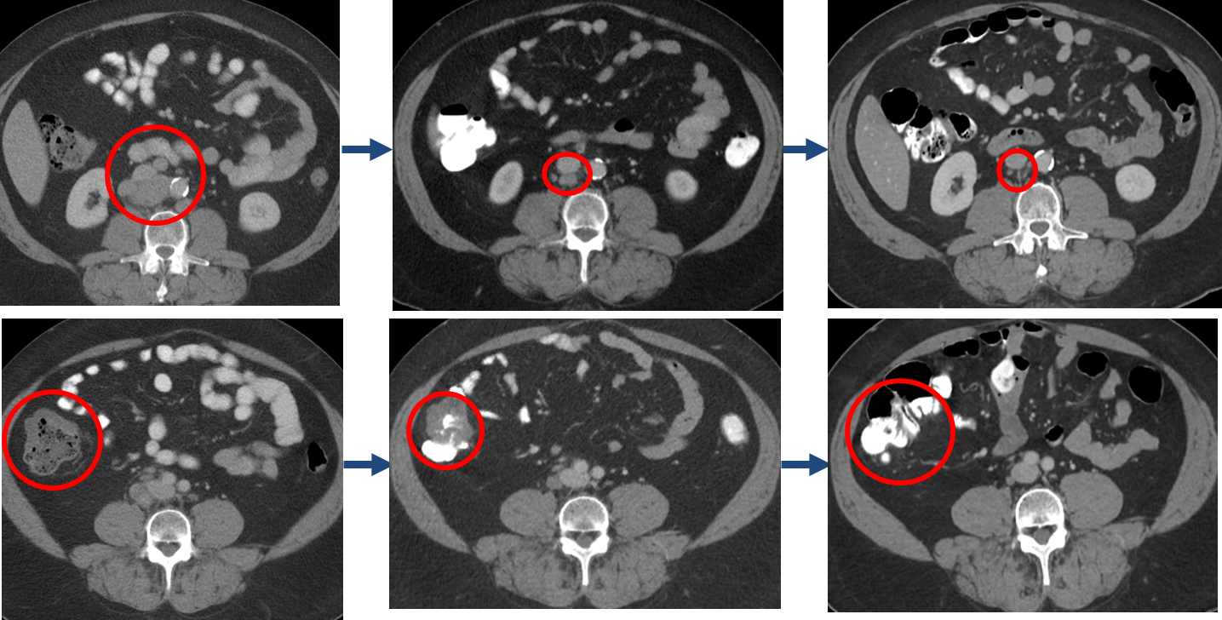
A 45 yo woman with BRAF-mutated mCRC who progressed on first-line therapy
Cetuximab plus encorafenib plus binimetinib
Baseline
2 Months
4 Months

Slide 28
TAS-102 and regorafenib as later- line therapies

Slide 29
Regorafenib: Oral Multikinase Inhibitor Targets Multiple Tumor Pathways¹⁻³
O
Cl
O
O
N
H
Kinase | Regorafenib IC₅₀² Mean ±SD nmol/L (n)
VEGFR1 | 13 ± 0.4 (2)
TIE2 | 311 ± 46 (4)
PDGFR-β | 22 ± 3 (2)
FGFR1 | 202 ± 18 (6)
KIT | 7 ± 2 (4)
RET | 1.5 ± 0.7 (2)
RAF-1 | 2.5 ± 0.6 (4)
BRAF | 28 ± 10 (6)
BRAF^{V600E} | 19 ± 6 (6)
F
N
H
N
H
N
F
F
F
Regorafenib
X
X
X
KIT
PDGFR
RET
PDGFR-β
FGFR
VEGFR1-3
TIE2
Inhibits tumor cell proliferation
Inhibits tumor microenvironment signaling
Inhibits
angiogenesis

Slide 30
Regorafenib Toxicities
Common toxicities associated with regorafenib include:
Hand-foot skin reaction
Fatigue
Hypertension
Diarrhea
Rash/desquamation

Slide 31
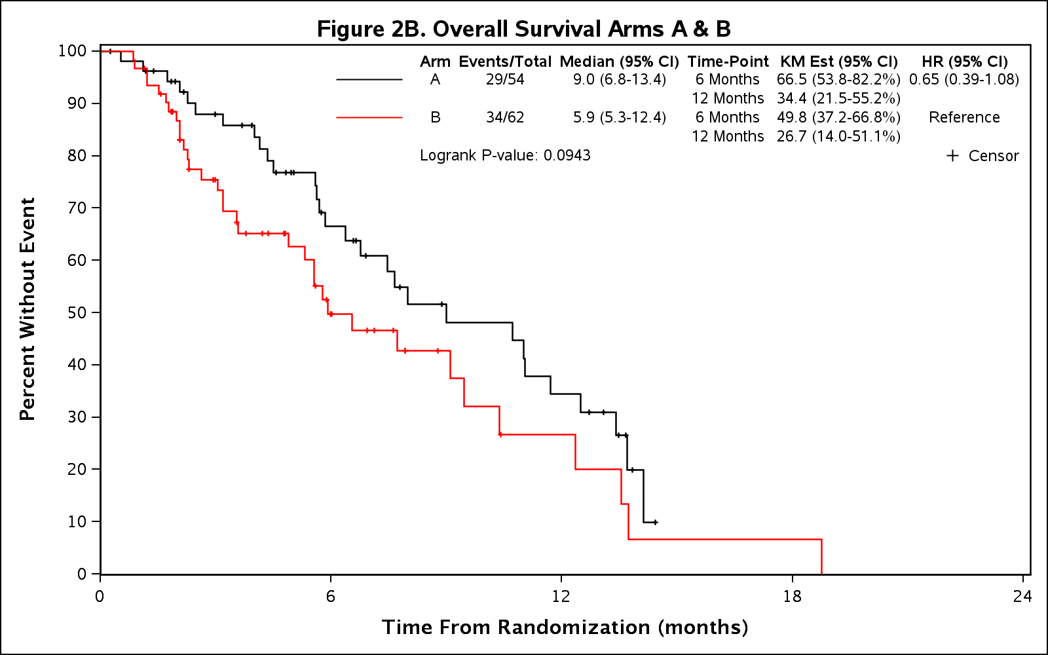
Phase II ReDOS Study: OS (secondary endpoint)

Slide 32
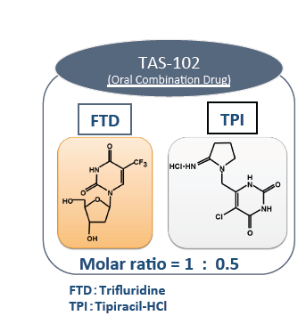
Trifluridine/Tipiracil-HCl (TAS-102): Mechanism of Action

Slide 33
RECOURSE: Trifluridine/Tipiracil-HCl (TAS-102) Improves Overall Survival in Refractory mCRC
Study population: ≥ 2 prior regimens including fluoropyrimidine, irinotecan, oxaliplatin, bevacizumab, and anti-EGFR if wild-type KRAS
100
90
80
Hazard ratio for death, 0.68 (95% CI, 0.58–0.81)
P < .001
70
60
Median OS
TAS-102: 7.1 months
Placebo: 5.3 months
Overall Survival (%)
50
40
30
TAS-102
20
10
Placebo
0
0
3
6
9
12
15
18
Months Since Randomization
No. at Risk
TAS-102 534 459 294 137 64 23 7
Placebo 266 198 107 47 24 9 3
The most frequent toxicities were gastrointestinal and hematologic
Rate of febrile neutropenia: 3.8%

Slide 34
MSI-high mCRC and gastric cancers – Diagnosis and role of immunotherapy
*** All patients with advanced CRC and gastric cancer should be tested for MMR or MSI

Slide 35
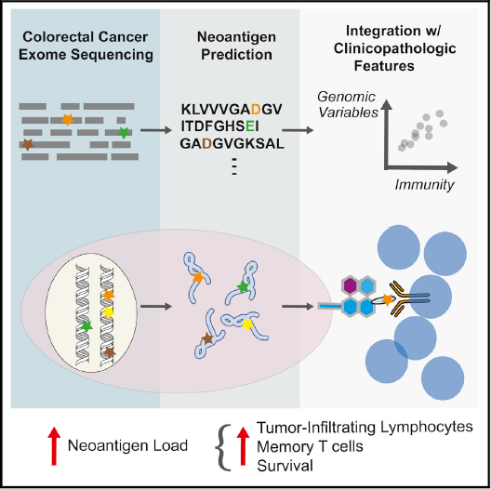
Hypermutation and Immuno-Oncology
MSI-H is associated with increases in immune infiltration and expression of immune checkpoint regulators^{1,2}
MSI-H is also associated with increased number of mutations per tumor
Tumor mutations produce tumor-specific neoantigens, which when expressed on the tumor cell surface, are a target for T cells
May improve response to immunotherapy
Elevated neoantigen load in CRC is associated with improved survival²
Llosa NJ, et al. Cancer Discov. 2015;5:43–51.
Giannakis M, et al. Cell Reports. 2016;15:857–865.

Slide 36
Pembrolizumab dMMR CRC
dMMR or pMMR CRC Tumor Response to Pembrolizumab¹
Median follow-up: 8.7 mo
Outcomes | dMMR CRC (N = 28) | pMMR CRC (N = 25)
ORR | 50% (31%-69%) | 0% (0%-14%)
DCR | 89% | 16%
mPFS | NR | 2.4 mo
mOS | NR | 6 mo
1. Le DT, et al. N Engl J Med. 2015;372:2509-2520. 2. Le DT, et al. J Clin Oncol. 2016;34 (suppl 15; abstr 103).

Slide 37
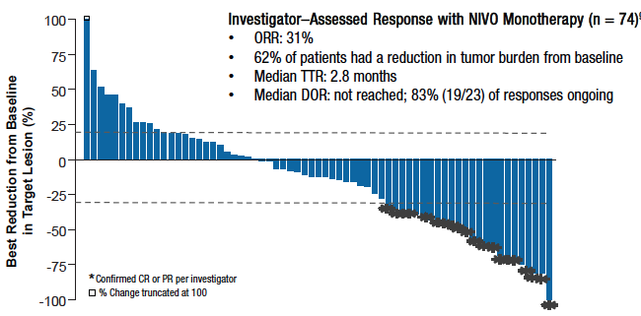
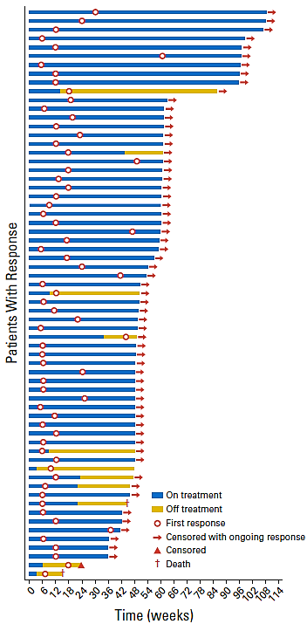
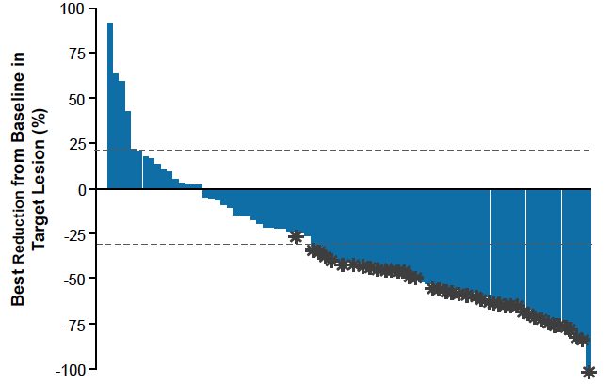
Nivolumab ± Ipilimumab in dMMR CRC
Tumor Response to Nivolumab¹
Characteristics of Response with Nivo/Ipi²
Tumor Response to Nivolumab/Ipilimumab²
Outcomes with Nivolumab ± Ipilimumab^{1,2}
Response | Nivo (N = 77) | Nivo/Ipi (N = 119)
ORR | 31% | 55%
DCR, ≥12 wk | 69% | 80%
PFS, 12-m | 50% | 71%
1. Overman MJ, et al. J Clin Oncol. 2016;34 (suppl; abstr 3501). 2. Overman MJ, et al. J Clin Oncol. 2018;36:773-779.

Slide 38
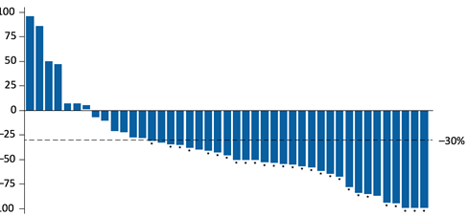
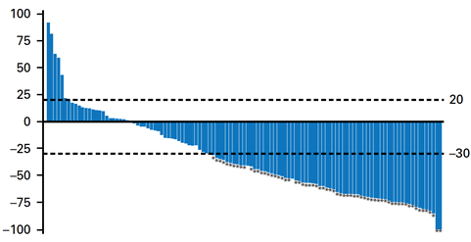
Treatment of MSI-H/dMMR CRC
CheckMate-142: Phase 2 trial of nivolumab plus ipilimumab in metastatic CRC that supported its approval in the second line¹
Subgroup of cohort 2 included previously untreated patients (n=45)
Change in Target Lesion With Nivolumab/Ipilimumab
ORR and Survival Benefit With Nivolumab/Ipilimumab¹
Front-line (N=45)²
Outcomes
ORR, % (95% CI) | 60% (44-74)
CR | 7%
PR | 53%
SD | 13%
PD | 2%
DCR, % (95%) | 84% (71-94)
DOR, mo (95% CI) | NR (11.5-NE)
mPFS, mo (95% CI) | NR (14.1-NE)
PFS, 12-mo (95% CI) | 77% (62.0-87.2)
mOS, mo (95% CI) | NR (NE)
OS, 12-mo (95% CI) | 83% (67.6-91.7)
Refractory (N=119)²
CI, confidence interval; CR, complete response; DCR, disease control rate; DOR, duration of response; m, median; NE, not evaluable; NR, not reached; ORR, objective response rate; OS, overall survival; PD, progressive disease; PFS, progression-free survival; PR, partial response; SD, stable disease.
1. Lenz HJ, et al. Ann Oncol. 2018;29 (suppl 5; abstr LBA18_PR). 2. Overman MJ, et al. J Clin Oncol. 2018;36:773-779.

Slide 39
56 yo man with Lynch syndrome and mCRC, treated with pembrolizumab

Slide 40
KEYNOTE-059 Cohort 1: Response by MSI Status (N = 174) 4.0% of Patients Were MSI-High
Responseª | MSI-High (n = 7) |  | Not MSI-High (n = 167)
 | % | 95% CI | % | 95% CI
ORR (CR + PR) | 57.1 | 18.4–90.1 | 9.0 | 5.1–14.4
CR | 14.3 | 0.4–57.9 | 2.4 | 0.7–6.0
PR | 42.9 | 9.9–81.6 | 6.6 | 3.3–11.5
DCR^{b} | 71.4 | 29.0–96.3 | 22.2 | 16.1–29.2
MSI = microsatellite instability.
ªOnly confirmed responses were included. ^{b}DCR = CR + PR + SD ≥2 months.
Data cutoff on January 16, 2017.
Fuchs CS et al. J Clin Oncol. 2017;35(suppl): abstract 4003.

Slide 41
KEYNOTE-061: OS Subgroup Analysis
Pembrolizumab improved OS in subgroups with ECOG PS 0, primary tumor in GEJ and in post-hoc analysis subgroups, PD-L1 CPS ≥ 10 and MSI-H
Result | Subgroup
 | Protocol-specified subgroups |  | Post-hoc analysis subgroups
 | ECOG PS 0 (n = 180) | Primary tumor in GEJ (n = 135) | PD-L1 CPS ≥10 (n = 108) | MSI-H tumors (n = 27)
HR for OS (95% CI) | 0.69 (0.49-0.97) | 0.61 (0.41-0.90) | 0.64 (0.41-1.02) | 0.42 (0.13-1.31)
MSI-H = microsatellite instability high/ instability high.

Slide 42
Gastric Cancer

Slide 43
Case #3
58 yo male, PMH of Lynch Syndrome, Rectal cancer s/p neoadjuvant chemoradiation, LAR, and adjuvant 5FU
Presented with fatigue, abdominal pain, weight loss, and melena
EGD revealed gastric antrum mass, biopsy +moderately differentiated adenocarcinoma (dMMR)
Staging CT scans showed no evidence of metastatic disease
Unsure if patient underwent staging EUS
Epirubicin/Cisplatin/5FU x 3 cycles
Lost to follow up after neoadjuvant chemotherapy as wife was diagnosed with gastric cancer as well

Slide 44
Case #3 (cont’d)
Patient pursued alternative therapy (traditional Chinese herbal therapies)
Continued to require frequent transfusions due to chronic melena
Received palliative radiation (30 Gy) due to bleeding
Eventually sought care again with surgical oncology
Underwent diagnostic laparoscopy—showed locally advanced disease, gastric tumor was involving the antrum, porta hepatis, and the head of the pancreas.
Surgery was not pursued
FOLFOX x 4 months, had progression with new gastric outlet obstruction, required duodenal stent placement

Slide 45
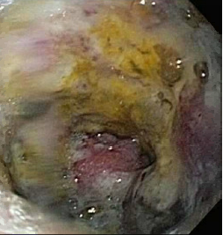
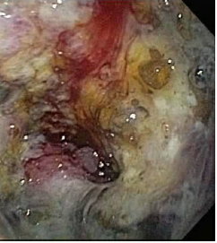
Case #3 (cont’d)

Slide 46
Case #3 (cont’d)
Attempted to get patient on a clinical trial with Pembrolizumab at the time, however, due to lack of measureable disease, he did not qualify
Was able to receive Nivolumab through compassionate use program

Slide 47
How does immunotherapy work?
Nivolumab is an antibody used to block PD-1
PD-1 shuts down the immune system's response to infection or cancer
An antibody to PD-1 can stop it from turning off the immune system’s response and may boost it to fight the cancer
MSI-H tumors are more likely to be “recognized” as abnormal by the immune system
Since we are boosting the immune system, we may boost its ability to attack normal, healthy organs and tissue
Common Side Effects
Fatigue
Decreased appetite
Headache
Nausea/Vomiting
Common Cold symptoms
Rash
More Serious Complications
Endocrinopathies
Colitis
Pneumonitis
Hepatitis
Nephritis
Pancreatitis

Slide 48
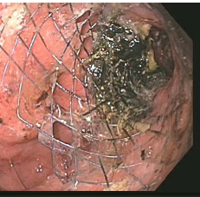
Case #3 (cont’d)
Patient had a dramatic clinical response after 3 months of therapy
Resolution in abdominal pain, melena, and anemia

Slide 49
Case #3 (cont’d)
Our patient’s adverse effects
Hypothyroidism
Peripheral neuropathy in fingertips and toes, intermittent, non-painful
Patient was on treatment for >2 years, was resistant to stopping treatment, but eventually stopped Spring 2019
Most recent imaging done October 2019 shows no evidence of disease, doing excellent!
Of note, patient’s wife did pass away, he has a son who also was diagnosed with Lynch, treated for Stage III colon cancer with us

Slide 50
Module 1: Metastatic colorectal and gastric cancers
Johanna Bendell, MD Chief Development Officer Director, Drug Development Unit Nashville Sarah Cannon Research Institute Tennessee Oncology Nashville, Tennessee

Slide 51
Case Study
An 81-year-old man was diagnosed with metastatic gastric adenocarcinoma with supraclavicular, mediastinal, and retroperitoneal adenopathy in 2015.
The patient’s tumor is found to be HER2 negative, and PD-L1 positive, CPS >1.
He initially received FOLFOX chemotherapy, with stable disease for 6 months.
At 8 months, there was progression of adenopathy.
Patient was started on paclitaxel and ramucirumab, with partial response.
At 4 months, there was progression of adenopathy.
ECOG PS = 0–1

Slide 52
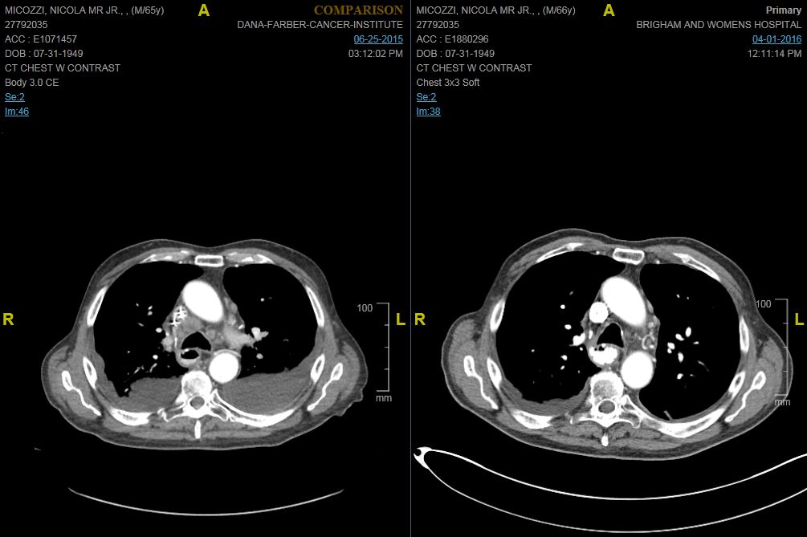
Case Study—Treatment
Patient started on a study of single-agent pembrolizumab.
Before After

Slide 53
Where to use PD1 inhibitors based on current data?
First line
Non-inferiority single agent pembro vs. chemo, but chemo RR higher
Second line
Microsatellite instable patients
PD-L1 status CPS > 10
Third line
PD-L1 high patients by IHC
Pembrolizumab FDA approved for these patients
Nivolumab approved for both PD-L1 positive and negative in Asia based on ONO study

Slide 54
My general approach to gastric cancer treatment - my own opinion and not necessarily based on approvals - does not include HER2+
PD-L1, CPS > 10
PD-L1, CPS > 1
PD-L1 negative
First line: Consider pembro vs. fluoropyrimidine/platinum
Second line: Pembro if none previous
If pembro previous, consider chemo, fluoropyrimidine/platinum
Third line: Pembro if none previous
If pembro previous, consider chemo, paclitaxel/ramucirumab
Fourth line and above: Irinotecan, TAS-102
First line: Fluoropyrimidine/platinum, can consider pembro
Second line: Paclitaxel/ramucirumab
Third line and above: Pembro if none previous
If previous pembro, chemo with paclitaxel/ramucirumab, irinotecan, TAS-102
First line: Fluoropyrimidine/platinum
Second line: Paclitaxel/ramucirumab
Third line and above: Irinotecan, TAS-102

Slide 55
Special Issues in Oncology Care
End-of-life care

