Slide 1
Module 12: Gynecologic Cancers
Paula J Anastasia, RN, MN, AOCN
Kathleen Moore, MD

Slide 2
Approximately how many patients with the following types of cancer have you interacted with over the past year?
Type of cancer | Median
Breast cancer | 40
Lung cancer | 35
Colorectal cancer | 30
Myelodysplastic syndromes | 20
Multiple myeloma | 20
Chronic lymphocytic leukemia | 15
Pancreatic cancer | 10
Diffuse large B-cell lymphoma | 10
Prostate cancer | 10
Follicular lymphoma | 7
Melanoma | 6
Type of cancer | Median
Ovarian cancer | 6
Renal cell carcinoma | 6
Hepatocellular carcinoma | 5
Gastric cancer | 5
Acute myeloid leukemia | 4
Hodgkin lymphoma | 4
Urothelial bladder cancer | 4
Endometrial cancer | 3
Cervical cancer | 2
Mantle cell lymphoma | 2

Slide 3
Day in the Life: Ovarian (Cervical/Endometrial Cancer)
44 F, niraparib, 3 small children
59 F, carboplatin/paclitaxel, humility
32 F, nab paclitaxel, has the best caregiving husband
56 F, pembrolizumab after multiple prior lines of therapy, rheumatoid arthritis pain but can't increase prednisone due to pembrolizumab
69 F, carboplatin/paclitaxel, refractory insomnia
64 F, nab paclitaxel, significant neuropathy but insisted on continuing chemo
48 F, bevacizumab and topotecan, developed uncontrolled HTN resulting in us holding her bevacizumab for the last few weeks
66 F, olaparib, fighting this for years, fired by her gyn/onc

Slide 4
Day in the Life: Ovarian (Cervical/Endometrial Cancer)
47 F, paclitaxel/carboplatin, under the CoolCap for 7 hours each treatment! Quite a trooper!
70 F, rucaparib, asks repeated questions
72 F, niraparib, big hugger and open to listening
65 F, EC, carboplatin/paclitaxel, grateful
79 F, EC, carboplatin/paclitaxel, always bakes sweets for the staff
74 F, EC, lung and bone mets, bevacizumab, informative
27 F, cervical cancer, cisplatin, fierce
63 F, cervical cancer and HCC, cisplatin, liver, lung and bone mets

Slide 5
Ovarian Cancer

Slide 6
Patients with ovarian cancer should generally have the following assay done at diagnosis regardless of family history of cancer.
a. BRCA germline testing
b. BRCA somatic testing
c. Multiplex germline testing
d. Multiplex somatic testing
e. Both a and b
f. Both c and d
g. I don’t know

Slide 7
Which of the following maintenance therapies has been demonstrated to reduce the risk of disease relapse or progression for patients who have undergone debulking surgery followed by chemotherapy for Stage III ovarian cancer with a BRCA germline mutation?
a. Olaparib
b. Niraparib
c. Rucaparib
d. All of the above
e. Only a and b
f. Only b and c
g. Only a and c
h. I don’t know

Slide 8
Which of the following maintenance therapies has been demonstrated to reduce the risk of disease relapse or progression for patients who have undergone debulking surgery followed by chemotherapy for Stage III ovarian cancer without a BRCA germline mutation?
a. Olaparib
b. Niraparib
c. Rucaparib
d. All of the above
e. Only a and b
f. Only b and c
g. Only a and c
h. I don’t know

Slide 9
Case 1: Olaparib Maintenance
60 yr G2P0 Caucasian, non-Jewish gBRCA1 mutation (multi panel genetic testing after diagnosis)
Her brother tested negative. Her parents are deceased
Stage 3C High Grade Serous OVCA – optimal debulk 8/3/18
6 cycles IV paclitaxel/carbo 09/2018-1/2019. Used Cold Caps
CA 125 pre-surgery: 2762, post op 89, after cycle 6, CA 125 = 7
Post chemo CT chest, abd, pelvis: NED
Started Olaparib Maintenance 300mg po BID 2/2019
Plan: Weekly CBC x 4, Monthly CMPL and CA-125 then q 3 mo

Slide 10
Last Chemo Christmas Eve (wearing cold cap)
Christmas morning with her dog Sophie
New Years Eve out dancing with her husband

Slide 11
Case 1: Social Hx
Married x 35 yrs, supportive husband, they enjoy traveling
They have a 6 yr old dog
She has large circle of girlfriends
Works full time CEO investment company, flexible hours
Lives out of state, and vacation home in Southern California
She received chemotherapy in California, drove 2-3 hrs one way for chemotherapy appts in LA
Equestrian Horse Rider

Slide 12
Case 1: Adverse Events
CBC x 4 weeks
Day 17: WBC: 2.5 ANC: 1000 Hgb: 9.1 Plt: 123K
Grade 1 fatigue, no SOB, needing to rest prn
Held Olaparib x 1 week, repeat CBC: WBC 3.5, ANC 1.5, Hgb 9.3, Plts 156K
Dose Reduction from 300mg BID (600mg total dose) to 150mg q am and 300mg q hs (450mg total dose)
Weekly CBC x 4 weeks
Stable: WBC 3-4K, Hgb 10+, Plts: 150+
Now monthly CBC, CMPL and follow up calls monthly (or prn) exams q 3 months with CA 125
Stable blood counts, maintaining all ADLS, grade 1 fatigue not interfering with ADLS
One year after her surgery, she placed 3rd in national competition

Slide 13
Alaskan Cruise two weeks after starting Olaparib
One year after her surgical debulking she won 3rd place Nationally 10/2019
Patient is following up every 3 months with exam and CA 125;
CBC, CMPL now every 2 months unless any new symptoms.
Plan CT 1 year post Olaparib

Slide 14
A woman who weighs 140 pounds and has a platelet count of 200,000 is about to begin niraparib. What is the optimal starting dose?
a. 300 mg daily
b. 200 mg daily
c. 100 mg daily
d. I don’t know

Slide 15
Case 2
51 G4P4 Non Jewish female with Stage 3C Grade 3 HGS ovarian cancer. gBRCA negative. s/p Optimal Tumor Debulking. 6 cycles Paclitaxel/Carboplatin. CA -125 normalized after cycle 3 No growth factor or blood transfusions required
CT after cycle 6 = NED. Surveillance every 3 months
12.3 months DFI then rising CA 125 and CT with several retroperitoneal adenopathy
Carboplatin/gemcitabine/bevacizumab x 6. CA 125 normalized after 3 cycles
Grade 2 HTN: 136/92 requiring low dose amlodipine; stabilized
Molecular profile HRD+

Slide 16
Recurrent OVCA and Maintenance Therapy
Complete response after 6 cycles evidenced by NED on CT and normalization of CA 125 after cycle 2
Growth factor support required w/ cycle 4-6. No blood transfusion. Hgb nadir 9.1. Plat nadir 137K
Discussed Maintenance therapy with PARP Inhibitor given positive HRD (as opposed to Bevacizumab maintenance)
Started Niraparib 300mg po daily. Weekly CBC
Day 23: WBC 3.4, ANC 2.9, Hgb 9.1 Plats 75K Grade 1 fatigue
Niraparib held for one week, Repeat CBC

Slide 17
Social History:
Loves to celebrate family, cooking, and Disneyland.
Milestones this year: one daughter’s college graduation, another daughter’s 20th birthday. Her siblings visited from overseas

Slide 18
Case 2: Maintenance Therapy
CBC: WBC 3.8, ANC 3.0, Hgb 9.3 Plats 172K
Restarted Niraparib at 200mg po daily
Weekly CBC x 4 weeks, CMPL monthly & CA 125 monthly x 3 months
Stable CBC, grade 1 fatigue and nausea not interfering with ADLS
Endorses insomnia evidenced as not being able to ‘sleep/nap’ in afternoon. She sleeps 6-8 hrs at night. No sleep aids
BP remained stable on double dose amlodipine

Slide 19
Case 2:
More Family and Cultural Celebrations. Enjoying snowball fights in Lake Arrowhead, California
Patient remains NED 10 months on Maintenance Niraparib 200mg PO

Slide 20
Paradigm Changes in the Treatment of Gynecologic Cancers
Kathleen Moore, MD
Virginia Kerley Cade Chair in Developmental Therapeutics
Associate Director, Clinical Research
Director, Early Phase Drug Development
Stephenson Cancer Center, Oklahoma City

Slide 21
The Typical Course of Advanced Ovarian Cancer
Patients for whom platinum is an option, formerly ‘Platinum-Sensitive’
Progression >6 months after completion of platinum-based chemotherapy
Surgery (primary or IDS) + primary or adjuvant chemotherapy +/- bevacizumab
Follow-up
Second Response/ Disease Stabilisation
Relapse/ Progression (100%)
First-Line Treatment
Stage III, IV
First Response*
Relapse/ Progression (70%–80%)
Patients for whom platinum is not an option, formerly ‘Platinum-Resistant’
Progression <6 months after completion of platinum-based chemotherapy
*Around 5% of patients are primary treatment-refractory, meaning disease progressed during therapy or within 4 weeks after the last dose.
IDS=interval debulking surgery.
1. Ledermann JA et al. Ann Oncol. 2013;24(Suppl 6):vi24-vi32. 2. Giornelli GH. Springerplus. 2016;5(1):1197. 3. Pignata S et al. Ann Oncol. 2017;28(suppl_8):viii51-viii56. 4. du Bois A et al. Cancer. 2009;115(6):1234-1244. 5. Wilson MK et al. Ann Oncol. 2017;28(4):727-732.

Slide 22
First-Line Chemotherapy Standard of Care (BRCAwt) Carboplatin and Paclitaxel
ICON8 Progression-Free Survival
 | Standard (n=522) | Weekly paclitaxel (n=523) | Weekly carbo-paclitaxel (n=521)
Progressions | 330 (63%) | 335 (64%) | 338 (65%)
Median PFS, mo | 17.9 | 20.6 | 21.1
Log rank (vs standard) |  | P=0.45 | P=0.56
HR vs Standard (97.5% CI) |  | 0.92 (0.77–1.09) | 0.94 (0.79–1.12)
Restricted means | 24.4 months | 24.9 months | 25.3 months
1.00
Standard
0.75
Weekly paclitaxel
Weekly carbo-paclitaxel
Progression-Free Survival (proportion)
0.50
0.25
0.00
0
6
12
18
24
30
36
42
48
54
60
66
No. at risk
Time from Randomisation (months)
Standard
522
471
354
250
198
130
92
59
32
18
3
1
Weekly paclitaxel
523
489
383
279
210
144
92
59
28
17
3
0
Weekly carbo-paclitaxel
521
468
385
281
208
153
99
66
33
15
6
0
Weekly dose-dense chemotherapy can be delivered successfully as first-line epithelial ovarian cancer treatment without substantial toxicity increase; it does not significantly improve PFS compared to standard 3-weekly chemotherapy
CI=confidence interval; HR=hazard ratio; PFS=progression-free survival.
Clamp AR et al. Presented at: ESMO Annual Meeting; 2017.

Slide 23
Paradigm Shift 1: First-Line Chemotherapy Standard of Care (BRCAwt) Carboplatin, Paclitaxel & Bevacizumab + Maintenance
GOG-0218¹
ICON7²
Paclitaxel + carboplatin + placebo
Placebo
Advanced epithelial ovarian cancer
Paclitaxel + carboplatin
Advanced epithelial ovarian cancer
Placebo (Bev Initiation)
Paclitaxel + carboplatin + bevacizumab
Paclitaxel + carboplatin + bevacizumab
Bevacizumab
Bevacizumab (Bev throughout)
Cycles 1–6; + bevacizumab at cycle 2
Until disease progression or up to 22 cycles
Cycles 1–6
Until disease progression or 12 cycles
1.0
Chemotherapy
100
Chemotherapy
0.9
Bev initiation
Bevacizumab
0.8
Bev throughout
75
19.0 months
0.7
0.6
14.1 months
17.3 months
Progression-Free Survival (proportion)
0.5
50
0.4
Progression-Free Survival (%)
0.3
HR (Bev throughout vs chemo) = 0.717
0.2
10.3 months
25
HR = 0.81
0.1
0.0
0
0
2
4
6
8
10
12
14
16
18
20
22
24
26
28
30
32
34
36
0
3
6
9
12
15
18
21
24
27
30
No. at risk
Time from Randomisation (months)
No. at risk
Time from Randomisation (months)
Chemotherapy
625
199
33
8
Chemotherapy
764
693
464
216
91
25
Bev initiation
625
219
29
6
Bevacizumab
764
715
585
263
73
19
Bev throughout
623
254
38
8
Bev=bevacizumab.
1. Burger RA et al. N Engl J Med. 2011;365(26):2473-2483. 2. Perren TJ et al. N Engl J Med. 2011;365(26):2484-2496.

Slide 24
Bevacizumab Is Here in Frontline—What About PARPi and Why PARPi?
Phase III SOLO-1: NCT01844986 Olaparib maintenance for newly diagnosed advanced BRCAm OC
Phase III PAOLA-1: NCT02477644 Olaparib + Bev maintenance for newly diagnosed advanced OC
Phase III PRIMA: NCT02655016 Niraparib maintenance for newly diagnosed advanced OC
Olaparib¹
Niraparib⁴
Olaparib + Bev³
Veliparib²
Phase III GOG-3005: NCT02470585 PC +/- concurrent and maintenance veliparib for newly diagnosed advanced OC
Bev=bevacizumab; BRCAm=BRCA mutated; OC=ovarian cancer; PARPi=PARP inhibitor; PC=paclitaxel and carboplatin.
1. ClinicalTrials.gov. https://clinicaltrials.gov/ct2/show/NCT01844986. Accessed 1 October 2018. 2. ClinicalTrials.gov. https://clinicaltrials.gov/ct2/show/NCT02470585. Accessed 1 October 2018. 3. ClinicalTrials.gov. https://clinicaltrials.gov/ct2/show/NCT02477644. Accessed 1 October 2018. 4. ClinicalTrials.gov. https://clinicaltrials.gov/ct2/show/NCT02655016. Accessed 1 October 2018.

Slide 25
PARPi Exploits the baseline vulnerability of cells with inherent DNA repair deficiency (DRD)
PARP inhibitor
PARP inhibitor
PARP
Increase in double-strand breaks in replicating cells
PARP
Trapped PARP on single-strand breaks
Double-strand breaks
HRR-deficient cancer cell
Normal cell

Reliance on error prone pathways leads to DNA damage accumulation and cell death
Repair of double-strand breaks via the HRR pathway and cell survival
✓
HRR, homologous recombination repair.
O’Connor MJ. Mol Cell. 2015.

Slide 26
DNA-Repair Deficiency (DRD) Present in ~ 50% of EOC
A subset of ovarian tumors may exhibit DRD in the absence of BRCA1/2 mutations
OTHER
Some may be DRD positive via upregulation of miRNAs or other mechanisms
BRCA1 germline mutations 8%
DRD
DRD positive may be sensitive to PARP inhibition
BRCA1 somatic mutations 3%
BRCA sensitive to PARP inhibition
Other 21%
BRCA2 germline mutations 6%
BRCA2 somatic mutations 3%
NER mutations 4-8%
BRCA1 promoter methylation 10%
MMR mutations 3%
DR PROFICIENT
DRD
DRD positive may be sensitive to PARP inhibition
Not sensitive to PARP inhibition
CDK12 mutations 3%
RAD51C promoter methylation 2%
Cyclin E1 amplification 15%
FA gene mutations 2%
Core RAD gene mutations 1.5%
HR DNA damage gene mutations 2%
PTEN homozygous loss 7%
EMSY amplification
6%
POSSIBLY DRD
CDK12, cyclin dependent kinase 12; EMSY, BRCA2-interacting transcriptional repressor; FA, Fanconi anemia; MMR, mismatch repair; miRNA, micro messenger ribonucleic acid; NER, nucleotide excision repair; PTEN, phosphatase and tensin homolog.
Konstantinopoulos PA, et al. Cancer Discov. 2015;5:1137-1154.
Notes:
Talking Points
Approximately half of high-grade serous epithelial ovarian cancer have alterations in HR repair genes. Germline BRCA1 and BRCA2 mutations are the most common alterations, and are present in as high as 22.6% of HGSOCs while somatic BRCA1 and BRCA2 mutations have been identified in 6–7% of high grade serous epithelial ovarian cancers. Other DRD pathway alterations include mutations in several FA genes (mainly PALB2, FANCA, FANCI, FANCL and FANCC), in core homologous recombination RAD genes such as RAD50, RAD51, RAD51C and RAD54L, and in DNA damage response genes such as ATM, ATR, CHEK1 and CHEK2¹
DRD describes the phenotypic traits that some sporadic ovarian tumors share with tumors in BRCA1/2 germline mutation carriers and reflects similar causative molecular abnormalities²
DRD tumors are particularly sensitive to DNA-damaging agents (eg, platinum agents) because of inadequate BRCA-mediated DNA repair mechanisms, such as nucleotide-excision repair and HR²
References
Konstantinopoulos PA, Ceccaldi R, Shapiro GI, D'Andrea AD. Homologous recombination deficiency: exploiting the fundamental vulnerability of ovarian Cancer. Cancer Discov. 2015;5:1137-1154.
Rigakos G, Razis E. BRCAness: finding the Achilles heel in ovarian cancer. Oncologist. 2012;17:956-962.

Slide 27
SOLO-1: Study Design
Newly diagnosed, FIGO stage III–IV, high-grade serous or endometrioid ovarian cancer, primary peritoneal cancer and/or fallopian tube cancer
Germline or somatic BRCAm
ECOG performance status 0–1
Cytoreductive surgery
Completed platinum-based chemotherapy
In clinical complete response or partial response
Primary endpoint
Investigator-assessed PFS (modified RECIST 1.1)
Secondary endpoints
PFS using BICR
PFS2
Overall survival
Time from randomisation to first subsequent therapy or death
Time from randomisation to second subsequent therapy or death
HRQoL (FACT-O TOI score)
Olaparib 300 mg BID (n=260)
Study treatment continued until disease progression
Patients with no evidence of disease at 2 years stopped treatment
Patients with a partial response at 2 years could continue treatment
2:1 randomisation
Stratified by response to platinum-based chemotherapy
Placebo (n=131)
Upfront or interval attempt at optimal cytoreductive surgery for stage III disease and either biopsy and/or upfront or interval cytoreductive surgery for stage IV disease.
BICR=blinded independent central review; BID=twice daily; ECOG=Eastern Cooperative Oncology Group; FACT-O=Functional Assessment of Cancer Therapy – Ovarian Cancer; FIGO=International Federation of Gynecology and Obstetrics; HRQoL=health-related quality of life; PFS=progression-free survival; PFS2=time to second progression or death; RECIST=Response Evaluation Criteria In Solid Tumours; TOI=Trial Outcome Index.
Moore K et al. Presented at: ESMO annual meeting; 2018.

Slide 28
Paradigm Shift 2: Olaparib Maintenance (BRCA+)
100
90
80
 | Olaparib (n=260) | Placebo (n=131)
Events (%) | 102 (39.2) | 96 (73.3)
Median PFS, mo | NR | 13.8
 | HR=0.30
 | 95% CI, 0.23–0.41 P<0.0001
70
60
Investigator-Assessed
Progression-Free Survival (%)
50
Olaparib
40
30
20
10
Placebo
0
0
3
6
9
12
15
18
21
24
27
30
33
36
39
42
45
48
51
54
57
60
Time from Randomisation (months)
No. at risk
Olaparib Placebo
260
131
240 118
229 103
221 82
212 65
201 56
194 53
184 47
172 41
149 39
138 38
133 31
111 28
88 22
45 6
36 5
4 1
3 0
0 0
0
0
0 0
CI=confidence interval; NR=not reached; HR=hazard ratio; PFS=progression-free survival.
Moore K et al. Presented at: ESMO annual meeting; 2018.

Slide 29
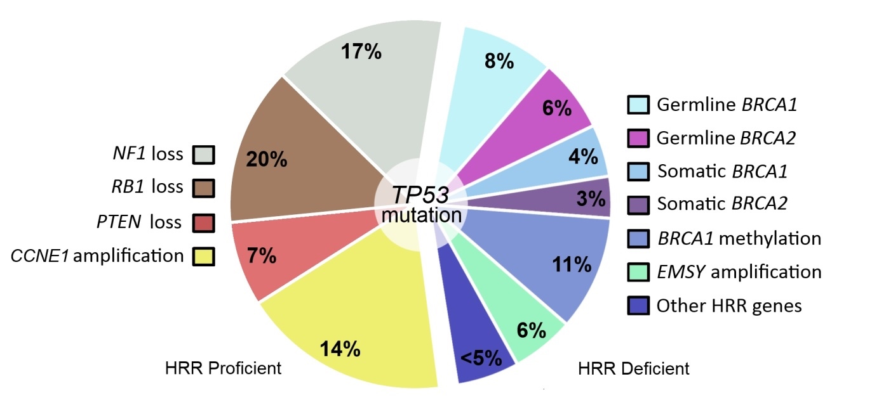
Selecting patients for PARP inhibitor treatment: consideration of somatic BRCA
Maintenance studies
Study | Agent | sBRCA PFS HR (95% CI) | gBRCA PFS HR (95% CI)
Study 19¹ | Olaparib vs placebo | 0.23 (0.04-1.12) | 0.17 (0.09-0.34)
NOVA² | Niraparib vs placebo | 0.27 (0.08-0.90) | 0.27 (0.17 to 0.41)
Treatment study
Hollis RL, et al. Cancer Biol Med. 2016; 13:236-247.
Study | Agent | sBRCA Response rate | gBRCA Response rate
ARIEL2³ | Rucaparib vs placebo | 63% | 74%
If you do not test for somatic BRCA via tumor test you may miss information that can help support treatment decisions and guide benefit/risk profile of treatment
Note: In the absence of head to head data between PARPi efficacy and safety comparisons between PARPi are not to be made or communicated
1. Dougherty BA, et al. Oncotarget. 2017;8(27):43653-43661. 2. Mirza MR, et al. NEJM. 2016; 375:2154-2164. 3. McNeish IA, et al. ASCO 2015. Abs 5508.

Slide 30
These 3 trials may change paradigm yet again for BRCAwt +/- HRD positive (Paradigm Shift 3)
Study Design |  | GOG-0218 (N=1873)¹⁻³ | SOLO-1 (N=451)³ | VELIA (N=1140)⁴ | PRIMA (N=620)³ | PAOLA-1 (N=612)⁴
Treatment arms vs placebo |  | Bevacizumab (n=625) | Olaparib (n=260) | Veliparib | Niraparib | Bevacizumab ± Olaparib
Key Patient Population |  | All comers | BRCA mutation | All comers | All comers | All comers
Undergo tumor testing |  | HRR (post-hoc) | BRCA | BRCA | HRD | BRCA
Stage | III | 73.8% | 84.6% | Eligible | Eligible: Attempt upfront debulking | Eligible
 | IV | 26.2% | 15.4% | Eligible | Eligible: Any debulking attempts | Eligible
Surgery | Residual disease after surgery | Stage III incomplete Macroscopic: 32.8% >1 cm: 41.0% | Macroscopicª Primary: 23.0% Interval: 19.1% | Primary or Interval | Required for Stage III | NR^{b}
 | Inoperable disease | 0 | 1.5% |  | Eligible | NR^{b}
Treatment Duration |  | 15 months | 24 months | 24 months | Until PD | 15 months for Bev 24 months for Olaparib
ªResidual disease based on stage was not reported. ^{b}Stage III and IV eligible, but requirements for prior surgery not reported (NR) on clinicaltrials.gov
1. Burger RA, et al. N Engl J Med. 2011;365:2473-2483. 2. Norquist B, et al. Clin Cancer Res. 2018;24(4):777-783. 3. AVASTIN [prescribing information] South San Francisco, CA: Genentech, Inc; 2016. 4. ClinicalTrials.gov. https://clinicaltrials.gov/ct2/show/NCT02470585. Accessed 1 October 2018. 5. Clinicaltrials.gov. NCT02655016. 6. Gonzalez-Martin A, et al. Presented at ASCO Annual Meeting 2016; June 3-7, 2016; Chicago, IL. Abstract TPS5606. 7. Clinicaltrials.gov. NCT02477644
Notes:
https://clinicaltrials.gov/ct2/show/NCT01844986 (SOLO-1)
https://clinicaltrials.gov/ct2/show/NCT02655016 (PRIMA)
https://clinicaltrials.gov/ct2/show/NCT02477644 (PAOLA-1)
https://clinicaltrials.gov/ct2/show/NCT00262847 (GOG-0218)

Slide 31
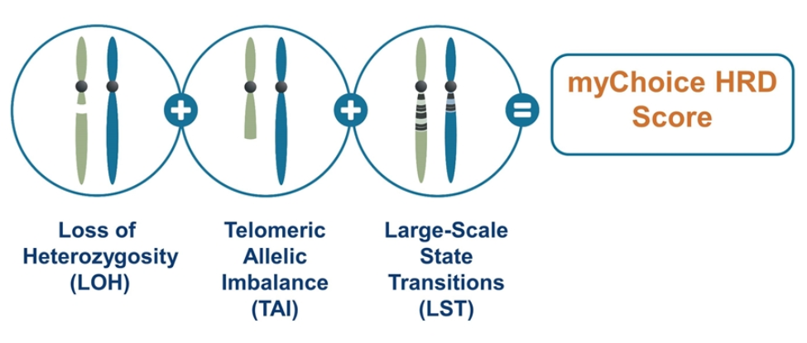
Tissue Test for Homologous Recombination
Testing for Homologous Recombination Deficiency (HRd) and Proficiency (HRp)
Next generation sequencing of DNA from tumor tissue
Provides a score based on algorithmic measurement of 3 tumor factors:
Loss of heterozygosity (LOH)
Telomeric allelic imbalance (TAI)
Large-scale state transitions (LST)
Homologous recombination status is determined by the following:
HR-deficient tumors: Tissue test score ≥42 OR a BRCA mutation
HR-proficient tumors: Tissue test score <42
HR-not-determined
Test
https://myriadmychoice.com/portfolio/ovarian-cancer/mychoice-hrd-ovarian-cancer/#result

Slide 32
Niraparib Therapy in Patients With Newly Diagnosed Advanced Ovarian Cancer (PRIMA/ENGOT-OV26/GOG-3012)
A. González-Martín,¹ B. Pothuri,² I. Vergote,³ R.D. Christensen,⁴ W. Graybill,⁵ M.R. Mirza,⁶ C. McCormick,⁷ D. Lorusso,⁸ P. Hoskins,⁹ G. Freyer,¹⁰ F. Backes,¹¹ K. Baumann,¹² A. Redondo,¹³ R. Moore,¹⁴ C. Vulsteke,¹⁵ R.E. O'Cearbhaill,¹⁶ B. Lund,¹⁷ Y. Li,¹⁸ D. Gupta,¹⁸ B.J. Monk¹⁹
¹Grupo Español de Investigación en Cáncer de Ovario (GEICO), Medical Oncology Department, Clínica Universidad de Navarra, Madrid, Spain; ²Gynecologic Oncology Group (GOG), Department of Obstetrics/Gynecology, Perlmutter Cancer Center, NYU Langone Cancer Center, New York, NY, USA; ³Belgium and Luxembourg Gynaecological Oncology Group (BGOG), Department of Gynaecology and Obstetrics, Division of Gynaecologic Oncology, University Hospitals Leuven, Leuven Cancer Institute, Leuven, Belgium; ⁴Nordic Society of Gynaecological Oncology (NSGO), Research Unit of General Practice, Institute of Public Health, University of Southern Denmark, Odense, Denmark; ⁵ GOG, Gynecologic Oncology, Medical University of South Carolina, Charleston, SC, USA; ⁶NSGO, Rigshospitalet–Copenhagen University Hospital, Copenhagen, Denmark; ⁷GOG, Legacy Medical Group Gynecologic Oncology, Portland, OR, USA; ⁸Multicentre Italian Trials in Ovarian Cancer and Gynecologic Malignancies (MITO), Fondazione IRCCS National Cancer Institute of Milan, Milan, Italy; ⁹US Oncology Research (USOR), Department of Medical Oncology, BC Cancer – Vancouver, Vancouver, BC, Canada; ¹⁰Groupe d'Investigateurs Nationaux pour l'Etude des Cancers Ovariens (GINECO), HCL Cancer Institute Department of Medical Oncology Lyon University, Lyon, France; ¹¹Division of Gynecologic Oncology, Ohio State University, Columbus, OH, USA; ¹²Arbeitsgemeinschaft Gynäkologische Onkologie (AGO), Department of Gynecology and Obstetrics, Klinikum der Stadt Ludwigshafen, Ludwigshafen, Germany; ¹³GEICO, Hospital Universitario La Paz-IdiPAZ, Madrid, Spain; ¹⁴USOR, Division of Gynecologic Oncology, Wilmot Cancer Institute, Department of Obstetrics and Gynecology, University of Rochester, Rochester, NY, USA; ¹⁵BGOG, Department of Medical Oncology and Hematology, AZ Maria Middelares, Gent, and Department of Molecular Imaging, Pathology, Radiotherapy & Oncology, Center for Oncological Research, Antwerp University, Antwerp, Belgium; ¹⁶GOG, Gynecologic Medical Oncology, Memorial Sloan Kettering Cancer Center, and Department of Medicine, Weill Cornell Medical College, New York, NY, USA; ¹⁷NSGO, Department of Oncology, Aalborg University, Aalborg, Denmark; ¹⁸TESARO: A GSK Company, Waltham, MA, USA; ¹⁹Arizona Oncology (US Oncology Network), University of Arizona College of Medicine, Phoenix Creighton University School of Medicine at St. Joseph’s Hospital, Phoenix, AZ, US

Slide 33
PRIMA: PFS Benefit in Biomarker Subgroups
HRD
HRD/BRCAmut
HRD/BRCAwt
HRP
100
HR 0.40 (95% CI: 0.27, 0.62)
100
HR 0.50 (95% CI: 0.31, 0.83)
100
HR 0.68 (95% CI: 0.49, 0.94)
90
90
90
80
80
80
70
70
70
60
Niraparib
60
Niraparib
60
PFS, %
50
50
50
40
40
40
30
30
Placebo
30
Niraparib
20
Placebo
20
20
10
10
10
Placebo
0
0
0
0
2
4
6
8
10
12
14
16
18
20
22
24
26
28
0
2
4
6
8
10
12
14
16
18
20
22
24
26
28
0
2
4
6
8
10
12
14
16
18
20
22
24
26
28
Months Since Randomization
Months Since Randomization
Months Since Randomization
Niraparib provided similar clinical benefit in the HRD subgroups (BRCAmut and BRCAwt)
Niraparib provided clinically significant benefit in the HRP subgroup with a 32% risk reduction in progression or death
González-Martín A, et al. ESMO 2019. Abstract LBA1. González-Martín A, et al. N Engl J Med. 2019. [Epub ahead of print].

Slide 34
Cervical and Endometrial Cancers

Slide 35
Pembrolizumab is approved as second-line treatment of metastatic cervical cancer…
a. In all patients
b. In patients with elevated PD-L1 levels
c. In combination with chemotherapy
d. All of the above
e. I don’t know

Slide 36
Which of the following therapies is approved as second-line treatment for metastatic endometrial cancer after first-line chemotherapy?
a. Pembrolizumab monotherapy for patients with MSI-high tumors
b. Pembrolizumab/lenvatinib for patients with MSS tumors
c. Pembrolizumab for all patients
d. All of the above
e. Only a and b
f. Only b and c
g. Only a and c
h. I don’t know

Slide 37
Paradigm Changes in the Treatment of Gynecologic Cancers
Kathleen Moore, MD
Virginia Kerley Cade Chair in Developmental Therapeutics
Associate Director, Clinical Research
Director, Early Phase Drug Development
Stephenson Cancer Center, Oklahoma City

Slide 38
FDA Accelerated Approval of Pembrolizumab with Lenvatinib for Advanced Endometrial Carcinoma Press Release – September 17, 2019
“The Food and Drug Administration granted accelerated approval to the combination of pembrolizumab plus lenvatinib for the treatment of patients with advanced endometrial carcinoma that is not microsatellite instability high (MSI-H) or mismatch repair deficient (dMMR) and who have disease progression following prior systemic therapy but are not candidates for curative surgery or radiation.
Efficacy was investigated in Study 111/KEYNOTE-146 (NCT02501096), a single-arm, multicenter, open-label, multi-cohort trial that enrolled 108 patients with metastatic endometrial carcinoma that had progressed following at least one prior systemic therapy in any setting.”
https://www.fda.gov/drugs/resources-information-approved-drugs/simultaneous-review-decisions-pembrolizumab-plus-lenvatinib-australia-canada-and-us

Slide 39
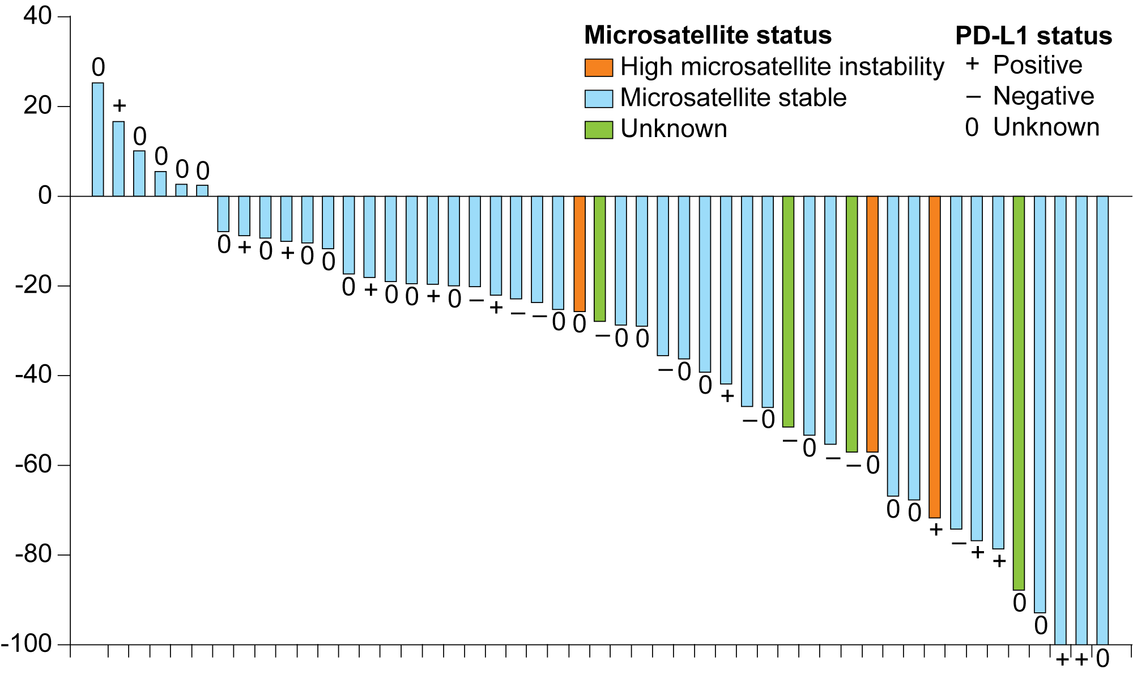
Phase II Trial of Lenvatinib/Pembrolizumab: Response and Survival
N = 53 patients in interim analysis
Change from baseline (%)
Endpoint | Total (N = 108) | Not MSI-H or dMMR (n = 94) | MSI-H or dMMR (n = 11)
ORR | 39% | 37% | 64%
mPFS | 7.4 mo | 7.4 mo | 18.9 mo
mOS | 16.7 mo | 16.4 mo | NR
Makker V et al. Lancet Oncol 2019;20(5):711-8. Makker V et al. Proc ESMO 2019; Abstract 994O.

Slide 40
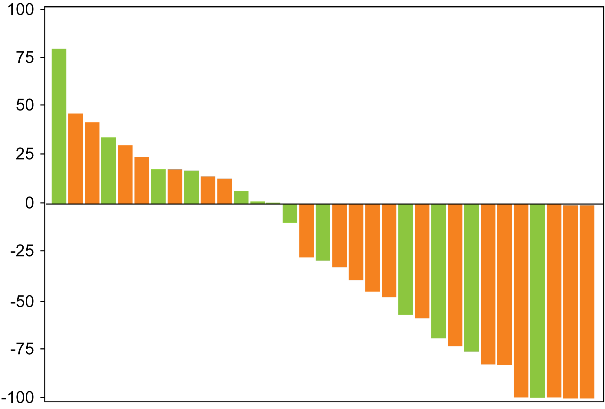
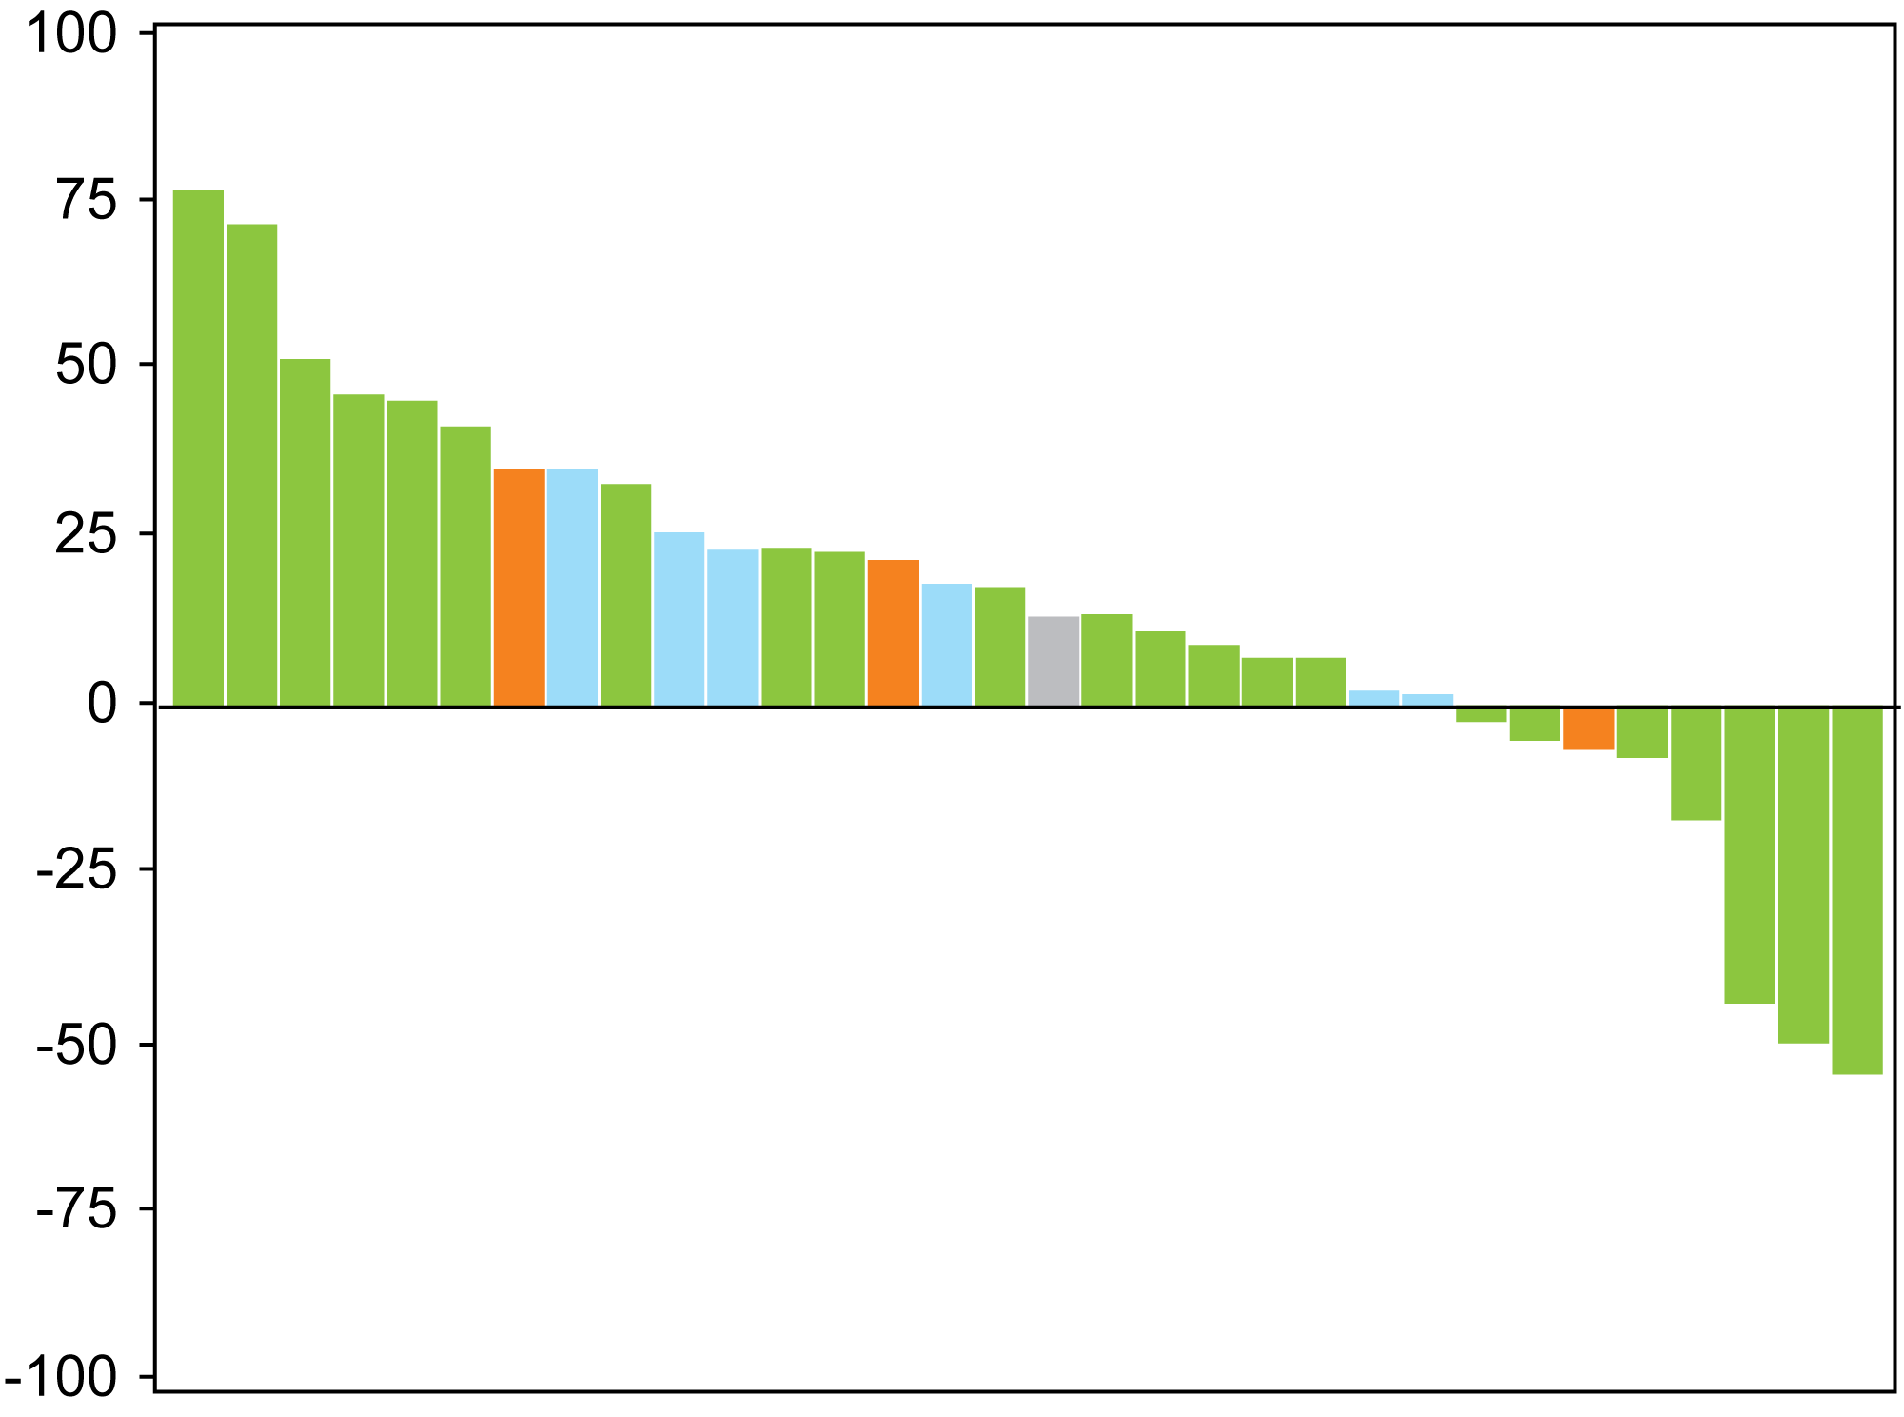
PHAEDRA: Tumor Response with Durvalumab in Advanced Endometrial Cancer According to Mismatch Repair Status
dMMR
pMMR
Lines of previous chemotherapy
Lines of previous chemotherapy
0
0
1
1
2
3
Change from baseline (%)
Best change from baseline (%)
Lines of previous chemotherapy | N | OTRR
0 | 21 | 11 (52%)
1 | 13 | 4 (31%)
2 | 1 | 0 (0%)
Total | 35 | 15 (43%)
 | pMMR (n = 35)
OTRR | 1 (3%)
CR | 0 (0%)
PR | 1 (3%)
SD | 9 (26%)
OTRR = objective tumor response rate
Antill YC et al. Proc ASCO 2019;Abstract 5501.

Slide 41
Phase III Trial of Standard Chemotherapy with or without Pembrolizumab for Stage III or IV or Recurrent Endometrial Cancer
N = 810
Measurable Stage III, IVA, IVB or recurrent endometrial cancer Performance status 0, 1 or 2 No prior chemotherapy OR prior adjuvant chemotherapy Sex F, age ≥18
Carboplatin + paclitaxel + placebo
R
Carboplatin + paclitaxel + pembrolizumab
Primary endpoint: Progression-free survival
www.clinicaltrials.gov (NCT03914612). Accessed October 2019.

Slide 42
AtTEnd: A Phase III Trial of Chemotherapy with or without Atezolizumab for Advanced or Recurrent Endometrial Cancer
N = 550
Newly diagnosed endometrial cancer with residual disease after surgery OR inoperable Stage III/IV disease OR Recurrent endometrial cancer not yet treated for recurrent disease Performance status 0-2 Sex F, age ≥18
Atezolizumab + carboplatin + paclitaxel
R
Carboplatin + paclitaxel + placebo
Primary endpoints
Overall survival
Progression-free survival
www.clinicaltrials.gov (NCT03603184). Accessed October 2019.

Slide 43
GARNET: A Phase I/II Trial of Dostarlimab (TSR-042) for Patients with Recurrent or Advanced MSI-H and MSS Endometrial Cancer
 | All evaluable patients (N = 94) | MSI-H | MSS
ORR | 27.7% | 50.0% | 19.1%
Disease control rate | 48.9% | NR | NR
Patients with ongoing responses | 88.4% | NR | NR
NR = not reported
Grade ≥3 TRAEs: 13 patients (11.8%)
Most common Grade ≥3 TRAE: increased aspartate aminotransferase (2.7%)
Oaknin A et al. Proc SGO 2019;Abstract 33.

Slide 44
RUBY: A Phase III Trial Design
Eligibility (N = 470)
Recurrent or advanced endometrial cancer Primary Stage III or IV disease or first recurrent endometrial cancer with a low potential for cure by radiation and/or surgery ECOG PS 0-1 No (neo)adjuvant systemic chemotherapy for primary Stage III/IV disease
Dostarlimab (TSR-042) + carboplatin/paclitaxel
R
Placebo + carboplatin/paclitaxel
Primary endpoint: Progression-free survival
www.clinicaltrials.gov;NCT03981796;Accessed September 2019.

Slide 45
FDA Approves Pembrolizumab for Advanced Cervical Cancer with Disease Progression During or After Chemotherapy Press Release – June 12, 2018
“The Food and Drug Administration approved pembrolizumab for patients with recurrent or metastatic cervical cancer with disease progression on or after chemotherapy whose tumors express PD-L1 (CPS ≥1) as determined by an FDA-approved test.
Pembrolizumab was investigated in 98 patients with recurrent or metastatic cervical cancer enrolled in a single cohort of KEYNOTE 158 (NCT02628067), a multicenter, non-randomized, open-label, multi-cohort trial.
Patients were treated with pembrolizumab intravenously at a dose of 200 mg every 3 weeks until unacceptable toxicity or documented disease progression.
Among the 98 patients, approval was based on 77 (79%) patients who had tumors that expressed PD-L1 with a CPS ≥1 and who had received at least 1 line of chemotherapy for metastatic disease.”
https://www.fda.gov/drugs/resources-information-approved-drugs/fda-approves-pembrolizumab-advanced-cervical-cancer-disease-progression-during-or-after-chemotherapy

Slide 46
KEYNOTE-158: Pembrolizumab for Pretreated Cervical Cancer — Objective Response
ORR: All pts: 12.2%
PD-L1+: 14.6%
Individual patients treated with pembrolizumab
Change from baseline (%)
Time (months)
Chung HC et al. J Clin Oncol 2019;37(17):1470-8.

Slide 47
Case 3: MSI High Endometrial Cancer
44-year-old woman: Dx with stage IIIc endometrial cancer after irregular bleeding
s/p TAH/BSO, I/24 LN involved, received pelvic RT and brachytherapy followed by Platinum and Doxorubicin; completed 2005
+ MLH gene mutation (Lynch Syndrome; Paternal transmission)
NED x 4 years
Recurrent Endometrial Cancer 1st relapse retroperitoneal lymphadenopathy. s/p retroperitoneal lymphadenectomy and 14/16 LN positive. s/p Carbo/Paclitaxel completed 2/2009.
DFI 24 months, rising CA 125, PET/CT w/ enlarged aortocaval LN, small left common iliac LN and activity L3, S/p IMRT
DFI 24 months, PET/CT revealed adenopathy Rt common iliac region

Slide 48
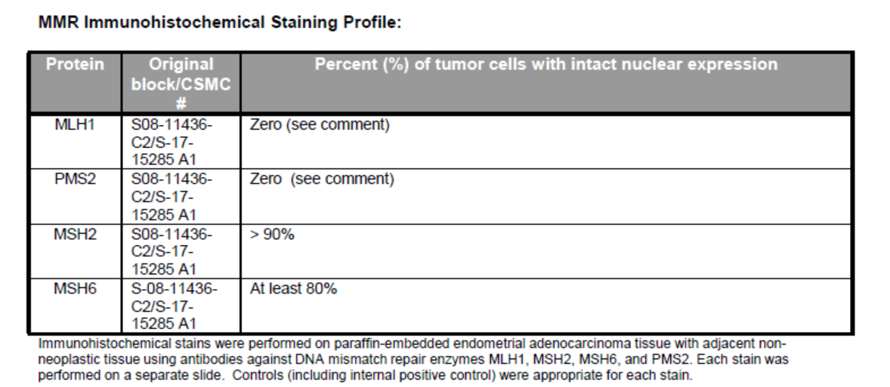

Slide 49
Case 3: 32 cycles of Pembrolizumab
Enrolled on KEYNOTE-158, 7/2016-9/2018
Started Pembrolizumab 200mg IV q 21 days. She chose to stop after 32 cycles due to grade 2-3 colitis → due to hx of diabetes she was not treated with steroids
CA 125 decreased from 633 to 22 after 2 cycles of Pembrolizumab
Complete response on CT after 2 cycles. She remains NED 3 yrs later
Adverse Events: Grade 1 rash, Grade 2 colitis, Grade 2 hyperglycemia; resolved after stopping Pembrolizumab
Today remains disease free, undergoing surveillance for Lynch Syndrome (Colon Cancer screening, Gastric and GI screening, Skin and Breast Cancer screening)
Cascade Testing: two adult children have been tested and screened

Slide 50
Case 3 Adverse Events
Patient with personal history of Type 2 Diabetes managed with oral medication.
After starting pembrolizumab her glucose continued to elevate and by cycle 10 she required insulin.
She started watching her diet and exercising and stopped her insulin. She continued her oral anti-diabetic medication.
Her fasting glucose was maintained between 100-150. Her Hgb A1C is maintained below the goal of < 7 so patient is managing her Type 2 diabetes with only an oral medication. She is feeling well.

Slide 51
Patient did not want to share photos due to her work in entertainment industry. She also wanted to protect her adult children.
However, she did give permission to share her hairless paclitaxel and carboplatin photo (2009) as she embraced the holiday season.

Slide 52
Special Issues in Oncology Care
Use of alternative or complementary oncology strategies, including medical marijuana

