Slide 1
Module 13:
Targeted Treatment
of Lung Cancer
Wendi S Lee, MSN, RN, NP-C
Anne S Tsao, MD

Slide 2
Disclosure for Ms Lee
Consulting Agreement | Pfizer Inc

Slide 3
Disclosures for Dr Tsao
Advisory Committee | Ariad Pharmaceuticals Inc, AstraZeneca Pharmaceuticals LP, Boehringer Ingelheim Pharmaceuticals Inc, Bristol-Myers Squibb Company, EMD Serono Inc, Genentech, Huron, Lilly, Merck, Novartis, Roche Laboratories Inc, Seattle Genetics, SELLAS Life Sciences, Takeda Oncology
Contracted Research | Ariad Pharmaceuticals Inc, Boehringer Ingelheim Pharmaceuticals Inc, Bristol-Myers Squibb Company, Epizyme, Genentech, Lilly, Merck, Polaris Group, Seattle Genetics, Takeda Oncology
Data and Safety Monitoring Board/Committee | Xcovery

Slide 4
Approximately how many patients with the following types of cancer have you interacted with over the past year?
Type of cancer | Median
Breast cancer | 40
Lung cancer | 35
Colorectal cancer | 30
Myelodysplastic syndromes | 20
Multiple myeloma | 20
Chronic lymphocytic leukemia | 15
Pancreatic cancer | 10
Diffuse large B-cell lymphoma | 10
Prostate cancer | 10
Follicular lymphoma | 7
Melanoma | 6
Type of cancer | Median
Ovarian cancer | 6
Renal cell carcinoma | 6
Hepatocellular carcinoma | 5
Gastric cancer | 5
Acute myeloid leukemia | 4
Hodgkin lymphoma | 4
Urothelial bladder cancer | 4
Endometrial cancer | 3
Cervical cancer | 2
Mantle cell lymphoma | 2

Slide 5
Day in the Life: Targeted Treatment of Lung Cancer
81 F, osimertinib, mild rash, issues with elderly husband’s health
78 F, osimertinib, Dx with brain mets in 2016, refused radiation or aggressive chemo but started osimertinib – recent scans showing decreased size of brain mets and stable lung nodule
84 F, TKI, rash
75 F, afatinib, very unusual — neurologic symptoms of unknown origin despite multiple MRIs/CTs looking for brain mets, progressing bone mets

Slide 6
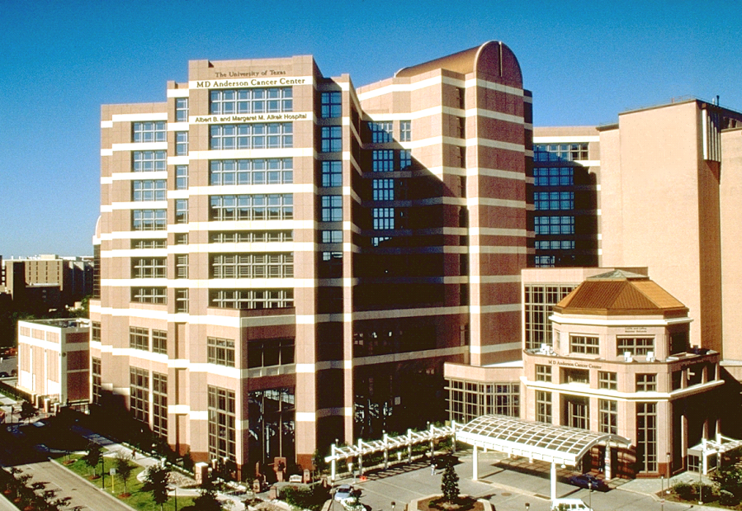

Updates on Targeted Therapies in NSCLC
Anne S. Tsao, M.D.
Professor
Section Chief, Thoracic Medical Oncology
Director, Mesothelioma Program
Director, Thoracic Chemo-XRT Program
November 2019
The University of Texas
MD ANDERSON
Department of Thoracic/Head & Neck
Medical Oncology
CANCER CENTER

Slide 7
Outline: Targeted Therapy Updates
Background
Molecular Profiling
Cell-free DNA (plasma testing)
Common and Rare Mutations
Toxicities
EGFR
ALK/ROS1
Agents
Toxicities
Other mutations
RET, BRAF, MET exon 14, NTRK Agents Toxicities

Slide 8
Molecular Testing per IASLC-ACP-AMP
Gene mutation testing (panels or NGS), PD-L1 IHC, ALK IHC, FISH
Tumor Tissue
Blood
Circulating cell-free tumor DNA (cfDNA)
Urine
ACP-IASLC-AMP 3 categories of Biomarkers:
Must-test (standard of care)
Should-test (direct to clinical trials)
Investigational and not for clinical use at this time
Experimental and Not Validated
Sputum

Slide 9
Frontline Histology and Molecular Profiling October 2019
NSCLC PATIENT
Any histology but no actionable mutation
PD-L1 IHC (+) > 50%
PD-L1 IHC (-) or < 50%
SCC
Pembrolizumab
> 50% PD-L1 Platinum-Pemetrexed-Pembrolizumab
Non-SCC
No actionable
Mutations and
PD-L1 < 50%
Platinum-taxane-pembrolizumab, IMpower131
Avoid pemetrexed or bevacizumab, or necitumumab + cis/gem
MET exon 14 skip mutation
Rare mutations: Afatinib
EGFR exon 20: Poziotinib,
TAK-788
Adenocarcinoma
Crizotinib, Tepotinib (trial)
Savolitinib (trial)
EGFR
RET
ROS1
BRAF V600E
Common mutations: Osimertinib, Dacomitinib, Erlotinib,
Gefitinib, Afatinib
EML 4 ALK
Cabozantinib, Vandetanib
LOXO-292 (trial)
BLU-667 (trial)
Crizotinib, Ceritinib, Entrectinib,
Lorlatinib
Dabrafenib+ Trametinib
Crizotinib, Alectinib, Ceritinib
Brigatinib
NTRK
If T790M and prior 1st or 2nd gen EGFR TKI, Osimertinib
Entrectinib
Larotrectinib
HER2
Platinum-pemetrexed-pembrolizumab
Platinum-paclitaxel-bevacizumab-atezolizumab (IMpower150)
Platinum-doublet + bevacizumab
Non-platinum or platinum based doublet
Ceritinib, Alectinib, Brigatinib,
Lorlatinib (breakthrough designation only)
Ado-trastuzumab
Exon 20: poziotinib (trial)

Slide 10
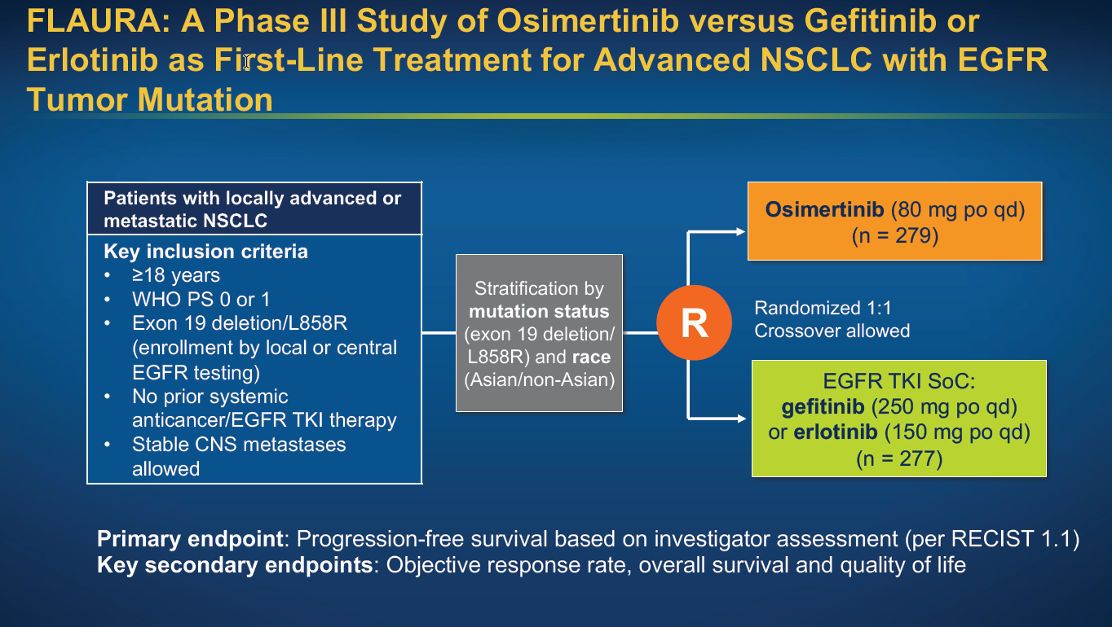
Soria et al, NEJM 2017

Slide 11
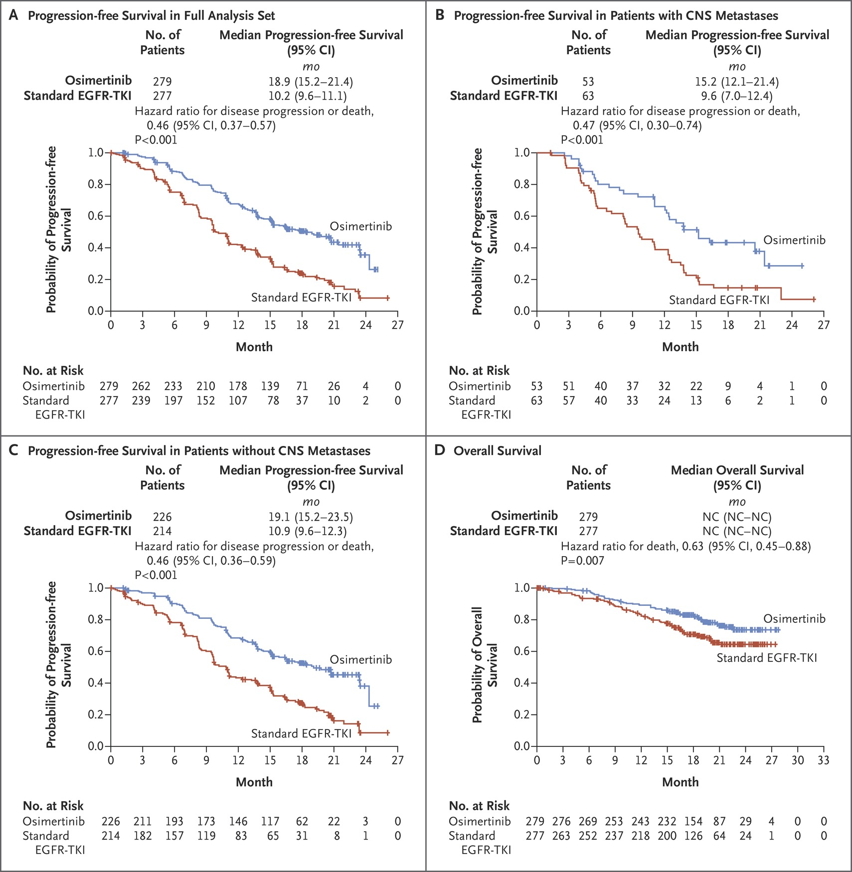
FLAURA: Survival
Soria J-C et al. N Engl J Med 2018;378:113-125
Notes:
Figure 1 Progression-free Survival and Overall Survival. Shown are Kaplan–Meier estimates of the duration of progression-free survival in the full analysis set as assessed by investigators (Panel A), in patients with known or treated central nervous system (CNS) metastases at trial entry (Panel B), and in patients without known or treated CNS metastases at trial entry (Panel C). Also shown are Kaplan–Meier estimates of overall survival (Panel D). Censored data are indicated by tick marks. For the analysis of progression-free survival, data for patients who had not had a progression event or had not died at the time of the analysis were censored at the time of their last assessment (according to Response Evaluation Criteria in Solid Tumors) that could be evaluated. For the analysis of overall survival, data for any patients who were not known to have died at the time of the analysis were censored at the last recorded date that the patient was known to be alive. CI denotes confidence interval, EGFR-TKI epidermal growth factor receptor tyrosine kinase inhibitor, and NC could not be calculated.

Slide 12
EGFR TKI Toxicity
1st generation TKIs
  Rash
  Diarrhea
  No concomitant H2 blocker use
  Fatigue
  Abnormal liver function
  Nail and eyelash changes
2nd generation TKIs
  Rash (more)
  Diarrhea (more)
  Fatigue
  Mouth ulcers
  Abnormal liver or kidney function
  Nail or eye irritation
3rd generation TKI
  QTc prolongation (check EKG, echo), decreased heart function
  Electrolyte abnormalities
  Rash (mild)
  Abnormal liver function
  Diarrhea

Slide 13
70 y/o Female with Metastatic Lung Adenocarcinoma with Activating EGFR Mutation
70 y/o woman from Colorado who presented to her physician in November 2018 with mild left hip pain
CT revealed a large sclerotic bony lesion in the left ilium and acetabulum
PET/CT on November 1, 2018 revealed a left upper lobe lung mass, hypermetabolic mediastinal and left hilar lymph nodes, diffuse hypermetabolic activity within the left iliac bone with associated sclerosis, a hypermetabolic sclerotic lesion in the left anterior third rib, and a hypermetabolic lesion in the right humerus
Biopsy of the left iliac bone mass revealed metastatic adenocarcinoma consistent with a lung primary. Molecular testing revealed an activating EGFR mutation (exon 21 L858R).

Slide 14
70 y/o Female with Metastatic Lung Adenocarcinoma with Activating EGFR Mutation
First visit in our clinic was in January 2019
Shortly after she started frontline therapy with Osimertinib on a phase 2 clinical trial that allows local consolidation therapy after initial Osimertinib
April 15, 2019 — PET/CT showed that the left upper lobe tumor, mediastinal and hilar lymph nodes, and bony lesions were no longer hypermetabolic. MRI of the brain was negative for intracranial disease
She subsequently underwent left upper lobectomy followed by post operative radiation therapy to the left upper lobe and hilum and SBRT to the right upper lobe lesion
Imaging continues to show response with stability of bony disease and no new lesions
This patient has had minimal side effects from Osimertinib

Slide 15
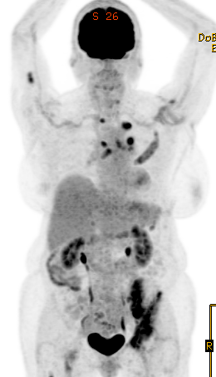
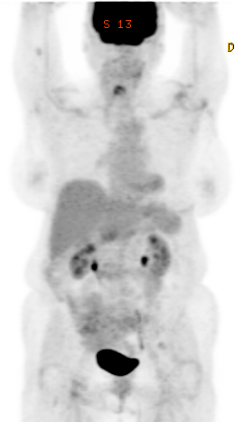
70 y/o Female with Metastatic Lung Adenocarcinoma with Activating EGFR Mutation
January 2019 before Osimertinib
April 2019 after
2.5 months of Osimertinib

Slide 16
Patient Education When Initiating Osimertinib
Explain reason for choosing Osimertinib as therapy (this medication targets the mutation found in your tumor cells)
Discuss barriers to receiving medication (insurance approval, prior auth, specialty pharmacy, home delivery, etc.)
Osimertinib may be taken with or without food at the same time every day
Recommend discontinuation of herbal supplements prior to initiating Osimertinib
Explain follow up, monitoring, and restaging schedule

Slide 17
Osimertinib: Potential Toxicities/Side Effects and Management
Skin (acneiform skin rash – trunk, face, scalp, extremities; dry skin)
  Management: Initiate emollients at start of therapy, use OTC steroid and antihistamine cream as needed, then escalate to prescription strength topical steroid/antibiotic or oral if necessary, steroid shampoos for scalp irritation, USE SUN SCREEN/PROTECTION
Nails (nail changes, irritation around nail beds, paronychia)
  Management: emollients, white vinegar soaks, steroid/antibiotic creams, oral antibiotics if needed, open toe shoes, use gloves, refer to podiatry/dermatology if no resolution
Diarrhea
  Management: Loperamide, prescription meds if needed, hold drug
Fatigue
Management: Encourage rest as needed and exercise as tolerated
Anorexia
Management: Encourage frequent meals/snacks

Slide 18
Osimertinib: Potential Toxicities/Side Effects
Uncommon Toxicities/Side Effects
- Mouth ulcers
- Cytopenias (white cells, red cells, platelets)
Potential Serious Adverse Events (Rare)
Pneumonitis/Interstitial lung disease
QTC prolongation (baseline EKG, f/u EKG as needed/per provider preference)
Cardiomyopathy (baseline Echo and f/u Echo as needed/per provider preference)
Keratitis

Slide 19
Updates on Targeted Therapies in NSCLC
Anne S. Tsao, M.D.
Professor
Section Chief, Thoracic Medical Oncology
Director, Mesothelioma Program
Director, Thoracic Chemo-XRT Program
November 2019
The University of Texas
MD ANDERSON
Department of Thoracic/Head & Neck
Medical Oncology
CANCER CENTER

Slide 20
Frontline Histology and Molecular Profiling October 2019
NSCLC PATIENT
Any histology but no actionable mutation
PD-L1 IHC (+) > 50%
PD-L1 IHC (-) or < 50%
SCC
Pembrolizumab
> 50% PD-L1 Platinum-Pemetrexed-Pembrolizumab
Non-SCC
No actionable
Mutations and
PD-L1 < 50%
Platinum-taxane-pembrolizumab, IMpower131
Avoid pemetrexed or bevacizumab, or necitumumab + cis/gem
MET exon 14 skip mutation
Rare mutations: Afatinib
EGFR exon 20: Poziotinib,
TAK-788
Adenocarcinoma
Crizotinib, Tepotinib (trial)
Savolitinib (trial)
EGFR
RET
ROS1
BRAF V600E
Common mutations: Osimertinib, Dacomitinib, Erlotinib,
Gefitinib, Afatinib
EML 4 ALK
Cabozantinib, Vandetanib
LOXO-292 (trial)
BLU-667 (trial)
Crizotinib, Ceritinib, Entrectinib, Lorlatinib
Dabrafenib+ Trametinib
Crizotinib, Alectinib, Ceritinib
Brigatinib
NTRK
If T790M and prior 1st or 2nd gen EGFR TKI, Osimertinib
Entrectinib
Larotrectinib
HER2
Platinum-pemetrexed-pembrolizumab
Platinum-paclitaxel-bevacizumab-atezolizumab (IMpower150)
Platinum-doublet + bevacizumab
Non-platinum or platinum based doublet
Ceritinib, Alectinib, Brigatinib,
Lorlatinib (breakthrough designation only)
Ado-trastuzumab
Exon 20: poziotinib (trial)

Slide 21
ALEX Study Design
ENDPOINTS
Primary
  PFS (RECIST 1.1), by investigator review
Secondary
  PFS by IRC
  Time to CNS progression
  ORR, DOR
  OS
  Safety and tolerability
  Patient-reported outcomes
KEY ELIGIBILITY
ALK+ by central IHC testing
Advanced or metastatic ALK+ NSCLC
Treatment-naïve
ECOG PS 0−2
Measurable disease
Asymptomatic brain metastases allowed
R
A
N
D
O
M
I
Z
E
    Alectinib
    600 mg BID PO
NO CROSSOVER
Crizotinib
250 mg BID PO
Stratification factors:
ECOG PS (0/1 vs 2)
Race (Asian vs non-Asian)
Brain metastases (present vs absent)
ALK, anaplastic lymphoma kinase; IHC, immunohistochemistry; NSCLC, non-small-cell lung cancer; ECOG PS, Eastern Cooperative Oncology Group Performance Status; PO, by mouth; PFS, progression-free survival; IRC, independent review committee; CNS, central nervous system; ORR, objective response rate; DOR, duration of response; OS, overall survival
Peters et al. NEJM 377: 829-838, Aug 2017

Slide 22
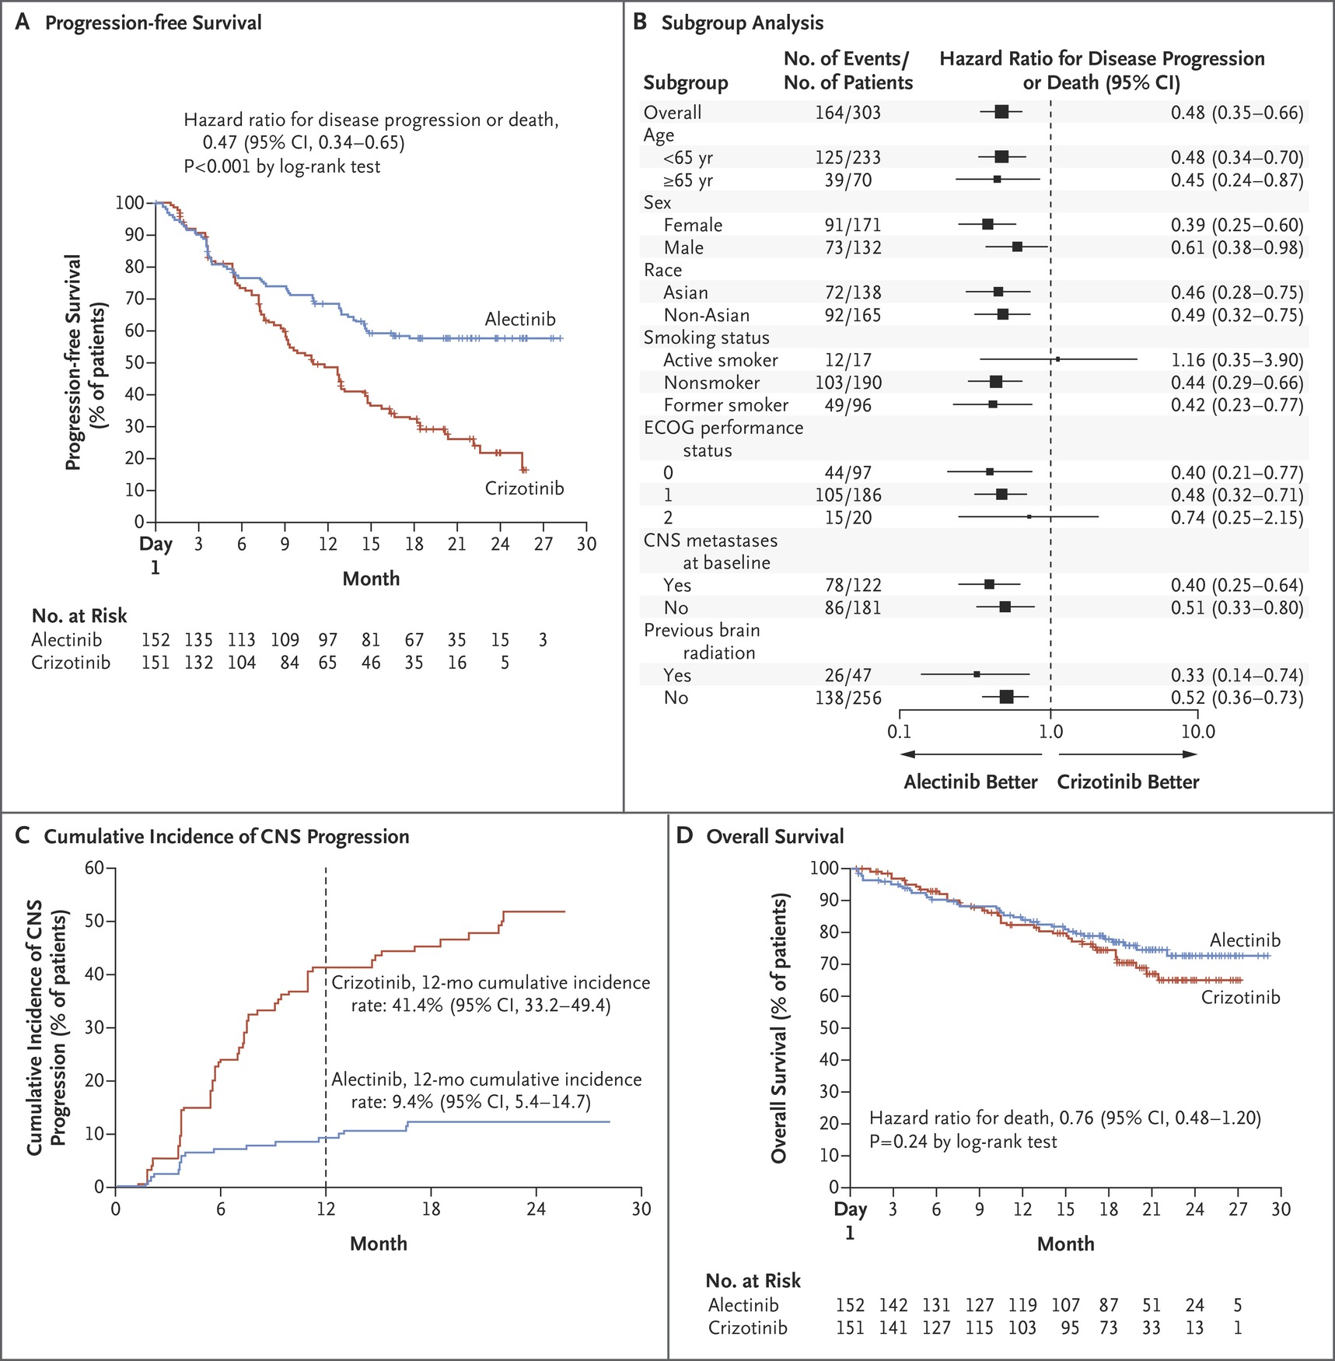
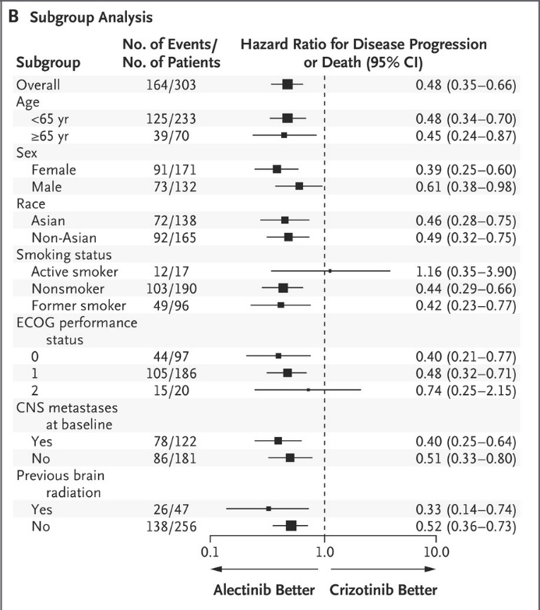
ALEX Survival
Peters et al. NEJM 377: 829-838, Aug 2017

Slide 23
ALEX CNS Activity
Agent | CNS Activity
Crizotinib | Limited
Alectinib | Yes
Ceritinib | Yes
Brigatinib | Yes
Lorlatinib | Yes
Ensartinib | Yes
Peters et al. NEJM 377: 829-838, Aug 2017

Slide 24
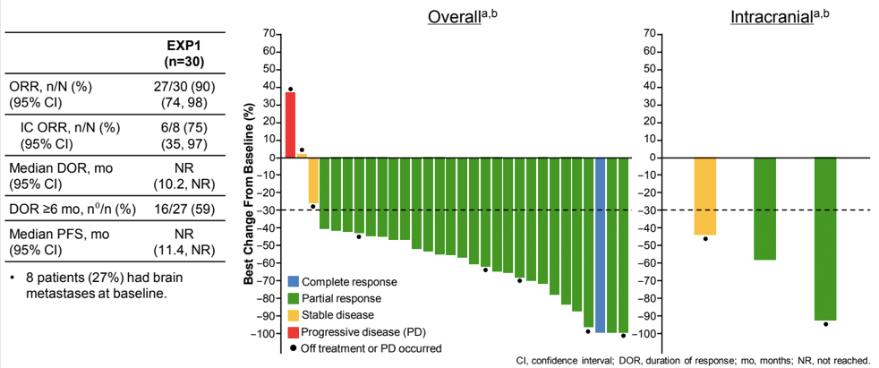
Lorlatinib in Treatment-Naïve ALK+ Patients
Solomon BJ, et al. WCLC 2017 abstr#8573

Slide 25
Toxicity Comparison of Selected ALK Inhibitors
Agent | Toxicities
Crizotinib | Vision Transaminitis Nausea, diarrhea Peripheral edema
Ceritinib | Abdominal pain Nausea Diarrhea Transaminitis
Alectinib | Myalgia LFT elevation
Brigatinib | Pulmonary toxicity
Lorlatinib | Hypercholesterolemia CNS (delirium, MS changes)

Slide 26
43 y/o Woman with Metastatic Lung Adenocarcinoma with ALK Rearrangement
43 y/o woman who presented in 2014 with hemoptysis. She was found to have a right upper lobe mass with extensive adenopathy.
Right upper lobe biopsy on August 25, 2014 revealed adenocarcinoma. Molecular profiling was later performed, revealing ALK gene rearrangement.
She received concurrent chemoradiation with weekly carboplatin and paclitaxel for locally advanced (stage IIIB) lung cancer. Combined therapy was complete in November 2014. She received two cycles of consolidation chemotherapy with carboplatin and pemetrexed.
Restaging PET/CT in February 2015 revealed disease progression with new bone and liver lesions.
Crizotinib was initiated as frontline therapy for stage IV disease with ALK rearrangement.

Slide 27
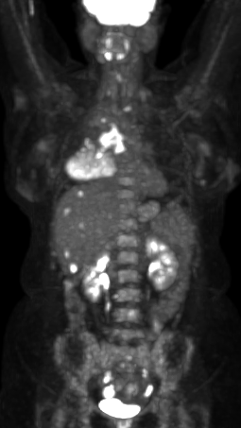
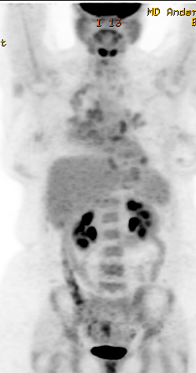
43 y/o Woman with Metastatic Lung Adenocarcinoma with ALK Rearrangement
February 2015 before treatment with Crizotinib
April 2015 after 8 weeks on Crizotinib
Toxicities Experienced with Crizotinib: Fatigue, nausea, anorexia – managed symptomatically, but ultimately required dose reduction

Slide 28
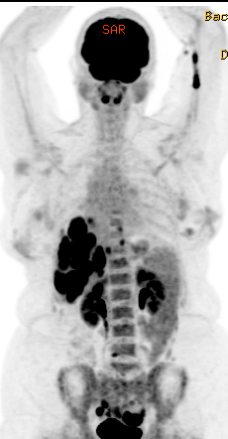
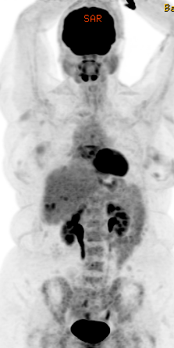

43 y/o Woman with Metastatic Lung Adenocarcinoma with ALK Rearrangement
In July 2016, she had disease progression in the liver and started second line therapy with Ceritinib
July 2016 prior to Ceritinib
November 2016 after 4 months of Ceritinib
Toxicities Experienced with Ceritinib: Nausea and Diarrhea - Managed symptomatically, but ultimately required dose reduction

Slide 29
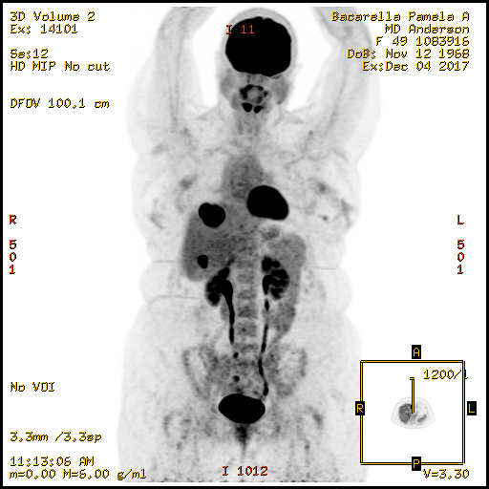
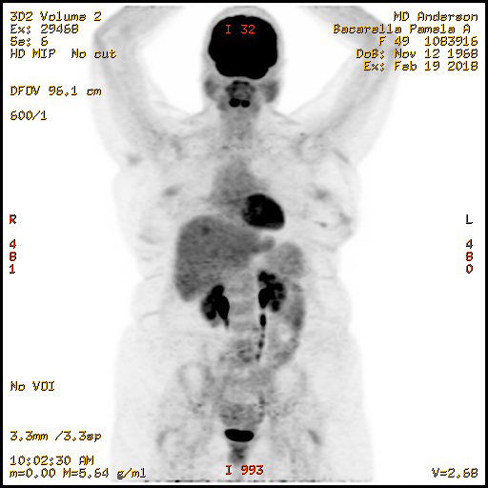
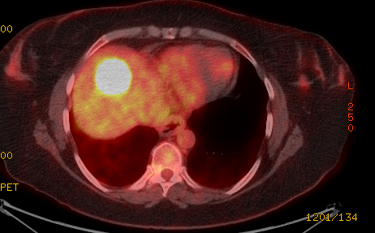
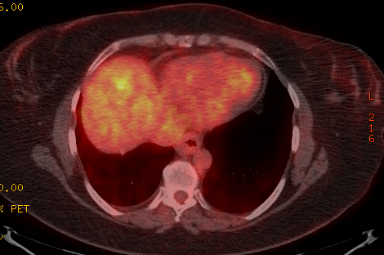

43 y/o Woman with Metastatic Lung Adenocarcinoma with ALK Rearrangement
In December 2017, she had progression in the liver and initiated third line therapy with Alectinib
December 2017 before Alectinib
February 2018 after 2 months of Alectinib
Toxicities Experienced with Alectinib: None significant, she actually experienced weight gain

Slide 30
43 y/o Woman with Metastatic Lung Adenocarcinoma with ALK Rearrangement
July 2019 – disease progression in the liver
New liquid biopsy was performed to evaluate for new alterations or mechanisms of resistance (no new actionable alterations were identified)
August 2019 – initiated 4th line therapy with Lorlatinib
10/2019 – PET/CT revealed resolution of the two new liver lesions, no new disease
Toxicities Experienced with Lorlatinib: Lower extremity edema (managed with intermittent diuretics), hyperlipidemia (managed with rosuvastatin), mild cognitive changes (no interventions/close monitoring for worsening)

Slide 31
Patient Education when initiating ALK TKIs
Explain reason for choosing this medication as first line, second, third, etc., therapy (this medication targets the mutation found in your tumor cells)
Discuss barriers to receiving medication (insurance approval, prior auth, specialty pharmacy, home delivery, etc.)
Explain how to take medication - With or without food?, swallow whole, take at the same time every day
Avoid grapefruit/grapefruit juice
Photosensitivity dermatitis is rare, but wearing sunscreen is recommended
Recommend discontinuation of herbal supplements prior to initiating an ALK inhibitor
Explain follow up, monitoring, and restaging schedule

Slide 32
ALK TKIs: Potential Toxicity/Side Effects and Management
Common Toxicities/Management:
GI Toxicities (nausea/vomiting, diarrhea, abdominal pain/cramping) - Management: supportive meds (anti-emetics, anti-diarrheal, pain meds), hold drug, dose reduction
Elevated Hepatic Enzymes - Management: monitor closely, higher grade - follow manufacturer guidelines for holding and dose reduction
Fatigue – Management: encourage rest and exercise, for severe fatigue – consider holding drug or dose reduction
Peripheral Edema – Management: encourage feet elevation, ambulation, exercise, for severe edema – can consider diuretics
Vision Changes – Management: ophthalmology consult, low threshold for holding drug, dose reduction
Weight Loss – Management: encourage increase caloric intake (frequent snacks), dietician consult, consider appetite stimulants
Myalgias – Management: for severe – hold drug and restart when grade one or less (may require dose reduction), monitor CK/CPK, pain meds if needed
Less Common Potentially Severe Toxicities:
Bradycardia, QT Prolongation
Interstitial Lung Disease
Hepatic Toxicity

Slide 33
ALK TKIs Specific Toxicities
Crizotinib: Visual disturbances, vision loss
Ceritinib: GI toxicity (nausea/vomiting, abdominal cramping, diarrhea), hyperglycemia, pancreatitis
Alectinib: Muscle cramping, elevated CK, anemia
Brigatinib: Respiratory toxicity (dyspnea/cough), increased risk of ILD in first week of treatment, HTN, hyperglycemia, headache, pancreatitis
Lorlatinib: High cholesterol, cognitive changes, weight gain

Slide 34
Intracranial Disease in Patients with ALK Rearrangement
Intracranial disease
ALK positive patients can develop intracranial disease.
Oncology nurses can help their providers remember to routinely image the brain in this patient population.
Ceritinib, Alectinib, Brigatinib and Lorlatinib have CNS penetration and intracranial disease can be treated systemically with these agents potentially avoiding further radiation.
Our patient described here had intracranial disease as described below
12/2015 PD in brain with at least 20 lesions, completed Whole Brain Radiation in 12/2015
6/2018 – Stereotactic Radiosurgery for two enlarging intracranial lesions
7/2019 – MRI showed stable to slightly more prominent subcentimeter enhancing lesions with 2 questionable new punctate foci. No new intervention to date.

Slide 35

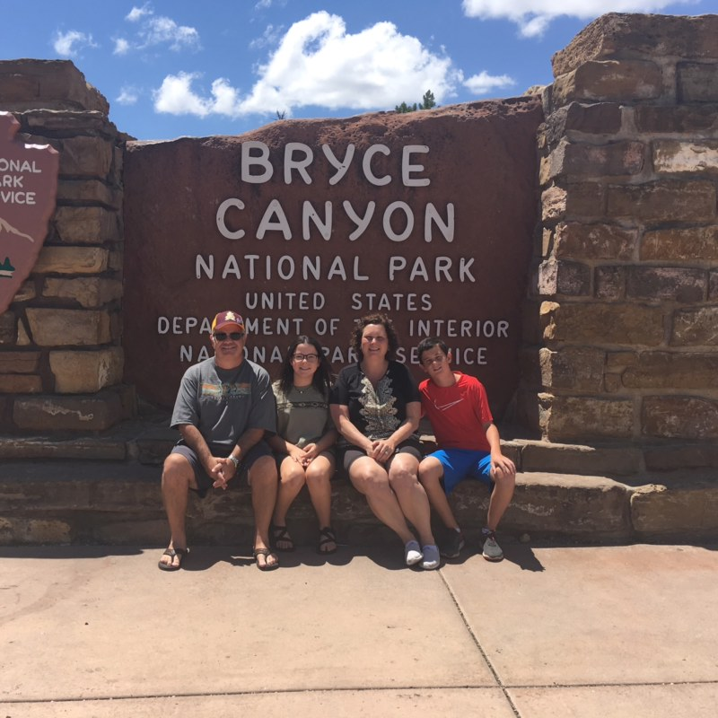

43 y/o Woman with Metastatic Lung Adenocarcinoma with ALK Rearrangement

Slide 36

Appalachian Mountains in Kentucky

Slide 37
Updates on Targeted Therapies in NSCLC
Anne S. Tsao, M.D.
Professor
Section Chief, Thoracic Medical Oncology
Director, Mesothelioma Program
Director, Thoracic Chemo-XRT Program
November 2019
The University of Texas
MD ANDERSON
Department of Thoracic/Head & Neck
Medical Oncology
CANCER CENTER

Slide 38
ROS1 Rearrangements in NSCLC
TPM3-ROS1
Present in ~1% of NSCLC cases (also found in some glioblastomas, gastric, ovarian, cholangiocarcinomas)
Enriched in younger never or light smokers with adenocarcinoma histology
No overlap with other oncogenic drivers
First-line agents: crizotinib, ceritinib, entrectinib
Not FDA approved: lorlatinib
SDC4-ROS1
SLC34A2-ROS1
CD74-ROS1
EZR-ROS1
LRIG3-ROS1
ROS1
Bergethon et al., JCO 30(8): 863-70, 2012; Takeuchi et al., Nat Med 18(3): 378-81, 2012

Slide 39
Entrectinib biology and pharmacology
ROS1 pathway
Extracellular matrix
Entrectinib is an oral, potent and selective ROS1/NTRK/ALK tyrosine kinase inhibitor that is CNS active
More potent ROS1 inhibitor than crizotinib in preclinical studies
Potent pan-TRK inhibitor in multiple tumor histologies
Entrectinib is FDA approved for ROS1 NSCLC
TRKA
TRKB
TRKC
ROS1
ALK
Cell
membrane
N
Fusion
Partner TRK
O
N
F
N
H
Inhibition of
downstream pathways
(MAPK–PI3K/AKT)
O
Cytoplasm
HN
F
Entrectinib
N
N
H
In-vitro/in-vivo
tumor growth
inhibition
Inhibition
of cell
proliferation
Cell cycle
arrest and
apoptosis
Inhibition
of TRK
phosphorylation
Rolfo, et al. Expert Opin Investig Drugs 2015; Ahn, et al. WCLC 201

Slide 40
Frontline Histology and Molecular Profiling October 2019
NSCLC PATIENT
Any histology but no actionable mutation
PD-L1 IHC (+) > 50%
PD-L1 IHC (-) or < 50%
SCC
Pembrolizumab
> 50% PD-L1 Platinum-Pemetrexed-Pembrolizumab
Non-SCC
No actionable
Mutations and
PD-L1 < 50%
Platinum-taxane-pembrolizumab, IMpower131
Avoid pemetrexed or bevacizumab, or necitumumab + cis/gem
MET exon 14 skip mutation
Rare mutations: Afatinib
EGFR exon 20: Poziotinib,
TAK-788
Adenocarcinoma
Crizotinib, Tepotinib (trial)
Savolitinib (trial)
EGFR
RET
ROS1
BRAF V600E
Common mutations: Osimertinib, Dacomitinib, Erlotinib,
Gefitinib, Afatinib
EML 4 ALK
Cabozantinib, Vandetanib
LOXO-292 (trial)
BLU-667 (trial)
Crizotinib, Ceritinib, Entrectinib
Lorlatinib
Dabrafenib+ Trametinib
Crizotinib, Alectinib, Ceritinib
Brigatinib
NTRK
If T790M and prior 1st or 2nd gen EGFR TKI, Osimertinib
Entrectinib
Larotrectinib
HER2
Platinum-pemetrexed-pembrolizumab
Platinum-paclitaxel-bevacizumab-atezolizumab (IMpower150)
Platinum-doublet + bevacizumab
Non-platinum or platinum based doublet
Ceritinib, Alectinib, Brigatinib,
Lorlatinib (breakthrough designation only)
Ado-trastuzumab
Exon 20: poziotinib (trial)

Slide 41
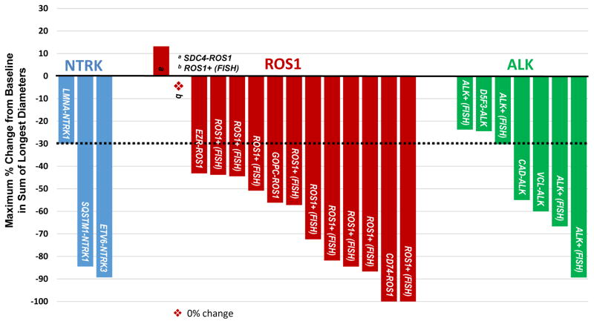
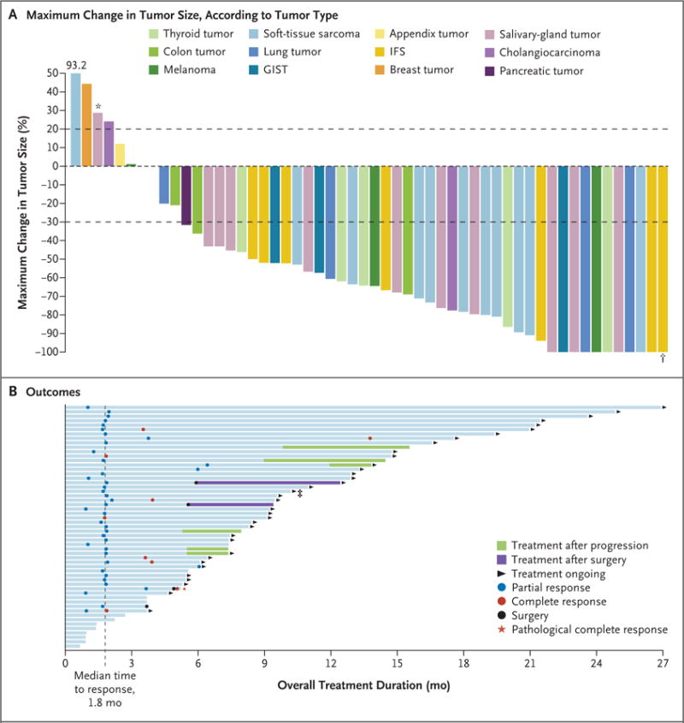
NTRK
TRK receptor family involves TrkA, TrkB, TrkC encoded by NTRK1,2,3. Involved in neuronal development
Gene rearrangements confer oncogenic properties to the TRK receptors
NTRK fusions in 0.1%-2.4% NSCLC, former or current smokers
NTRK1,2,3 mutations are mutually exclusive
Phase 1 Basket trials 3 responses (one NSCLC)
Larotrectinib highly selective inhibitor
  Basket trial 3/4 responses in NSCLC
Farago AF et al, J Thorac Oncol 10:1670, 2015; Ricciuti B et al, Med Oncol 34:105, 2017; Okamura K et al, Lung Cancer 78:100-6, 2012; Khotskaya YB, et al: Pharmacology and Therapeutiecs 173:58-99, 2017; Drilon et al, Cancer Discov 7(4):400-409, 2017; Farago et al, WCLC, 2018; Drilon A et al: NEJM #&*:731, 2018

Slide 42
NTRK Inhibitors
Entrectinib
CHF (median time to onset 2 months)
Cognitive impairment, dizziness
Mood disorders
Sleep disturbance
Abnormal liver function labs
Hyperuricemia
QTc prolongation
Visual changes
Fatigue
Edema
Diarrhea
Nausea
Myalgia
Larotrectinib
Fatigue
Pyrexia
Peripheral edema
Nausea/vomiting
Diarrhea
Abnormal liver function labs
Anemia
CNS toxicity (delerium, encephalopathy)

Slide 43
BRAF Mutations in NSCLC
Serine-threonine kinase of RAF family downstream of KRAS; activates MAPK
BRAF mutations originally described in melanoma but also seen in colon, thyroid, lung cancers and other solid tumors
Lung adenocarcinomas 1-5% with 50% having V600E mutation; other mutations G469A, D594G
Patient characteristics
  V600E – female, light/never smoker
  Non V600E – smokers
Prognostic significance unclear
  Reports of slow disease progression and long-term survival
Rothschild: Cancers 7:930, 2015; Tissot: Lung Cancer 91:3, 2016; Myall: Clin Lung Ca 17:e17, 2016; Caparica: Crit Rev Oncol/Hem 101:32, 2016

Slide 44
Mechanism of Action for Dual MAPK Pathway Inhibition With Dabrafenib + Trametinib
Dabrafenib mechanism of action
Reversible, small molecule
BRAF inhibitor
ATP competitive
BRAF V600E: IC₅₀ 0.65 nM
Trametinib mechanism of action
Reversible, small molecule
MEK1 and MEK2 allosteric inhibitor
MEK1 and MEK2: IC₅₀ 0.7 and 0.9 nM
RTKs
SOS
P
P
Grb2
Dabrafenib
P
P
SHC
P
P
RAS
PI3K/AKT/mTOR
pathway
BRAF
V600
BRAF
CRAF
MEK
ERK1/2
Trametinib
p90RSK
MSK1
Proliferation, Growth, Survival
Davies H, et al. Nature. 2002;417:949-954; Platz A, et al. Mol Oncol. 2008;1:395-405; Karasarides M, et al. Oncogene. 2004;23:6292-6298; Long, et al. N Engl J Med. 2014;371:1877; Gilmartin AG, et al. Clin Cancer Res. 2011;17:989-1000.

Slide 45
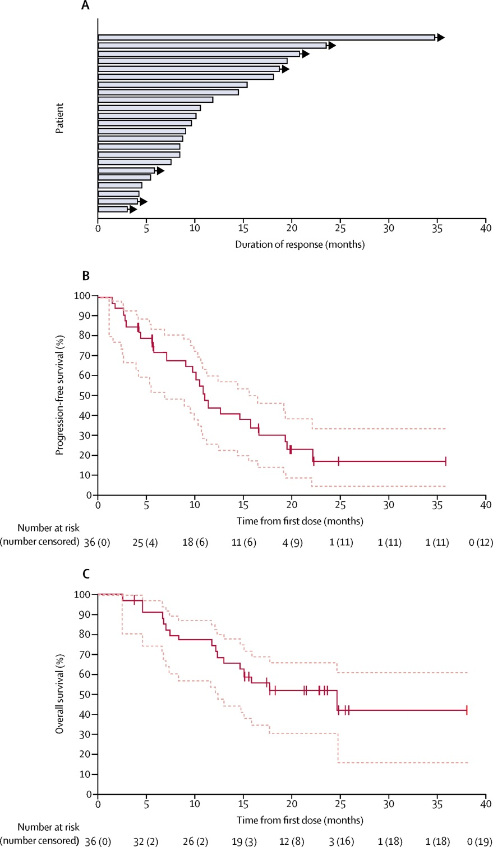
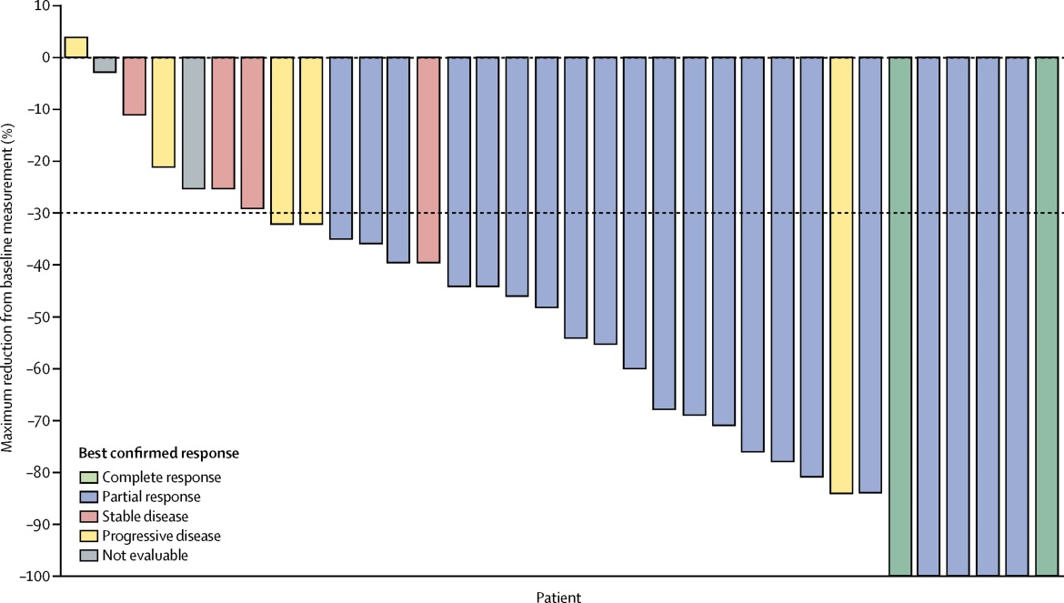
Dabrafenib and Trametinib
V600E Treatment Naive
RR 64%, 2 CR
Med DOR 10.4 mo
Med PFS 10.9 mo
Med OS 24.6 mo
Planchard D, et al. Lancet Oncol. 18:1307-16, 2017

Slide 46
Frontline Histology and Molecular Profiling October 2019
NSCLC PATIENT
Any histology but no actionable mutation
PD-L1 IHC (+) > 50%
PD-L1 IHC (-) or < 50%
SCC
Pembrolizumab
> 50% PD-L1 Platinum-Pemetrexed-Pembrolizumab
Non-SCC
No actionable
Mutations and
PD-L1 < 50%
Platinum-taxane-pembrolizumab, IMpower131
Avoid pemetrexed or bevacizumab, or necitumumab + cis/gem
MET exon 14 skip mutation
Rare mutations: Afatinib
EGFR exon 20: Poziotinib,
TAK-788
Adenocarcinoma
Crizotinib, Tepotinib (trial)
Savolitinib (trial)
EGFR
RET
ROS1
BRAF V600E
Common mutations: Osimertinib, Dacomitinib, Erlotinib,
Gefitinib, Afatinib
EML 4 ALK
Cabozantinib, Vandetanib
LOXO-292 (trial)
BLU-667 (trial)
Crizotinib, Ceritinib, Entrectinib, Lorlatinib
Dabrafenib+ Trametinib
Crizotinib, Alectinib, Ceritinib
Brigatinib
NTRK
If T790M and prior 1st or 2nd gen EGFR TKI, Osimertinib
Entrectinib
Larotrectinib
HER2
Platinum-pemetrexed-pembrolizumab
Platinum-paclitaxel-bevacizumab-atezolizumab (IMpower150)
Platinum-doublet + bevacizumab
Non-platinum or platinum based doublet
Ceritinib, Alectinib, Brigatinib,
Lorlatinib (breakthrough designation only)
Ado-trastuzumab
Exon 20: poziotinib (trial)

Slide 47
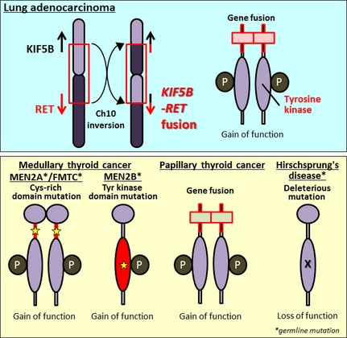
RET Fusions in NSCLC
Intact tyrosine kinase domain fused to an upstream gene partner
  most common: KIF5B
  others: CCDC6, NCOA4, TRIM33, KIAA1468
Ligand-independent dimerization and downstream growth pathway activation
Oncogenic in vitro and in vivo
1-2% NSCLC; younger; never/light smokers; adenocarcinoma/poorly differentiated
Drilon AD, Cancer Discov 2013;3:630-5, Kohno T, Nat Med 2012;18:375-7, Saito M, Carcinogenesis 2014;35:2452-6;Suehara Y, Nat Med 2012;18;6599-608, Lipson D, Nat Med 2012;18:382-40, Takeuchi K, Nat Med 2012;18:378-81

Slide 48
Efficacy of LOXO-292 (selpercatinib) in RET fusion-positive NSCLC
FDA breakthrough designation
RET fusion-positive NSCLC
Enrolled | 38
Eligible for response evaluation | 38
Overall Response Rate (95% CI) | 26/38 68% (51% - 83%)
Confirmed ORR* | 25/37 68% (50% - 82%)
CR | -
PR** | 26
SD | 8
PD | 2
NE | 2
4/4 confirmed intracranial responses (1 CR, 3 PR) in patients with measurable (> 5 mm) intracranial lesions
Toxicities – Fatigue, Diarrhea, Constipation, Dry mouth, Nausea, Dyspnea
▼pending confirmation; * Excludes one patient with unconfirmed PR pending confirmation at time of data cut-off; ** 25 confirmed PR, 1 unconfirmed PR pending confirmation
Follow-up as of July 19, 2018.
Oxnard et al, WCLC 2018

Slide 49
Special Issues in Oncology Care
Management of current smokers; vaping

