Slide 1
Module 14: Immune Checkpoint Inhibitors in Lung Cancer
Kelly EH Goodwin, MSN, RN, ANP-BC
Matthew Gubens, MD, MS

Slide 2
Disclosures for Ms Goodwin
No relevant conflicts of interest to disclose.

Slide 3
Disclosures for Dr Gubens
Consulting Agreements | AstraZeneca Pharmaceuticals LP, Boehringer Ingelheim Pharmaceuticals Inc, Bristol-Myers Squibb Company, Genentech, Heron Therapeutics Inc, Roche Laboratories Inc, Takeda Oncology
Contracted Research | Celgene Corporation, Merck, Novartis, OncoMed Pharmaceuticals Inc, Roche Laboratories Inc

Slide 4
Day in the Life: Immune Checkpoint Inhibitors in Lung Cancer
94 M, pembrolizumab, 4th year on treatment
42 M, pembrolizumab/pemetrexed/carboplatin, independence
72 F, nivolumab, rheumatoid arthritis, receiving infliximab, progressed on chemo/XRT, newly diagnosed triple-negative breast cancer
70 M, pembrolizumab, transaminitis requiring high-dose steroids
70 F, pembrolizumab, intolerance to chemo
60 F, durvalumab, severe esophagitis after XRT has caused multiple complications
64 F, nivolumab, concern re: memory deficits
64 F, nab paclitaxel/carbo/pembrolizumab, optimistic
70 F, pemetrexed/carbo/pembrolizumab, acceptance of disease

Slide 5
Day in the Life: Immune Checkpoint Inhibitors in Lung Cancer
80 F, also diagnosed with AML, pembrolizumab, venetoclax, azacitidine, Family support
66 F, carbo/paclitaxel/pembrolizumab, emotional state
78 F, pemetrexed/pembrolizumab, very active, tumor causing hoarseness
62 M, mets to brain, bone, atezolizumab, seizures
76 F, pembrolizumab, smoker for years, great positive attitude
70 M, immunotherapy, skipped some treatment
83 M, nivolumab, likes to party with friends
72 M, nivolumab, appreciation of caretakers
71 M, immunotherapy, has responded well on single-agent therapy

Slide 6
Immune Checkpoint Inhibitors in Lung Cancer
First Annual Research To Practice Oncology Nursing Retreat
November 10, 2019
Matthew Gubens, MD, MS
Associate Professor of Medicine
UCSF Helen Diller Family Comprehensive Cancer Center

Slide 7
4 questions
Can we use immunotherapy alone in the first line in stage IV?
Can we combine immunotherapy and chemo in the first line?
Can we use immunotherapy in stage III?
Can we use immunotherapy in small cell lung cancer?

Slide 8
Q1: Can we use immunotherapy alone in the first line?
KEYNOTE-024: Pembrolizumab in PD-L1 >= 50%
KEYNOTE-042: Pembrolizumab in PD-L1 >=1%
CheckMate 227: Nivolumab and ipilimumab

Slide 9
Pembrolizumab 1st line (PD-L1>=50%)
Reck M et al. ESMO 2016;Abstract LBA8_PR

Slide 10
Pembrolizumab 1st line (PD-L1>=50%): KEYNOTE-024
Response rate
45% vs 28%
Crossover from chemo to pembro: 66/151 (44%)
Reck M et al. ESMO 2016

Slide 11
Pembrolizumab 1st line (PD-L1>=1%): KEYNOTE-042
Lopez, ASCO 2018

Slide 12
Pembrolizumab 1st line (PD-L1>=1%): KEYNOTE-042
NO CROSSOVER ALLOWED
Only 20% of chemo patients eventually got immunotherapy
Lopez, ASCO 2018

Slide 13
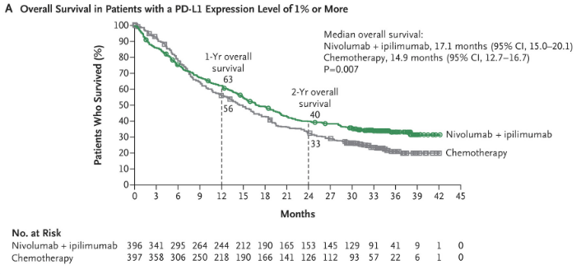
CheckMate 227: Nivolumab and ipilimumab vs chemo
All levels PD-L1
17.1 vs 13.9 mo
PD-L1+
17.1 vs 14.9 mo
PD-L1-
17.2 vs 12.2 mo
Hellmann, NEJM 2019

Slide 14
Q1: Can we use immunotherapy alone in the first line?
KEYNOTE-024: Pembrolizumab in PD-L1 >= 50%
Yes– FDA approved, clearly superior to chemo
KEYNOTE-042: Pembrolizumab in PD-L1 >=1%
Yes– FDA approved
But NOT superior to chemo 1-49%
Checkmate 227: Nivolumab and ipilimumab
Not yet FDA approved but superior to chemo (?and even more so in PD-L1 0%), but watch out for more toxicity

Slide 15
Q2: Can we combine immunotherapy and chemo?
KEYNOTE-189: Non-squamous– Platinum and pemetrexed with or without pembrolizumab
KEYNOTE-407: Squamous– Carboplatin and taxane with or without pembrolizumab
IMpower150: Non-squamous– Carboplatin and paclitaxel with bevacizumab +/- atezolizumab

Slide 16
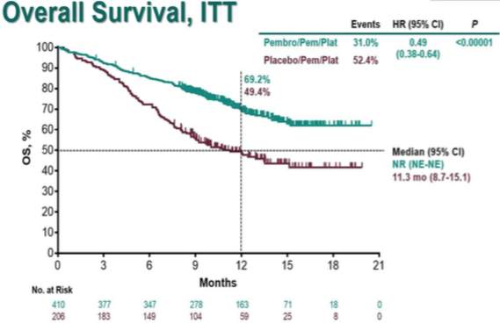
KEYNOTE-189 (non-squamous) Platinum/pemetrexed +/- pembro
Gandhi, AACR 2018

Slide 17
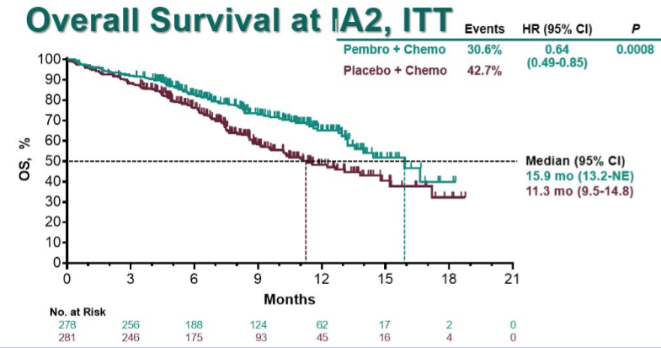
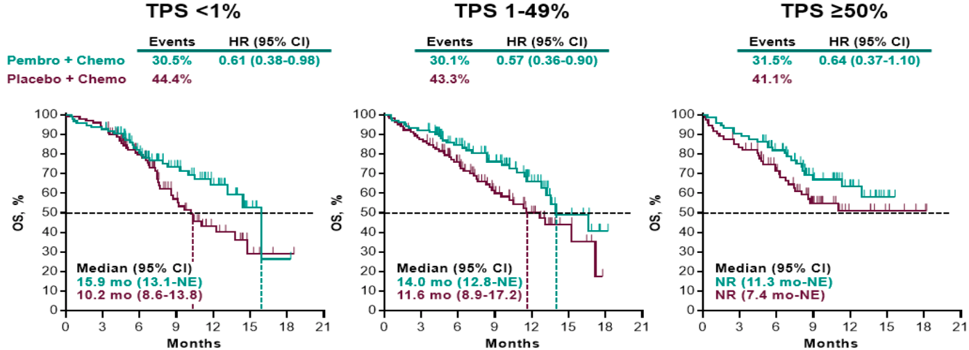
KEYNOTE-407
(squamous) Platinum/taxane +/- pembro
Choice of taxane
Paclitaxel 0.67
Nab-paclitaxel 0.59
Paz Ares, ASCO 2018

Slide 18
What if non-squam patients aren’t eligible for pemetrexed?
IMpower150
Carbo/paclitaxel + bevacizumab +/- atezolizumab
19.2 vs 14.7mo, HR 0.78, p=0.0164
Subgroups for PD-L1 high, low and negative trended toward benefit (HR 0.70, 0.80, 0.82)
Socinski, AACR 2018

Slide 19
Q2: Can we combine immunotherapy and chemo?
KEYNOTE-189: Non-squamous– Platinum and pemetrexed with or without pembrolizumab
KEYNOTE-407: Squamous– Carboplatin and taxane with or without pembrolizumab
Both FDA-approved
IMpower150: Non-squamous– Carboplatin and paclitaxel with bevacizumab +/- atezolizumab
Also FDA-approved, but harder to justify use of a taxane in non-squamous patients without clear benefit

Slide 20
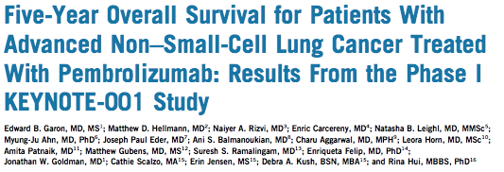
Long-term outcomes in stage IV NSCLC
5 year overall survival?
NCI SEER: 4.9% at 5 years
What about in the immunotherapy era?
Est 5-y overall survival | All | PD-L1 ≥50%
Treatment-naïve | 23.2% | 29.6%
Previously treated | 15.5% | 25.0%
NCI SEER 2014. Garon, JCO 2019
Notes:
Will give anecdote about KEYNOTE-001 patient I’ve known since 2011 at this point – brain mets, alive and well

Slide 21
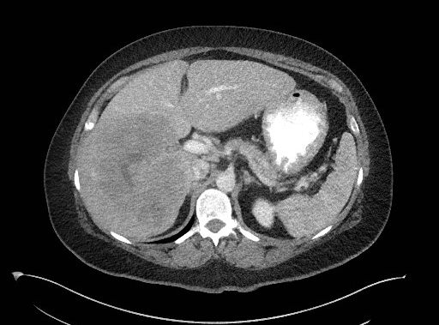
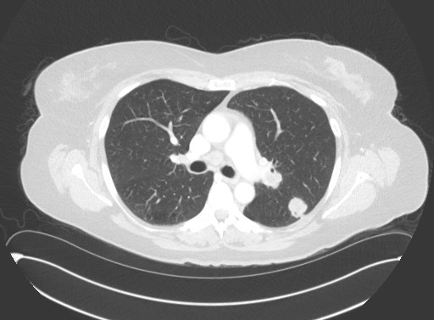
Case 2
TP 51yo F former light smoker (12.5 pack years, quit > 10 years ago) with PMH GERD, Barrett’s esophagus, hyperlipidemia, HTN and depression who presented to local ED April 2019 with persistent RUQ pain, nausea/vomiting, general malaise several weeks after being diagnosed with UTI and influenza. Abdominal US and MRI Liver show 13cm liver mass. Referred to Liver surgeon MGH.
Liver surgeon ordered CT C/A/P and biopsies. Imaging remarkable for LUL lung nodule with hilar, mediastinal and supraclavicular LAN. Liver biopsy suggestive lung primary but could not exclude cholangiocarcinoma. Lung biopsy showed poorly differentiated adenocarcinoma, IHC staining consistent with lung primary. Genetic analysis negative. PD-L1 >95%.
MRI Brain with 9mm L hippocampus metastasis.
Works as unit secretary at outside hospital. Married with 2 children and 6 grandchildren. Significant nausea/vomiting with pregnancies.
Lives > 1 hour from MGH

Slide 23
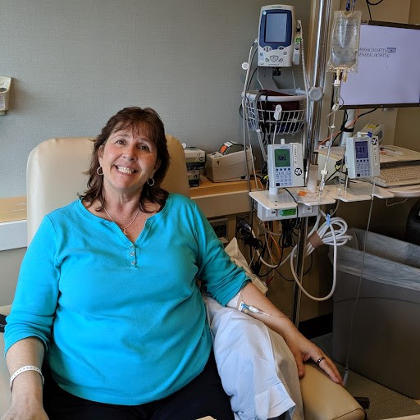
Pembrolizumab single agent appropriate for high PD-L1 positivity but given intracranial disease and rising LFTs initiated carboplatin + pemetrexed + pembrolizumab on 5/20/19.
4/23/19 T bili 0.7, ALT 36, AST 40, Alk Phos 799
5/20/19 T bili 2.4, ALT 191, AST 210, Alk Phos 1129
Teaching session with particular focus on aggressive
prophylactic and prn antiemetics given baseline symptoms.
Plan for close interval MRI Brain and likely SRS
Significant time reviewing risks of treatment with
liver dysfunction. DNR/DNI

Slide 24
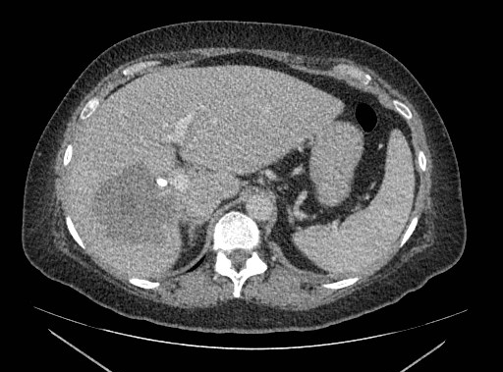
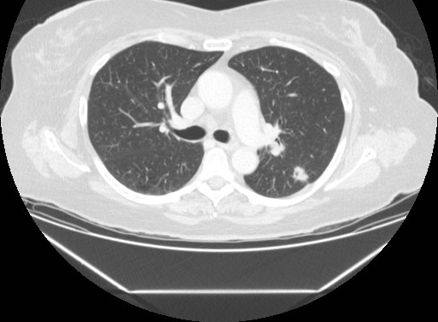
Restaging CT C/A/P and CT Head 6/19/19 with nice response to therapy with decreasing lung, liver and brain mets. R hepatic met now 7.6 x 7.9 cm with resolution of biliary ductal dilatation.
SRS on hold given nice intracranial response
Continued triplet therapy for total 4 cycles, transitioned to maintenance pem/pembro. Tolerating therapy well.
Most recent restaging 10/28/19 with continued slight interval decrease in LUL mass, L hilar and L mediastinal lymph nodes. R hepatic met now 6.0 x 5.4 cm. MRI Brain with resolution of cerebellar met.
Working and travelling

Slide 26
Immune Checkpoint Inhibitors in Lung Cancer
First Annual Research To Practice Oncology Nursing Retreat
November 10, 2019
Matthew Gubens, MD, MS
Associate Professor of Medicine
UCSF Helen Diller Family Comprehensive Cancer Center

Slide 27
Q3: Can we use immunotherapy in stage III unresectable NSCLC?
PACIFIC: Durvalumab after chemoradiation

Slide 28
Antonia SJ et al. N Engl J Med 2018;379(24):2342-50.

Slide 29
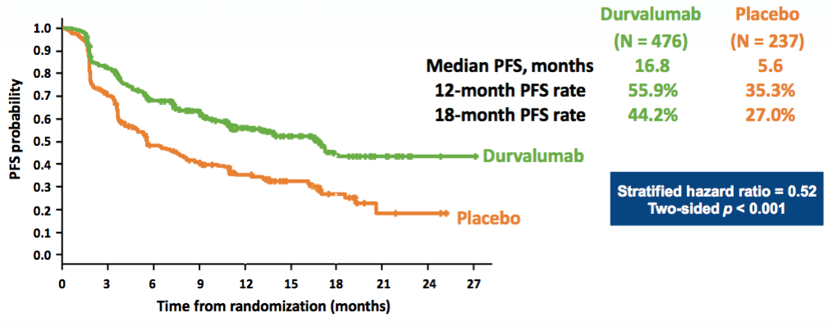
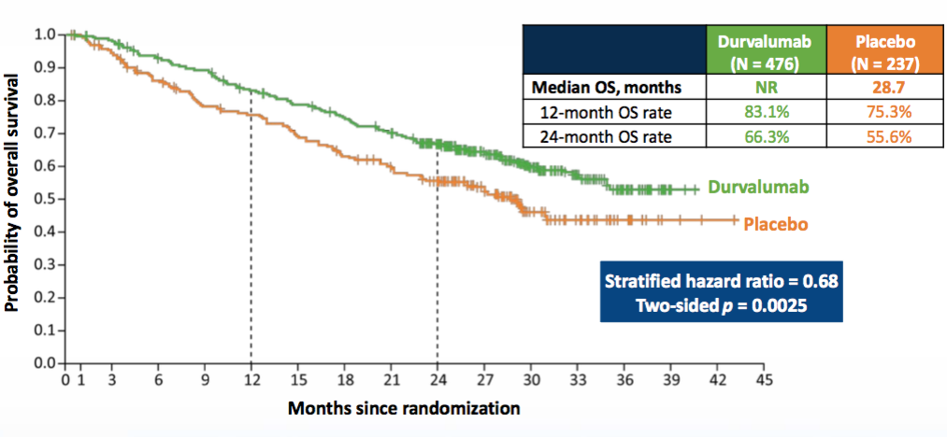
PACIFIC: Durvalumab after chemoradiation in stage III
PFS
Grade 3/4 toxicity
29.9 vs 26.1%
Grade 3/4 pneumonitis
3.4 vs 2.6%
Discontinuation rate
15.4 vs 9.8%
OS
Antonia SJ et al. N Engl J Med 2018;379(24):2342-50.

Slide 30
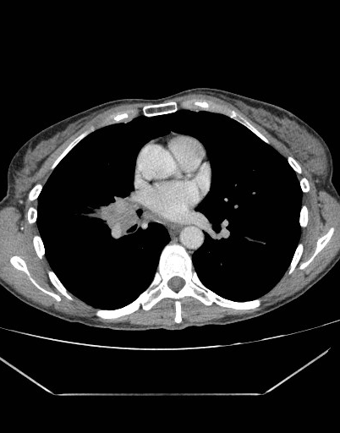
Case 1
CH 51yo F never smoker with PMH significant for seasonal allergies presents to PCP in February 2018 with 1 year h/o cough, worsening over last 2-3 months. CXR with R pneumonia. No improvement with antibiotics.
CT Chest 3/8/2018 reveals 2.6 cm x 2.9 cm x 3.0 cm R hilar mass with associated subcarinal lymphadenopathy. PET-CT and MRI brain negative for metastatic disease.
Bronchoscopy/mediastinoscopy reveals lung adenocarcinoma. EGFR and ALK testing negative for targetable mutations. Full genetic panel ultimately returns ROS1 +. PD-L1 60-80% (moderate to strong).

Slide 31
Married, mother of 2, managing partner in a law firm
16yo daughter, 19yo son
Husband 1 year s/p surgery for prostate CA – did not share diagnosis/treatment with children until his 1 year anniversary with normal PSA
Met with PACT team to discuss disclosing her diagnosis to children
Chemotherapy teaching session week prior to initiation of cisplatin + pemetrexed + radiation. Plan 3 cycles chemotherapy, RT 66 Gy in 33 fractions.
Definitive chemotherapy + radiation 5/29/18-7/13/18
Teaching geared to patient’s goals, level of understanding
Potential side effects of definitive chemoRT– fatigue, appetite changes, bone marrow changes, renal dysfunction, liver dysfunction, electrolyte abnormalities, GI toxicities, hearing deficits/tinnitus, peripheral neuropathy, hair loss/hair thinning, allergic reaction, teratogenicity, peripheral edema, excessive tears, rhinorrhea, esophagitis
Prophylactic and prn antiemetics, bowel regimen, mouth care, B12/folate, diet/hydration
Review how/when to contact office with toxicities
Weekly followup

Slide 32
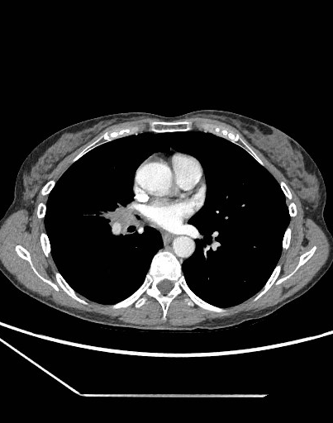
Initiated adjuvant durvalumab 8/7/18, plan 1 year treatment with surveillance CTs every 3 months
Rationale/mechanism of action different so side effects different.
Activating immune system to improve chance of cure but potential complications if overactivated.
Side effects can occur after a single dose or months after discontinuation. Side effects can be mild to life threatening. Requires frequent communication and close followup.
Thyroid dysfunction, pneumonitis, myocarditis, hepatitis, nephritis, colitis, endocrinopathies (AI, hyperglycemia), neurotoxicity (myositis), rash, infusion reactions
Developed occasional loose stool (1-2 episodes/week) following 2nd infusion – onset, associated symptoms, aggravating/alleviating factors.
DDX – infection, recent travel, diet, immune-mediated colitis or thyroid dysfunction.
Resolved spontaneously < 1 month.

Slide 33
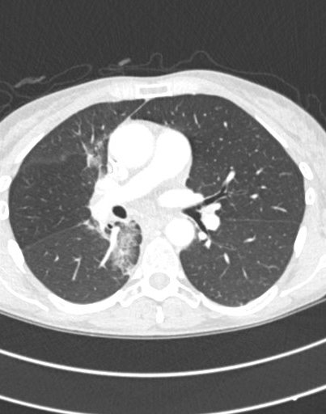
Developed worsening cough and new wheezing 10/30/18 – onset, associated symptoms, aggravating/alleviating factors.
DDx – seasonal allergies, infection, cancer recurrence, pneumonitis (radiation or immune-mediated)
CT Chest shows further decrease in size of the central R hilar lesion, reopening of RML bronchus and post-treatment changes in the paramediastinal R lung c/w radiation pneumonitis

Slide 34
Treated with short course of steroids + antibiotics with significant clinical improvement
Durvalumab held 10/30/18, resumed 11/13/18 after completion of steroids
Trials allowed low dose steroids with IO
Duration of steroids depends on severity of symptoms
IO typically well tolerated but complications can be severe so must always do comprehensive review of systems, history and physical
Start within 8 weeks of completing chemoRT, concerns about overlapping toxicities
Immune mediated toxicities always high on differential
Multidisciplinary team

Slide 35
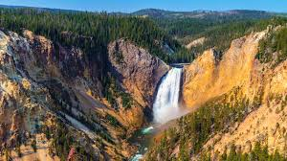
Completed durvalumab 7/30/19 to allow for family vacations. Tolerated remainder of year well – hiking, skiing, college tours with daughter
Surveillance scans 9/5/19 without evidence of disease
Some persistent mild cough and wheeze – education/expectation setting
Fears of recurrence – survivorship clinic
Social work, Cognitive behavioral therapy, psych-onc, nutrition, return to PCP/routine health maintenance, regular surveillance imaging

Slide 36
Immune Checkpoint Inhibitors in Lung Cancer
First Annual Research To Practice Oncology Nursing Retreat
November 10, 2019
Matthew Gubens, MD, MS
Associate Professor of Medicine
UCSF Helen Diller Family Comprehensive Cancer Center

Slide 37
Q4: Can we use immunotherapy in small cell lung cancer?
3rd line
CheckMate 032 Nivolumab ORR 12%
KEYNOTE-158 and 028 Pembrolizumab ORR 19%
1st line
IMpower133: Carboplatin and etoposide +/- atezolizumab

Slide 38
IMpower133: Overall Survival
Liu, WCLC 2018

Slide 39
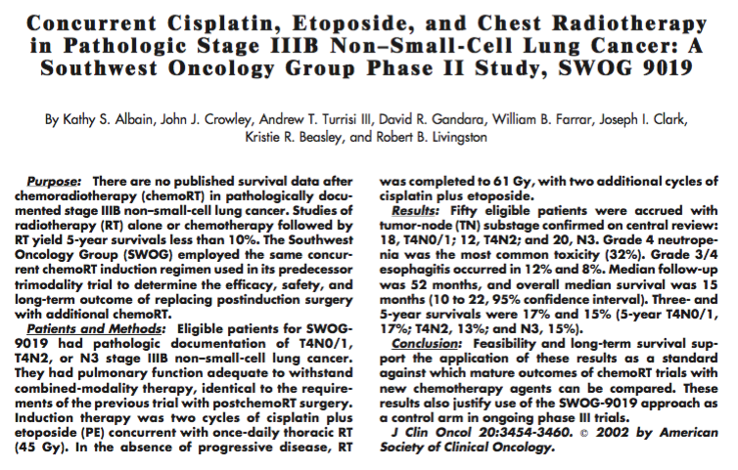
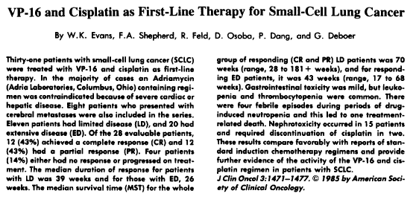
Stage III NSCLC
PACIFIC: Consolidation durvalumab x 1 year after chemorads
Metastatic SCLC
IMpower133: Addition of atezolizumab to platinum/etoposide

Slide 40
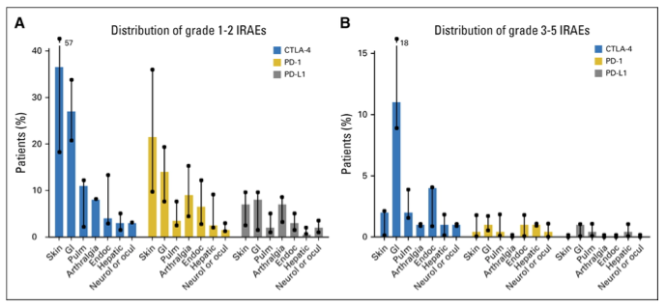
Bonus Q: What about autoimmune toxicity and pre-existing autoimmune conditions?
Brahmer, JCO 2018

Slide 41
Bonus Q: What about autoimmune toxicity and pre-existing autoimmune conditions?
Possibly some association between toxicity and efficacy
4 center NSCLC retrospective study, n=134
Immune-related adverse event in 51% (18% needed steroids)
mPFS 9.2 vs 4.8 mos and OS NR vs 11.1 mos favoring those who had adverse events
Pre-existing autoimmune disease?
1 center NSCLC retrospective study, n=56 (RA in 11, psoriasis in 14)
Flares of autoimmune disease and/or autoimmune effect in 55%
Largely manageable with discontinuation rate 14%
Response rate 22%
Haratani, JAMA Onc 2018, Leonardi, JCO 2018

Slide 42
Special Issues in Oncology Care
Patients with minor children or grandchildren

