Slide 1
Module 2:
Hepatocellular Carcinoma
and Pancreatic Cancer
Jessica Mitchell, APRN, CNP, MPH
Eileen M O’Reilly, MD

Slide 2
Disclosures for Ms Mitchell
No financial interests or affiliations to disclose

Slide 3
Disclosures for Dr O’Reilly
Consulting Agreements | Agios Pharmaceuticals Inc, Amgen Inc, Astellas, AstraZeneca Pharmaceuticals LP, Bayer HealthCare Pharmaceuticals, Bristol-Myers Squibb Company, Celgene Corporation, CytomX Therapeutics, Daiichi Sankyo Inc, Eisai Inc, Exelixis Inc, Halozyme Inc, Incyte Corporation, Ipsen Biopharmaceuticals Inc, Janssen Biotech Inc, Jazz Pharmaceuticals Inc, Lilly, Merck, Pfizer Inc, Sanofi Genzyme
Contracted Research | AstraZeneca Pharmaceuticals LP, Bristol-Myers Squibb Company, Celgene Corporation, Genentech, Halozyme Inc, Incyte Corporation, Lilly, Novartis

Slide 4
Approximately how many patients with the following types of cancer have you interacted with over the past year?
Type of cancer | Median
Breast cancer | 40
Lung cancer | 35
Colorectal cancer | 30
Myelodysplastic syndromes | 20
Multiple myeloma | 20
Chronic lymphocytic leukemia | 15
Pancreatic cancer | 10
Diffuse large B-cell lymphoma | 10
Prostate cancer | 10
Follicular lymphoma | 7
Melanoma | 6
Type of cancer | Median
Ovarian cancer | 6
Renal cell carcinoma | 6
Hepatocellular carcinoma | 5
Gastric cancer | 5
Acute myeloid leukemia | 4
Hodgkin lymphoma | 4
Urothelial bladder cancer | 4
Endometrial cancer | 3
Cervical cancer | 2
Mantle cell lymphoma | 2

Slide 5
Hepatocellular Carcinoma

Slide 6
Metastatic HCC, Multiple Lines of Therapy
62 yo male, h/o cirrhosis due to heavy alcohol use
  Previously treated with RFA,TACE,HAE with eventual continued progression.
  Ultimately received liver transplant from a hepatitis C positive donor, now on chronic immunosuppressive therapy (therefore not eligible for immunotherapy)
In follow up nine months after transplant, new retroperitoneal lymph nodes, new liver lesions. Child Pugh A, Baseline AFP 26

Slide 7
Started on sorafenib 400 mg BID, PO. Developed hand-foot syndrome (blistering/difficulty walking), diffuse body rash, mucositis, anorexia, weight loss. Dose reduced to 200 mg BID PO helpful. Repeat CT after six months showed progression with increasing size/number liver lesions, new peritoneal disease. AFP 100.

Slide 8
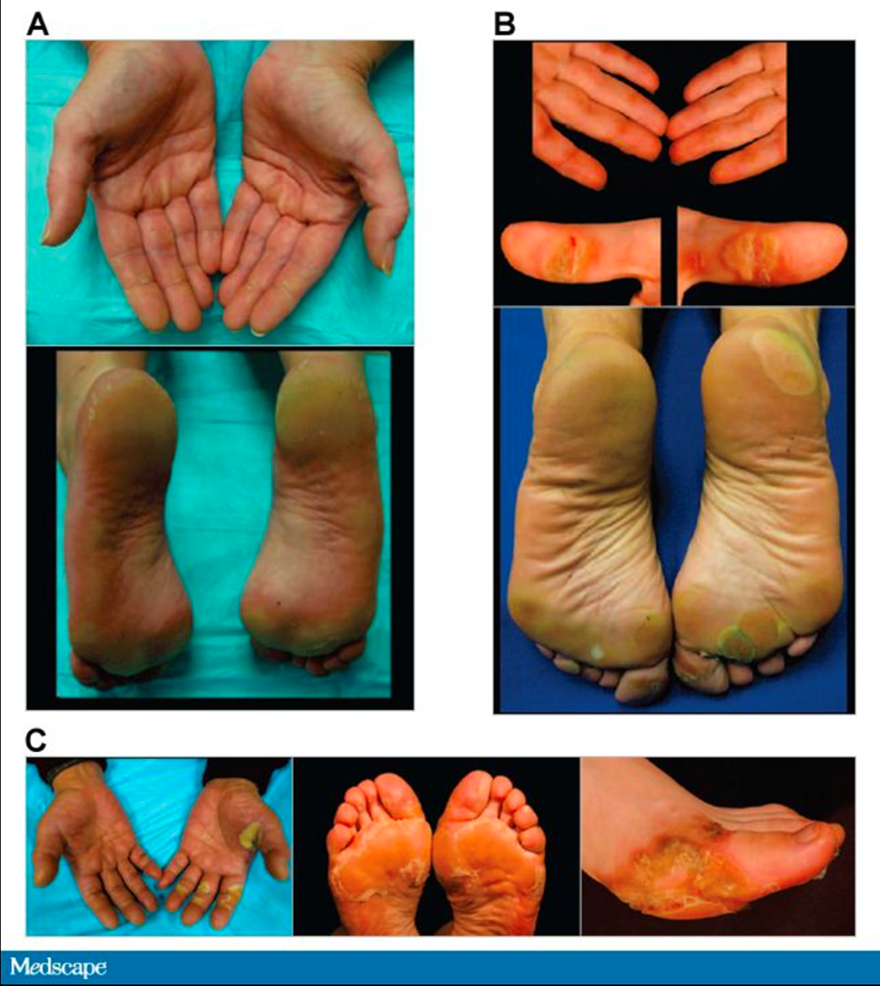
From Lacouture ME, et al. The Oncologist. 2008;13:1001-1011.

Slide 9
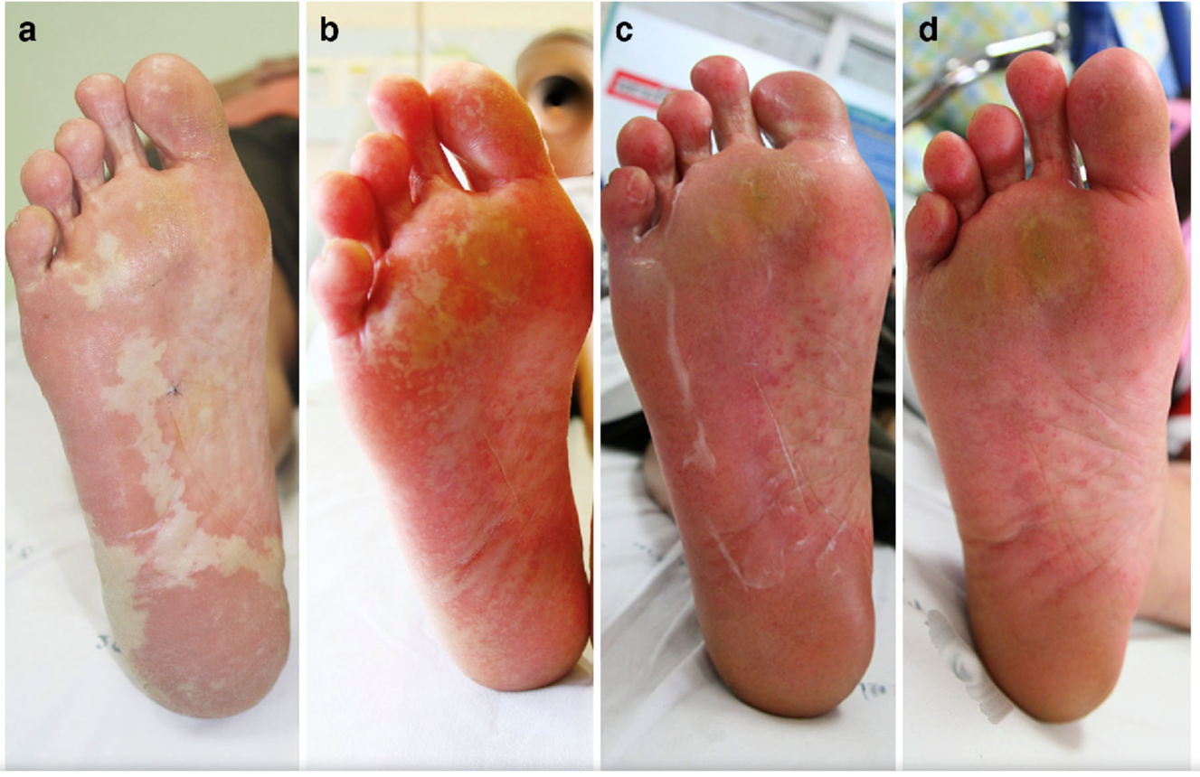
Published in American Journal of Clinical Dermatology 2016
Multikinase Inhibitor-Induced Hand–Foot Skin Reaction: A Review of Clinical Presentation, Pathogenesis, and Management
Kumutnart Chanprapaph et al.

Slide 10
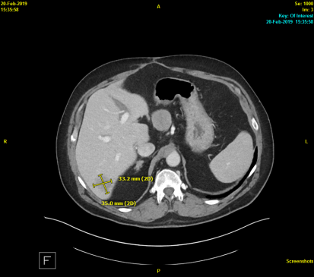
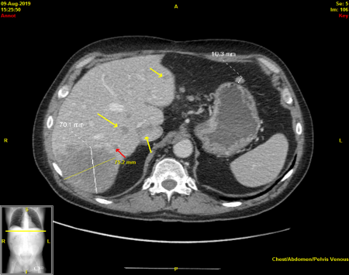
Baseline liver scan
Scan six months after sorafenib

Slide 11
Therapy switched to cabozantinib 60 mg QD, PO. Developed hypertension (requiring multiple antihypertensives), fatigue, anorexia, increasing abdominal pain.
After three months, CT imaging showing progression. AFP 450. Switched to ramucirumab, overall tolerating well, no scan yet to determine response.

Slide 12
Side Effect Teaching Points
Tyrosine Kinase Inhibitor (TKI) drugs commonly cause fatigue, diarrhea, hand-foot reaction, nausea, vomiting, anorexia, weight loss, hypertension
  Early/frequent intervention and good provider communication KEY to overall tolerance
      Daily blood pressure logging
      Skin care education
      Nutritional counseling
      Proactive antiemetic use

Slide 13
Side Effect Teaching Points
Ramucirumab
  Increased risk of bleeding, careful monitoring especially in HCC patient with decreased liver function
  Hypertension, maintain daily blood pressure records from home monitoring, watch for other signs of increased blood pressure such as headache, dizziness

Slide 14
Psychosocial Aspects
Hand-foot syndrome caused difficulty walking/pain, decreasing patient’s ability to be independent/active, which was a very important component of his life. Additional physical changes (temporal wasting, cachexia, abdominal distention due to ascites) impacted his desire of continuing to be social.
However, patient very active in Alcoholics Anonymous community, doing public speaking about his situation/taking responsibility for life choices. Very focused on cultivating forgiveness/peace/mending broken relationships from prior alcoholism before death.

Slide 15
Research To Practice: HCC & Pancreatic Cancer
11-09-2019 Nursing Symposium
Eileen M O’Reilly, MD
Winthrop Rockefeller Chair in Medical Oncology
Associate Director, David M Rubenstein Center Pancreas Research
Section Head, Hepatopancreaticobiliary & Neuroendocrine Cancers
Attending Physician, Member
Memorial Sloan Kettering Cancer Center
Professor of Medicine
Weill Cornell Medical College

Slide 16
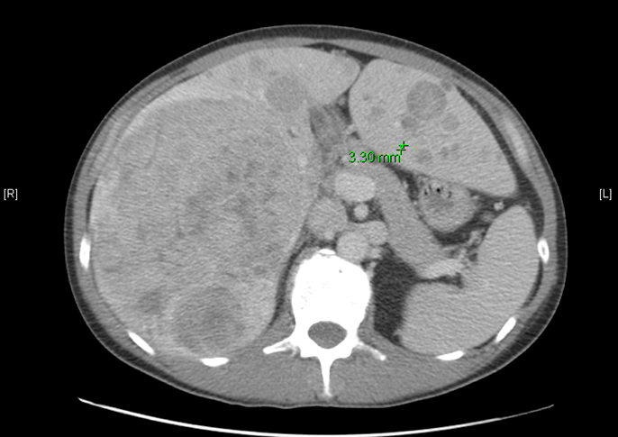
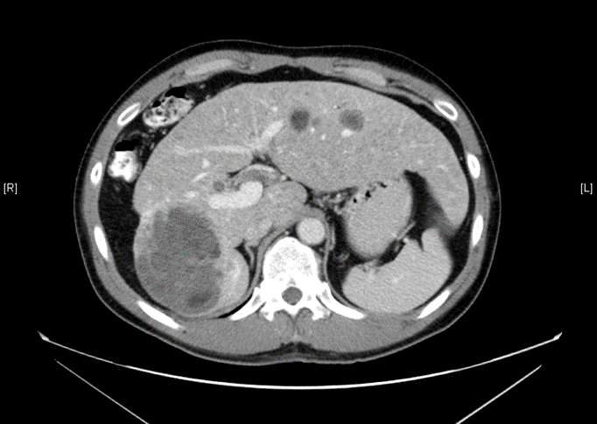
41-Year Old Hep B HCC: Symptomatic
How Best To Treat?
AFP 6.1 ng/ml
AFP 5.8 ng/ml

Slide 17
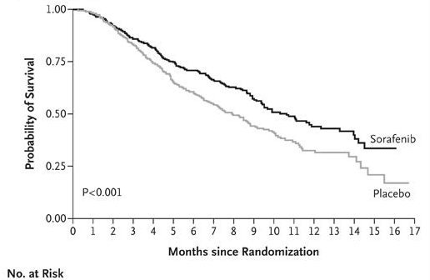
First-Line Therapy for HCC
SHARP: Sorafenib vs Placebo Overall Survival
Sorafenib
Median: 10.7 months
Placebo
Median: 7.9 months
HR = 0.69
Llovet JM, et al. N Engl J Med. 2008;359: 378-390

Slide 18
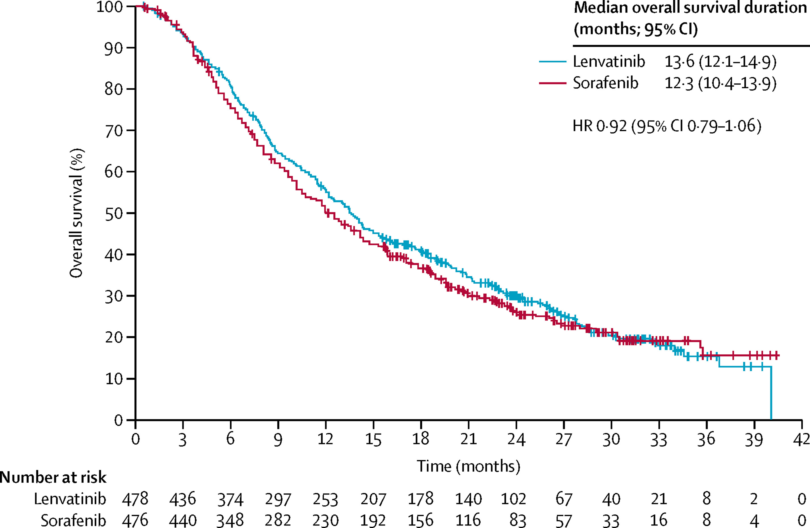
First-Line Therapy for HCC
REFLECT: Lenvatinib vs Sorafenib: Survival
Non-Inferiority met
 | Lenvatinib | Sorafenib | Statistic
Median OS | 13.6 mths | 12.3 mths | HR 0.92
Response Rate | 24% | 9% | OR 3
Prog Free Survival | 7.4 mths | 3.7 mths | HR 0.66
Kudo, M, et al. The Lancet 2018
Notes:
No difference OS
Met pre-specified NI margin of 95% CI upper limit being <1.08

Slide 19
Second-Line HCC
REACH 2: Phase III Ramucirumab vs Placebo
R
A
N
D
O
M
I
Z
E
Ramucirumab (2:1) IV
8 mg/kg q 2 weeks
Advanced HCC
AFP > 400 ng/ml
Prior Sorafenib
CP A; ECOG 0-1
Placebo IV q 2 weeks
Primary Endpoint: Overall Survival
Zhu, A. Lancet Oncology, 2019

Slide 20
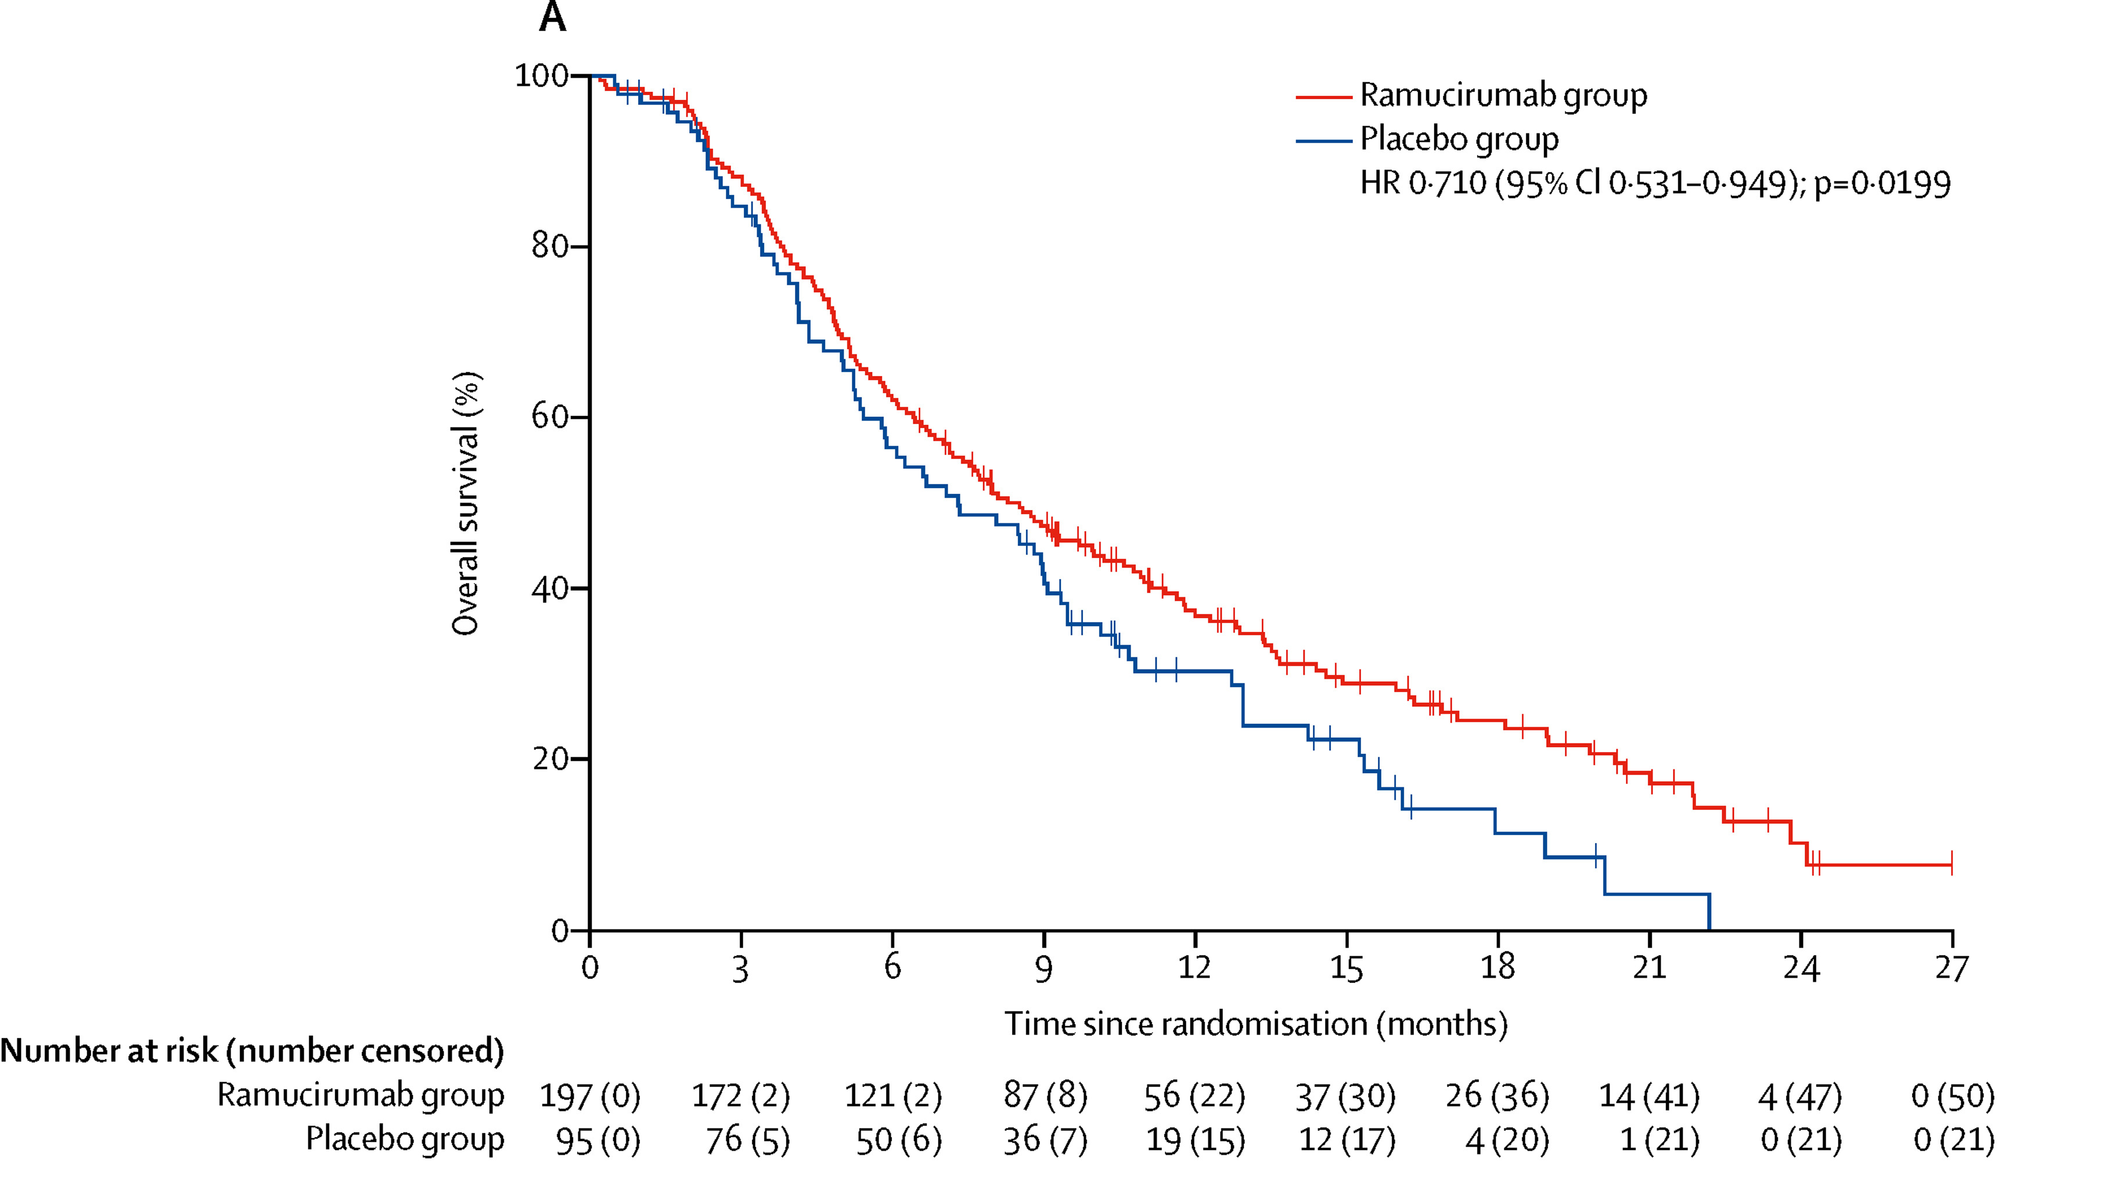
Second-Line/Beyond
REACH 2: Overall Survival (AFP > 400 ng/ml)
Zhu, A. Lancet Oncol, 2019

Slide 21
HCC Options for 2nd-Line/ 3rd-Line
Regorafenib (RESORCE)
  Regorafenib vs placebo (prior sorafenib)
Cabozantinib (CELESTIAL)
  Cabozantinib vs placebo; 2nd line and beyond
Ramucirumab (REACH 2)
  Elevated AFP – biomarker selected
Checkpoint inhibitors
  Single arm (non-randomized) trials: nivolumab, pembrolizumab

Slide 22
Checkpoint Inhibitor Therapy in HCC
Confusing data!

Slide 23
First-Line Therapy HCC
CheckMate 459: Nivolumab vs Sorafenib OS
Median OS: HR 0.85, p= 0.075
Nivolumab (N= 371) 16.4 months
Sorafenib (N= 372) 14.7 months
Results are NOT practice changing
100
80
60
Overall survival (%)
40
Nivolumab
20
Sorafenib
0
0
3
6
9
12
15
18
21
24
27
30
33
36
39
No. at risk
Months
Nivolumab
371
326
271
235
211
187
165
146
129
104
63
39
17
0
Sorafenib
372
328
274
232
196
174
155
133
115
80
47
30
7
0
Yau, T, et al, ESMO 2019

Slide 24
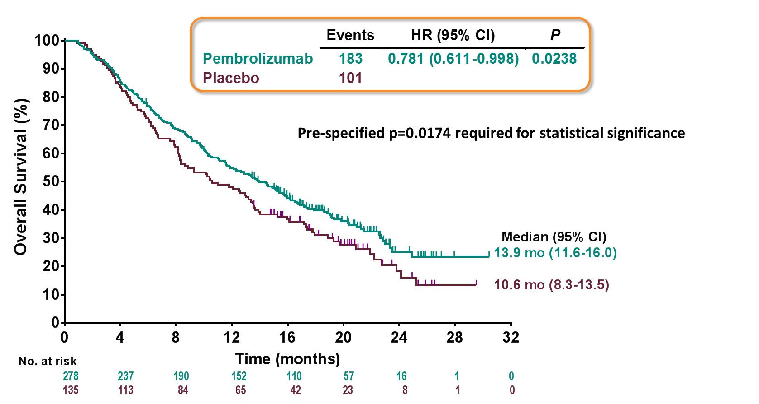
KEYNOTE 240 Phase III HCC in 2nd Line
Pembrolizumab vs Placebo: Overall Survival
Finn, R. ASCO, 2019

Slide 25
Ongoing/ Pending Data: Front-Line HCC Trials
Study | N | Randomization
LEAP-002 | 750 | Lenvatinib + Pembrolizumab Lenvatinib
IMbrave150 | 480 | Atezolizumab + Bevacizumab Sorafenib
HIMALAYA | 1,310 (1:1:1) | Durvalumab Durvalumab + Tremelimumab (2 dosing schedules) Sorafenib
COSMIC-312 | 640 (6:3:1) | Cabozantinib + Atezolizumab Sorafenib Cabozantinib
Adapted with thanks RTP

Slide 26
HCC Summary 2019
Front-line treatment
  TKI standard; if symptomatic/need response: lenvatinib > sorafenib
  Local therapies
Second-line treatment
  If good response to TKI – regorafenib
  Checkpoint inhibitor therapy nivolumab or pembrolizumab
Third-line treatment
  Ramucirumab (elevated AFP > 400 ng/ml)
  Cabozantinib

Slide 27
Pancreatic Cancer

Slide 28
Day in the Life: Pancreatic Cancer
65 M, FOLFIRINOX, He likes to talk about golf
63 M, FOLFIRI, He is very unkempt in his physical appearance, gentle in actions, thankful for all the care and attention he receives. Compliments all the nurses and practices his Spanish with anyone that will listen. He makes us all feel appreciated and loved, which touches my heart as he is so sick and battling an awful disease.
86 F, nab paclitaxel, hospice talk
43 F, FOLFIRINOX, Very active mother with horrible disease and tough treatment, faced all of it with such courage and strength she touched the lives of all that encountered her.

Slide 29
Day in the Life: Pancreatic Cancer
60 F, Gemcitabine and nab paclitaxel, Patient blames herself due to her smoking history. Very sad
67 F, FOLFIRI, weight loss
54 M, nab paclitaxel/gemcitabine, He is trying to work and continue to support his family
53 F, nab paclitaxel/gemcitabine, She has been battling pancreatic cancer for 3 years
68 F, Pancreatic cancer and Hodgkin lymphoma, FOLFIRI, The tumor is shrinking, patient knows she will have to continue chemotherapy

Slide 30
Metastatic Pancreatic Cancer, BRCA1 positive,
PARP inhibitor
66 yo female, BRCA 1 positive, with history of:
    L-sided breast cancer at 36 yo; s/p lumpectomy, adjuvant chemo/rads
    Ovarian cancer, at 41 yo; s/p TAH/BSO, adjuvant chemotherapy (BRCA 1 found)
    Presented with weight loss/poor glycemic control, found to have metastatic pancreatic cancer to liver
      Started on FOLFIRINOX, excellent overall tolerance, with continued response over 20 cycles, developed peripheral neuropathy (PN) slowly (worsening from cycle 15-20). CT showing continued response after 15 months of therapy, but due to worsening PN, switched to FOLFIRI

Slide 31
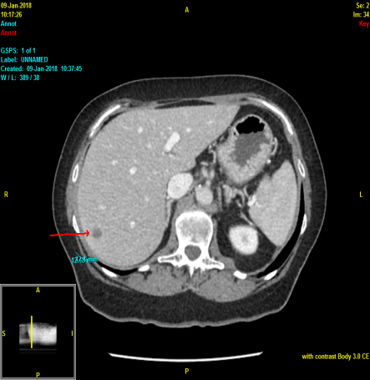
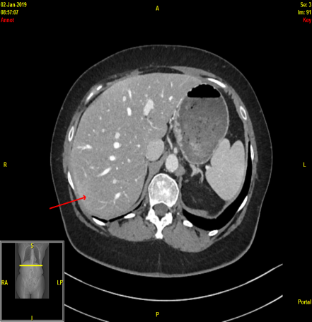
Baseline liver lesions
Scan after one year on FOLFIRINOX

Slide 32
      After two months on FOLFIRI, progression. Switched to gemcitabine/nab paclitaxel, with poor tolerance: elevated LFTs, significant bilateral LLE, anorexia, fatigue, n/v, increasing pain.
      CT showed progression with multiple new liver lesions, peritoneal disease.

Slide 33
After recovery, started on olaparib, 300 mg BID, PO.
    Developed shortness of breath, continued weight loss/anorexia, myelosuppression.
    Dose reduced to 200 mg BID, better tolerance.
    CT chest negative for pneumonitis, not yet checked for response.

Slide 34
Side Effect Teaching Points
PARP inhibitors main side effects:
    Weight loss/anorexia/change in taste
    Shortness of breath-keep careful watch to make sure not developing pneumonitis
    Myelosuppression-often many prior lines of therapy, keep careful watch on counts-weekly/biweekly count checks; reinforce neutropenic precautions, fever, bruising
    Fatigue/weakness
    Nausea/vomiting/diarrhea

Slide 35
Psychosocial Aspects
Multiple cancers, long response time with reasonable tolerance until last six months (almost three years on treatment for metastatic pancreatic cancer) but difficult time managing expectations on treatment’s effectiveness and dealing with end-of-life issues for herself/family
Difficulty accepting possibility of passing on BRCA gene to subsequent generations; children’s unwillingness to get genetic testing

Slide 36
Research To Practice: HCC & Pancreatic Cancer
11-09-2019 Nursing Symposium
Eileen M O’Reilly, MD
Winthrop Rockefeller Chair in Medical Oncology
Associate Director, David M Rubenstein Center Pancreas Research
Section Head, Hepatopancreaticobiliary & Neuroendocrine Cancers
Attending Physician, Member
Memorial Sloan Kettering Cancer Center
Professor of Medicine
Weill Cornell Medical College

Slide 37
Therapeutic Landscape for PDAC 2019
(adapted with thanks)
nab-Paclitaxel + Gemcitabine
Gemcitabine
Gemcitabine + Erlotinib
?Olaparib
gBRCA 1,2
5-FU/LV
FOLFIRINOX
Nal-IRI + 5FU/LV
1997 2007 2011 2013 2015 2017 2018 2019
S1 (Japan)
Pembrolizumab MSI-H/dMMR
Larotrectinib
NTRK fusions

Slide 38
Factors For Therapy Selection
Performance status, co-morbidities, age, organ function
Patient preferences
Comparative efficacy, toxicity, cost
Logistics
Treatment sequencing
Genomic context

Slide 39
Front-Line Metastatic Pancreas Cancer
FOLFIRINOX vs Gemcitabine
R
A
N
D
O
M
I
Z
E
FOLFIRINOX (N= 171)
Metastatic PDAC
ECOG 0-1
N= 342
Gemcitabine (N= 172)
Primary Endpoint: Overall Survival
Conroy, T. N Engl J Med, 2011

Slide 40
FOLFIRINOX (FFX) vs Gemcitabine
Overall Survival
 | FFX | Gem | HR, P
Response Rate | 32% | 9. % | <0.001
PFS, months | 6.4 | 3.3 | 0.47, <0.001
OS, months | 11.1 | 6.8 | 0.57, <0.001
1-Year OS | 48% | 21%
18-month OS | 19% | 6%
1
.
0
0
FOLFIRINOX
Gemcitabine
y
0
.
7
5
t
i
l
i
b
a
0
.
5
0
b
o
r
P
0
.
2
5
0
.
0
0
0
3
6
9
1
2
1
5
1
8
2
1
2
4
2
7
3
0
3
3
3
6
Number at risk
M
o
n
t
h
s
Gemcitabine
FOLFIRINOX
171 134 89 48 28 14 7 6 3 3 2 2 2
171 146 116 81 62 34 20 13 9 5 3 2 2
Conroy, T. NEJM, 2011

Slide 41
FOLFIRINOX vs Gemcitabine
Quality of Life
Time until definitive deterioration
EORTC-C30 global health status/QoL questionnaire
1.0
0.8
0.6
Deterioration (Probability)
0.4
Gemcitabine
FOLFIRINOX
P < 0.001
0.2
0
0
3
6
9
12
Months
Gourgou-Bourgade S, et al. J Clin Oncol. 2013

Slide 42
Front-Line Metastatic Pancreas Cancer
MPACT: Phase III Gem/Nab-P vs Gem
R
A
N
D
O
M
I
Z
E
Gemcitabine + Nab-Paclitaxel
(N= 431)
Metastatic PDAC
KPS 70- 100%
N= 861
Gemcitabine (N= 430)
Primary Endpoint: Overall Survival
Von Hoff, D. N Engl J Med, 2013

Slide 43
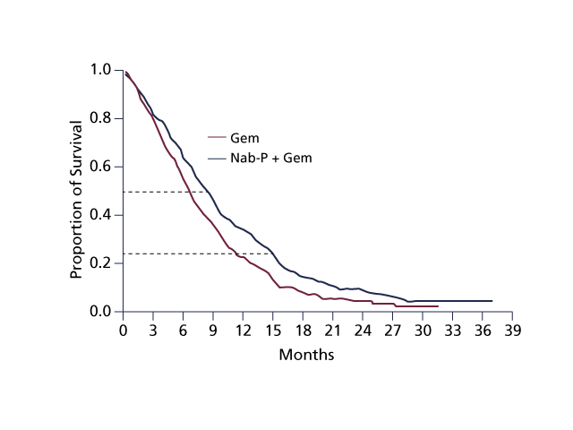
MPACT: Overall Survival Gem+nab-P vs Gem
 | Gem/nab-P | Gem | HR, P
RR | 23% | 7% | <0.001
PFS, months | 5.5 | 3.7 | 0.69, <0.001
OS, months | 8.5 | 6.7 | 0.72, <0.001
2-Year OS | 10% | 5%
42-month OS | 3% | -
Von Hoff, D. N Engl J Med, 2013

Slide 44
Adjuvant or Neoadjuvant Therapy Pancreas Cancer

Slide 45
Surgery First vs Neoadjuvant Therapy?
SUMMARY
Surgery First
Traditional paradigm
Significant % patients don’t receive
Early, frequent relapse
Systemic disease
Surgery is immune suppressive
Survival is changing
Neoadjuvant Therapy
Improved delivery of multimodality therapy
Early therapy for micro-metastases
Biology and time selection
↑R0, ↓lymph node positivity rates
Concern lost window for surgery?
Signal for improved outcome

Slide 46
Adjuvant mFOLFIRINOX vs Gemcitabine
R
A
N
D
O
M
I
Z
E
mFOLFIRINOX (N= 247)
Every 2 weeks; 12 cycles
Resected pancreas cancer
CA19-9 <180 U/mL
ECOG 0-1
N= 493
Gemcitabine (N= 246)
6 cycles
  Primary endpoint: Disease-Free Survival
  Secondary: Overall Survival
Conroy T, et al. NEJM, 2018

Slide 47
PRODIGE: Overall Survival
A: Gemcitabine
B: mFOLFIRINOX
Median overall survival:
mFOLFIRINOX 54.4 months
Gemcitabine 35 months
HR 0.64, p=0.003
Number at risk
A: Gemcitabine 246 233 215 171 120 81 55 33 18 9 4
B: mFOLFIRINOX 247 223 210 165 119 91 68 46 32 16 4

Slide 48
A021806 US Co-Operative Group Trial
R
A
N
D
O
M
I
Z
E
Surgery
Adjuvant
mFOLFIRINOX
x 12 cycles
Resectable Pancreatic Cancer
ECOG 0-1
Neoadjuvant
mFOLFIRINOX
x 8 cycles
Surgery
Adjuvant
mFOLFIRINOX x 4 cycles
  Primary endpoint: Overall survival
Ferrone, C, Chawla, A. Alliance/NCTN Opening 2020

Slide 49
Genomics & Treatment for Pancreas Cancer

Slide 50
Pancreas Cancer: NCCN Updated 2019
Tumor (somatic) profiling recommended for all locally advanced/metastatic patients who are candidates for anti-cancer therapy to identify uncommon actionable mutations
  Tissue testing preferred
  cfDNA back up if insufficient tumor
Germline testing recommended for all patients with PDAC
  Multigene panel

Slide 51
45-Year Old Male gBRCA1 PDAC:
Cisplatin-Gemcitabine
12/12/201x
Ca 19-9 9,858
CEA 19.8
06/02/201x
Ca 19-9 152
CEA 2.7

Slide 52
Phase III Maintenance (POLO):
Platinum Therapy → Olaparib/Placebo
R
A
N
D
O
M
I
Z
E
Olaparib 300 mg BID
Pancreas cancer
Germline BRCA1/2+
Platinum > 16 wks
ECOG 0-1
N= 145
Randomization 3: 2
Placebo 300 mg BID
  Primary endpoint: Progression-Free Survival
  N 3,500 screened
Golan, T. New Engl J Med, 2019

Slide 53
Primary Endpoint: PFS by Blinded Central Review
 | Olaparib N= 92 | Placebo N= 62
 | 7.4 months | 3.8 months
 | HR 0.53
 | p= 0.0038
>3.5 month difference
Doubled proportion who are progression-free at 6 and 12 months
1.0
0.9
0.8
0.7
0.6
Probability of PFS
0.5
0.4
0.3
0.2
Olaparib
0.1
Placebo
0.0
0
2
4
6
8
10
12
14
16
18
20
22
24
26
28
30
32
34
36
38
40
42
44
46
48
50
No. at risk
Time since randomization (months)
92
69
50
41
34
24
18
17
14
10
10
8
8
7
5
3
3
3
3
2
1
1
1
0
Olaparib
62
39
23
10
6
6
4
4
4
2
2
2
2
1
1
0
Placebo
Golan, T. New Engl J Med, 2019

Slide 54
Summary Pancreas 2019
Moving in direction of neoadjuvant therapy
For front-line therapy for advanced disease
  (m)FOLFIRINOX or gemcitabine/nab-paclitaxel
For second-line therapy
  Depends on first-line choice
  Nano-liposomal irinotecan/5-FU or FOLFOX
Remember germline and tumor (somatic) testing!
  For BRCA+: platinum drugs, PARP inhibitors

Slide 55
Special Issues in Oncology Care
Local therapy for hepatocellular carcinoma (eg, TACE); management of hepatic insufficiency

