Slide 1
Module 9:
HER2-Positive and
Triple-Negative Breast Cancer
Jamie Carroll, APRN, MSN, CNP
Hope S Rugo, MD

Slide 2
Disclosures for Ms Carroll
No financial interests or affiliations to disclose

Slide 3
Disclosures for Dr Rugo
Contracted Research | Daiichi Sankyo Inc, Eisai Inc, Genentech, Immunomedics Inc, Lilly, MacroGenics Inc, Merck, Novartis, OBI Pharma Inc, Odonate Therapeutics, Pfizer Inc, Seattle Genetics
Paid Travel | Amgen Inc, AstraZeneca Pharmaceuticals LP, Lilly, MacroGenics Inc, Merck, Mylan NV, Pfizer Inc, Puma Biotechnology Inc.

Slide 4
Day in the Life: HER2-Positive Breast Cancer
71 M, trastuzumab/paclitaxel, HER2-positive male breast cancer
70 F, erubulin, trastuzumab, loneliness
29 F, TCHP, mother of 3 under the age of 3 yrs
36 F, T-DM1, first treatment in her mid-twenties, highly anxious
55 F, trastuzumab maintenance, morbid obesity, insurance issues
62 F, pertuzumab/trastuzumab, level of education; lack of social support; perception that physician "looked down on her"
52 F, capecitabine and neratinib, brain mets
46 F, T-DM1, anxiety disorder
68 F, trastuzumab, a smile for everyone
46 F, trastuzumab/docetaxel, always with makeup

Slide 5
Day in the Life: Triple-Negative Breast Cancer
52 F, nab-paclitaxel + atezolizumab, acute onset DM from immunotherapy
40 F, nab-paclitaxel/atezolizumab, lump in breast detcted a year ago, but pt declined a biopsy and treated herself with dietary and supplemental modalities. Last month presented to ER with terrific back pain: triple-negative, BRACA1 as well as CHEK 2 Gene mutation, metastatic disease VERY reluctant to do chemotherapy, very suspicious of medicine, partially cultural I felt. Fearful and unsettled about dying
30 F, PARP inhibitor on clinical trial, Grade 3 drug toxicity
52 F, paclitaxel/carboplatin, very brave and family oriented
76 F, nab-paclitaxel/gemcitabine, full of southern charm and sass, quick witted

Slide 6
HER2-Positive Breast Cancer

Slide 7


Case 1-Horses or Zebras?
44-year-old woman presented with a self detected left breast mass. Grade 3, IDC, ER/PR positive, HER-2 positive by FISH.
She received TCHP. At time of surgery, she had a 6 mm residual of invasive cancer, negative nodes.
44-year-old woman presented with a self detected left breast mass. This was a grade 3, invasive ductal carcinoma, ER/PR positive, HER2 positive by FISH.
She received TCHP. At time of surgery, she had a 6 mm residual of invasive cancer, negative nodes.
Notes:
Per Katherine study, we put her on adjuvant TDM-1 x 14 cycles.

Slide 8
T-DM1
Assessment:
Fatigue
Nausea
Echo every 3 months
Musculoskeletal pain
Decreased counts
Increased liver enzymes
Notes:
TDM-1 is generally tolerated pretty well but it still can come with side effects.
Fatigue can occur which is unfortunate since most patients have fatigue with chemo and subsequent radiation.
By this time, most patients can manage nausea well.
Echocardiogram is checked every 3 months for the 2-3% reversible risk of cardiomyopathy
If experiencing musculoskeletal pain, trialing an anti-histamine such as Claritin has been beneficial
This patient is treated locally and comes to see me every 3 months for visits. At our last visit, she told me about a dry cough that had been occurring for the last few months. Nurse assessment kicks in and you think of all of the differentials that can cause her dry cough. I decided to get a CT chest.

Slide 9
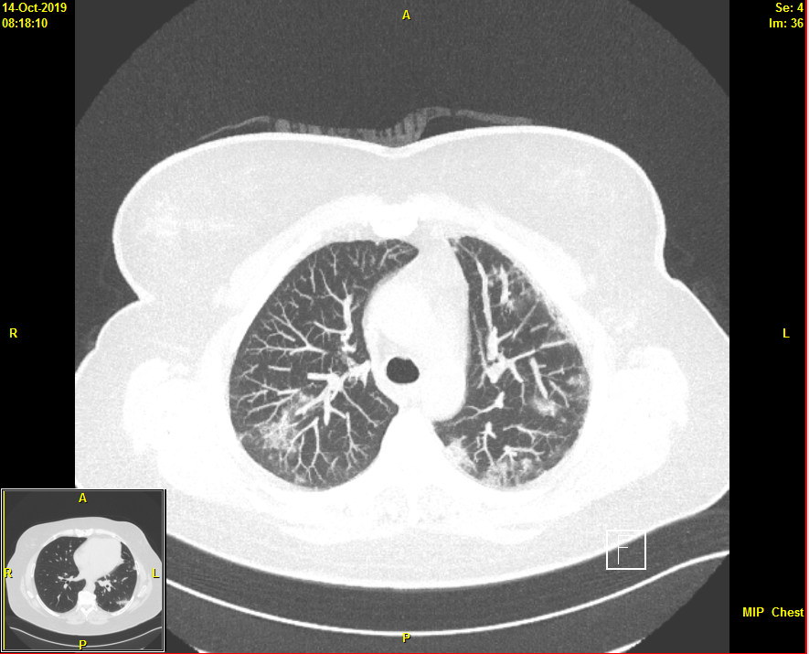
Notes:
This was the result. The lungs showed several areas of consolidation most consistent with drug reaction. We are stopping any further TDM-1 and will re-image in 2 months. Thankfully, she only had one infusion remaining. She will continue with Tamoxifen and monthly Zoladex.

Slide 10

Module 9: HER2-Positive and Triple-Negative Breast Cancer (BC)
Hope S. Rugo, MD
Professor of Medicine
Director of Breast Oncology and Clinical Trials Education
University of California San Francisco

Slide 11
HER2+ Breast Cancer 2019
About 20% of breast cancers are HER2+
  About half ER+ and half ER-
There is still controversy about testing!
Most women with early stage HER2+ breast cancer will be cured of their disease
  Understanding subsets is increasingly important
  We are over treating at least a subset of patients
    Learning to de-escalate therapy is a new challenge
Treatment based on response is a new standard
  Neoadjuvant therapy offers the option to change outcome by varying treatment based on response
  Precision medicine for HER2+ disease
Resistance is still a problem
  Effective new agents are on the horizon!

Slide 12
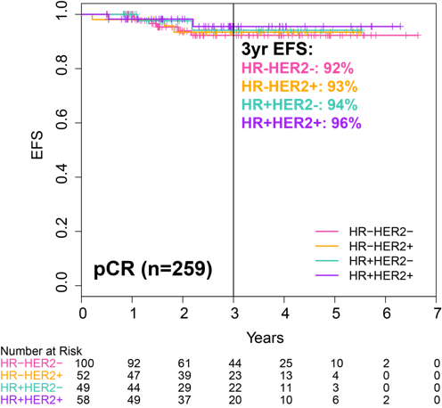
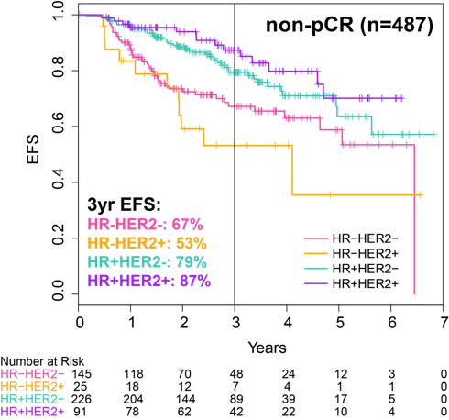
Event Free Survival by pCR & non-pCR by Subtype
Pathologic Complete Response is a Great Early Endpoint
Yee et al., SABCS 2018
Notes:
In this KM curves, the groups are shown together. Patients achieving a pCR had similar excellent freedom from an event. Those patients deemed non-PCR had clearly worse outcome with some variation in risk. The HR+ subgroup appears to have more favorable outcomes when measured by 3 year EFS, but this is clearly inferior to the group of patients who achieved pCR.

Slide 13
KATHERINE (NSABP B50, GBG 77)
Phase III Study of T-DM1 vs Trastuzumab as Adjuvant Therapy in Pts with HER2+ EBC with Residual Invasive Disease after NAC and HER2-Targeted Therapy Including Trastuzumab
cT1-4/N0-3/M0 at presentation (cT1a-b/N0 excluded)
Centrally confirmed HER2-positive breast cancer
Neoadjuvant therapy must have consisted of
  Minimum of 6 cycles of chemotherapy
    Minimum of 9 weeks of taxane
    Anthracyclines and alkylating agents allowed
    All chemotherapy prior to surgery
  Minimum of 9 weeks of trastuzumab
    Second HER2-targeted agent allowed
Residual invasive tumor in breast or axillary nodes
Randomization within 12 weeks of surgery
T-DM1
3.6 mg/kg IV Q3W
14 cycles
R
1:1
N=1486
Trastuzumab
6 mg/kg IV Q3W
14 cycles
Radiation and endocrine therapy per protocol and local guidelines
Primary endpoint: IDFS (70 to 76.5%), boundary HR<.732, p<.0124
First interim OS analysis to be done at interim IDFS if boundary crossed
Demographics
72% ER+
18% received pertuzumab
~53% node negative
Geyer et al, SABCS 2018; von Minckwitz et al, NEJM 2018

Slide 14
Invasive Disease-Free Survival
First IDFS Events
2% (trastuzumab) vs 18% (T-DM1) discontinued due to adverse events
Overall well tolerated: thrombocytopenia and peripheral neuropathy higher with T-DM1

Slide 15
KATHERINE Summary and Conclusions
T-DM1 demonstrated a statistically significant and clinically meaningful improvement in IDFS compared with trastuzumab
  Unstratified HR=0.50; 95% CI 0.39–0.64; P<0.0001
  3-year IDFS increased from 77.0% to 88.3% (difference=11.3%)
The IDFS benefit was consistent across all key subgroups including HR status, extent of residual invasive disease, and single or dual HER2-targeted neoadjuvant therapy
Additional follow-up will be necessary to evaluate the effect of T-DM1 on OS
The Standard of Care Has Changed:
T-DM1 should be recommended to the majority
of patients with residual disease after a taxane-based
neoadjuvant regimen
Neoadjuvant therapy is preferred for patients with >T2 or N+ HER2+ breast cancer

Slide 16
Brain Metastases:
Differences in Clinical Behavior by Tumor Subtype
Clinical Features | HER2+ | TNBC
Timing of CNS Relapse | Continuous over time | Tends to be early
Control of extracranial disease at time of CNS relapse | Frequent | Uncommon
Median OS from time of CNS relapse | ~2 years | ~6 months
Cause of death in pts with CNS involvement | Up to 50% due to CNS PD | Rarely due to CNS PD alone

Slide 17
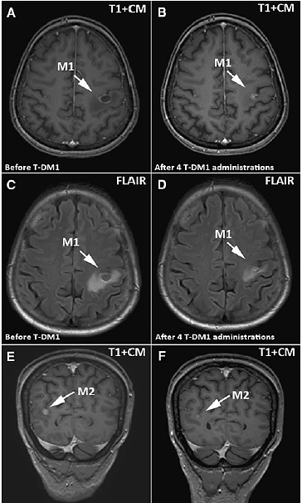
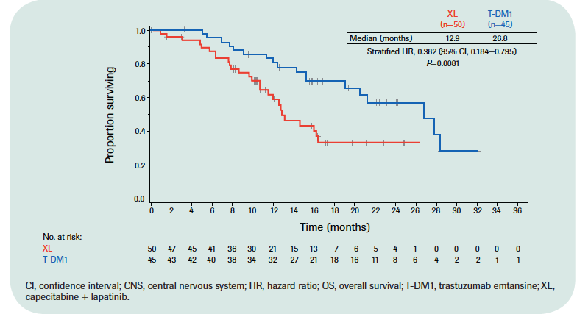
EMILIA and Case Series: CNS response with T-DM1
EMILIA Trial
Results:
PFS in pts with CNS mets at baseline
  50 v 45 pts
  12.9 vs 26.8 mo
    P=.0081 (HR .382)
Median brain metastasis free survival 11 mo.
    PR: 44.4%
    SD: 22.2%
Pre-T-DM1
Post-T-DM1
Bartsch et al, J Neurooncol 2014; Krop et al.

Slide 18
HER2-Directed Tyrosine Kinase Inhibitors:
Activity in the CNS
Agent | Target | Phase of Development | CNS ORR (Monotherapy) | CNS ORR in combination with capecitabine
Lapatinib | HER1/HER2 | FDA Approved | 6%¹ | 20%², 66%³
Neratinib | HER1/HER2/HER4 | FDA Approved (Adjuvant) Phase 3 (Metastatic) | 8%⁴ | 49%⁵
Additional notes: ⁸Neratinib plus paclitaxel delayed time to CNS metastases ⁹Phase III NALA trial: Delayed time to intervention with neratinib/capecitabine vs lapatinib capecitabine
Tucatinib | HER2 | Phase 3 | 5-9%⁶ (+ trastuzumab) | 42%⁷ (+trastuzumab) ¹
¹Lin et al, CCR 2009, ²Lin et al, CCR 2009, ³Bachelot et al, Lancet Oncol 2013, ⁴Freedman et al, JCO 2016, ⁵Freedman et al, JCO 2019, ⁶Metzger et al, SABCS 2016, ⁷Hamilton et al, SABCS 2016, ⁸Awaada et al, JAMA Oncol 2016, ⁹Saura et al, JCO 2019
Notes:
HER2 directed tyrosine kinase inhibitors have a lower molecular weight compared to monoclonal antibodies, allowing them more efficacious penetration through the blood brain barrier and are presently considered the most effective class of compounds for the treatment of HER2 brain metastases
These agents have been studied alone or in combination with capecitabine and studies demonstrate low response rates as monotherapy, but response rates of almost 50% in combination with capecitabine

Slide 19
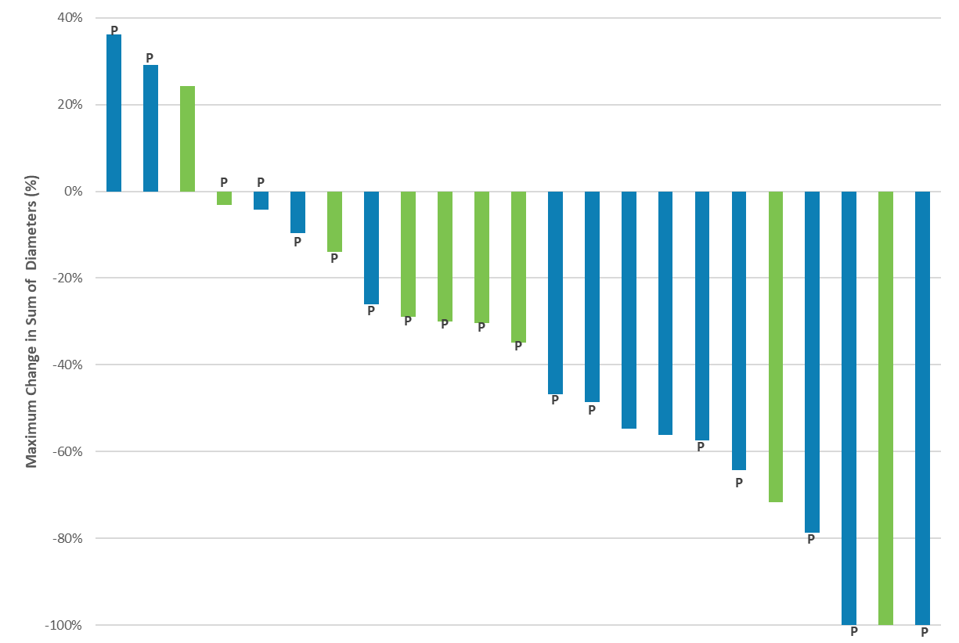
ONT-380-005: Response in Patients With Measurable Disease in Triplet Cohort
ORR: 14/23 (61%)¹
Median duration of response: 11 months (95% CI: 2.9⎯18.6)¹
Tucatinib + capecitabine + trastuzumab (N=23)²
-30%
Without brain metastases (n=14)
With brain metastases (n=9)
Bars represent change in measurable lesions; four patients in the triplet cohort had
non-measurable lesions only and are not represented on the waterfall.
P = Prior pertuzumab treatment (n=18)
ORR = objective response rate.
1. Murthy R, et al. Lancet Oncol 2018;19:880–8; 2. Hamilton E, et al. Proceedings of the San Antonio Breast Cancer Symposium 2016:abstr. P4-21-01.

Slide 20
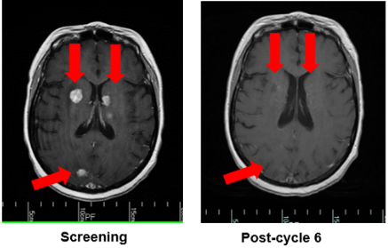
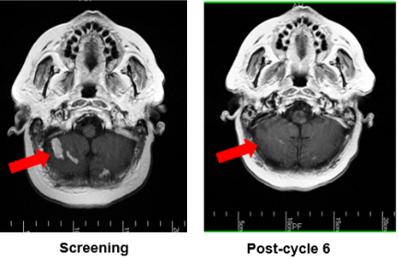
ONT-380-005: Triplet Combination Cohort
Durable Response in Progressing Brain Metastases After Prior Local Therapy
HER2CLIMB: Positive Results!
Study treatment | Tucatinib + capecitabine + trastuzumab
Patient history | Metastatic disease: chest, lymph nodes, bone and brain Progression: taxane/Herceptin, pertuzumab, T-DM1, lapatinib WBRT 21 months prior to study entry Progression on lapatinib + cabazitaxel in 4 months immediately prior to study enrolment Entered study December 2014
Disposition | After six cycles: 55% reduction in CNS lesions Durable partial response; active on therapy after 936 days of treatment as of 20/9/17
10.21.19 Press release:
Overall efficacy
PFS superior with tucatinib: HR 0.54, P<0.00001
OS superior with tucatinib: HR 0.66, P=0.0048
47% had brain metastases at baseline:
PFS superior with tucatinib: HR 0.48, P<0.00001
Safety:
Grade >3 diarrhea: 12.9v 8.6%
Slight increase in grade 3 ALT, AST, bilirubin
No need for prophylactic anti-diarrheal medications
CNS = central nervous system; T-DM1 = ado-trastuzumab emtansine; WBRT = whole brain radiation therapy.
Murthy RK, et al. Presented at ASCO June 01-05 2018, Chicago, IL; abstract 1015;

Slide 21
Brain Metastases in HER2+ MBC
May occur at any time during metastatic course
Median survival less than two years from diagnosis, death from refractory brain metastases not uncommon in this patient subgroup
New treatments may provide better treatment options
  Hopefully will translate into more effective prevention in the future
Agents with efficacy in HER2+ brain metastases
  T-DM1
  Capecitabine plus oral tyrosine kinase inhibitors of HER2/EGFR (HER1)
    Lapatinib
    Neratinib
    Tucatinib: new press release, data at SABCS!

Slide 22
Triple-Negative Breast Cancer

Slide 23

Case 4
Notes:
This is my next patient. This is Heidi. She is a mother or two and grandmother of two, Will and Sophie. Heidi was diagnosed in June of 2017 with de novo metastatic triple negative breast cancer. The most important thing to Heidi is the relationship with her kids and her faith. She has used her breast cancer as a vehicle to encourage others in her community to undergo mammography. She also now swims every day and we are working on smoking cessation. Baby steps..

Slide 24
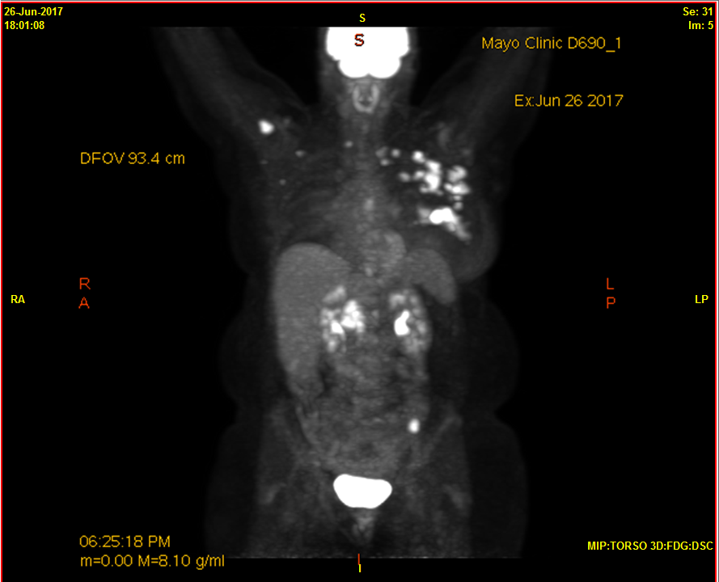
Notes:
Initial staging PET scan. Left breast enlarged, thickened skin, multiple lymph nodes in axilla, supraclavicular and even on right side.

Slide 25
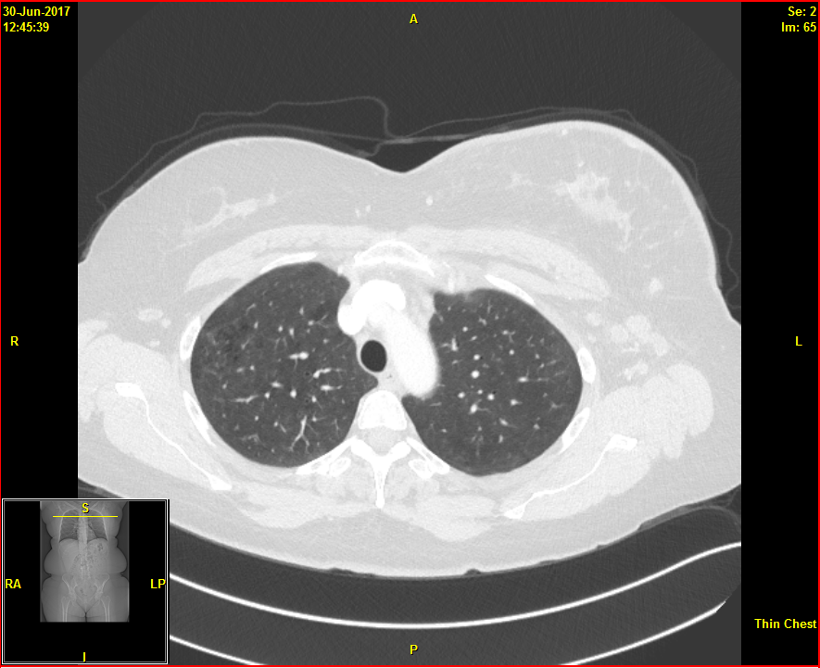
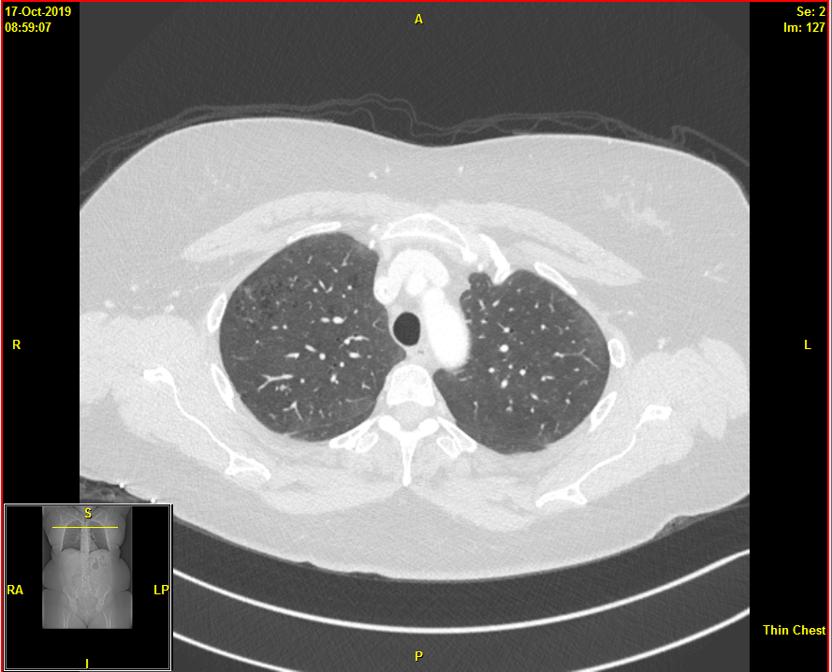
Notes:
This is her original CT chest. Left breast has densities, skin is thickened and she has multiple enlarged left axillary lymph nodes.
Most recent CT chest shows that she has no enlarged left axillary nodes, breast is similar in size to right and skin is symmetric.

Slide 26
Olaparib
Assessment:
Anemia/leukopenia/neutropenia
Nausea
Diarrhea
Fatigue
Headache
Notes:
Overall, I’ve seen that patients tolerate PARP inhibitors well.
Decrease in hematologic values with anemia being most prevalent.
Most patients do well with the nausea that they present with if taking anti-emetic
37% noted fatigue on OlympiAD trial. For Heidi, she decided her therapy after diagnosis was to remodel her house. This is how she combated fatigue.

Slide 27
Module 9: HER2-Positive and Triple-Negative Breast Cancer (BC)
Hope S. Rugo, MD
Professor of Medicine
Director of Breast Oncology and Clinical Trials Education
University of California San Francisco

Slide 28
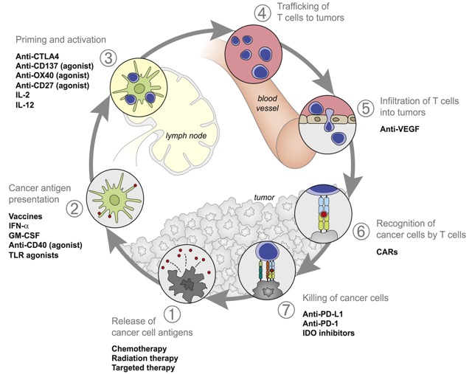
Augmenting the Cancer Immunity Cycle
Chen DS and Mellman I. Immunity 2013;39:1-9

Slide 29
IMpassion130 study design
Key IMpassion130 eligibility criteriaª:
Metastatic or inoperable locally advanced TNBC
  Histologically documented^{b}
No prior therapy for advanced TNBC
  Prior chemo in the curative setting, including taxanes, allowed if TFI ≥ 12 mo
ECOG PS 0-1
Stratification factors:
Prior taxane use (yes vs no)
Liver metastases (yes vs no)
PD-L1 status on IC (positive [≥ 1%] vs negative [< 1%])^{c}
Atezo + nab-P arm:
Atezolizumab 840 mg IV
  On days 1 and 15 of 28-day cycle
+ nab-paclitaxel 100 mg/m² IV
  On days 1, 8 and 15 of 28-day cycle
R
^{1:1}
RECIST v1.1 PD or toxicity
Double blind; no crossover permitted
Plac + nab-P arm:
Placebo IV
  On days 1 and 15 of 28-day cycle
+ nab-paclitaxel 100 mg/m² IV
  On days 1, 8 and 15 of 28-day cycle
Co-primary endpoints were PFS and OS in the ITT and PD-L1+ populations^{d}
  Key secondary efficacy endpoints (ORR and DOR) and safety were also evaluated

Slide 30
PD-L1 IC status by SP142 predicts PFS and OS benefit with atezolizumab + nab-paclitaxel^{1,2}
(41% positive by SP142)
Population | Median PFS |  | HR (95% CI)
 | A + nP | P + nP
PD-L1 IC+ (41%) | 7.5 mo | 5.3 mo | 0.63 (0.50, 0.80)
PD-L1 IC- (59%) | 5.6 mo | 5.6 mo | 0.93 (0.77, 1.11)
Population | Median OS |  | HR (95% CI)
 | A + nP | P + nP
PD-L1 IC+ | 25.0 mo | 18.0 mo | 0.71 (0.54, 0.93)
PD-L1 IC- | 19.7 mo | 19.6 mo | 0.97 (0.78, 1.20)
100
90
80
70
60
50
40
30
20
10
0
100
90
80
70
60
50
40
30
20
10
0
Difference in PD-L1+
2.2 months
Progression-Free Survival (%)
Overall Survival (%)
Difference in PD-L1+
7 months
0 | 3 | 6 | 9 | 12 | 15 | 18 | 21 | 24 | 27 | 30 | 33 | 36 | 39 | 42
0 | 3 | 6 | 9 | 12 | 15 | 18 | 21 | 24 | 27 | 30 | 33 | 36 | 39 | 42
Months
Months
A + nP | (IC+, n = 185)
P + nP | (IC+, n = 184)
A + nP | (IC-, n = 266)
P + nP | (IC-, n = 267)
A + nP, atezolizumab + nab-paclitaxel; HR, hazard ratio; ITT, intention to treat; OS, overall survival; P + nP, placebo + nab-paclitaxel; PFS, progression-free survival.
PD-L1 IC+: PD-L1 in ≥ 1% of IC as percentage of tumour area assessed with the VENTANA SP142 assay.
NCT02425891. Stratification factors: prior taxane use, liver metastases and PD-L1 IC status. Co-primary endpoints in ITT and PD-L1 IC+: PFS and OS.
Clinical cutoff date: 2 January 2019.
1. Schmid, ASCO 2019. 2. Schmid et al., submitted.

Slide 31
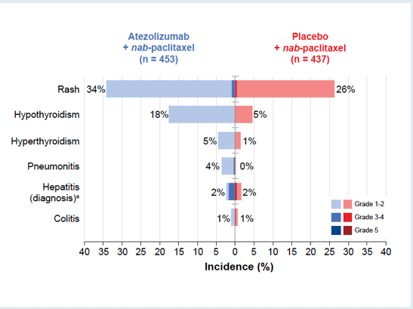
Immune-Related Adverse Events
Immune-Mediated AESI Requiring Systemic Corticosteroids
Most Clinically Relevant AESI by Grade
AESI = adverse event of special interest
Schneeweiss, Rugo et al, ASCO 2019

Slide 32
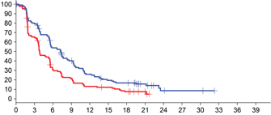
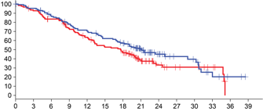
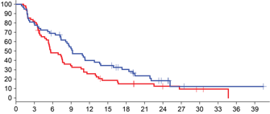
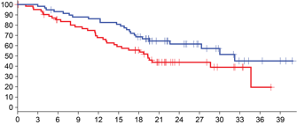
PD-L1 status in Primary vs Metastatic Tissues
 | Efficacy in PD-L1 IC+
 | PFS | OS
Primary
Metastatic
PD-L1 status by
primary vs metastatic tissueª
HR, 0.61 (95% CI: 0.47, 0.81)
HR, 0.79 (95% CI: 0.57, 1.09)
P = 0.014
Survival (%)
Survival (%)
PD-L1 IC+
Months
Months
PD-L1 status by anatomical locationª
HR, 0.69 (95% CI: 0.46, 1.03)
HR, 0.55 (95% CI: 0.32, 0.93)
Survival (%)
Survival (%)
Months
Months
Atezolizumab + nab-paclitaxel
Placebo + nab-paclitaxel
Median time of sample collection to randomization: 61 days
PD-L1 IC+
ª Evaluable population (n = 901). PD-L1 IC+: PD-L1 in ≥ 1% of IC as percentage of tumour area assessed with the VENTANA SP142 assay.
HRs adjusted for prior taxanes, presence of liver metastases, age and ECOG PS. No major differences were observed for clinical benefit in samples collected within 61 days of randomization or beyond that period (Emens, et al, manuscript in preparation).

Slide 33
Checkpoint Inhibitors for Metastatic TNBC
The addition of atezolizumab to nab-paclitaxel
  Improves survival MORE than PFS in patients with PD-L1 immune cell positive TNBC
  41% of patients had PD-L1 IC+ disease using SP142 assay
  Other assays are not as predictive, more patients tumors test positive
  Is generally well tolerated; must be aware of immune toxicity!
  Testing can be done on breast or metastatic tumor tissue
New directions
  Data from combinations with atezolizumab or pembrolizumab with paclitaxel, gemcitabine and carboplatin, capecitabine are expected next year
  Early stage disease!

Slide 34

BRCA Mutations: Germline vs Somatic
BRCA1 and BRCA2 are genes that produce tumor suppressor proteins involved in DNA repair^{1,2}
  Alteration or mutation to either gene may lead to improper repair of DNA damage, which can lead to development of certain types of cancer, including breast cancer
Germline (inherited) variants: mutation occurs in the parental egg or sperm^{1,3}
Somatic (acquired) variants:
mutation occurs in the tumor³
Heritable
Carried in every cell in the body
Nonheritable, acquired
Only tumor cells carry the mutation
Caused by DNA errors or outside exposures
BRCA=breast cancer susceptibility gene.
1. National Cancer Institute. BRCA mutations: cancer risk and genetic testing [Internet]. 2018 Jan 30 [cited 2018 Dec 13]. Available from: https://www.cancer.gov/about-cancer/causes-prevention/genetics/brca-fact-sheet#q1. 2. Levin B, et al. Mol Med. 2012 Dec 6;18:1327-37. 3. NIH US National Library of Medicine. What is a gene mutation and how do mutations occur? [Internet] Updated 2019 Jul 16 [cited 2018 Dec 13]. Available from: https://ghr.nlm.nih.gov/primer/mutationsanddisorders/genemutation.
Notes:
NCI/p1/para1
Levin/2012/p1327/col1/para1
NCI/p1/para3
NIH/p1/para2/bullet1
NIH/p1/para2/bullet2

Slide 35
Epidemiology of gBRCA Mutations
Female breast cancer
  ~3%–6% of all breast cancer patients¹⁻⁴
  2.7%–4.3% among MBC patients^{1,2}
  9.3%–15.4% in TNBC⁵⁻⁷
Male breast cancer
  16% of all male breast cancers⁸
Hereditary breast cancer
  ~25% of hereditary breast cancers⁹
Lifetime risks of breast cancer by age 70
  ~57% for BRCA1 mutation carriers; ~49% for BRCA2 mutation carriers
Younger age at diagnosis
Individuals with gBRCA mutations are diagnosed with breast cancer ~20 years younger than the overall breast cancer population¹⁰
Women with gBRCA mutations are more likely to develop a second breast cancer¹¹
BRCA=breast cancer susceptibility gene; MBC=metastatic breast cancer; TNBC=triple-negative breast cancer.
1. Meynard G, et al. Ann Oncol. 2017;28(suppl 5):v74-v108. 2. Fasching PA, et al. Abstract PD1-02. SABCS 2017. 3. Tung N, et al. J Clin Oncol. 2016 May 1;34(13):1460-8. 4. Nelson HD, et al. Risk assessment, genetic counseling, and genetic testing for BRCA-related cancer: systematic review to update the U.S. Preventive Services Task Force recommendation. Evidence Synthesis No. 101. Rockville, MD: Agency for Healthcare Research and Quality; 2013. AHRQ Publication No. 12-05164-EF-1. 5. Wong-Brown MW, et al. Breast Cancer Res Treat. 2015 Feb;150(1):71-80. 6. Couch FJ, et al. J Clin Oncol. 2015 Feb;33(4):304-11. 7. Sharma P, et al. Breast Cancer Res Treat. 2014 Jun;145(3):707-14. 8. Giordano SH. N Engl J Med. 2018 Jun 14;378(24):2311-20. 9. Arpino G, et al. BMC Cancer. 2016 Nov 29;16(1):924. 10. Kim R, et al. Poster P5-08-28. SABCS 2016. 11. Godet I, Gilkes DM. Integr Cancer Sci Ther. 2017 Feb;4(1). doi:10.15761/ICST.1000228.
Notes:
Meynard/2017/abst/p1/para2 (Results)
Fasching/abst PD1-02/2017/p1/col2/figure1;col3/para1
Calculation:
((20+43)/1462)*100=4.3
Tung/p1462/col1/para5
Nelson/p30/para1
Meynard/2017/abst/p1/para2
Fasching/abst PD1-02/2017/p1/col2/figure1;col3/para1
Calculation:
((20+43)/1462)*100=4.3
Wong/2015/p77/col2/para3-p78/col1/ para1
Couch/2015/p306/col1/para4-col2/ para1
Calculation:
((155+49)/1824)*100=11.2%
Sharma/2014/p4/para1; p6/para4
Giordano/2018/p2311/para3
Arpino/2016/p1/col1/para1
Kim/2016/abst p5-08-28/ p1/col4/conclusion/bullet1
Godet/2017/p7/para4

Slide 36

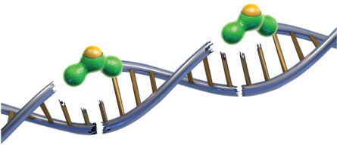
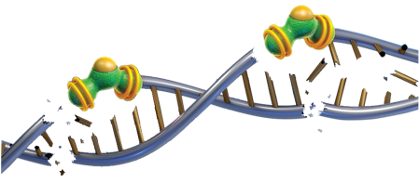
PARP Inhibition
PARPi are inhibitors of PARP enzymes, including PARP1 and PARP2, which play a role in DNA repair
  PARP inhibitor-induced cytotoxicity resulted in DNA damage, cell apoptosis and/or death
In vitro studies with cancer cell lines that harbored defects in DNA repair genes, including BRCA1 and BRCA2, have shown that talazoparib-induced cytotoxicity may involve:
Inhibition of PARP enzymatic activity and the subsequent recruitment of DNA repair proteins
Increased formation
of PARP-DNA complexes
PARP Inhibitor
DNA Repair
Proteins
Trapped PARP-
DNA Complex
PARP
BRCA=breast cancer susceptibility gene; PARP=poly (ADP-ribose) polymerase.
Livraghi L, Garber JE. BMC Med. 2015 Aug 13;13:188.
Notes:
TALZENNA/SmPC/p9/para5
Livraghi/2015/p2/col1/para3-col2/para1

Slide 37
PARP Inhibitors in the Clinic
Two approved PARP inhibitors for metastatic HER2 neg breast cancer with germline BRCA mutations
  Olaparib
  Talazoparib
Both drugs doubled response rate, and almost doubled progression free survival
Olaparib: no difference in overall survival in the trial population
  Subset analysis suggested possible improved OS in first-line
Toxicities
  Anemia, nausea, headache, thrombocytopenia
Next steps
  Metastatic
    Combinations with chemotherapy, immunotherapy
    Maintenance therapy after induction chemotherapy
  Adjuvant and neoadjuvant therapy

Slide 38
Special Issues in Oncology Care
Issues in the treatment of younger women
(fertility, therapy during pregnancy)
Use of scalp cooling caps

