Slide 1
Module 1:
Colorectal and Gastric Cancer

Slide 2
 | Percent with Patients | Number of Patients (Median)
Metastatic colorectal cancer | 100 | 13
Metastatic pancreatic cancer | 100 | 4
Metastatic gastric cancer | 96 | 2
Metastatic esophageal cancer | 92 | 2
Localized pancreatic cancer (resectable or borderline-resectable) | 88 | 2
Metastatic hepatocellular cancer | 71 | 2
Survey of general medical oncologists, February 2020

Slide 3
Detection, work up, and treatment of msi-H mcrc
Johanna Bendell, MD
Chief Development Officer
Director, Drug Development Unit Nashville
Sarah Cannon Research Institute
Tennessee Oncology
Nashville, Tennessee

Slide 4
Disclosures
Consulting Agreements | Agios Pharmaceuticals Inc, Amgen Inc, Apexigen, Arch Oncology, ARMO BioSciences, Array BioPharma Inc, AstraZeneca Pharmaceuticals LP, Bayer HealthCare Pharmaceuticals, BeiGene, Boehringer Ingelheim Pharmaceuticals Inc, Bristol-Myers Squibb Company, Celgene Corporation, Continuum Clinical, Cyteir Therapeutics, Daiichi Sankyo Inc, Five Prime Therapeutics Inc, FORMA Therapeutics, Genentech, a member of the Roche Group, Gilead Sciences Inc, GlaxoSmithKline, Incyte Corporation, Innate Pharma, Ipsen Biopharmaceuticals Inc, Janssen Biotech Inc, Leap Therapeutics Inc, Lilly, MacroGenics Inc, Merck, Merrimack Pharmaceuticals Inc, Moderna Inc, Molecular Partners, Novartis, OncoGenex Pharmaceuticals Inc, OncoMed Pharmaceuticals Inc, Pfizer Inc, PhoenixBio, Prelude Therapeutics, Roche Laboratories Inc, Sanofi Genzyme, Seattle Genetics, Taiho Oncology Inc, Tanabe Research Laboratories, TG Therapeutics Inc, Tizona Therapeutics Inc, Tolero Pharmaceuticals, Torque Therapeutics, Translational Drug Development
Contracted Research | AbbVie Inc, Acerta Pharma — A member of the AstraZeneca Group, ADC Therapeutics SA, Agios Pharmaceuticals Inc, Amgen Inc, Apexigen, Arch Oncology, Arcus Biosciences, ARMO BioSciences, Array BioPharma Inc, Arrys Therapeutics, a wholly owned subsidiary of Kyn Therapeutics, AstraZeneca Pharmaceuticals LP, Bayer HealthCare Pharmaceuticals, Bellicum Pharmaceuticals Inc, Blueprint Medicines, Boehringer Ingelheim Pharmaceuticals Inc, Boston Biomedical Inc, Bristol-Myers Squibb Company, Calithera Biosciences, Celgene Corporation, Celldex Therapeutics, CytomX Therapeutics, Daiichi Sankyo Inc, eFFECTOR Therapeutics Inc, Eisai Inc, EMD Serono Inc, Evelo Biosciences Inc, Five Prime Therapeutics Inc, FORMA Therapeutics, Forty Seven Inc, Genentech, a member of the Roche Group, Gilead Sciences Inc, GlaxoSmithKline, Gossamer Bio, Harpoon Therapeutics, ImClone Systems, a wholly owned subsidiary of Eli Lilly and Company, Incyte Corporation, Innate Pharma, Ipsen Biopharmaceuticals Inc, Jacobio Pharmaceuticals Co Ltd, Kolltan Pharmaceuticals Inc, Leap Therapeutics Inc, Lilly, MacroGenics Inc, MEI Pharma Inc, Merck, Merrimack Pharmaceuticals Inc, Mersana Therapeutics, Merus BV, Nektar, Novartis, Novocure, OncoGenex Pharmaceuticals Inc, OncoMed Pharmaceuticals Inc, Onyx Pharmaceuticals, an Amgen subsidiary, Pfizer Inc, Pieris Pharmaceuticals Inc, Prelude Therapeutics, Rgenix, Roche Laboratories Inc, Sanofi Genzyme, Seattle Genetics, Shattuck Labs, Sierra Oncology, SynDevRx Inc, Taiho Oncology Inc, Takeda Oncology, Tarveda Therapeutics, Tempest Therapeutics Inc, TG Therapeutics Inc, TRACON Pharmaceuticals Inc, Tyrogenex Inc, Unum Therapeutics, Vyriad
Data and Safety Monitoring Board/Committee | Five Prime Therapeutics Inc

Slide 5
Case
49 yo man who presented with abdominal pain, fever, and night sweats.
CT scan revealed a mass in the right lower quadrant.
R hemicolectomy was performed and pathology showed a T3 N0 M0 high grade adenocarcinoma that was KRAS mutated, dMMR. Germline testing confirmed Lynch syndrome.
No adjuvant therapy was given.
3 years later surveillance CT showed 2 peritoneal masses. Biopsy of one of the masses confirmed recurrent colon adenocarcinoma.
He was started on FOLFOX-bevacizumab to which he had a PR but had progressive disease 10 months later.
What immunotherapy treatment option would you choose for this patient?
  A – Nivolumab
  B – Pembrolizumab
  C – Atezolizumab
  D – Nivolumab plus ipilimumab

Slide 6
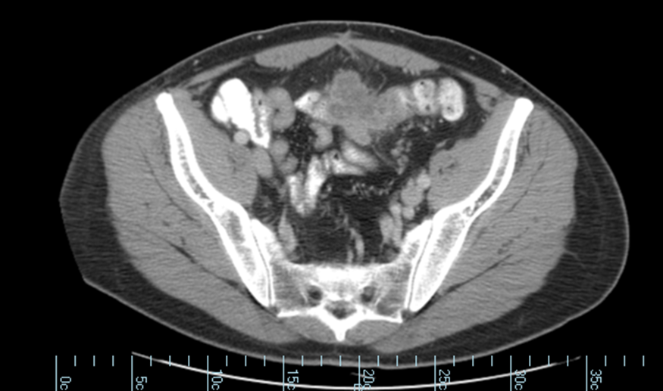
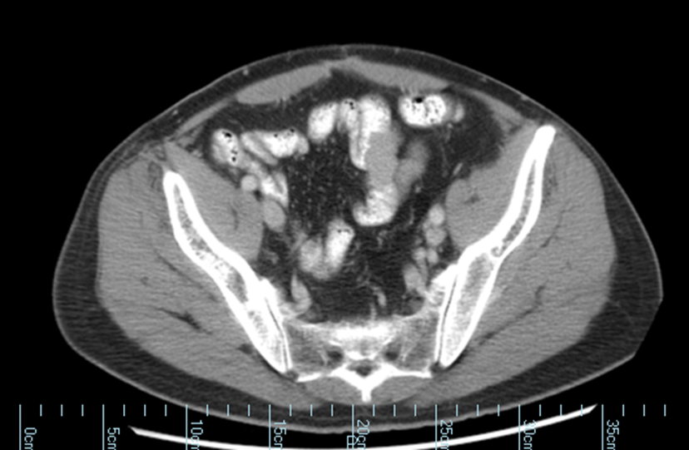
56 yo man with Lynch syndrome and mCRC, treated with pembrolizumab
He remains on pembrolizumab 5 years later in a PR.

Slide 7
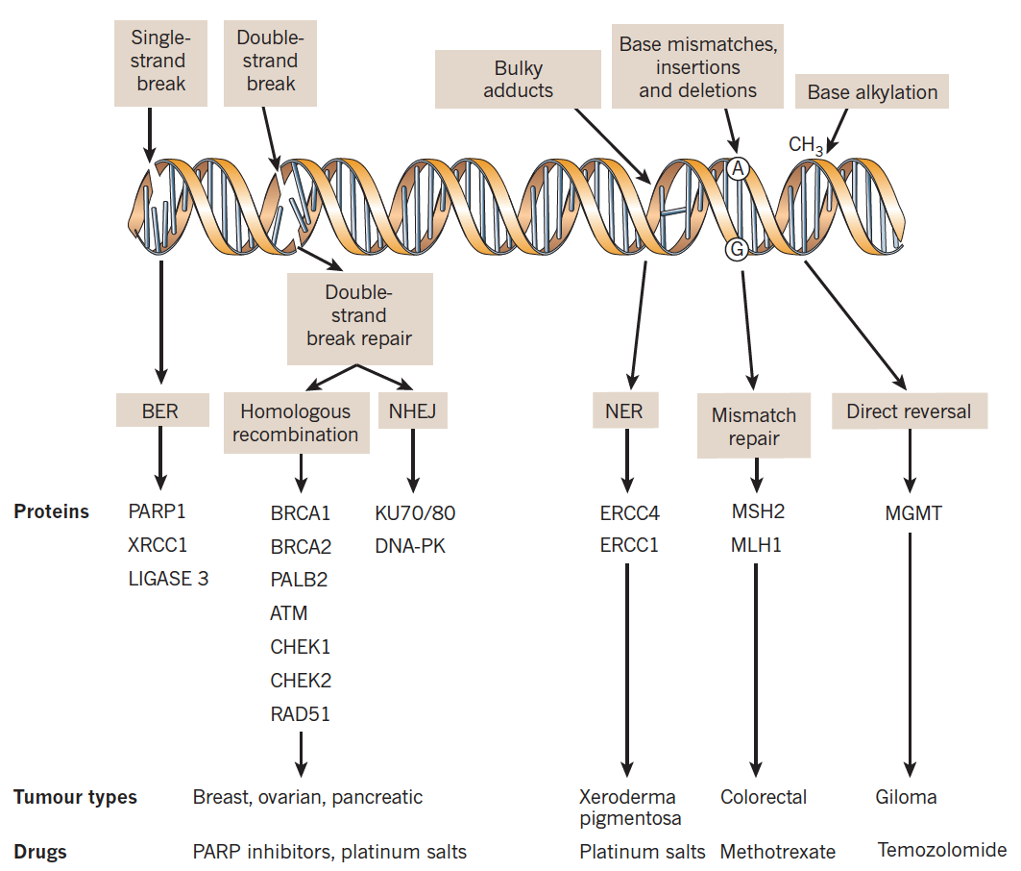
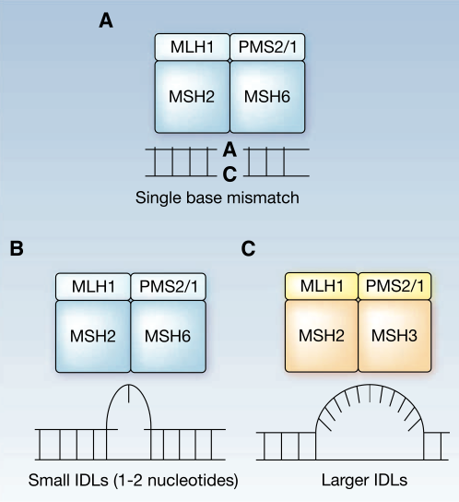
DNA Repair Mechanisms
There are multiple DNA repair pathways; their use is mostly determined by the type of DNA lesion¹
Stage Distribution
Stage | MSI-H
II | 22%
III | 12%
IV | 3.5%
MMR deficiency leads to accumulation of high numbers of mutations²
  Preferentially occurs in microsatellites
MMR deficiency occurs due to:²
  Lynch syndrome: 3%
  Sporadic mutations: 12%
Tumor types
Glioma
MSI-H, microsatellite instability-high; MMR, mismatch repair.
1. Lord CJ, et al. Nat Rev. 2012;481:287-294. 2. Kloor M, et al. Trends Cancer. 2016;2:121-133.

Slide 8
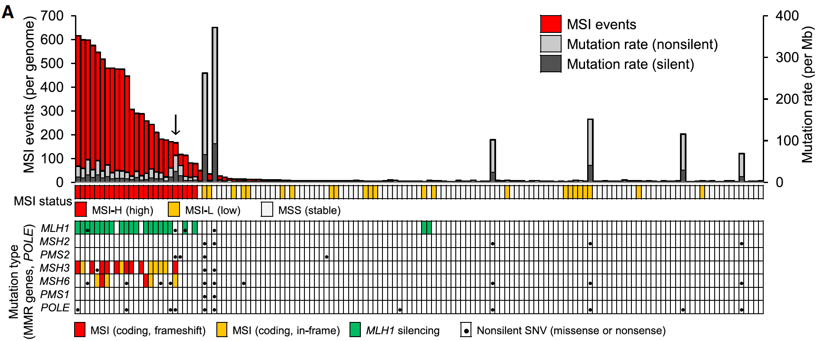
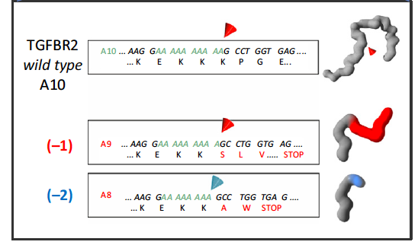
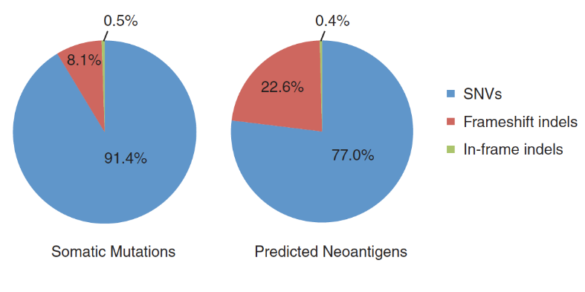
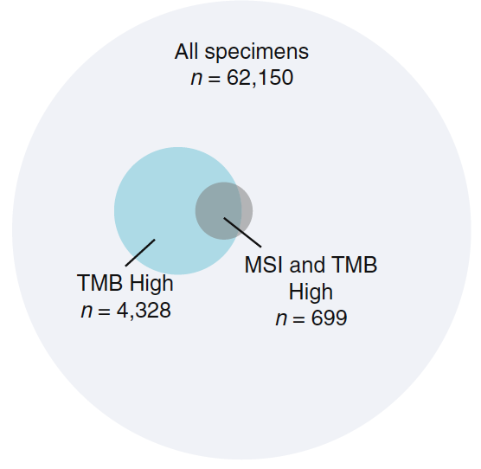
MSI-H/dMMR CRC Results in
Frameshift Neoantigens
CRC Cases With MSI Events¹
Frameshift mutations in microsatellite regions result in MSI²
Frameshift indels produce neoantigens that are recognized by CD8+ T cells^{2,3}
Most MSI-H cancers also have high tumor mutational burden (TMB)⁴
MSI-H
N=141
Indel Frameshifts in B2M Gene Cause Loss of HLA-I Antigens and T-Cell Recognition²
Frameshift Indels Resulted in Proportionally More Neoantigens Than SNVs³
Most MSI-H Samples Were Also High TMB⁴
SNV, single-nucleotide variant
1. Kim TM, et al. Cell. 2013;155(4):858-868. 2. Kloor M, et al. Trends Cancer. 2016;2:121-133. 3. Giannakis M, et al. Cell Report. 2016;15:857-865. 4. Chalmers ZR, et al. Genomic Med. 2017;9(1):34.

Slide 9
Guideline for Testing MSI/MMR
2017 ASCP/CAP/AMP/ASCO guideline recommends all patients with CRC be tested at diagnosis
How Should Samples Be Tested?
What Are Best Practices for Testing?
IHC on FFPE samples for MMR proteins | Validated tests
PCR for MSI | BRAF V600E testing in MLH1 non-expressing tissue
NGS for MSI | 10-day turnaround
 | Understandable, standardized pathology reports
IHC, immunohistochemistry testing; FFPE, formalin-fixed paraffin-embedded; PCR, polymerase chain reaction.
Sepulveda AR, et al. J Clin Oncol. 2017;35:1453-1486.

Slide 10
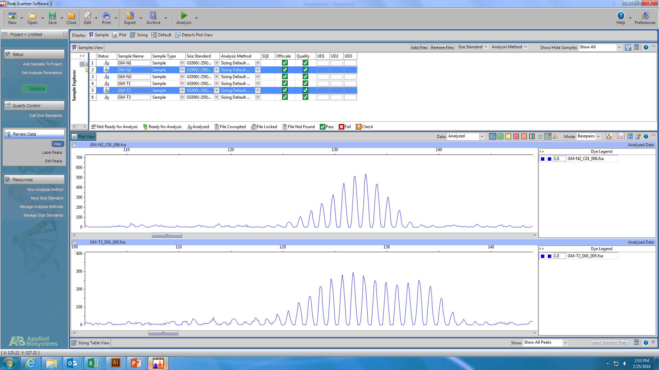
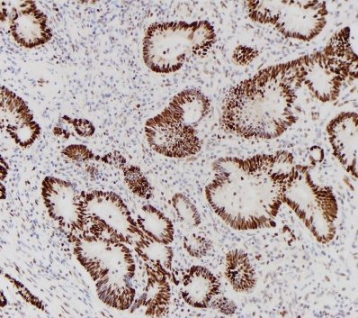
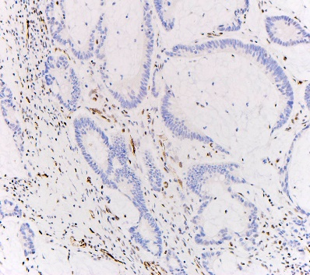
Testing Strategies for MSI/dMMR
DNA Damage Recognized by MMR Pathway²
FDA approvals not based on specific testing methodology because there is strong concordance across all methods¹
Testing approaches evaluate:¹
Next-generation sequencing³
Polymerase chain reaction
  IHC: 4 most common MMR proteins: MLH1, MSH2, MSH6, PMS2
  PCR: Microsatellite length of BAT25, BAT26, D2S123, D5S346, D17S250
  NGS: Large number of microsatellites across the genome
IHC
Complete loss of expression in one of the MMR proteins = MSI-H
Panel of ≥5 microsatellites with allelic shift in ≥2 (>30%) markers = MSI-H
Intact expression
Loss of expression
1. Overman MJ, et al. Am Soc Clin Oncol Educ Book. 2018;23:239-247. 2. Martin SA, et al. Clin Cancer Res. 2010;16:S107-S113. 3. Niu B, et al. Bioinformatics. 2014;30:1015-1016. Other images courtesy of Dr. Michael J. Overman.

Slide 11
Pembrolizumab in dMMR Tumors
Phase 2 study, 3 parallel cohorts treated with pembrolizumab
41 patients with progressive mCRC or other solid tumors that were dMMR
Cohort A: dMMR mCRC
(n=10)
Coprimary Endpoints:
Immune-related
ORR
20-wk PFS
Cohort B: pMMR mCRC
(n=18)
Pembrolizumab
10 mg/kg Q2W
Cohort C: dMMR solid tumors (n=7)
MMR status determined by MSI Analysis System of selected microsatellite sequences
Q2W, every 2 weeks
Le DT, et al. N Engl J Med. 2015;372:2509-2520.

Slide 12
Pembrolizumab Showed Efficacy in dMMR CRC and Solid Tumors
dMMR or pMMR CRC Tumor Response to Pembrolizumab¹
Median follow-up: 8.7 mo
Outcomes² | dMMR CRC (N = 28) | pMMR CRC (N = 25)
ORR | 50% (31%-69%) | 0% (0%-14%)
DCR | 89% | 16%
mPFS | NR | 2.4 mo
mOS | NR | 6 mo
1. Le DT, et al. N Engl J Med. 2015;372:2509-2520. 2. Le DT, et al. J Clin Oncol. 2016;34 (suppl 15; abstr 103).

Slide 13
Nivolumab in dMMR Tumors
CheckMate 142: International, multicenter, open-label, phase 2 trial of patients with recurrent or mCRC that is dMMR/MSI-H^{1,2}
  ≥1 prior treatment, including FP, oxaliplatin, or irinotecan
Nivolumab¹
3 mg/kg Q2W
(N=74)
Until disease progression, discontinuation due to toxicity, death, withdrawal of consent, study end
dMMR/MSI-H mCRC or other solid tumor
Nivolumab 3 mg/kg +
ipilimumab 1 mg/kg Q3W for 4 doses²
(N=119)
Nivolumab
3 mg/kg Q2W
(N=119)
Primary endpoint:
ORR
1. Overman MJ, et al. Lancet Oncol. 2017;18:1182-1191. 2. Overman MJ, et al. J Clin Oncol. 2018;36:773-779.

Slide 14
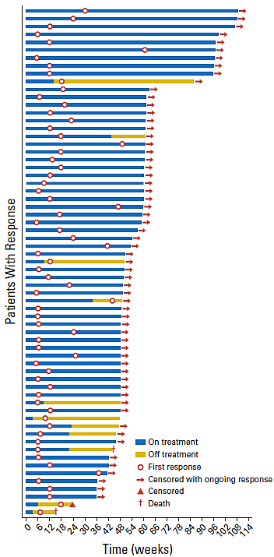
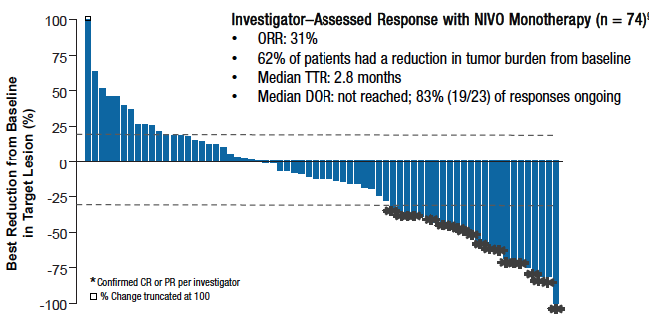
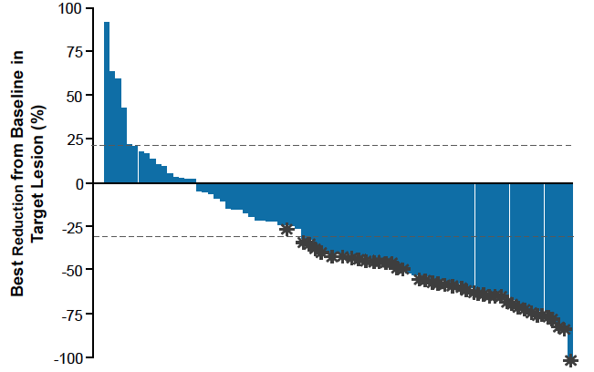
Nivolumab ± Ipilimumab Effective in dMMR CRC
Characteristics of Response with Nivo/Ipi²
Tumor Response to Nivolumab¹
Tumor Response to Nivolumab/Ipilimumab²
Outcomes with Nivolumab ± Ipilimumab^{1,2}
Response | Nivo (N = 77) | Nivo/Ipi (N = 119)
ORR | 31% | 55%
DCR, ≥12 wk | 69% | 80%
PFS, 12-m | 50% | 71%
1. Overman MJ, et al. J Clin Oncol. 2016;34 (suppl; abstr 3501). 2. Overman MJ, et al. J Clin Oncol. 2018;36:773-779.

Slide 15
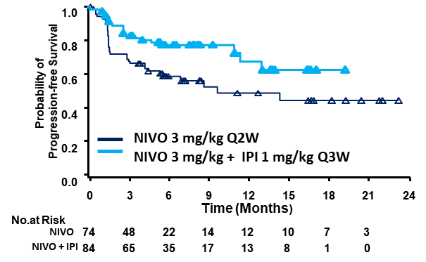
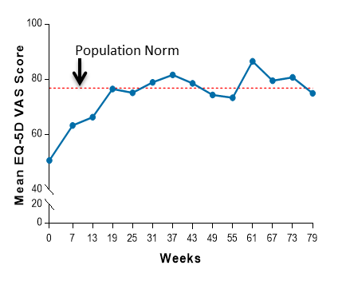
Nivolumab ± Ipilimumab Results in PFS Benefit in dMMR CRC
Nivolumab with or without ipilimumab demonstrated a PFS benefit^{1,2}
  Nivolumab also improved quality of life²
PFS With Nivolumab ± Ipilimumab¹
Quality of Life With Nivolumab²
Survival Outcomes | Nivolumab³ | Nivolumab/Ipilimumab^{1,4}
PFS, 12-mo, % (95% CI) | 50% (38.1%-61.4%) | 71% (61.4%-78.7%)
mPFS, mo (95% CI) | 5.3 (1.5-NE) | NE (3.4-NE)
OS, 12-mo, % (95% CI) | 66% (48.0%-78.6%) | 85% (77.0%-90.2%)
mOS, mo (95% CI) | 17.2 (8.6-NE) | NE
Duration of response | NR | NR
1. Overman MJ, et al. J Clin Oncol. 2018;36:773-779. 2. Overman MJ, et al. J Clin Oncol. 2017;35 (suppl 4; abstr 519).
3. Overman MJ, et al. Lancet Oncol. 2017;18:1182-1191. 4. Overman MJ, et al. J Clin Oncol. 2016;34 (suppl; abstr 3501).

Slide 16
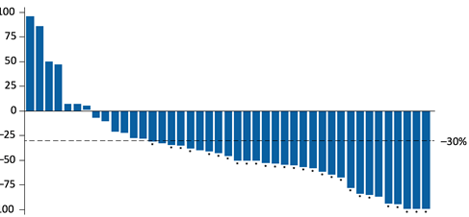
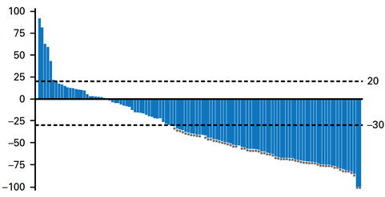
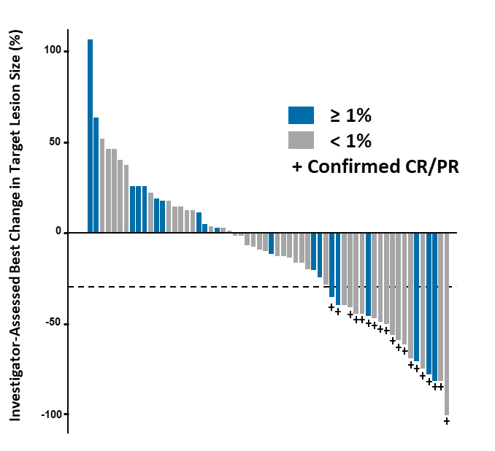
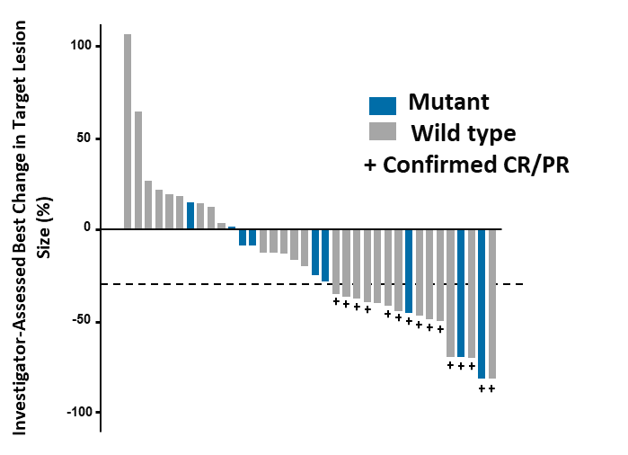
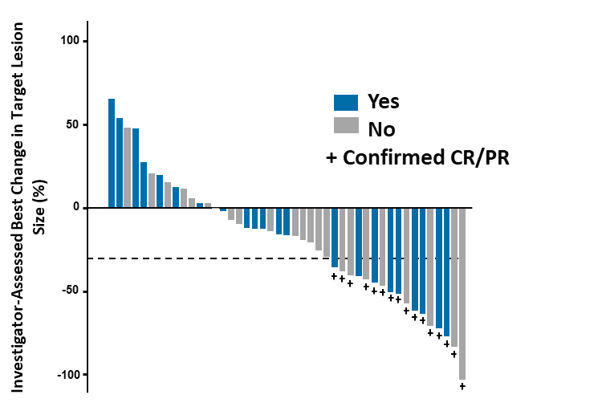
Efficacy of Nivolumab ± Ipilimumab in Subgroups
ORR, PFS, and OS benefits were observed regardless of PD-L1 expression, Lynch syndrome, or refractory or untreated disease^{1,2}
Change in Target Lesion With Nivolumab ± Ipilimumab
Front-line (n=45)¹
Refractory (n=119)²
100
75
50
25
0
-25
-50
-75
-100
PD-L1 Expression³
BRAF Status³
Lynch Syndrome³
1. Lenz HJ, et al. Ann Oncol. 2018;29 (suppl 5; abstr LBA18_PR). 2. Overman MJ, et al. J Clin Oncol. 2018;36:773-779. 3. Overman MJ, et al. J Clin Oncol. 2017;35 (suppl 4; abstr 519).

Slide 17
FDA-Approved Immunotherapy for dMMR/MSI-H CRC
FDA-approved Immunotherapies for CRC
or MSI-H/dMMR Tumors
Agent | Date | Indication | Based On
Pembrolizumab^{1,2} | 2017 | Adult/pediatric MSI-H/dMMR solid tumors following progression on prior treatment or who have no satisfactory alternative treatment options | KEYNOTE-016, prospective and retrospective analyses from 4 other trials
 |  | MSI-H/dMMR CRC after progression on fluoropyrimidine, oxaliplatin, irinotecan
Nivolumab^{1,3} | 2017 | Adult/pediatric (age ≥12) MSI-H/dMMR CRC after progression on fluoropyrimidine, oxaliplatin, irinotecanª | CheckMate 142
Nivolumab/ipilimumab^{1,3,4} | 2018
ª This indication is approved under accelerated approval based on overall response rate and duration of response, and continued approval may be contingent upon verification of benefit in confirmatory trials.
1. Overman ASCO Ed Book. 2. Pembrolizumab [package insert]; 2020. 3. Nivolumab [package insert] 2019. 4. Ipilimumab [package insert] 2019.

Slide 18
Emerging First-Line Treatment of MSI-H/dMMR CRC
CheckMate 142: Phase 2 trial of nivolumab plus ipilimumab in metastatic CRC that supported its approval in the second line¹
  Subgroup of cohort 2 included previously untreated patients (n=45)
Change in Target Lesion With Nivolumab/Ipilimumab
ORR and Survival Benefit With Nivolumab/Ipilimumab¹
100
75
50
25
0
-25
-50
-75
-100
Outcomes
ORR, % (95% CI) | 60% (44-74)
CR | 7%
PR | 53%
SD | 13%
PD | 2%
DCR, % (95% CI) | 84% (71-94)
DOR, mo (95% CI) | NR (11.5-NE)
mPFS, mo (95% CI) | NR (14.1-NE)
PFS, 12-mo (95% CI) | 77% (62.0-87.2)
mOS, mo (95% CI) | NR (NE)
OS, 12-mo (95% CI) | 83% (67.6-91.7)
Front-line (N=45)²
100
75
50
25
0
-25
-50
-75
-100
Refractory (N=119)²
CI, confidence interval; CR, complete response; DCR, disease control rate; DOR, duration of response; m, median; NE, not evaluable; NR, not reached;
ORR, objective response rate; OS, overall survival; PD, progressive disease; PFS, progression-free survival; PR, partial response; SD, stable disease.
1. Lenz HJ, et al. Ann Oncol. 2018;29 (suppl 5; abstr LBA18_PR). 2. Overman MJ, et al. J Clin Oncol. 2018;36:773-779.

Slide 19
Emerging First-Line Treatment of
MSI-H/dMMR CRC (Continued)
KEYNOTE-177: Ongoing open-label study evaluating pembrolizumab or standard-of-care chemotherapy for first-line treatment of MSI-H/dMMR mCRC
  270 patients planned for enrollment
Pembrolizumab
200 mg Q3W
PD
Protocol-specified follow-up
SOC chemotherapy:
Modified FOLFOX6 ± bevacizumab or cetuximab
FOLFIRI ± bevacizumab or cetuximab
PD
Pembrolizumab
200 mg Q3W
Protocol-specified follow-up
PD
Primary endpoint: PFS
Secondary endpoints: ORR, OS, safety and tolerability
Protocol-specified follow-up
Q3W, every 3 weeks; SOC, standard of care.
Diaz LA Jr, et al. J Clin Oncol. 2018; abstr TPS877.

Slide 20
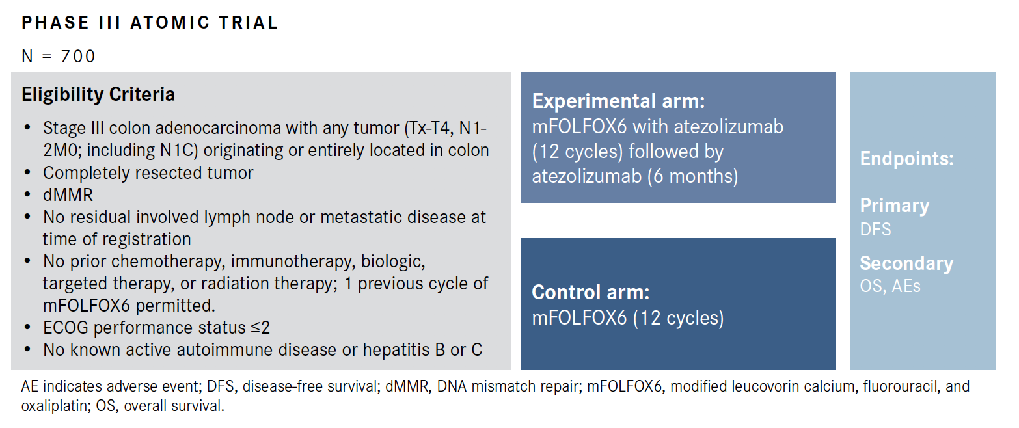
Dmmr adjuvant colon cancer trial
www.clinicaltrials.gov; Accessed February 2020.

Slide 21
Other dmmr colorectal cancer trials
Select Phase III Immunotherapy Trials in dMMR Metastatic Colorectal Cancer
Trial Name/ClinicalTrials.gov Identifier | Agent/Mechanism of Action | Therapy | Estimated Enrollment/ Estimated Primary Completion Date
COMMIT; NCT02997228 | Atezolizumab; anti-PD-1 | Atezolizumab vs mFOLFOX + bevacizumab with or without atezolizumab | 347; April 30, 2022
POLEM; NCT03827044 | Avelumab; anti-PD-L1 | Chemotherapy (CAPOX or capecitabine) vs chemotherapy followed by avelumab | 402; July 2024
CAPOX indicates capecitabine and oxaliplatin; dMMR, mismatch repair-deficient; mFOLFOX, modified folinic acid, fluorouracil, and oxaliplatin
www.clinicaltrials.gov; Accessed February 2020; Lau D et al. ASCO 2019;abstr TPS3615.

Slide 22
Sequencing Options in Metastatic Gastric and Colorectal Cancers
John L Marshall, MD
Chief, Hematology and Oncology
Director, Ruesch Center for the Cure of GI Cancers
Lombardi Comprehensive Cancer Center
Georgetown University
Washington, DC

Slide 23
Disclosures
Advisory Committee, Consulting Agreements and Contracted Research | Amgen Inc, Bayer HealthCare Pharmaceuticals, Caris Life Sciences, Celgene Corporation, Indivumed GmbH, Roche Laboratories Inc, Taiho Oncology Inc
Speakers Bureau | Amgen Inc, Bayer HealthCare Pharmaceuticals, Celgene Corporation, Merck, Roche Laboratories Inc, Taiho Oncology Inc

Slide 24
Case Summary:
46 y/o attorney diagnosed 4 years ago with MSS, RAS WT, BRAF WT, HER2- sigmoid colon cancer with 5 liver mets
Cape/oxali/bev for 3 months, staged surgeries to render NED
Maintenance cape/bev for 2 years, relapsed 3 months after stopping
RFA to lone liver lesion, resumed cape/bev for one year
PD in 3 liver lesions, one peri-pancreatic node
Panitumumab and irinotecan for 3 months, then panitumumab alone for 6 months - stopped due to rash
New liver lesions after 3 month holiday

Slide 25
You would recommend?
Resume EGFR based therapy
TAS-102
TAS-102 + Bevacizumab
Regorafenib
Resume oxaliplatin based therapy
Pembrolizumab
FOLFIRI + Bev

Slide 26
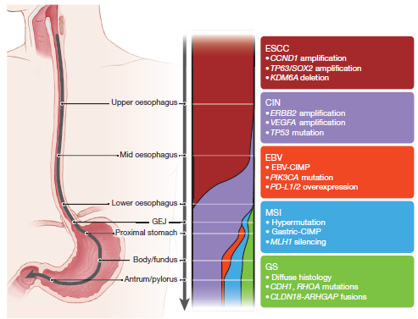
Molecular Subclasses of Gastroesophageal Cancer
Kim. Nature. 2017;541:169.

Slide 27
Sorting Gastric Cancers
Wang. Gastroenterol Res. 2019;12:275.

Slide 28
Sorting Gastric Cancers
No response to adjuvant chemotherapy
Wang. Gastroenterol Res. 2019;12:275.

Slide 29
Sorting Gastric Cancers
Wang. Gastroenterol Res. 2019;12:275.

Slide 30
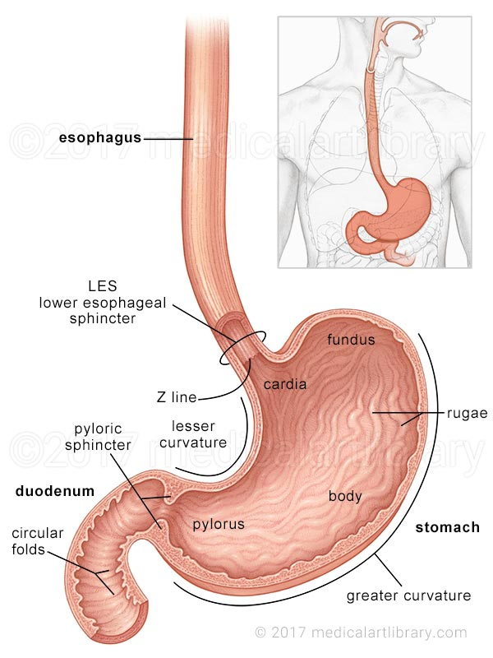
Simplify Your Categories
Esophageal
Squamous Cell Chemo/RT
More IO Effect
GE Junction
Adenocarcinoma
Chemo/RT
Gastric
Adenocarcinoma
FLOT

Slide 31
Molecular Testing in Gastric Cancer
Standard molecular testing:
  HER2 (IHC or FISH, NGS for amplification)
  MSI (variety of techniques)
  PD-L1 (IHC)
  NTRK (RNA fusion)
Germline
  CDH-1 and a long list of others (FAP, Lynch, etc)

Slide 32
GEJ/Gastric: Marker Negative
1st Line: Doublet chemo (5FU/platinum)
2nd Line: Ramucirumab + Paclitaxel
3rd Line: Dealer’s choice - TAS-102, Irinotecan

Slide 33
GEJ/Gastric: HER2+
1st Line: Doublet chemo (5FU/platinum) + trastuzumab
2nd Line: Ramucirumab + Paclitaxel
3rd Line: Dealer’s choice - TAS-102, Irinotecan

Slide 34
GEJ/Gastric: MSI-H
1st Line: Doublet chemo (5FU/platinum) - IO tempting
2nd Line: IO/Pembrolizumab
3rd Line: Ramucirumab + Paclitaxel
4th Line: Dealer’s choice - TAS-102, Irinotecan

Slide 35
GEJ/Gastric: PD-L1 > 10 CPS
1st Line: Doublet chemo (5FU/platinum)
2nd Line: IO
3rd Line: Ramucirumab + Paclitaxel
4th Line: Dealer’s choice - TAS-102, Irinotecan

Slide 36
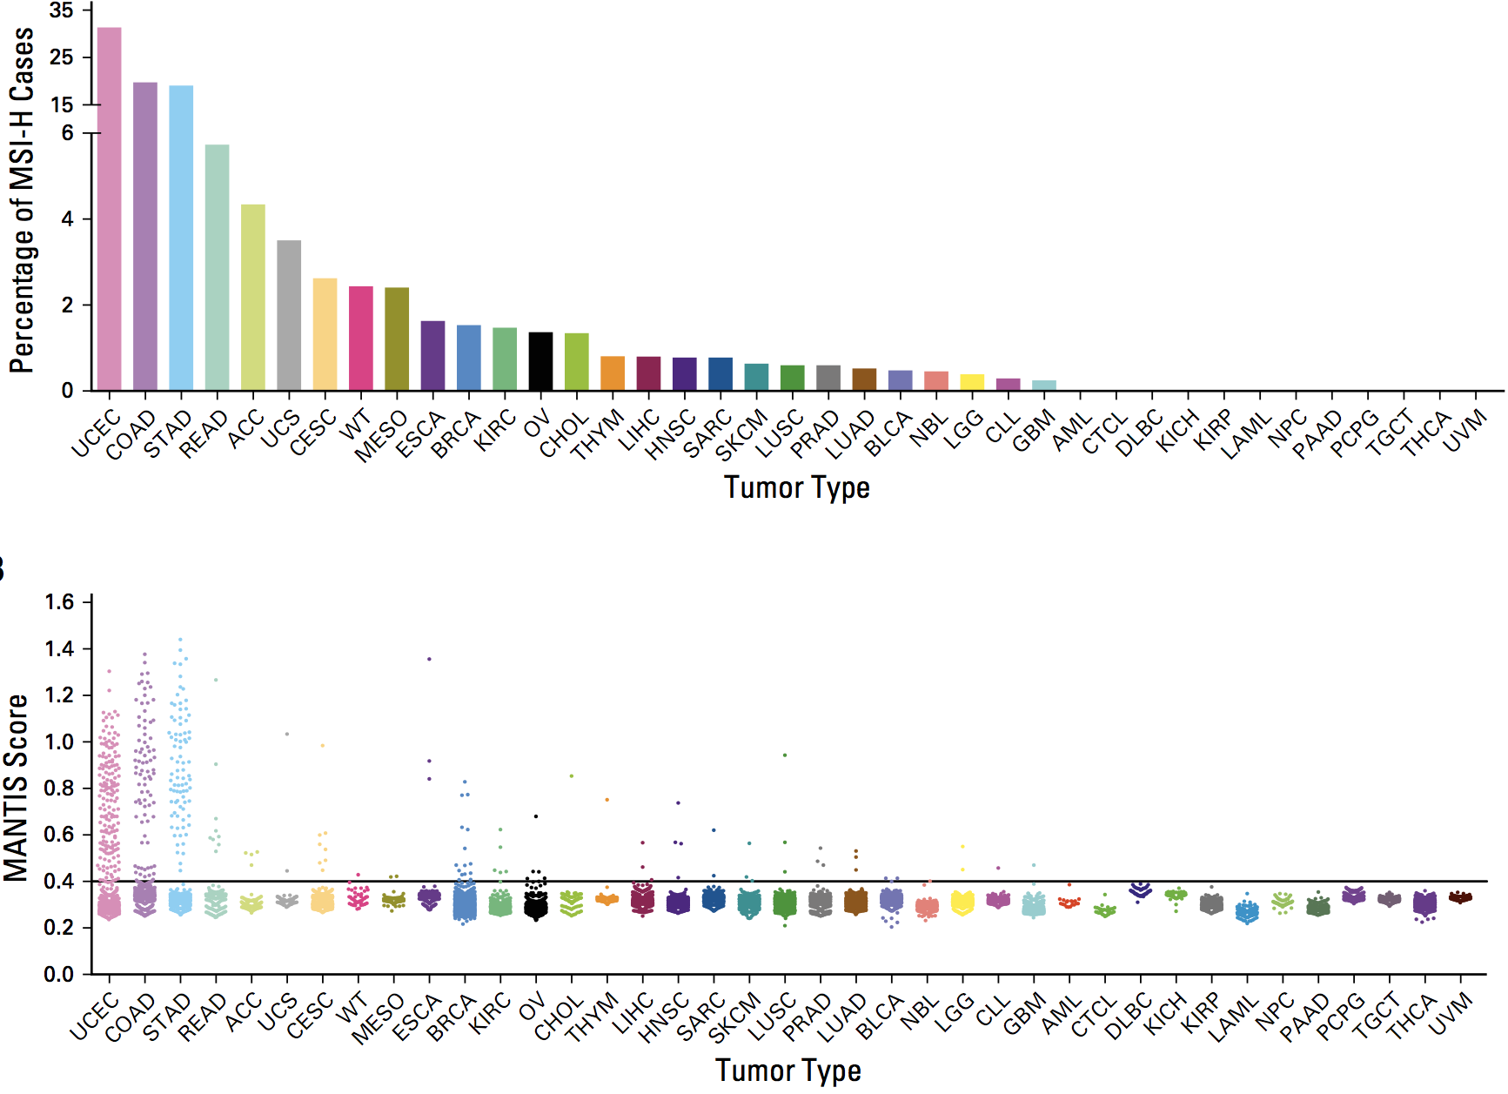
MSI-H/dMMR in 39 Cancer Types; 11,139 Tumors
TOP 15
Uterine endometrial carcinoma
Colon adenocarcinoma
Stomach adenocarcinoma
Rectal adenocarcinoma
Adrenocortical carcinoma
Uterine carcinosarcoma
Cervical
Wilms tumor
Mesothelioma
Esophageal carcinoma
Breast carcinoma
Renal, clear cell
Ovarian
Cholangiocarcinoma
Thymoma
Bonneville. JCO Precis Oncol. 2017;2017.

Slide 37
Refractory CRC

Slide 38
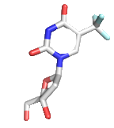
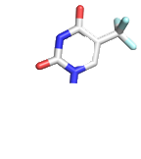



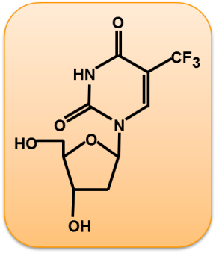
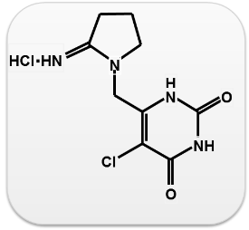
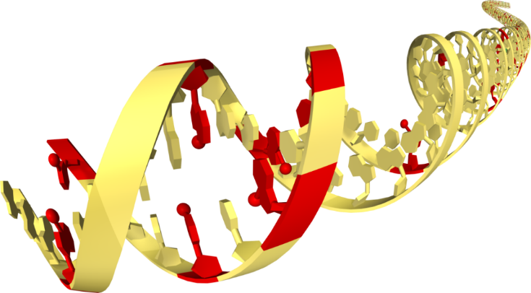
TAS-102; Mechanism of Action
TPase
F₃dThd (FTD)
FTY
Inhibition of
tumor growth
(inactive form)
TPI
F₃dTMP
TAS-102
(Oral Combination Drug)
F₃dTDP
DNA dysfunction
FTD
TPI
F₃dTTP
FTD incorporation
into DNA
Molar ratio = 1 : 0.5
FTD：Trifluridine
TPI：Tipiracil-HCl
Yoshino et al., WCGIC 2014

Slide 39
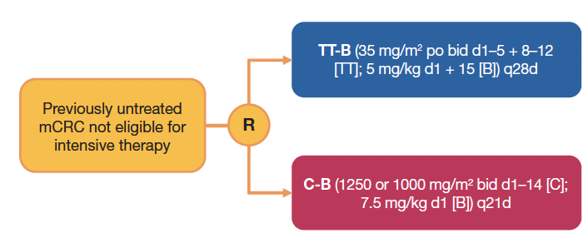
Refractory mCRC: TASCO-1
Multicenter, randomized, open-label Phase II study
Primary endpoint
PFS
Secondary endpoints
OS, ORR, DCR, tumor response
Safety, tolerability
Median PFS was 9.2 months TT/B vs 7.8 months
  HR of 0.71 (95% CI, 0.48-1.06)
Preliminary median OS was 18 months TT/B vs
16.2 months C-B
  HR of 0.56 (95% CI, 0.32-0.98)
What comes next if this is 1L?
BID, twice daily; C-B, capecitabine + bevacizumab; CI, confidence interval;
DCR, disease control rate; HR, hazard ratio; ORR; overall response rate;
OS, overall survival; PFS, progression-free survival; PO, by mouth;
TT/B, trifluridine/tipiracil + bevacizumab.
Lesniewski-Kmak K, et al. Ann Oncol. 2018;29 (suppl 5; abstr O-022).

Slide 40
Phase I Study of Trifluridine/Tipiracil Plus Irinotecan and Bevacizumab in Advanced Gastrointestinal Tumors
Baseline
assessments
FTD/TPI and IRI treatment continued until a treatment
discontinuation criterion was met
Treatment continued until
a treatment discontinued
Varghese AM, Cardin DB, Hersch J, Benson A, Hochster HS, Makris L, Hamada K, Berlin J, Saltz LB.
Clin Cancer Res. 2020 Jan 10. [Epub ahead of print]

Slide 41
TAS-102 with or without bevacizumab in patients with chemorefractory metastatic colorectal cancer: an investigator-initiated, open-label, randomised, phase 2 trial
Pfeiffer et al: Lancet Oncology January 27, 2020 https://doi.org/10.1016/S1470-2045(19)30827-7

