Slide 1
Module 2:
Hepatocellular Carcinoma
and Pancreatic Cancer

Slide 2
 | Percent with Patients | Number of Patients (Median)
Metastatic colorectal cancer | 100 | 13
Metastatic pancreatic cancer | 100 | 4
Metastatic gastric cancer | 96 | 2
Metastatic esophageal cancer | 92 | 2
Localized pancreatic cancer (resectable or borderline-resectable) | 88 | 2
Metastatic hepatocellular cancer | 71 | 2
Survey of general medical oncologists, February 2020

Slide 3
Navigating an Increasingly Complex Treatment Landscape in the Management of Metastatic Hepatocellular Carcinoma (HCC)
Tanios Bekaii-Saab, MD
Professor, Mayo Clinic College of Medicine and Science
Program Leader, Gastrointestinal Cancer, Mayo Clinic Cancer Center
Vice-Chair and Section Lead, Division of Medical Oncology
Medical Director, Cancer Clinical Research Office
Senior Associate Consultant
Mayo Clinic
Phoenix, Arizona

Slide 4
Disclosures
Advisory Committee | Amgen Inc, Immuneering Corporation, Imugene
Consulting Agreements | AbbVie Inc, Array BioPharma Inc, Bayer HealthCare Pharmaceuticals
Contracted Research | Arrys Therapeutics, a wholly owned subsidiary of Kyn Therapeutics, Astellas, Bayer HealthCare Pharmaceuticals, Boston Biomedical Inc, Bristol-Myers Squibb Company, Genentech, Ipsen Biopharmaceuticals Inc, Novartis
Data and Safety Monitoring Board | ARMO BioSciences, AstraZeneca Pharmaceuticals LP, Exelixis Inc, Merck, SillaJen

Slide 5
Case: Patient with HCC
58 y.o. female with history of Hepatitis C presents to her PCP with weight loss and RUQ pain that keeps her up at night.
CT scan of the abdomen reveals a large irregular heterogeneous density mass in the large portion of the right lobe of the liver that measured 6.5 x 9.2 centimeters in addition to numerous lymph nodes seen in the porta hepatitis and para aortic areas. CT chest shows no disease
She underwent a biopsy of the liver mass with findings consistent with hepatocellular carcinoma well to moderately differentiated, with background features of cirrhosis.
Determined to be unresectable hepatocellular carcinoma (Child Pugh A/BCLC stage B).
AFP at diagnosis = 768.3 ng/mL

Slide 6
What would be your preferred choice for initial treatment?
Nivolumab
Lenvatinib
Atezolizumab and Bevacizumab
Sorafenib
Lenvatinib and Pembrolizumab

Slide 7
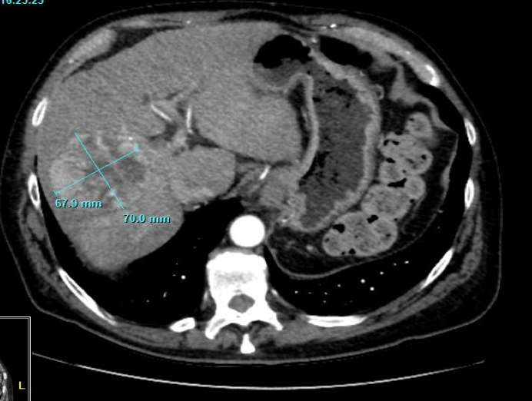
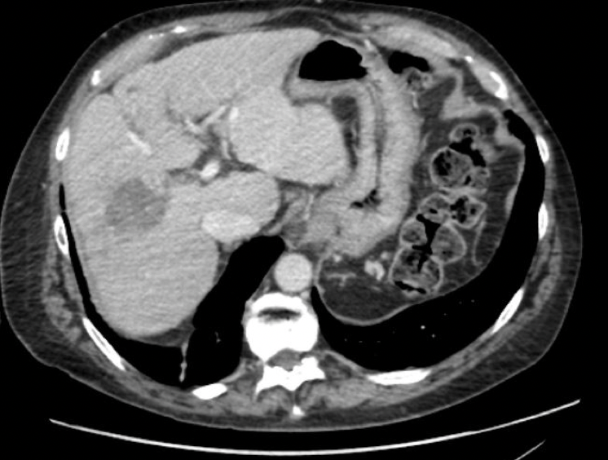
In October 2019 patient starts on Atezolizumab and Bevacizumab with excellent tolerability
Oct 2019
Jan 2020

Slide 8
Alpha-fetoprotein Level Response
AFP ng/mL
Date

Slide 9
Sorafenib Superior to Placebo: SHARP PIII Trial

Slide 10
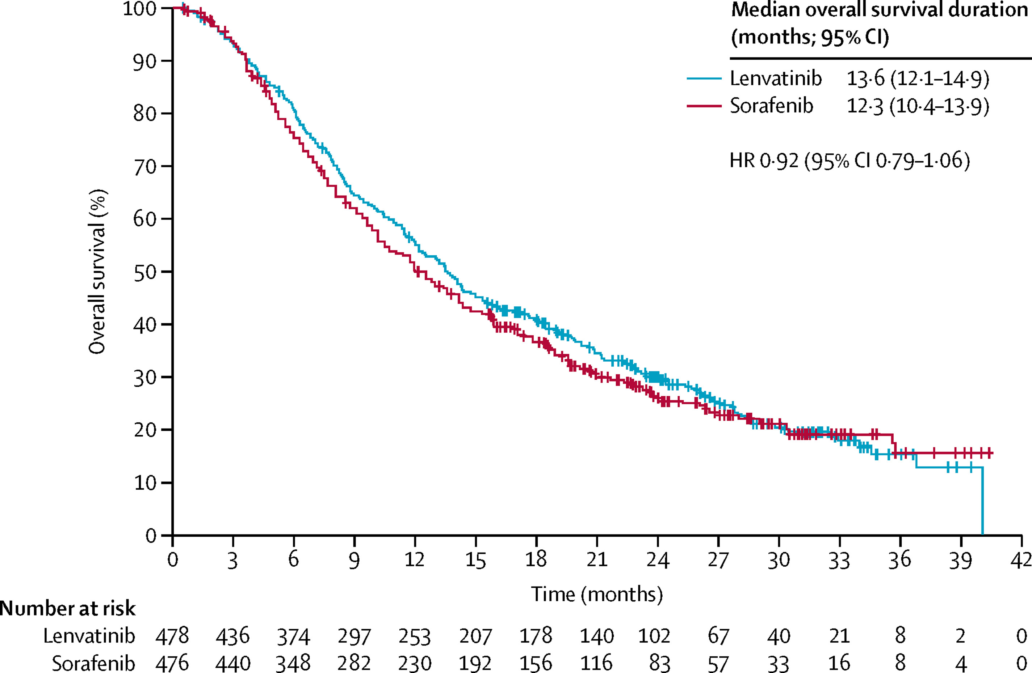
Lenvatinib Is Non-Inferior to Sorafenib: REFLECT Trial
The Lancet 2018 391, 1163-1173 DOI: (10.1016/S0140-6736(18)30207-1)

Slide 11
Summary of Agents Beyond First Line Sorafenib
 | Regorafenib vs. PBO | Cabozantinib vs. PBO | Ramucirumab vs. PBO (AFP ≥400)
mOS | HR = 0.63 | HR = 0.76 | HR = 0.71
mPFS | HR = 0.46 | HR = 0.44 | HR = 0.452
ORR | 10.6 vs. 4.1% | 4 vs. 0.4% | 4.6 vs. 1.1%
G3/4 T | HSFR, HTN | PPE, HTN | HTN
Bruix Lancet 2017; Abou-Alfa NEJM 2018; Zhu Lancet Oncol 2019

Slide 12
The Role of Immunotherapy

Slide 13
CheckMate 459: Nivolumab vs Sorafenib in First Line
Yau. ESMO 2019. Abstr LBA38_PR.

Slide 14
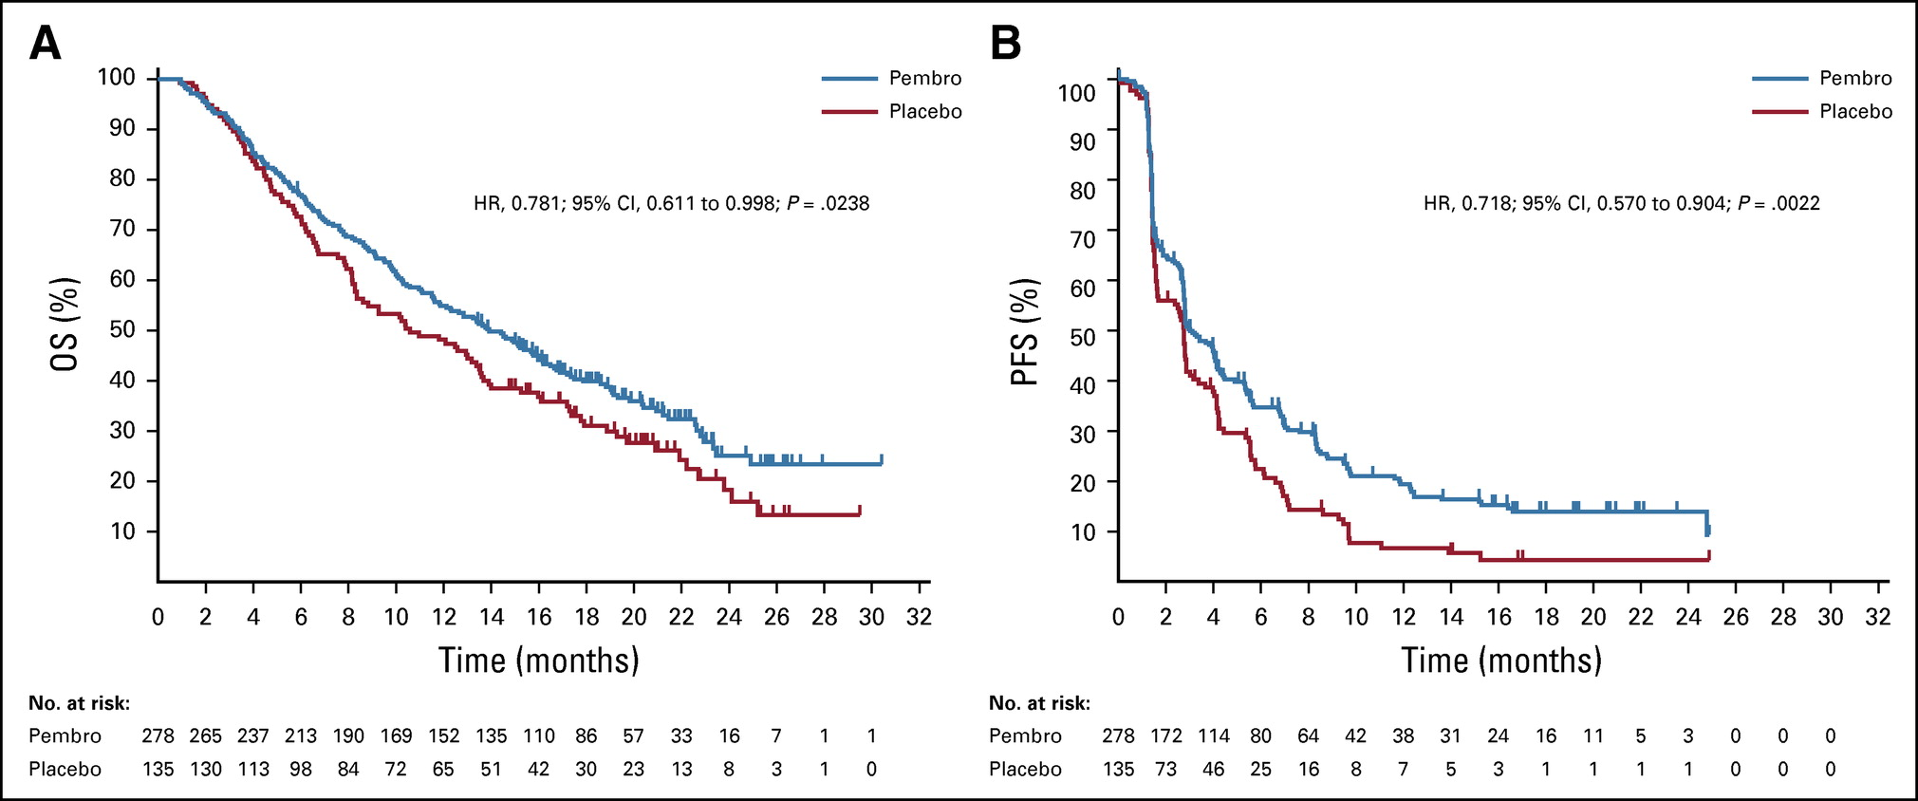
KEYNOTE-240: Pembrolizumab vs. Placebo in Prior Sorafenib Exposed Pts
Published in: Richard S. Finn; Baek-Yeol Ryoo; Philippe Merle; Masatoshi Kudo; Mohamed Bouattour; Ho Yeong Lim; Valeriy Breder; Julien Edeline; Yee Chao; Sadahisa Ogasawara; Thomas Yau; Marcelo Garrido; Stephen L. Chan; Jennifer Knox; Bruno Daniele; Scot W. Ebbinghaus; Erluo Chen; Abby B. Siegel; Andrew X. Zhu; Ann-Lii Cheng; Journal of Clinical Oncology 2020 38:193-202.
DOI: 10.1200/JCO.19.01307

Slide 15
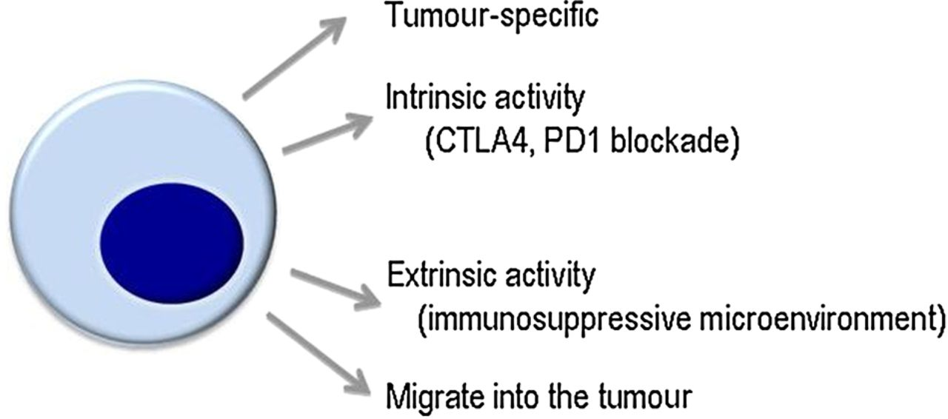
How do we expand the benefit of immunotherapy to more patients with hepatocellular carcinoma?
Enhance tumor associated antigen exposure (SBRT, locoregional tx, Intra-tumoral tx)
Tumor-specific
Beyond PD-1: OX40, LAG-3
IO/IO combinations
Anti VEGF combinations (TKI, Bevacizumab)
Other ongoing preclinical and
early clinical research
Migrate into the tumor
Chen Y et al. Hepatology. 2015;61(5):1591-1602.
Greten et al. Rev Recent Clin Trial. 2008
Hedge PS, Semin Cancer Biol 2017
Tim F Greten et al. Gut 2015;64:842-848

Slide 16
IMbrave150 study design
Stratification
  Region (Asia, excluding Japanª/rest of world)
  ECOG PS (0/1)
  Macrovascular invasion (MVI) and/or extrahepatic spread (EHS) (presence/absence)
  Baseline α-fetoprotein (AFP; < 400/≥ 400 ng/mL)
Atezolizumab 1200 mg IV q3w
+
bevacizumab 15 mg/kg q3w
Key eligibility
Locally advanced or metastatic and/or unresectable HCC
No prior systemic therapy
Until loss of clinical benefit or unacceptable toxicity
Survival follow-up
R
2:1
N = 501^{b}
Sorafenib
400 mg BID
(open-label)
Co-primary endpoints
OS
IRF-assessed PFS per RECIST 1.1
Key secondary endpoints (in testing strategy)
IRF-assessed ORR per RECIST 1.1
IRF-assessed ORR per HCC mRECIST
ª Japan is included in rest of world.
^{b} An additional 57 Chinese patients in the China extension cohort were not included in the global population/analysis.

Slide 17
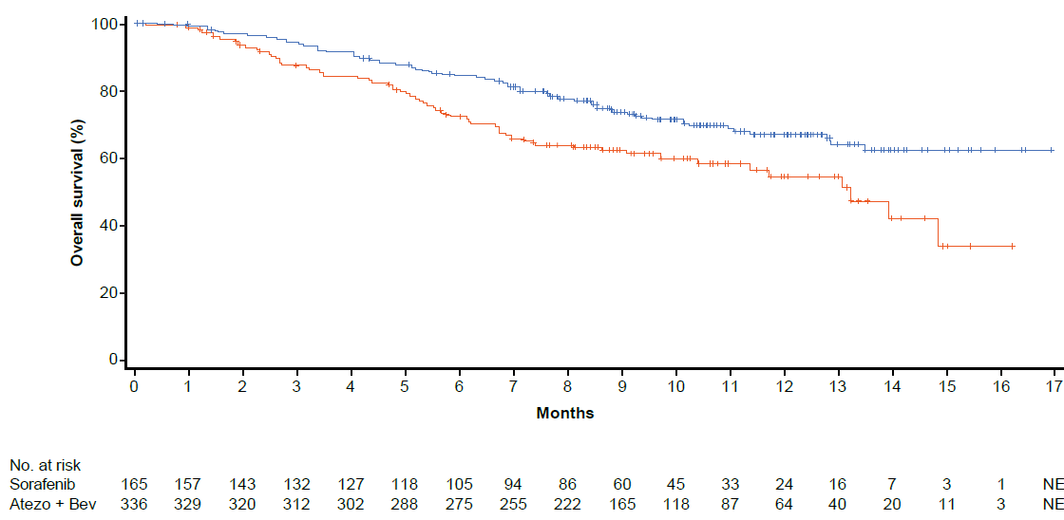
OS: co-primary endpoint
Median OS (95% CI), moª
Atezo + Bev | NE
Sorafenib | 13.2 (10.4, NE)
HR, 0.58 (95% CI: 0.42, 0.79)^{b} P = 0.0006^{b,c}
6-mo OS rate: 85%
mOS: NE
6-mo OS rate: 72%
Atezo + Bev
mOS: 13.2 mo
Sorafenib
NE, not estimable. ª 96 patients (29%) in the Atezo + Bev arm vs 65 (39%) in the sorafenib arm had an event. ^{b} HR and P value were from Cox model and log-rank test and were stratified by geographic region (Asia vs rest of world, including Japan), AFP level (< 400 vs ≥ 400 ng/mL) at baseline and MVI and/or EHS (yes vs no) per IxRS. ^{c} The 2-sided P value boundary based on 161 events is 0.0033. Data cutoff, 29 Aug 2019; median survival follow-up, 8.6 mo.
Cheng ESMO Asia 2019;Abst LBA3

Slide 18
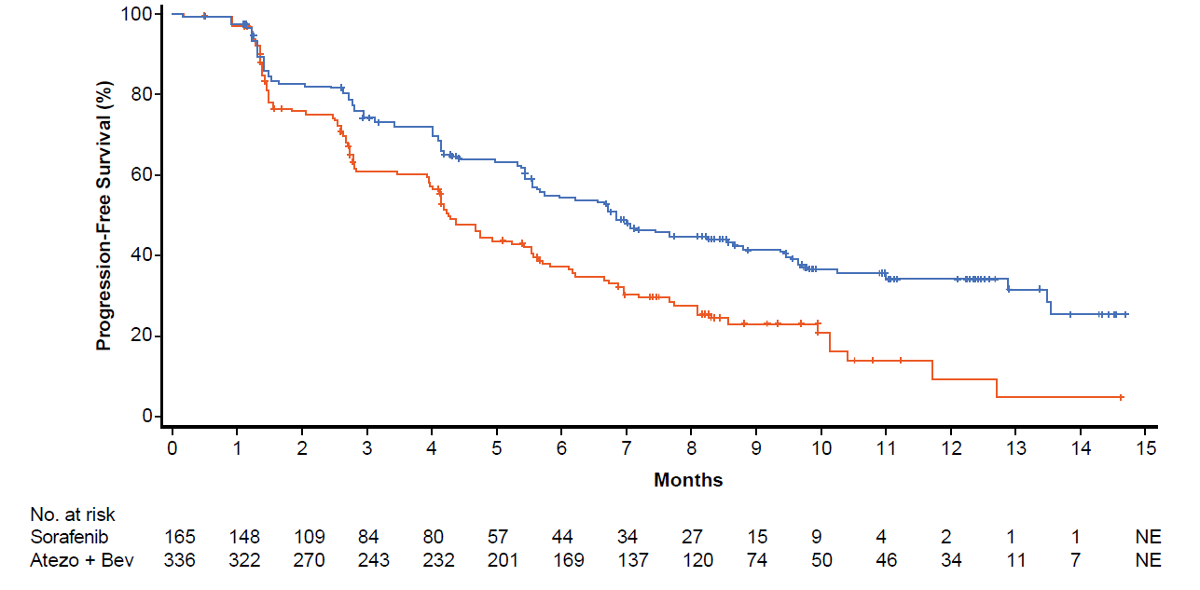
Confirmed PFS: co-primary endpoint
Median PFS (95% CI), mo^{b}
Atezo + Bev | 6.8 (5.7, 8.3)
Sorafenib | 4.3 (4.0, 5.6)
HR, 0.59 (95% CI: 0.47, 0.76)^{c,d} P < 0.0001^{d}
6-mo PFS rate: 55%
6-mo PFS rate: 37%
Atezo + Bev
mPFS: 4.3 mo
mPFS: 6.8 mo
Sorafenib
ª Assessed by IRF per RECIST 1.1. ^{b} 197 patients (59%) in the Atezo + Bev arm vs 109 (66%) in the sorafenib arm had an event. ^{c} HR and P value were from Cox model and log-rank test and were stratified by geographic region (Asia vs rest of world, including Japan), AFP level (< 400 vs ≥ 400 ng/mL) at baseline and MVI and/or EHS (yes vs no) per IxRS. ^{d} The 2-sided P value boundary is 0.002. Data cutoff, 29 Aug 2019; median survival follow-up, 8.6 mo.
Cheng ESMO Asia 2019;Abst LBA3

Slide 19
Safety
≥ 10% frequency of AEs in either arm and > 5% difference between arms

Slide 20
Patient-reported outcomesª
EORTC QLQ-C30, European Organisation for Research and Treatment of Cancer Quality-of-Life Questionnaire for Cancer; TTD, time to deterioration.
ª Pre-specified secondary endpoint that was not formally tested; EORTC QLQ-C30 administered every 3 weeks on treatment and every 3 months after treatment discontinuation or progression. ^{b} Time to deterioration defined as first decrease from baseline of ≥ 10 points in the patient-reported health-related global health status/quality of life (GHS/QoL) scale of the EORTC QLQ-C30 maintained for 2 consecutive assessments or 1 assessment followed by death from any cause within 3 weeks. Data cutoff, 29 Aug 2019; median survival follow-up, 8.6 mo.

Slide 21
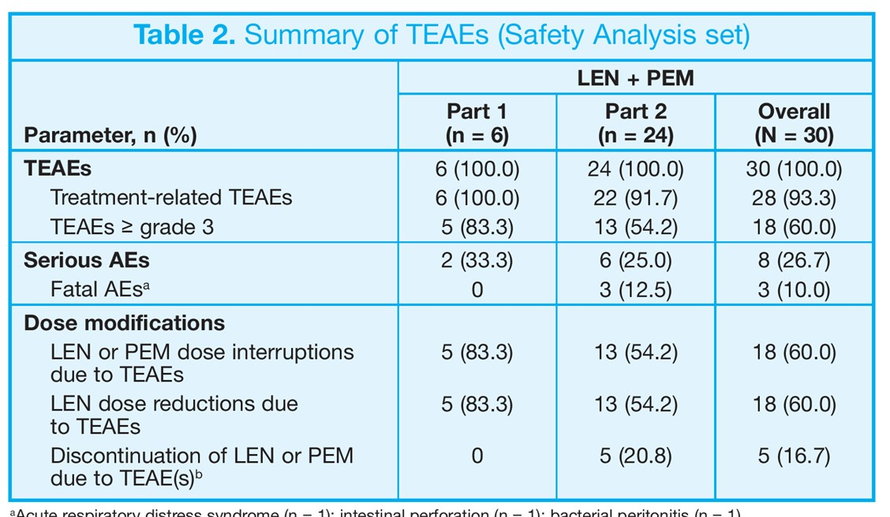
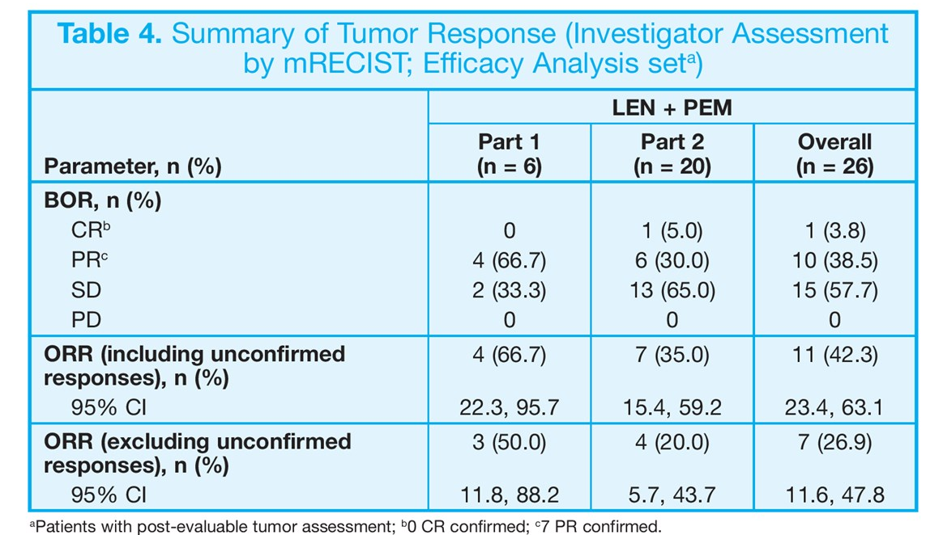
A Phase Ib Trial of Lenvatinib and Pembrolizumab in First Line
ª Acute respiratory distress syndrome (n = 1) intestinal perforation (n = 1) bacterial peritonitis (n = 1)
Ikeda M et al, ASCO 2018

Slide 22

CheckMate 040: Nivolumab and Ipilimumab in Combination for Patients with Advanced HCC Previously Treated with Sorafenib
 | Nivo 1 mg/Ipi 3 mg Q3W (n = 50) | Nivo 3 mg/Ipi 1 mg Q3W (n = 49) | Nivo 3 mg Q2W/ Ipi 1 mg Q6W (n = 49)
ORR | 32% | 31% | 31%
Complete response | 8% | 6% | 0
Partial response | 24% | 24% | 31%
DCR | 54% | 43% | 49%
Median OS | 23 mo | 12 mo | 13 mo
12-mo OS rate | 61% | 56% | 51%
Yau T et al. Proc ASCO 2019;Abstract 4012.

Slide 23
How to Best Sequence Patients With Advanced Disease
First Line
Second Line
Third Line
Sorafenib
Regorafenib
Cabozantinib
Atezolizumab + Bevacizumab
Lenvatinib
Cabozantinib
Nivolumab or Pembrolizumab
AFP > 400: Ramucirumab
NEGATIVE -- phase 3 study (CK459) of nivolumab vs sorafenib
NEGATIVE -- Phase 3 study (K240) of pembrolizumab vs BSC

Slide 24
Management of Pancreatic Cancer
Wells A Messersmith, MD
Professor and Head, Division of Medical Oncology
Associate Director for Translational Research
University of Colorado Cancer Center
Aurora, Colorado

Slide 25
Disclosures
Contracted Research | Aduro Biotech, ALX Oncology, AstraZeneca Pharmaceuticals LP, BeiGene, D3 Pharma, Gossamer Bio, Immunomedics Inc, OncoMed Pharmaceuticals Inc, Pfizer Inc
Data and Safety Monitoring Board/Committee | Five Prime Therapeutics Inc, QED Therapeutics

Slide 26
Patient Case
A 46 year-old male presents with painless jaundice; work-up reveals a pancreatic head mass with bi-lobar liver lesions. Biopsy of one of the liver lesions reveals adenocarcinoma consistent with a pancreatic primary. CA19-9 is elevated at 5,466. Patient is started on palliative FOLFIRINOX. Germline and tumor testing are ordered.
Testing reveals a germline BRCA2 mutation. The family is referred for genetic counseling.
After 8 cycles (16 weeks) of FOLFIRINOX, the patient complains of fatigue, neuropathy, and diarrhea. ECOG PS=1.

Slide 27
What is the best next step?
A) Continue FOLFIRINOX for 12 cycles, with dose adjustments
B) Start maintenance FOLF (LV5FU2)
C) Switch to olaparib
D) Switch to 5-FU/nal-IRI
E) Stop therapy altogether
Follow-up question: What if the patient was tolerating the FOLFIRINOX quite well?

Slide 28
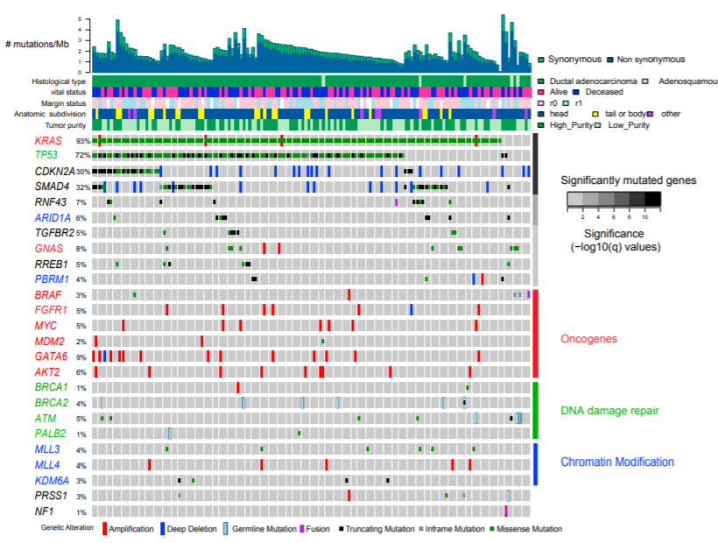
Genetic Alterations in Pancreatic Cancer
Integrated genomic, transcriptomic, and proteomic profiling
150 pancreatic ductal adenocarcinoma (PDAC) specimens, Stage I-III (resected)
complex molecular landscape; “top 4” mutated genes are KRAS, TP53, CDKN2A, SMAD4
predicted pathogenic germline mutations in 8% of patients (BRCA2, ATM, PALB2, BRCA1, and others)
2017 TCGA, Cancer Cell;32:185–203
© 2017 Published by Elsevier Inc

Slide 29
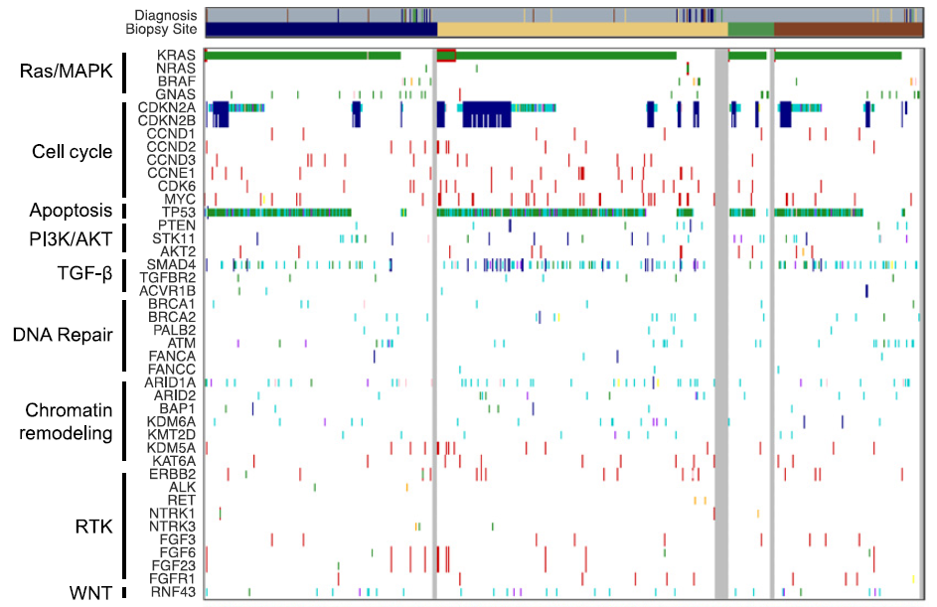
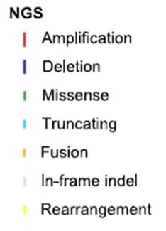
Genetic Alterations in Pancreatic Cancer
“Know Your Tumor” Program
640 patients from 287 academic and community practices
458 metastatic (IV) patients
15% had alterations in DNA repair
87% were
KRAS mutated
BRCA1, BRCA2, PALB2, ATM, FANCA, FANCC
Pishvaian, Clin Can Res 2018;24(20): 5018-5027
© 2018 American Association for Cancer Research

Slide 30
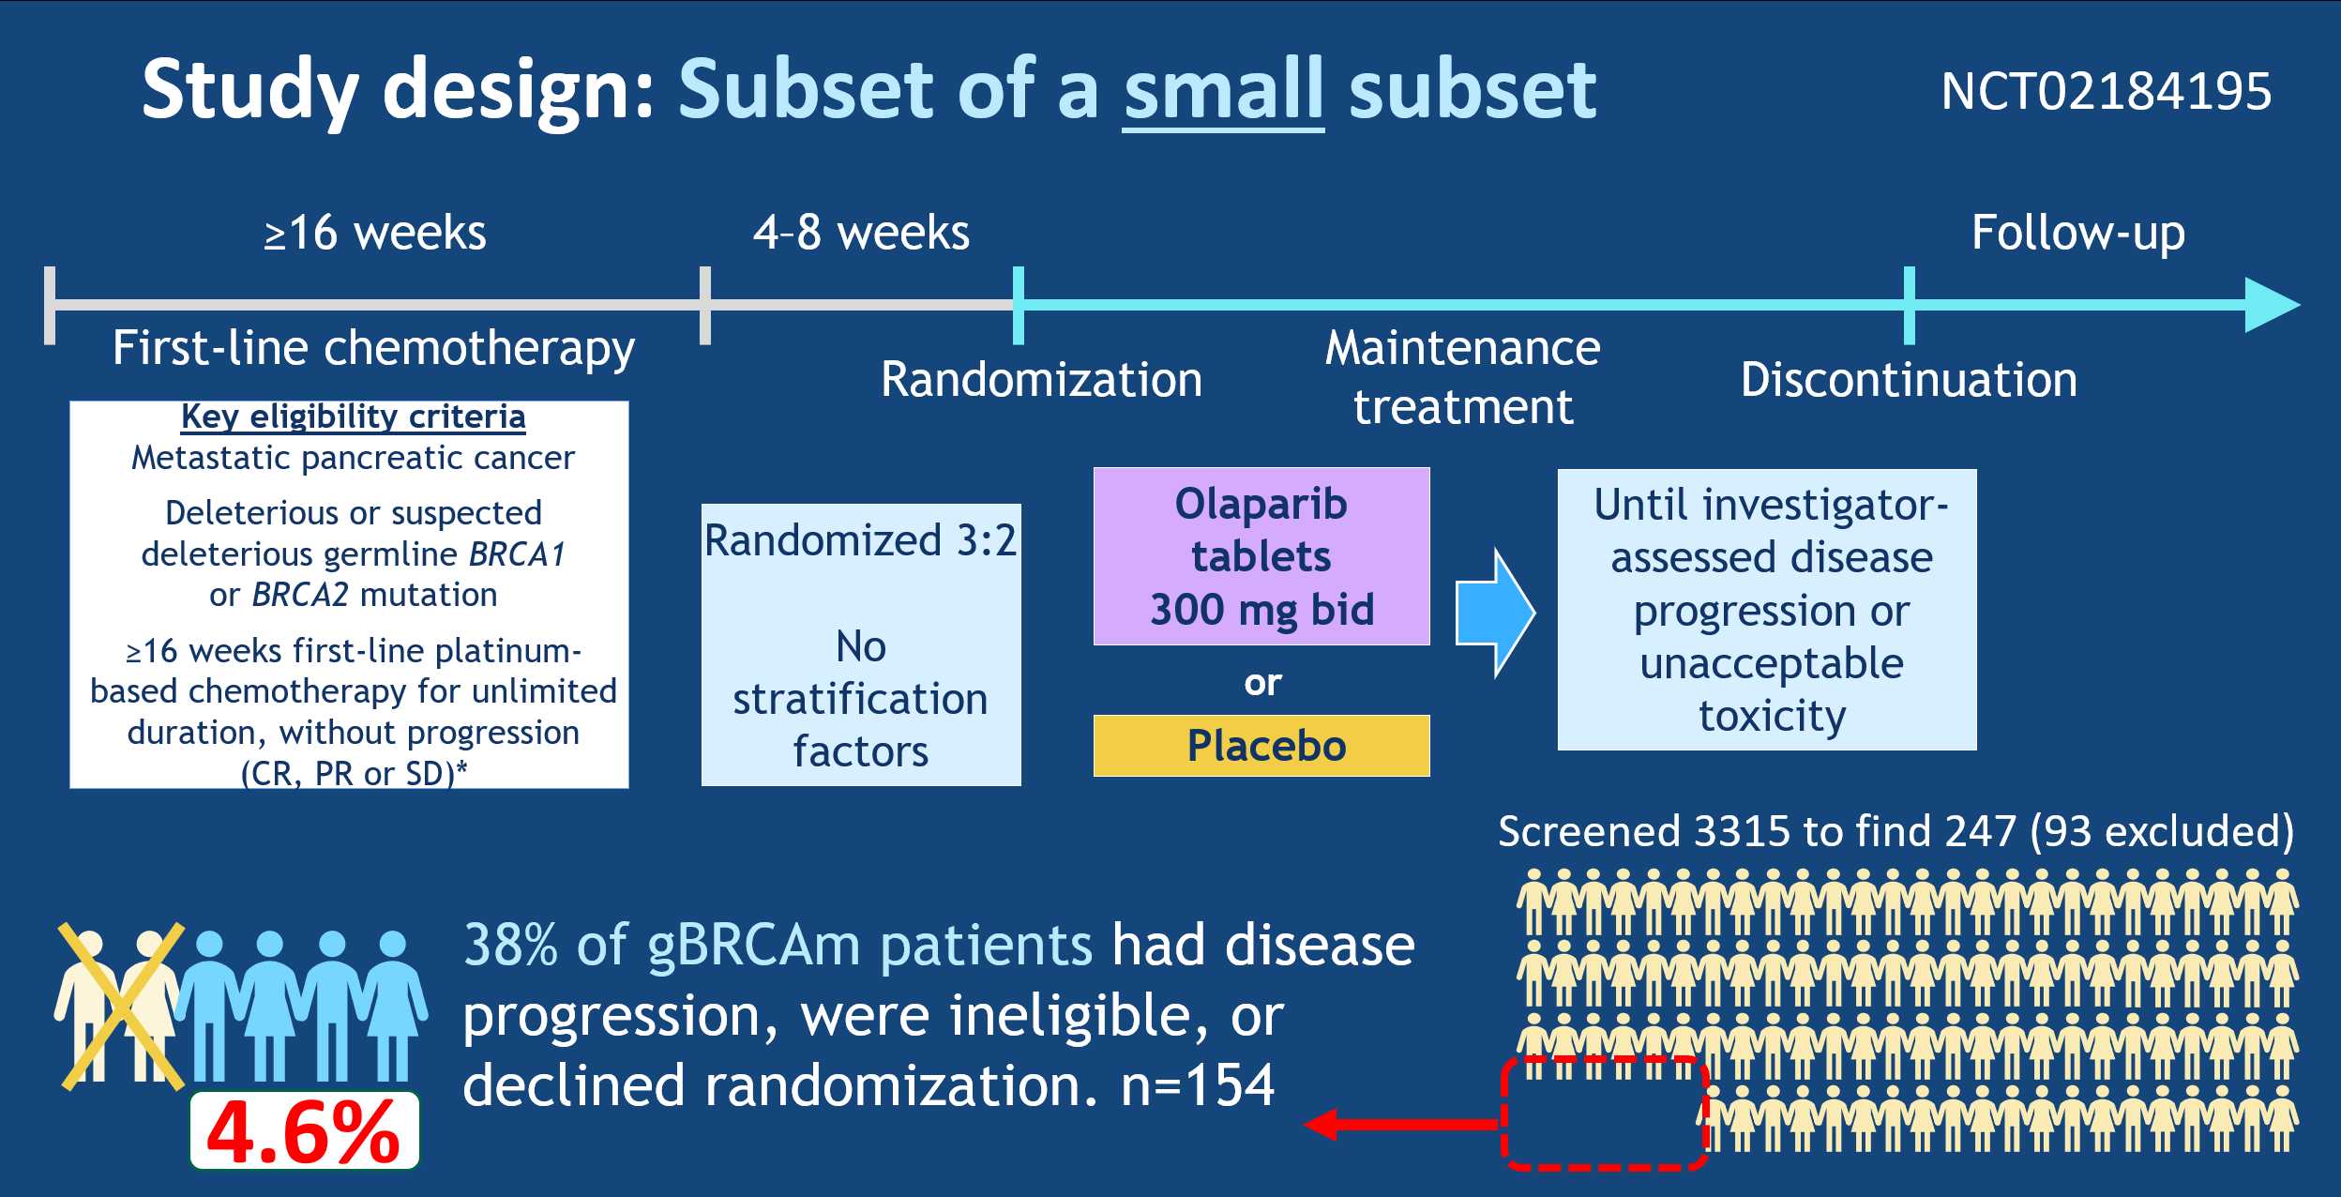
POLO trial study design: Subset of a small subset
Kindler HL et al. Proc ASCO 2019;Abstract LBA4.

Slide 31
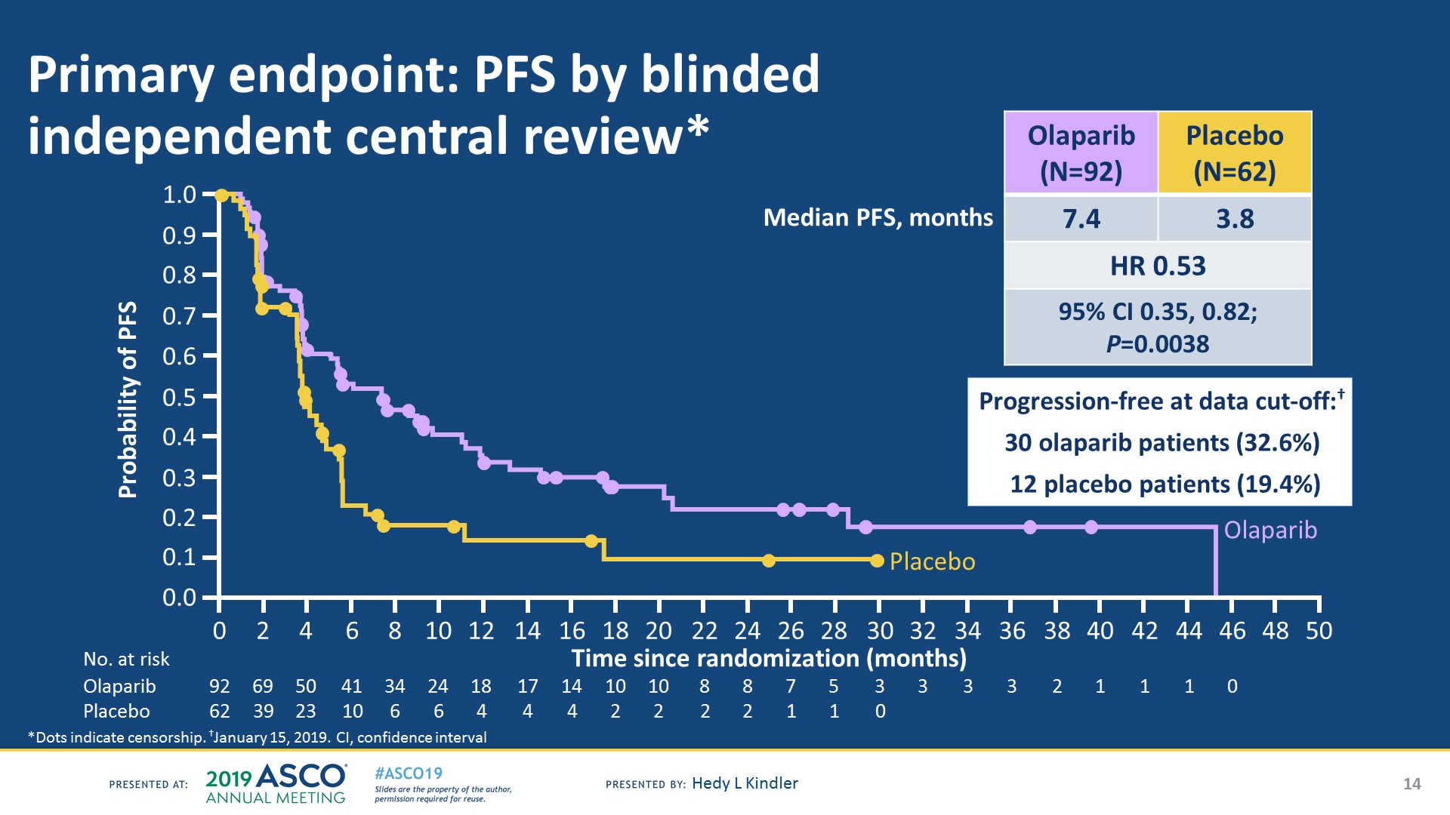
Kindler HL et al. Proc ASCO 2019;Abstract LBA4.

Slide 32
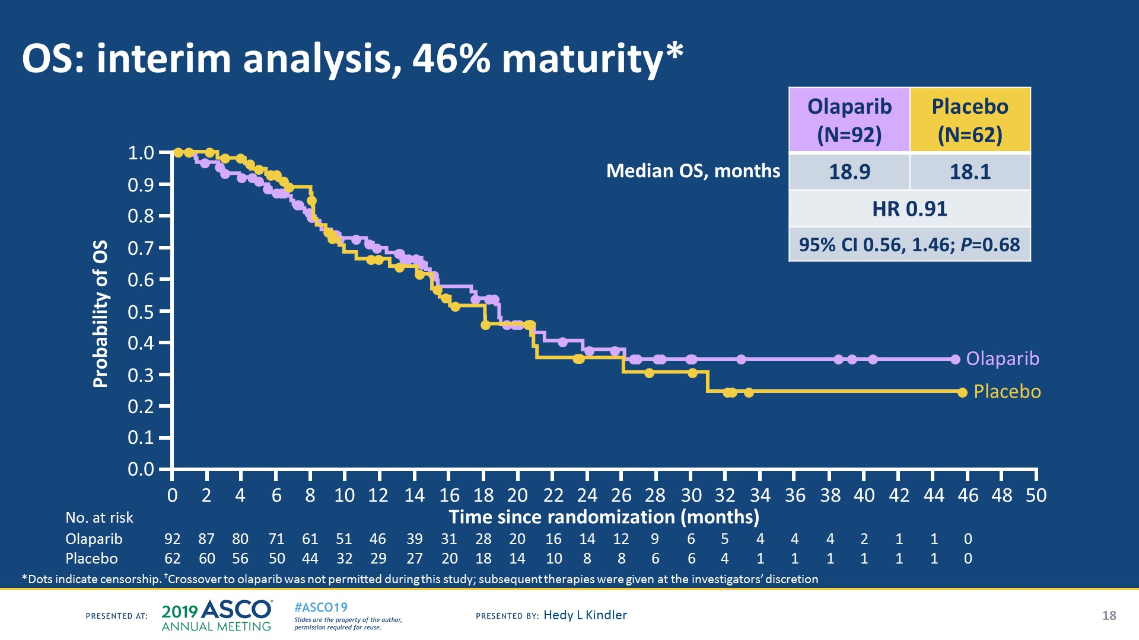
No OS benefit yet with minimal usage of subsequent PARP
Subsequent treatment with a PARP inhibitor:†
1 olaparib patient (1.1%)
9 placebo patients
(14.5%)
Final OS analysis planned at 106 events
Kindler HL et al. Proc ASCO 2019;Abstract LBA4.

Slide 33
FDA Approval of Olaparib based on POLO
On December 27, 2019, the Food and Drug Administration approved olaparib for the maintenance treatment of adult patients with deleterious or suspected deleterious germline BRCA-mutated (gBRCAm) metastatic pancreatic adenocarcinoma, as detected by an FDA-approved test, whose disease has not progressed on at least 16 weeks of a first-line platinum-based chemotherapy regimen.
The FDA also approved the BRACAnalysis CDx test (Myriad Genetic Laboratories, Inc.) as a companion diagnostic.

Slide 34
NCCN Updated Guidelines 2019
NCCN Pancreatic Cancer (Version 2.2019 – released 4/9/2019)
Germline testing should be considered is recommended for any patient with confirmed pancreatic cancer using comprehensive gene panels for hereditary cancer syndromes. Genetic counseling is recommended for patients who test positive for a pathogenic mutation or for patients with a positive family history of cancer.
Tumor/somatic gene profiling is recommended for patients with locally advanced/metastatic disease who are candidates for anticancer therapy, to identify uncommon but actionable mutations.
NCCN Genetic/Familial High-Risk Assessment BC/OC (Version 3.2019 – 1/18/2019)
Genetic risk evaluation recommended for any individual diagnosed with pancreatic cancer.
©National Comprehensive Cancer Network
Wells Messersmith, MD (University of Colorado Cancer Center)

Slide 35
Algorithm for management of localized pancreatic cancer
Suspected pancreatic cancer
Locally advanced unresectable
Borderline resectable
Clearly resectable
Neoadjuvant chemo
Or chemorads
Neoadjuvant chemorads/
chemo
surgery
Re-assess
resectability
Adjuvant
therapy
Yes
No
Surgery
adjuvant
therapy
chemo

Slide 36
Margin Positive resection
= poor survival
Institution | Margin + Resection rate | Median OS (R2) months | Median OS (R1) months | Median OS (R0) months
Mayo Clinic ¹ | 24% | 10 | 15 | 18.5
Johns Hopkins ² | 42% | 9 | 14 | 20
MGH ³ | 30% | 11 | 15 | 22
¹Fatima J et al: Arch surg 2010, ²Winter JM et al: J Gastrointest surgery 2006, ³Konstantinidis IT et al: Ann Surg 2013

Slide 37
Goals of neoadjuvant approach for resectable or borderline resectable pancreatic cancer
Decrease local recurrence
  Permit adequate surgical resection (R0 ideally)
  Potentially make surgery more technically feasible
Prevent/delay distant recurrence
  Start with the therapy against the most life-threatening issue (metastases)
Prevent surgery in patients who would not benefit
  Follow “incidental findings” on scan (lung nodules; tiny liver lesions; lymph nodes)
  Characterizing the biology of the cancer
Ultimately, improve survival

Slide 38
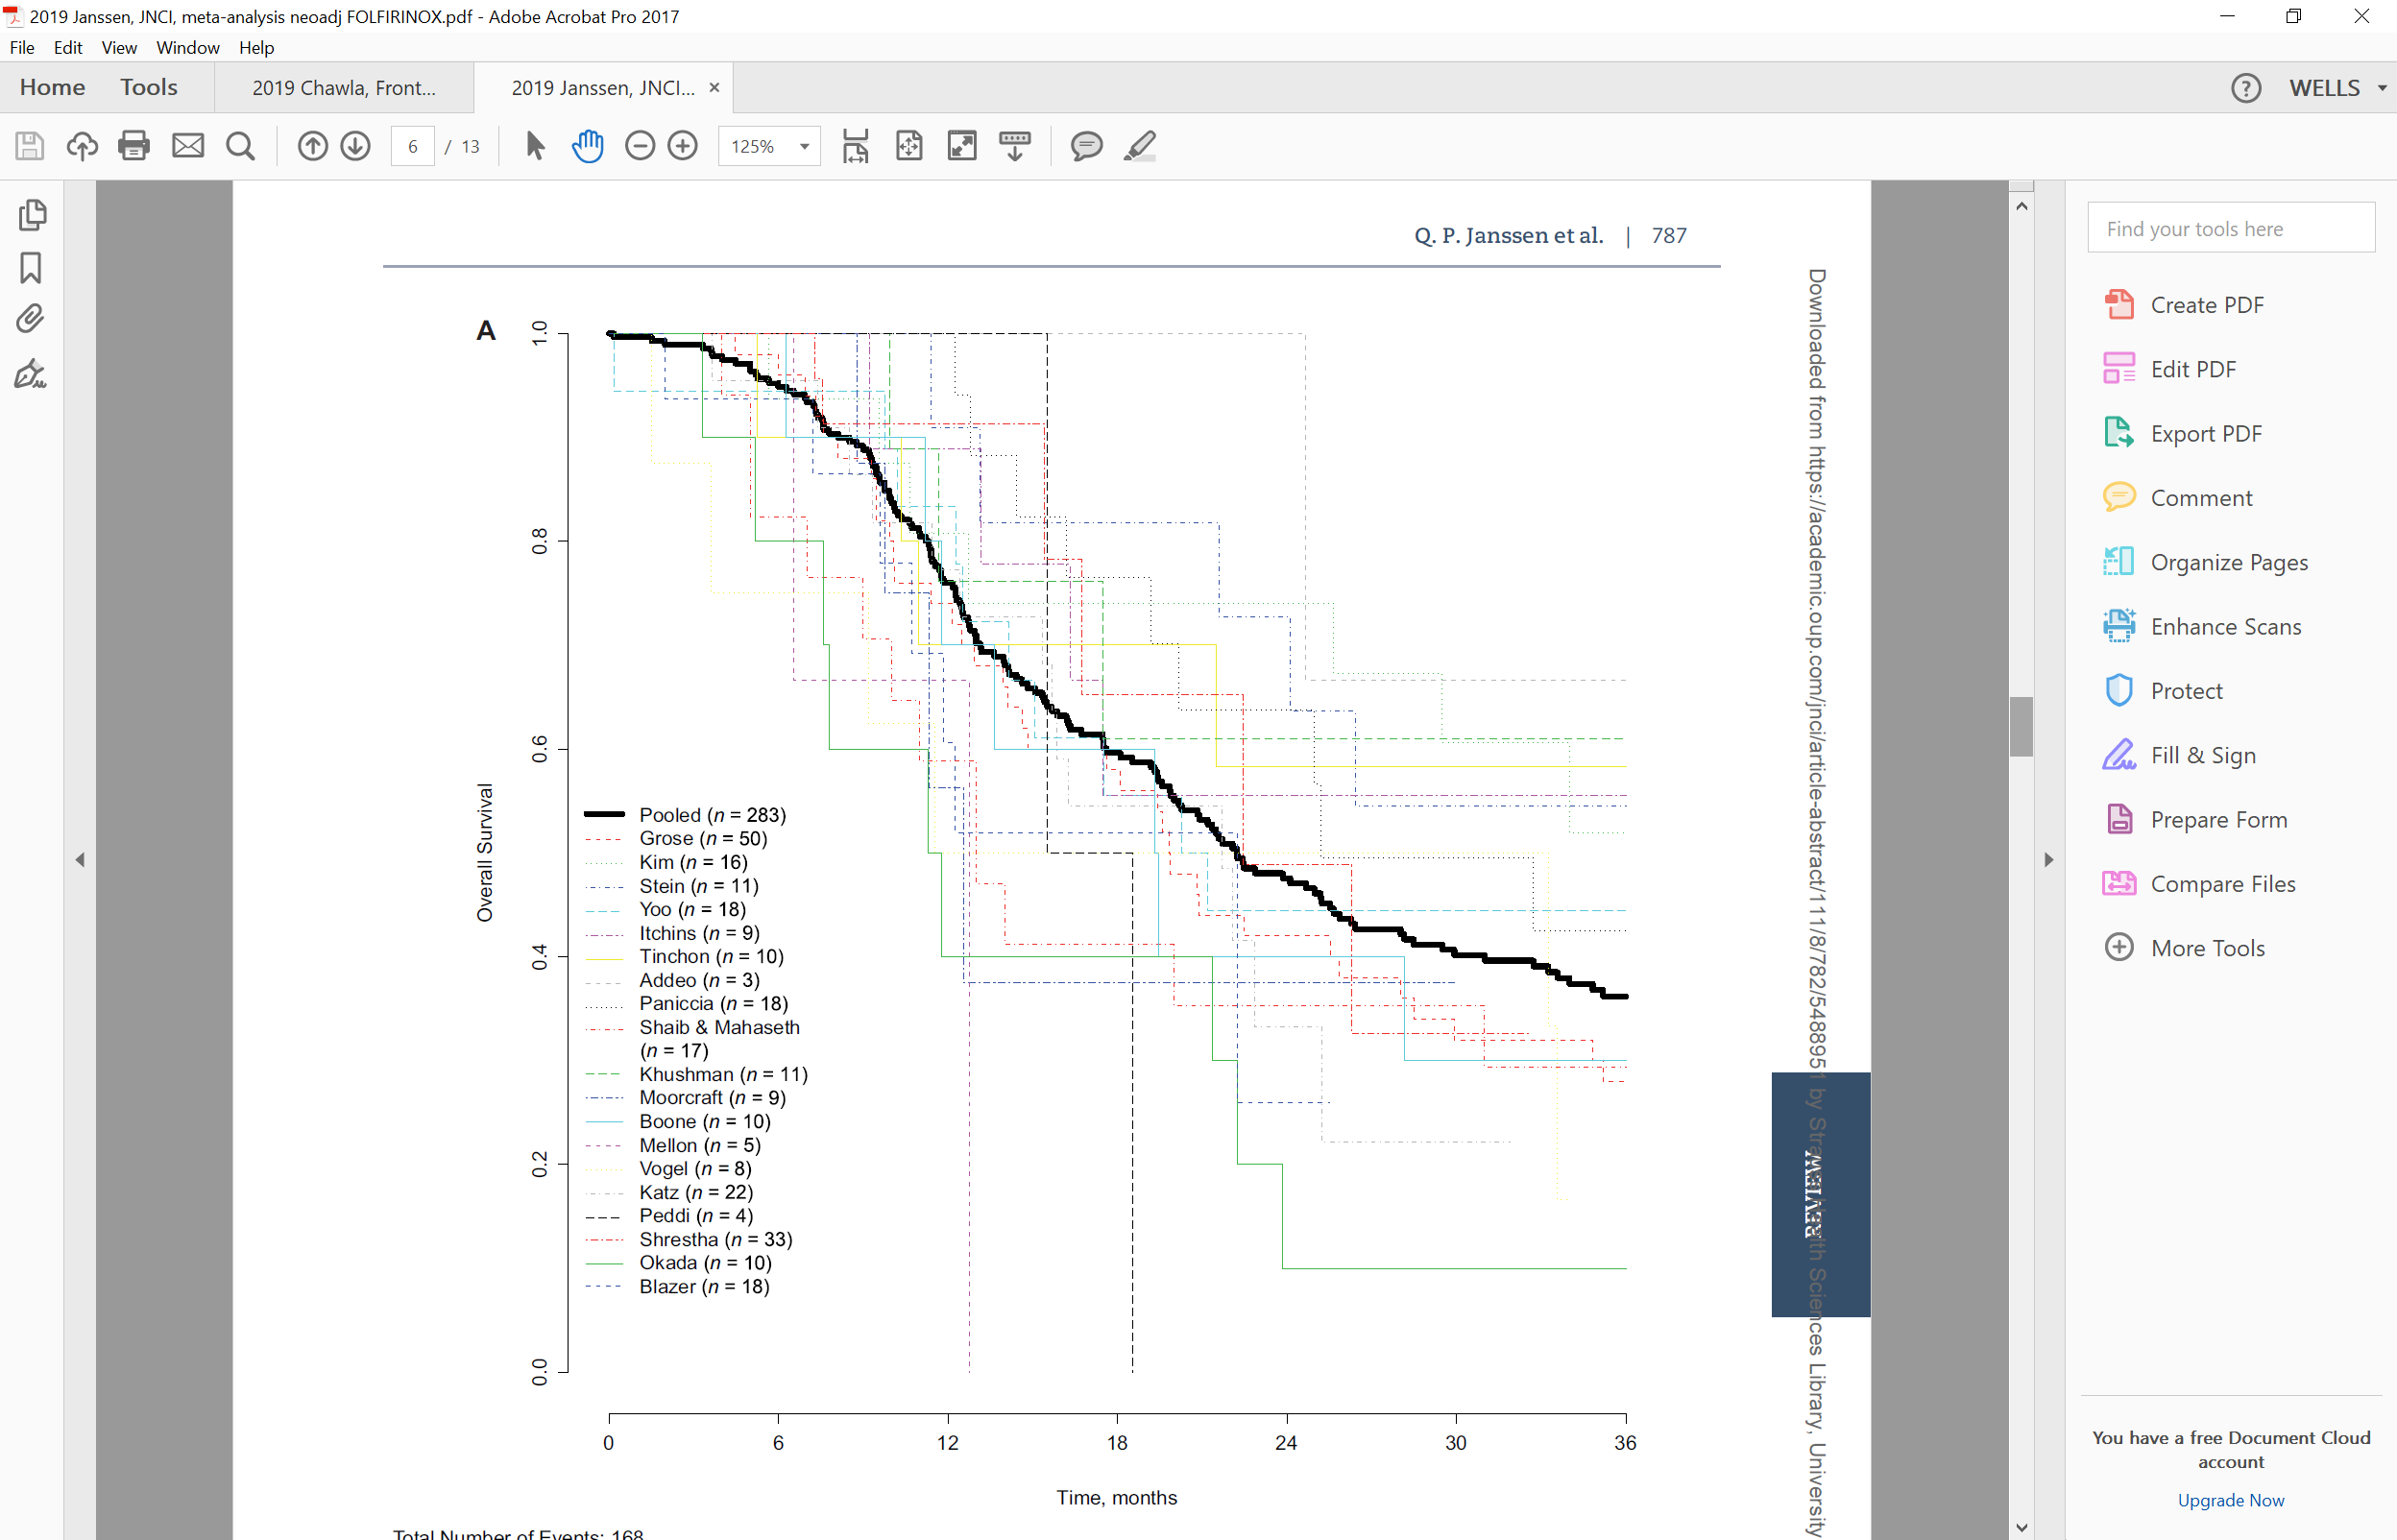
Key Neoadjuvant Studies for Pancreatic Adenocarcinoma
Study | Tx | Median survival (mo)
PREOPANC-1 (2018) N=246 | Peri-op Gem and chemorads v. post-op Gem | 29.9 vs. 16.8 (p<.001)
JSAP-05 (2019) N=364 | Peri-op Gem and S-1 v. adjuvant S-1 | 36.7 vs. 26.6 (p=.015)
Meta-Analysis (2019) N=283 (19 pubs) | Single-arm preoperative FOLFIRINOX | 22.2
Janssen, JNCI (2019) 111(8)
Several trials have shown a survival benefit to a neoadjuvant or peri-operative approach.

Slide 39
Key Adjuvant Studies for Resected Pancreatic Adenocarcinoma
Study | Tx | 2 year survival | 5 year survival | Disease or progression-free survival (mo) | Median survival (mo)
CONKO-1 (2013) N=354 | Obs v. Gem | 42% v. 47% | 11% v. 22% | 6.9 v. 13.4 (p<.001) | 20 v. 22.8 (p=.01)
RTOG-9704 (2008) N=538 | Gem- 5FU/XRT v. 5-FU-5FU/XRT | 35% v. 39% | ~ 20% v. ~20% | NR | 20.6 v. 16.9 (p=.03)
ESPAC-3 (2009) N=1030 | Gem v. 5FU | ~40% v. 40% | 17.5% v 15.9% | 14.3 v. 14.1 | 23.6 v. 23
ESPAC-4 (2016) N=722 | Gem (6 mo) versus Gem/cape (6 mo) | ~50% v 50% | 16.3% v 28.8% | NR | 25.5 v. 28.0
PRODIGE (2018) N=493 | FOLFIRINOX (6m) versus Gem | 3y: 40% v. 21% | NR | 21.6 v. 12.8 (DFS) | 54.4 v. 35
APACT (2019) N=866 | Gem/pac (6m) versus Gem | NR | NR | 19.4 v 18.8 (NS) | 40.5 v. 36.2

Slide 40
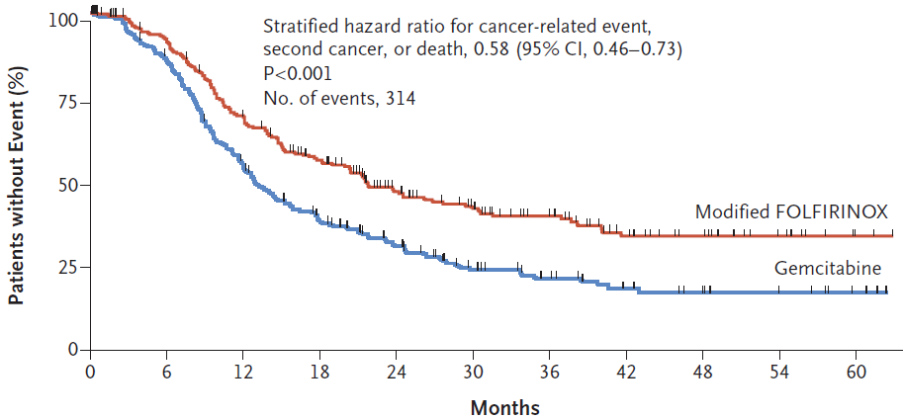
PRODIGE Adjuvant Study: Disease-Free Survival
Conroy, N Engl J Med 2018;379:2395-406.
©Massachusetts Medical Society

Slide 41
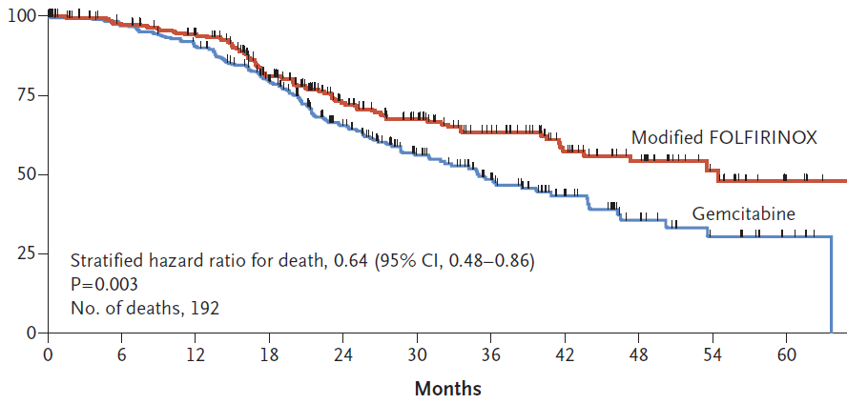
PRODIGE Adjuvant Study: Overall Survival
Conroy, N Engl J Med 2018;379:2395-406.
©Massachusetts Medical Society

Slide 42
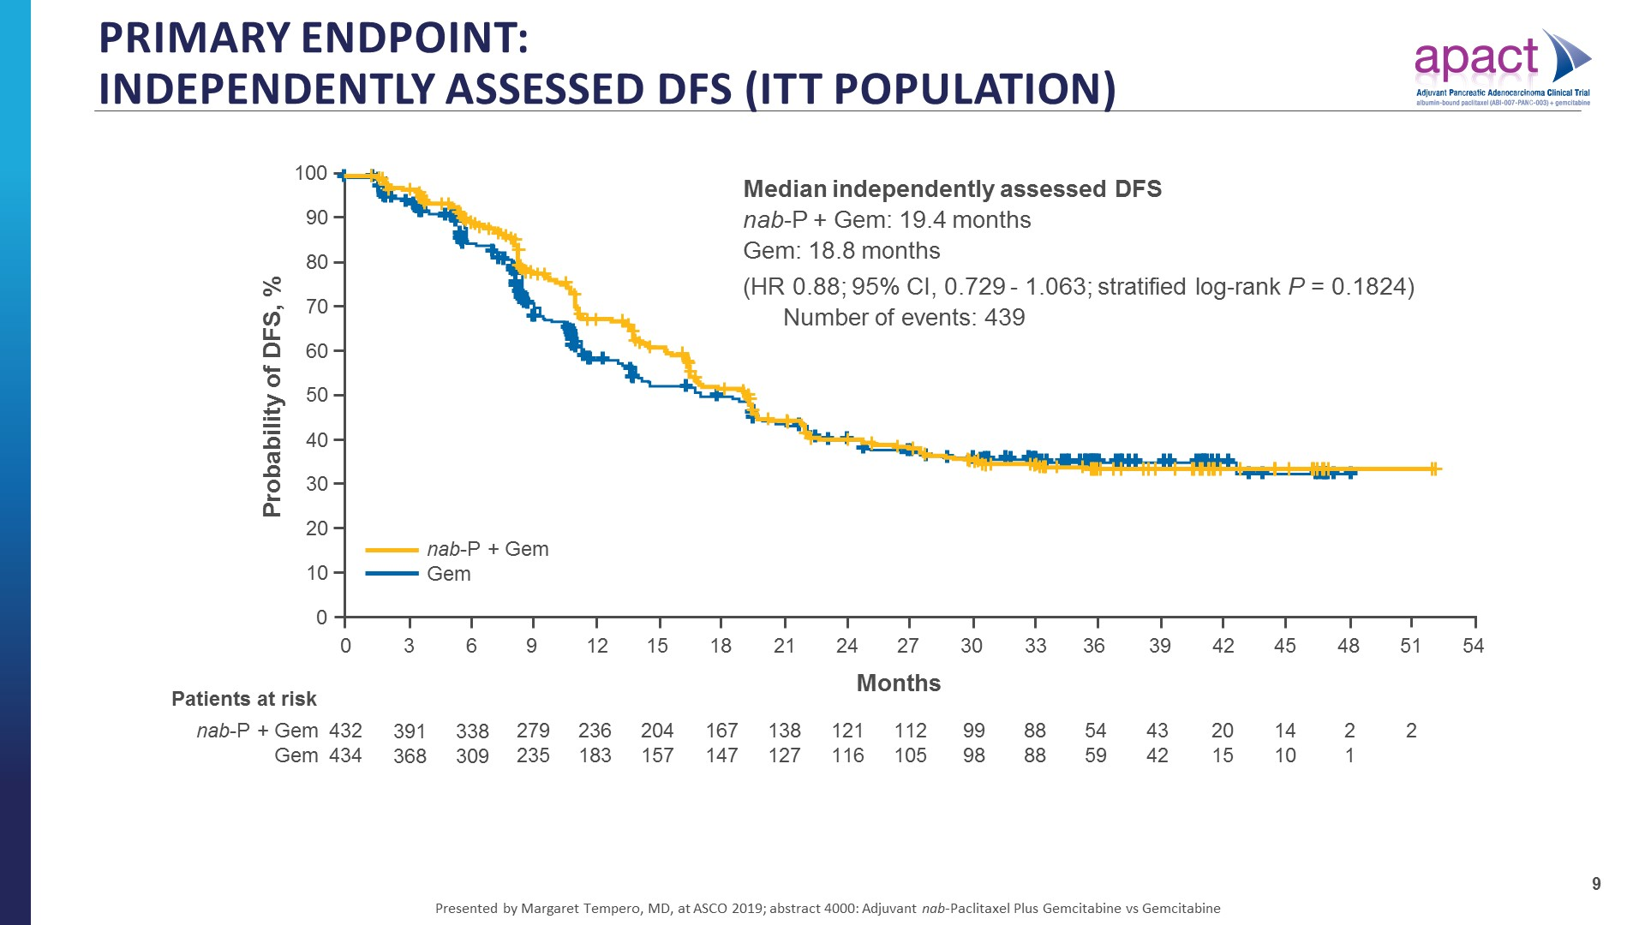
Median DFS 19.4 vs. 18.8 mths, NS
Tempero, Journal of Clinical Oncology 37, no. 15_suppl (May 20, 2019) 4000

Slide 43
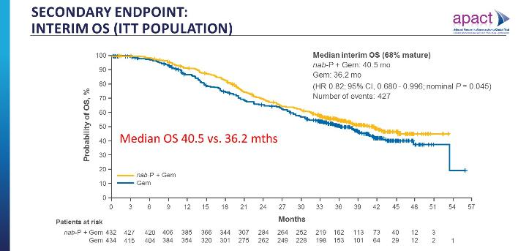
Secondary endpoint:<br />Interim os (Itt population)
Tempero, Journal of Clinical Oncology 37, no. 15_suppl (May 20, 2019) 4000

Slide 44
Take Home Points - APACT
The primary endpoint of independently assessed DFS was not met
Investigator-assessed DFS aligned more closely with OS results than independently assessed DFS
OS with Gem monotherapy (control arm) was markedly improved from prior studies, suggesting better patient selection and benefit from contemporary therapies upon recurrence
Interim OS analysis is trending positively, final analysis pending
The nab-P + Gem safety profile was consistent with prior studies
Tempero, Journal of Clinical Oncology 37, no. 15_suppl (May 20, 2019) 4000

Slide 45
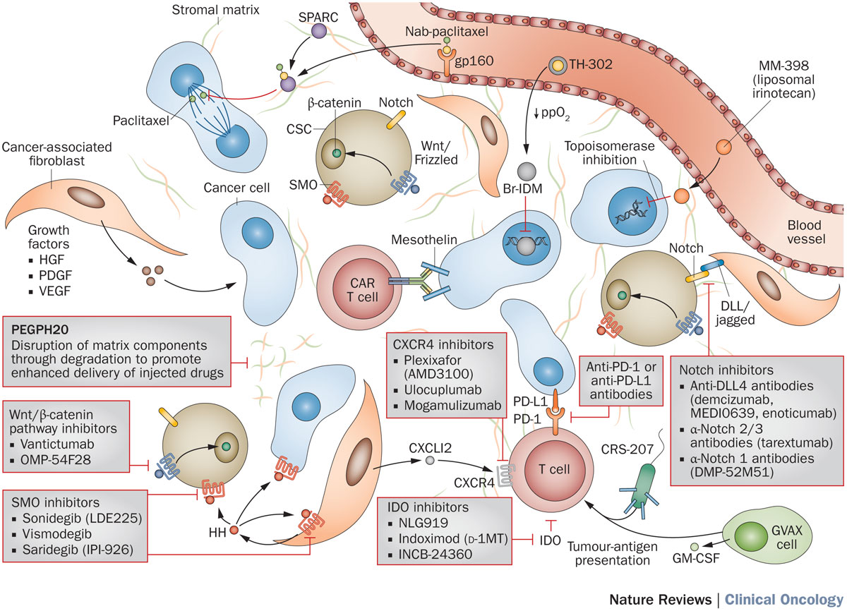
Novel Therapies in Pancreas Cancer
Garrido-Laguna, I, Hildalgo, M. Nat Cancer Reviews, 2015

