Slide 1
Module 4:
Hodgkin and Non-Hodgkin Lymphomas

Slide 2

 | Percent with Patients | Number of Patients (Median)
Follicular lymphoma | 96 | 5
Mantle cell lymphoma | 80 | 3
Hodgkin Lymphoma | 96 | 3
Relapsed/refractory diffuse large B-cell lymphoma | 80 | 3
Peripheral T-cell lymphoma | 48 | 2
Anaplastic large cell lymphoma | 32 | 1

Slide 3

Follicular lymphoma
Defining risk and sequencing therapy
Jonathan W Friedberg, MD, MMSc
Samuel E Durand Professor of Medicine
Director, James P Wilmot Cancer Institute
University of Rochester
Rochester, New York

Slide 4
Disclosures
Data and Safety Monitoring Board/Committee | Acerta Pharma — A member of the AstraZeneca Group, Bayer HealthCare Pharmaceuticals

Slide 5
47 yo dentist with follicular lymphoma
2013: Inguinal adenopathy (South America)
  Diagnosis low grade FL
  XRT bilateral pelvis and rituximab x 8
2016 Recurrent disease
  BR x 6 in Florida
Achieved CR

Slide 6
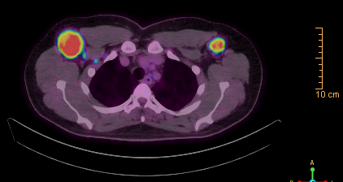
47 yo dentist with FL
August 2019:
  New lymph node noticed while shaving

Slide 7
47 yo dentist with follicular lymphoma
Biopsy of right axilla:
  Grade 2 FL; single small focus of grade 3A

Slide 8

How would you treat this patient?
(R) or (G) CHOP
(R) or (G) CHOP + ASCT
(R) or (G) Lenalidomide
(R) or (G) Lenalidomide + ASCT
PI3K inhibitor +/- CD20
CAR-T cells
Other

Slide 9
47 yo dentist with follicular lymphoma
Biopsy of right axilla:
  Grade 2 FL; single small focus of grade 3A
Impression: “Borderline” high risk FL
Discussed:
  Lenalidomide/obinutuzumab
  Consider ASCT

Slide 10
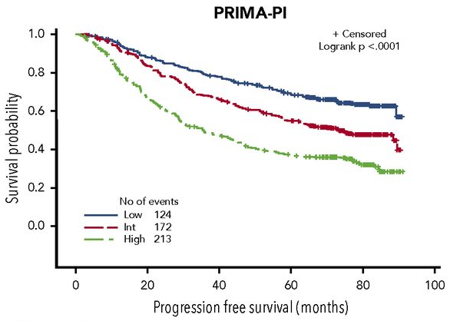
Refining clinical risk beyond FLIPI: beta-2 microglobulin (beta-2m)
PRIMA-PI:
Balanced sizes of risk groups
Beta-2m above 3 mg/L = high risk
Beta-2m ≤ 3 mg/L with marrow
involvement = int risk
Beta-2m ≤ 3 mg/L without marrow
involvement = low risk
Bachy et al, Blood 132:49-58, 2018

Slide 11
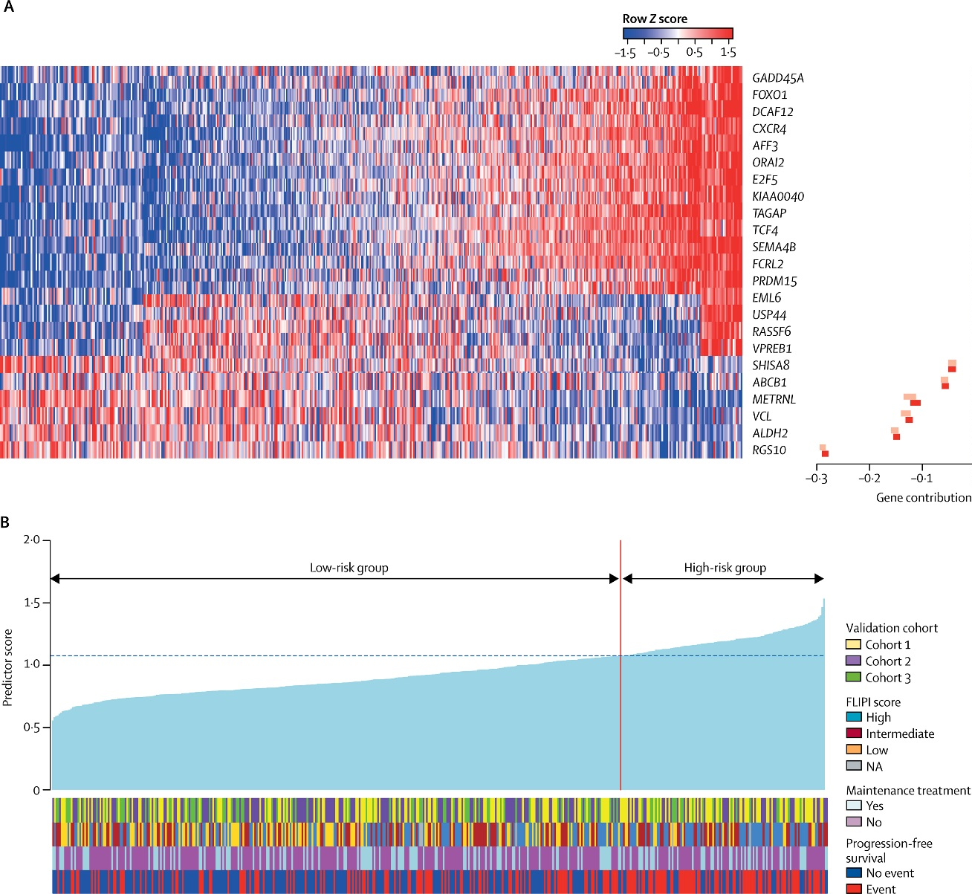
Gene-expression profiling score to predict FL outcome (based upon PRIMA)
5 year PFS:
26% high-risk group 73% low-risk group
2 year progression:
38% high-risk group 19% low-risk group
Exploratory analysis:
“ICA13” signature characteristics of Burkitt-like cells and centroblasts.
Huet et al, Lancet Oncol 2018

Slide 12
Prognostic indices: Current status
  Several recent prognostic indices incorporating gene expression and mutation analyses confirm biological heterogeneity of follicular lymphoma.
  Low frequency clones at diagnosis often contribute to therapy resistance and transformation; these may not appear in routine genetic and molecular studies.
  At present, none of these indices serve as predictive biomarkers for a precision medicine approach to therapy.
    The ability to analyze circulating tumor DNA may accelerate progress in this area.

Slide 13
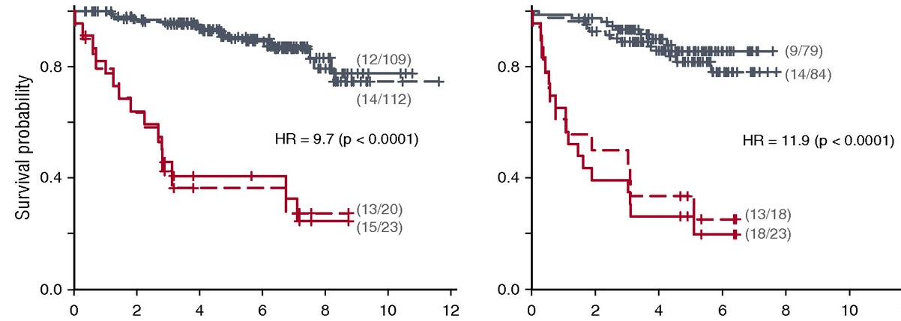
Early relapse associated with high mortality in FL
GLSG
BCCA
No early progression
Early progression
Overall survival in years from
risk-defining event
Overall survival in years from
risk-defining event
Jurinovic et al, Blood 128:1112 2016

Slide 14
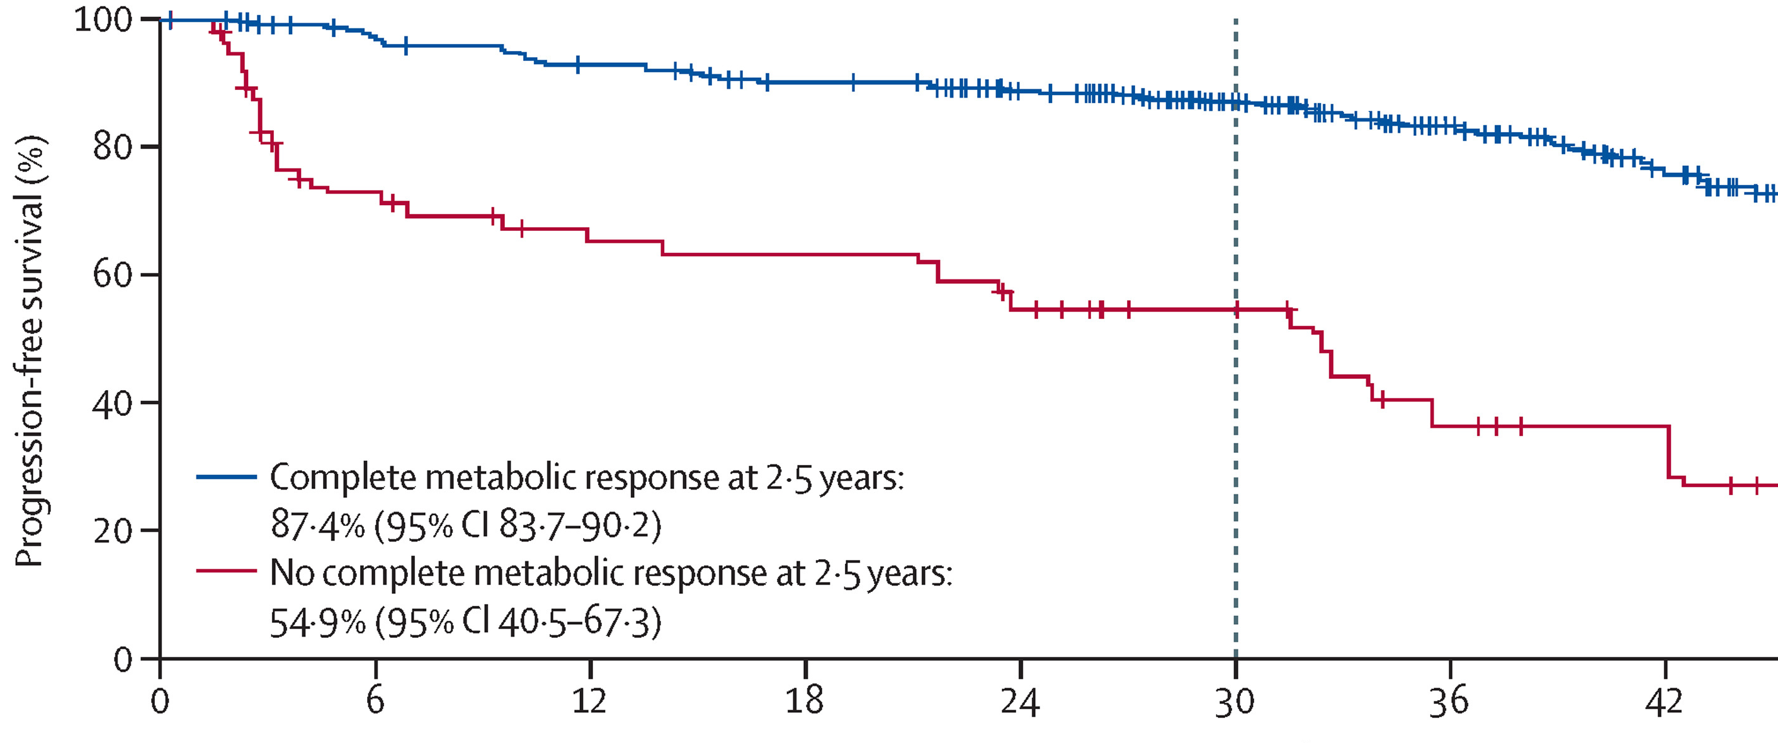
PET positivity at end of chemoimmunotherapy predicts for poor outcome in follicular lymphoma
GALLIUM patient population
Subset with PET scans
Lugano criteria most predictive
Identifies 12% of patients with poor outcomes
PET CR 87% 30 month PFS
N=448
PET nonCR 55% 30 month PFS
N=60
Trotman et al., Lancet Oncology 19:1530-42, 2018

Slide 15
GADOLIN Study: Rituximab-refractory FL
G-B
CR/ PR/ SD
G-maintenance
Rituximab-refractory
CD20+ iNHL
(incl FL, MZL and SLL)
(N=413)
Obinutuzumab
1000 mg i.v. Days 1, 8 and 15 Cycle 1;
Day 1 Cycle 2–6 (28 day cycles)
Bendamustine
90 mg/m²/day i.v. Days 1 and 2 Cycles
1–6 (28 day cycles)
Obinutuzumab
1000 mg i.v. every 2 months for 2 years or until progression
R
1:1
Stratification factors:
NHL subtype (FL vs other)
Prior therapies (≤2 vs >2)
Refractory type (R-mono vs R-chemo)
Geographic region
B
Bendamustine
120 mg/m²/day Days 1 and 2 Cycles 1–6 (28 day cycles)
International, randomized, open-label study
Response monitored by CT scan post-induction, then every 3 months for 2 years, then every 6 months (modified Cheson criteria 2007)
Sehn et al, Lancet Oncol 17:1081 2016

Slide 16
GADOLIN: OS improvement seen in long-term follow-up
OS: FL cohort
1.0
G-B, n=164
B, n=171
Bendamustine-obinutuzumab
0.8
Pts with event, n (%)
39 (23.8)
64 (37.4)
Probability
0.6
Bendamustine
Median OS (mo)
NR (NR, NR)
53.9
(40.9, NR)
0.4
HR (95% CI),
p-value
0.58 (0.39, 0.86), p=0.0061
0.2
0
0
6
12 18 24 30 36 42 48 54 60 66
Median follow-up (FL): 31.2 months
Time (months)
Cheson et al. JCO 36:2259-66, 2018

Slide 17
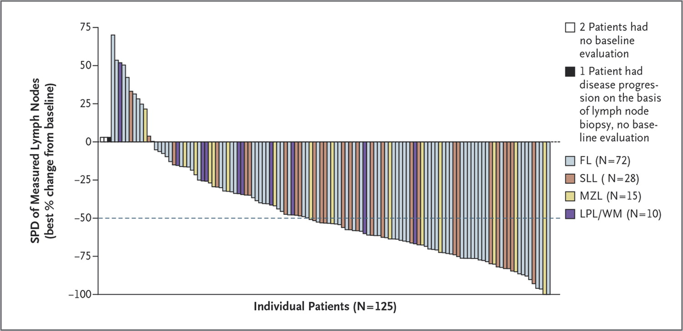
Treatment options for early FL progression: Idelalisib
Patients with indolent NHL refractory to rituximab and alkylating agents
ORR 57%; 6% CR
Median PFS 11 months
Manageable toxicity profile
FDA approval: Relapsed FL in patients who received 2 prior systemic therapies
Gopal et al, NEJM 370:1008-18, 2014

Slide 18
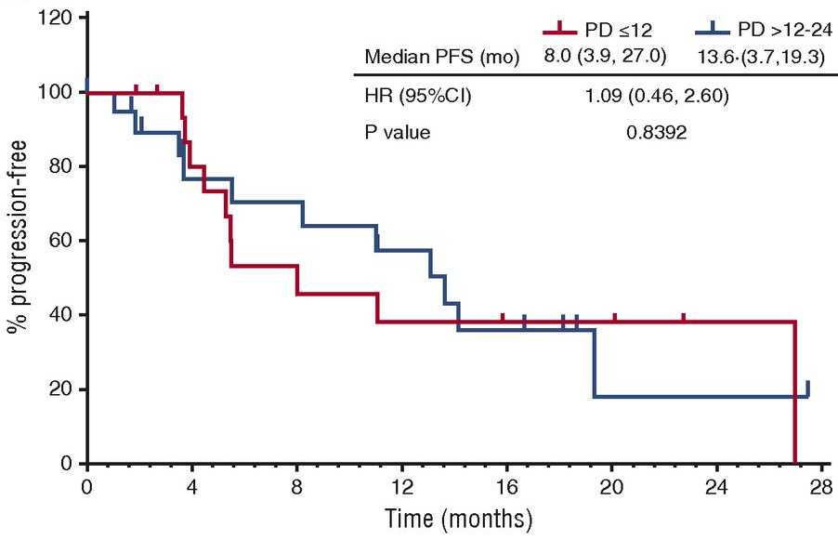
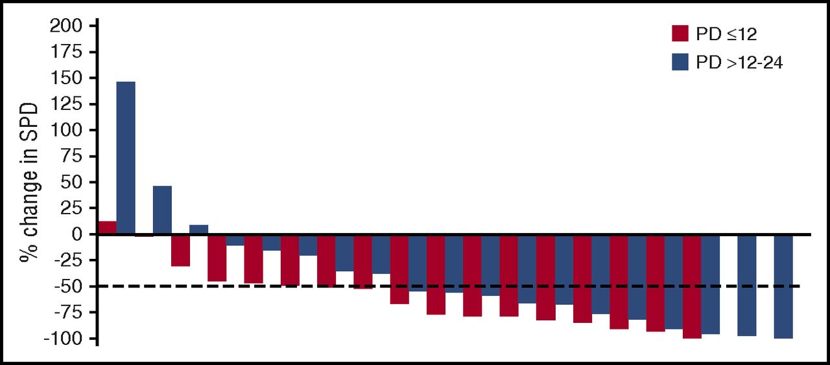
Idelalisib in “high risk” early progressing FL
PD 12-24
PD < 12
Gopal et al, Blood 129:3037 2017

Slide 19
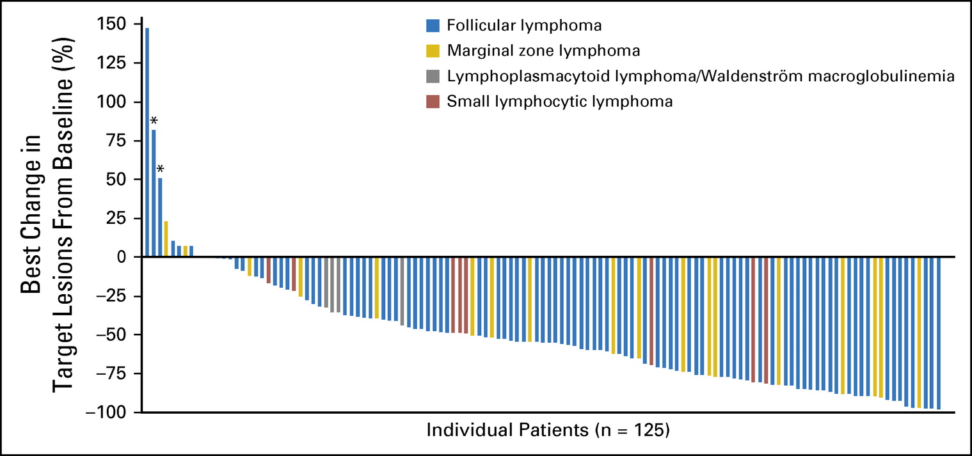
Copanlisib for relapsed/refractory indolent lymphoma
(after rituximab and alkylating agents)
FL patients: ORR 59%; CR 14%; Median DOR 12 months, Median PFS 11 months
Dreyling et al., JCO 35:3898 2017

Slide 20
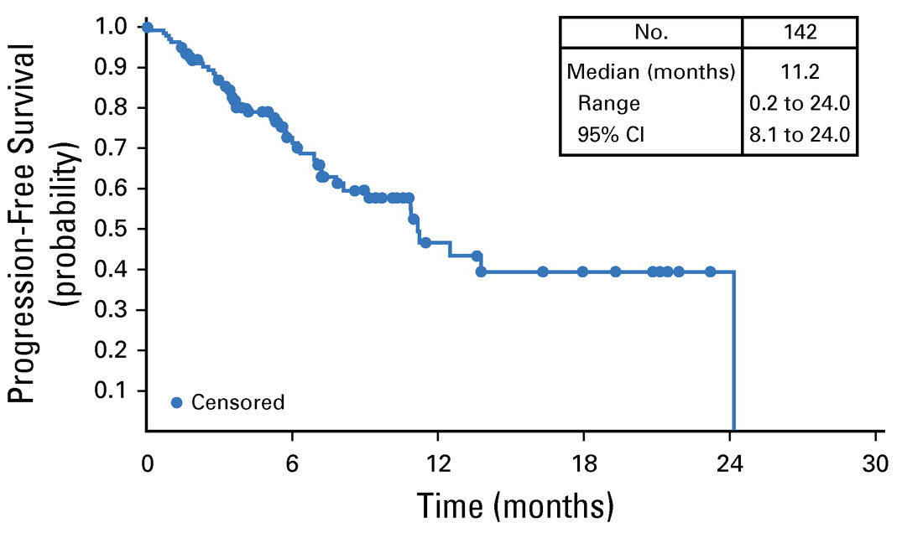
Copanlisib: Toxicity and Efficacy
Increased LFTs and cytopenias
Hypertension
Hyperglycemia
Dreyling et al., JCO 35:3898 2017

Slide 21
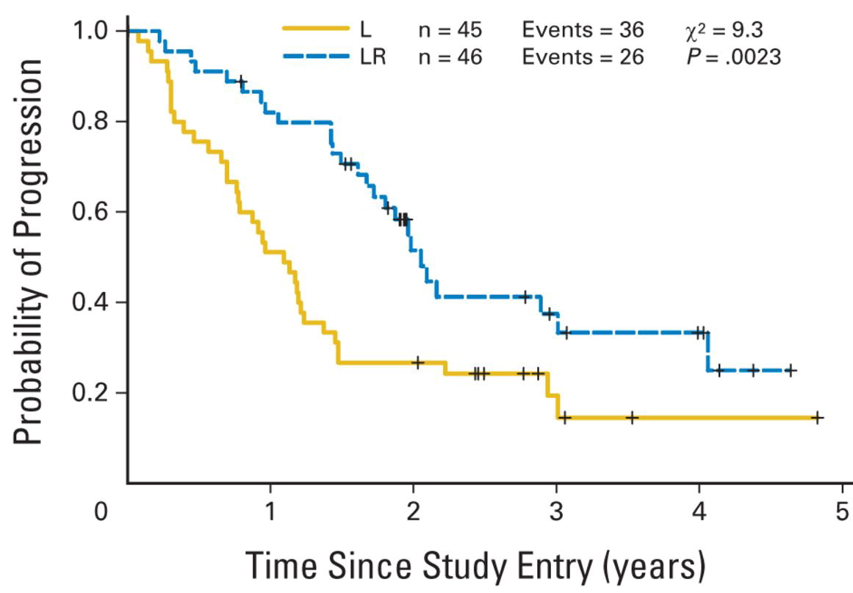
Treatment options for early FL progression:
Lenalidomide and rituximab
Time to progression
 | L | L + R
ORR | 51.1% | 72.7%
CR | 13.3% | 36.4%
2 year EFS | 27% | 44%
p = 0.002 (log-rank test)
Lenalidomide-rituximab
Median TTP = 2 years
Lenalidomide
Median TTP = 1.1 years
Leonard et al, JCO 33:3635 2015

Slide 22
AUGMENT trial
≤ 12 cycles or until PD, relapse, or intolerability
R-lenalidomide (R²)
Rituximab: 375 mg/m² d1, 8, 15, 22 of cycle 1; d1 of cycles 2-5
Lenalidomide: 20 mg/d*, d1-21/28 (12 cycles)
5-year follow-up for OS, SPMs, subsequent treatment, and histological transformations
Relapsed/refractory
FL and MZL
(N = 358)
1:1
R-placebo
Rituximab: 375 mg/m² d1, 8, 15, 22 of cycle 1; d1 of cycles 2-5
Placebo: matched capsules (12 cycles)
Primary endpoint: PFS by IRC (2007 IWG criteria w/o PET)
Leonard et al., JCO 37:1188-99 2019

Slide 23
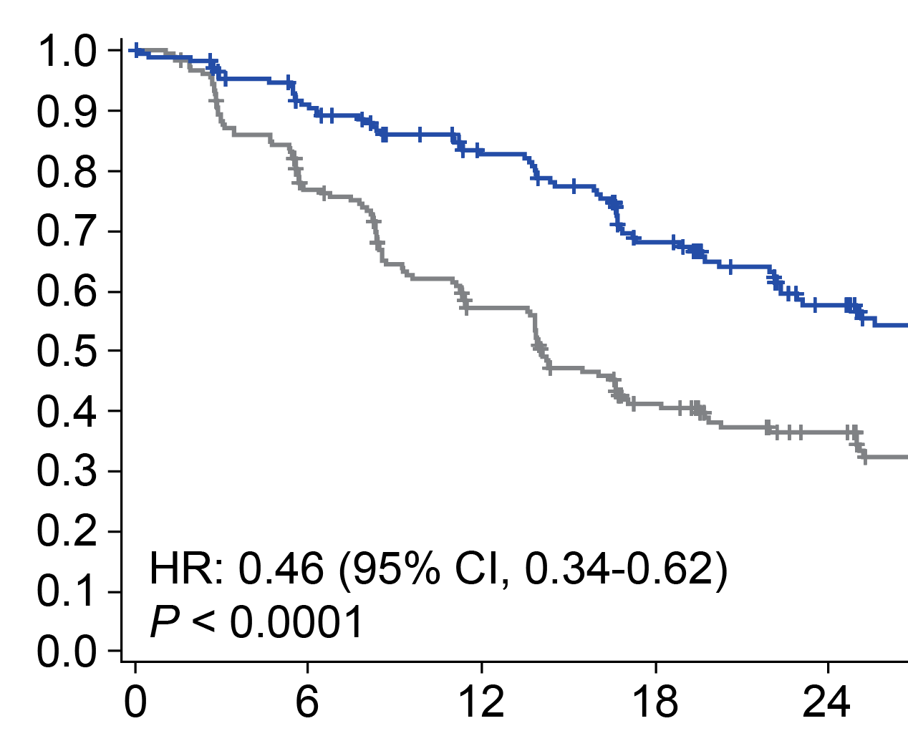
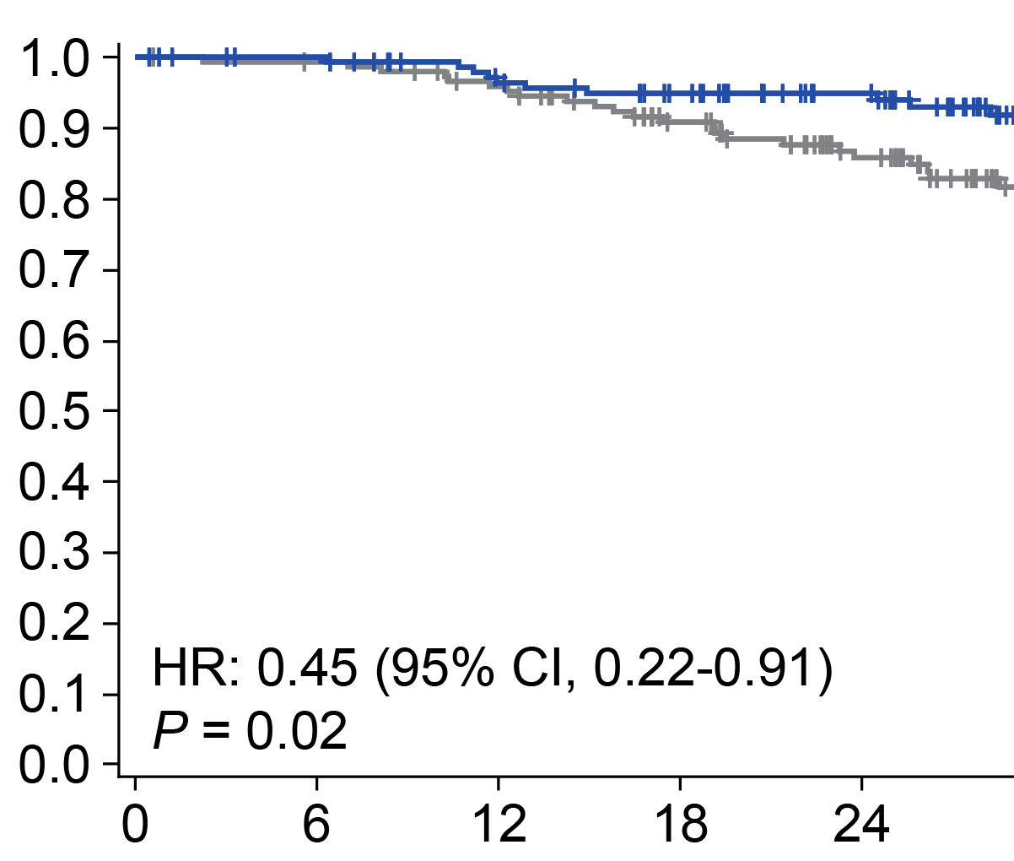
AUGMENT trial: Rituximab vs. R-lenalidomide
PFS
All patients (Primary endpoint)
OS
FL Subset
R-Lenalidomide
Rituximab
Leonard et al., JCO 37:1188-99 2019

Slide 24
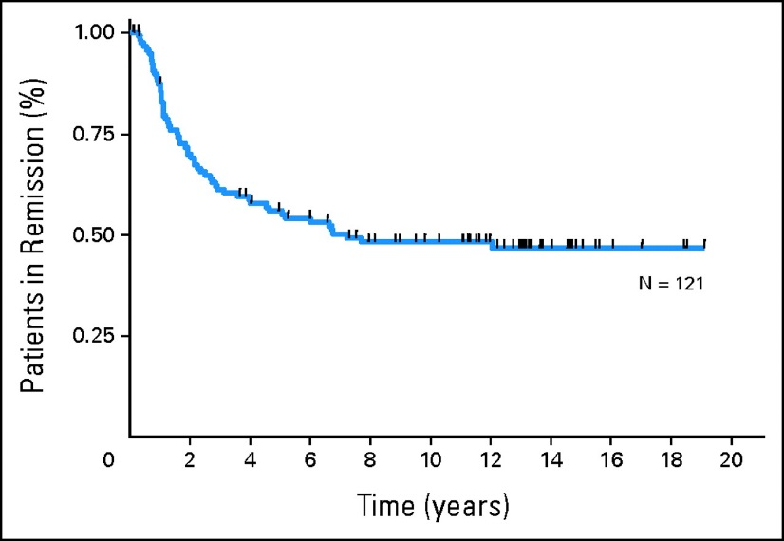
Prolonged PFS: ASCT in second remission for FL
121 patients, median f/u 13 yrs; pre-rituximab era
60 patients have relapsed
15 deaths from MDS/AML
Apparent PFS plateau at 48%
Rohatiner et al JCO 25:2554, 2007

Slide 25
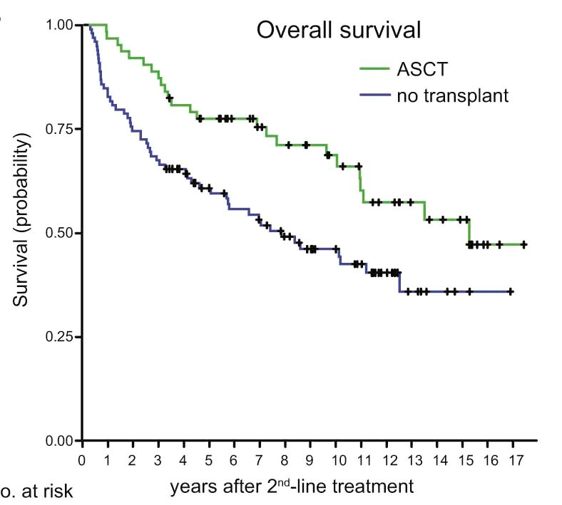
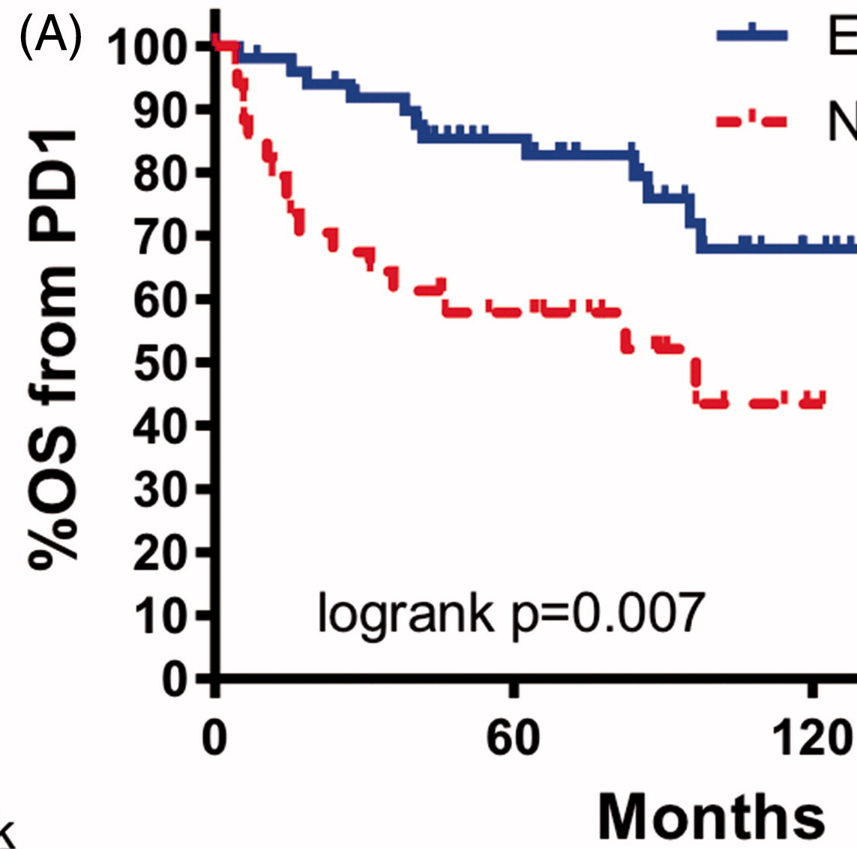
OS: Early progressing FL, ASCT vs. no ASCT
Calgary and German cohorts (nonrandomized)
Calgary
Germany
HR = 0.53
p = 0.0086
ASCT
ASCT
5-year OS = 78%
No ASCT
No ASCT
5-year OS = 60%
Manna et al. Leuk Lymphoma online 2018
Jurinovic et al., BBMT 24:1172-9 2018

Slide 26


SWOG-S1608: Randomized trial in early progressing/refractory FL
Primary clinical objective: CR by PET/CT
Primary translational objective: Validation of m7-FLIPI
FL progressing within 2 years or
PET positive after CHOP or Bendamustine based therapy
Umbralisib
+
Obinutuzumab
Lenalidomide
+
Obinutuzumab
Chemotherapy
+
Obinutuzumab
N =45
N =45
N =45

Slide 27
Conclusions
Sequencing therapy in high-risk FL
  Lenalidomide/rituximab or lenalidomide/obinutuzumab
  CHOP/obinutuzumab or bendamustine/obinutuzumab
  PI3K inhibitors more toxic and generally reserved for after lenalidomide
  Consider ASCT for younger fit patients
  SWOG-S1608 very appealing trial option for these patients
Friedberg JCO 36:2363-65 2018

Slide 28
Therapeutic Approaches for Mantle Cell Lymphoma and Upfront Treatment of Hodgkin Lymphoma
Mitchell R Smith, MD, PhD
Professor of Medicine
Associate Center Director for Clinical Investigations
Director, Division of Hematology and Oncology
GW Cancer Center
Washington, DC

Slide 29
Disclosures
Data and Safety Monitoring Board/Committee | Eastern Cooperative Oncology Group
Speakers Bureau | AstraZeneca Pharmaceuticals LP, EUSA Pharma

Slide 30
MCL CASE
In 2007, 58 yo man presented with fatigue, weight loss, and early satiety.
  Had splenomegaly and widespread lymphadenopathy
  Lymph node biopsy revealed MCL, Ki67 < 30%
  MIPI 6.3 (intermediate)
  VcR-CVAD (E1405 trial), achieved CR, Declined R maintenance or SCT
1st Relapse 2011 with symptomatic splenomegaly
  BR x 6 with CR; then Rituximab for 2 years
2nd Relapse 2015 with epistaxis (nasal polyp) and cytopenias. Marrow involved
  Ibrutinib (approved for MCL 2013), achieved CR
3rd relapse late 2016 (18 months) worsening splenomegaly and cytopenias; diffuse lymphadenopathy
  Splenectomy to control worsening cytopenias secondary to both hypersplenism and bone marrow involvement
  Spleen involved by MCL, Ki-67 60%
  Received CART on ZUMA-2 clinical trial April 2017, achieved CR
4th relapse August 2019 (just over 2 years), with SQ nodules forehead, pre-auricular area, biopsy + MCL
  Received palliative 200 x 2 XRT to SQ nodules with rapid remission
WHAT ARE TREATMENT OPTIONS NOW?
  VENETOCLAX (started) vs R² VS OTHER

Slide 31
Regarding mantle cell lymphoma (MCL), venetoclax:
Is FDA approved to treat MCL
Has caused tumor lysis so should be initiated carefully using ramped-up dosing
Has been shown to result in durable remissions after discontinuation of single agent therapy in patients who become MRD negative
Should be combined with a BTK inhibitor based on randomized trial data
Should be combined with an anti-CD20 monoclonal antibody based on randomized trial data

Slide 32
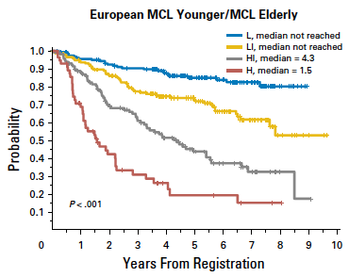
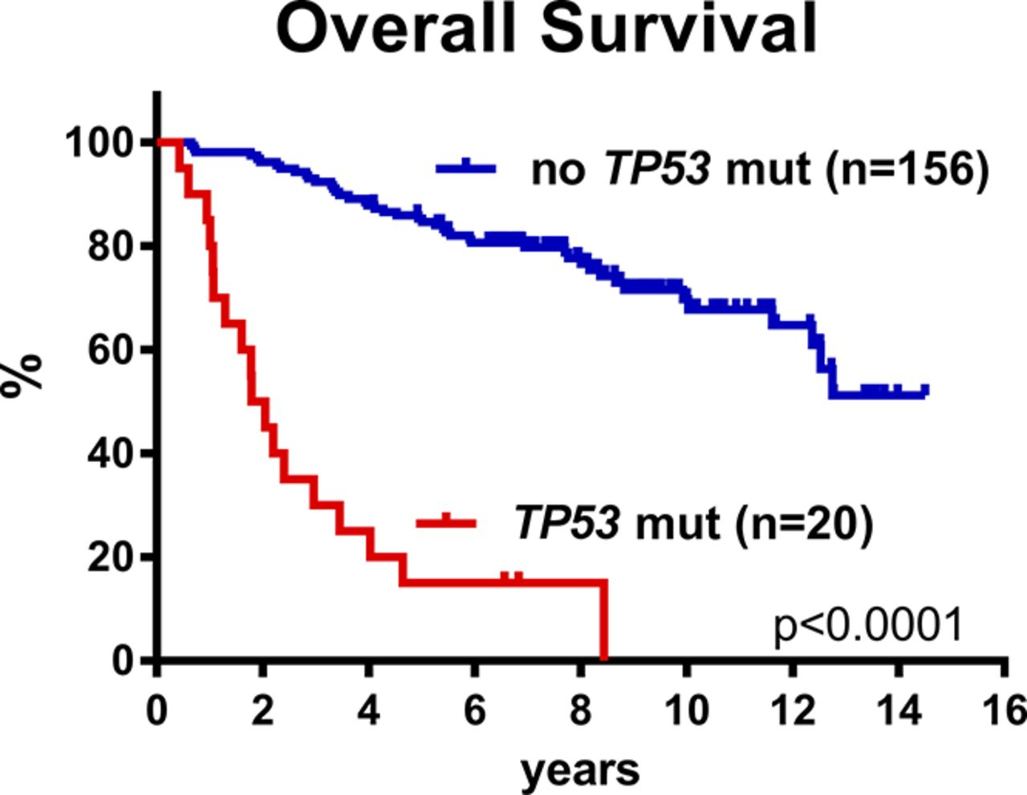
MCL: Prognostic Features
Overall Survival
MIPI:
Age, PS, LDH, WBC
+ Ki67 > 30%
Young patients on Nordic 2&3 trials
HDAC-R does not overcome p53mut status

Slide 33
NCCN GUIDELINES: MCL Frontline therapy 2020
AGGRESSIVE:
  Nordic regimen (R-Maxi-CHOP alt R-HiDAC → autoSCT)
  R-CHOP/R-DHAP
  R-DHA+PLATINUM
  R-HyperCVAD/R-HDMtx+Ara-C
  BR (category 2B)
Consolidation HDC/autoSCT + post-SCT rituximab q8wk x 3 years
LESS AGGRESSIVE:
  Preferred:
  BR
  VR-CAP
  R-CHOP [+ Rituximab maintenance]
  Lenalidomide-Rituximab (R²)
  Others:
  Modified R-HyperCVAD (part A) + rituximab maintenance
  ?RB-cytarabine (RBAC) (category 2B)
Rituximab maintenance?

Slide 34
MCL Frontline therapy: AGGRESSIVE
U.S. Intergroup S1106 (completed): BR x 6 vs R-HCVAD-MA x 4, then HDC/autoSCT
EA4151 / BMT-CTN1601: Investigator Choice of Initial Regimen
  Post-induction MRD negative, randomize to SCT or No SCT, + rituximab x 3 years
  Post-induction MRD+, SCT and eligible for other SCT/maintenance trials
European MCL Network TRIANGLE:
Ibr-R “window” until CR or up to 12 cycles followed by R-HCVAD-MA x 4 (age ≤ 65), no SCT
  80% low risk sMIPI, Ki67 < 50%, median age 56
  RR to Ibr-R 88% CR + 12% PR
  3 year estimated PFS 85% (median f/u 22 months, range 2-24 mos)
      Wang et al ASH2019 A3987
R-CHOP/
R-DHAP x 6
ASCT
Observation
R
Arm A + Ibrutinib
R-CHOP/
R-DHAP x 6 + I
ASCT
2 yrs I-maintenance
Observation
Ibr but NO ASCT
R-CHOP/
R-DHAP x 6 + I
2 yrs I-maintenance
Observation

Slide 35
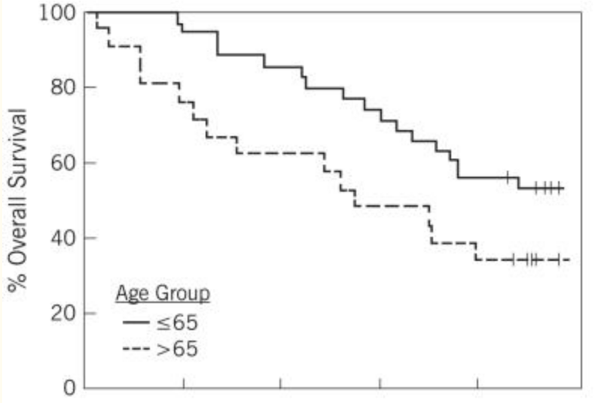
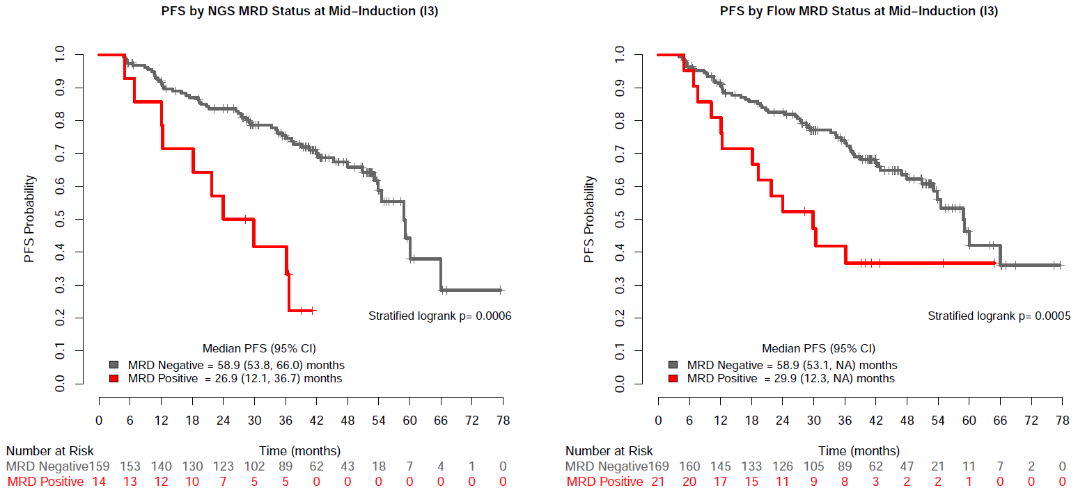
MCL Frontline therapy:
LESS AGGRESSIVE
E1411: BR(±V) + R(±Len)
R-CHOP x4 → RIT: 10 year f/u
Smith MR et al Leukemia 2017
N = 56
Mean age 67 years (range 42-90)
Smith MR et al ASH 2019
PFS by MRD STATUS, POST-CYCLE 3
N = 106
Median age 70
Rummel ASCO 2016
Overall Survival
N=169
N=21
0 2 4 6 8 10
years
Median PFS 43 months (3.5 yrs)
Median PFS ~ 5 years

Slide 36
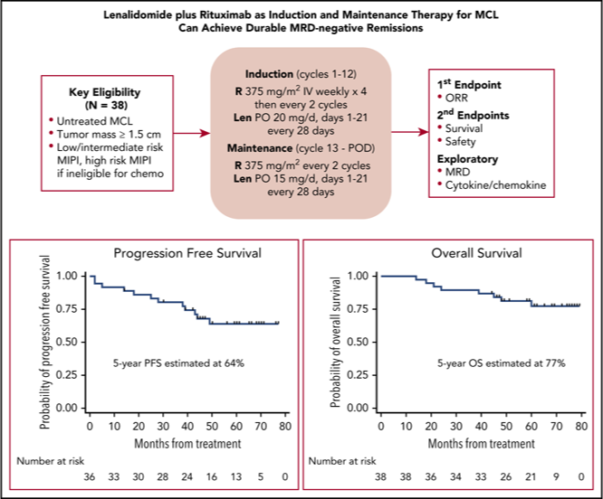
MCL Frontline therapy: LESS AGGRESSIVE
R² regimen: 5-year follow-up
N = 38
Ibrutinib-Rituximab, age > 65
Jain P et al ASH 2019 A3988
N = 50
Median f/u 22 months
60% CR + 28% PR
60% still on study,
38% off study, 4 PD, rest toxicity
Excluded blastoid or Ki67> 50%,
but 3 pts have transformed
Ruan J et al Blood 2018

Slide 37
NCCN GUIDELINES: MCL 2nd-Line therapy 2020
Shorter response to initial chemoimmunotherapy:
Preferred:
  BTKi
  acalabrutinib
  ibrutinib
  zanubrutinib
Lenalidomide-Rituximab (R²)
Venetoclax (off label)
Category 2B:
R²+ibrutinib;
ibrutinib + venetoclax
Longer response to initial CIT:
Preferred:
  BR (if not previously given)
  Bortezomib ± rituximab
  BTKi
  Lenalidomide-Rituximab (R²)
Other recommended:
Venetoclax (off label)
Category 2B:
BR + bortezomib
PEPC
R-CHOP or VRCAP (if not previously given)

Slide 38
MCL: NOT SO NOVEL AGENTS
MODE OF ACTION | AGENT
B CELL SIGNALING | BTKi PI3Ki (idelalisib short DoR, dual PI3K α+δ?) mTORCi (temsirolimus) EU approved
ANTIBODIES BISPECIFIC ANTIBODIES ANTIBODY DRUG CONJUGATE | OFATUMUMAB OBINUTUZUMAB (not that exciting) UBLITUXIMAB BLINATUMOMAB (αCD3/αCD19 bispecific Ab) POLATUZUMAB VEDOTIN
PRO-APOPTOTIC | VENETOCLAX (ABT-199)
IMMUNE THERAPY CHECKPOINT BLOCKADE | LENALIDOMIDE (R²) CAR-T CELL THERAPY NIVOLUMAB/PEMBROLIZUMAB

Slide 39
Relapsed/Refractory MCL
THERAPY | STATUS | N | Median Age | PRIOR Rx | ORR | CR | DOR (mos)
BORTEZOMIB | APPROVED | 155 | 65 | 1 (1-3) | 33% | 8% | 9
LENALIDOMIDE + rituximab | APPROVED (not filed) | 134 52 | 67 72 | 4 (2-10) 2 (1-4) | 28% 57% | 8% 36% | 17 19
IBRUTINIB | APPROVED | 111 | 68 | 3 (1-5) | 67% | 23% | 18
ACALABRUTINIB | APPROVED | 124 | 68 | 2 (1-5) | 81% | 40% | 20
ZANUBRUTINIB | APPROVED | 118 | 61 | 2 (1-4) | 84% | 59% | 20
VENETOCLAX | Off-label | 28 | 72 | 3 (1-7) | 75% | 21% | 14
IBR-VEN | Phase 2 | 24 | 68 | 2 (1-6) |  | 71% | TETE
R²-IBRUTINIB | Phase 2 | 50 | 69 | 2 (1-7) | 76% | 56% | 16
CART (modified axi-cel) | Phase 2 | 60 | 65 |  | 93% | 67%

Slide 40
Hodgkin Lymphoma (cHL):
1st Line Therapeutic Approaches
Mitchell R Smith, MD, PhD
Professor of Medicine
Associate Center Director for Clinical Investigations
Director, Division of Hematology and Oncology
GW Cancer Center
Washington, DC

Slide 41
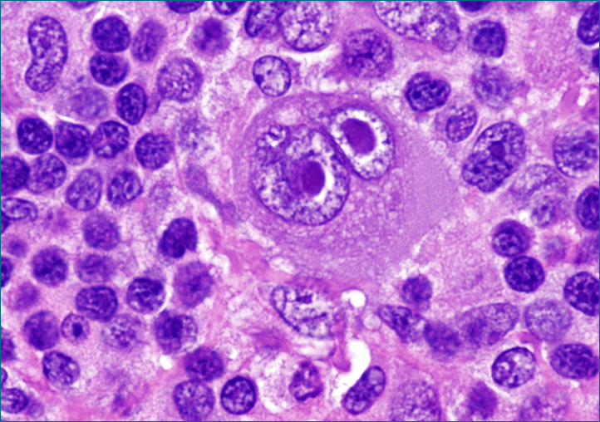
Advanced Stage Hodgkin Lymphoma (cHL):
NCCN Guidelines v1.2020
ABVD x 2 PET/CT Deauville 1-3 A-VD x 4 Observe vs ISRT to initial bulky sites or PET+ sites
(80% of patients)
Deauville 4 ABVD or escBEACOPP x 2 PET/CT if Neg, 2 more cycles same
if +, biopsy, Rx as refractory
Deauville 5 escBEACOPP x 2
S0816 | n=331 | 2-yr PFS
PET2 - | 271 (82%) | 82%
PET2 + escBEACOPP | 60 (18%) | 64%
Useful in certain circumstances:
BV-AVD (with growth factor) category 2B
Category 2A in select patients,
e.g. no neuropathy, IPS 4-7 or bleomycin contraindicated
RATHL. Johnson PW et al NEJM 2016
GHSG HD15. Engert, A et al Lancet 2012
ECHELON-1. Connors JM et al NEJM 2018
S0816 Press OW, et al. J Clin Oncol. 2016

Slide 42
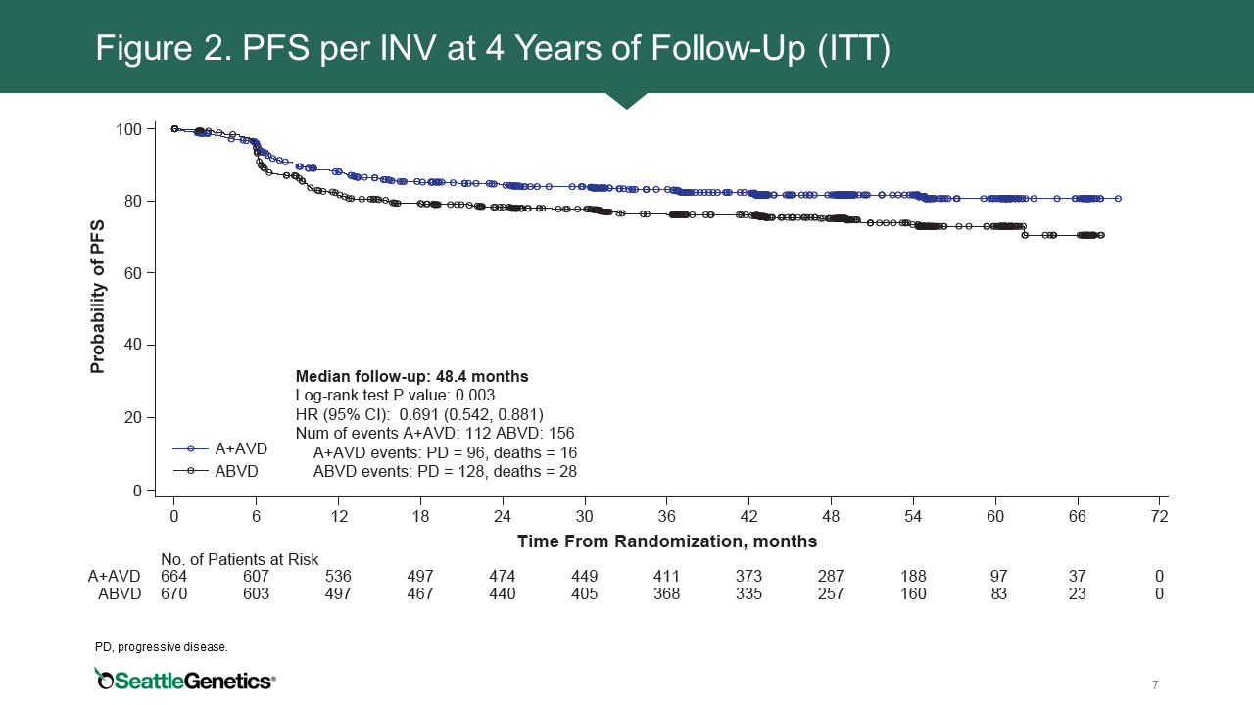
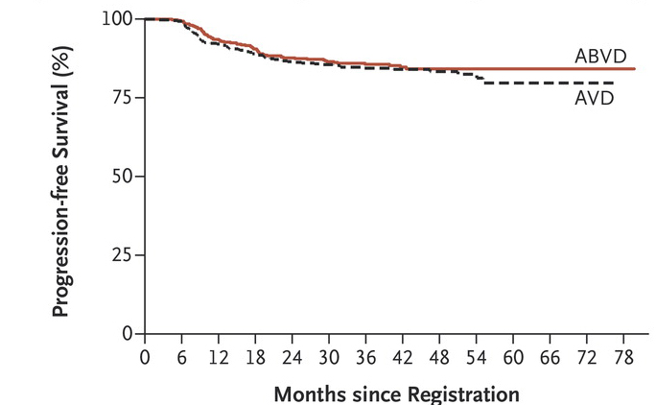
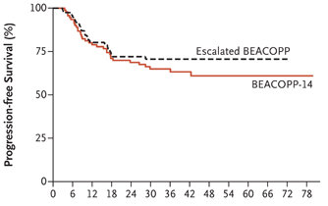
Advanced Stage Hodgkin Lymphoma (HL)
RATHL
ECHELON-1
IPSS: PFS for ABVD patients
82%
75%
ABVDx2 -> A-VD x 4
IPS 0-3
PFS for PET2- (Deauville 1-3)
IPS 4-7
  Age ≥ 45 yr
  Albumin < 4.0 g/dL
  WBC ≥ 15 x 10⁹/L
  Hemoglobin < 10.5 g/dL
  Lymphocytes < 0.6x10⁹/L or < 8%
  Male sex
  Stage IV
Time (years)
Moccia AA. J Clin Oncol. 2012;30(27):3383-8
PFS for PET2+ (Deauville 4-5)
ASH 2019, Abstract 4026. Bartlett N et al
Johnson P, et al. New Engl J Med. 2016;374(25):2419-29

Slide 43
ECHELON-1: TOXICITY
INITIAL REPORT¹ | A-AVD |  | ABVD
Any grade ≥ 3 | 83% |  | 66%
Hospitalizations | 37% |  | 28%
grade ≥ 3 ANC | 54% |  | 39%
Febrile Neutropenia (+/- G-CSF prophylaxis) | 21% | 11% | 8% | 7%
Peripheral sensory neuropathy grade ≥ 3 | 5% |  | <1%
4 year follow-up: Peripheral Neuropathy²
Grade 1/2 | 19% |  | 10%
Grade 3/4 | 3% (N = 17) |  | 0.6% (N = 4)
¹ Connors JM et al. N Engl J Med 2018;378:331-44.
² Bartlett NL et al. Proc ASH 2019;Abstract 4026.

Slide 44
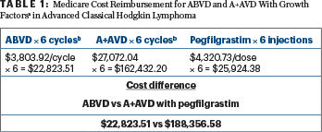
Does ECHELON-1 change approach to advanced HL?
Does the PFS benefit/fewer patients requiring “salvage” therapy justify the neurotoxicity/need for G-CSF/added hospitalizations?
Should we abandon the PET-response adapted approach that gives us 80% of patients who will do well with ABVD x 2 → A-VD x 4?
Should we consider cost?
Should we think of overall strategy rather than simply PFS?
    When is best time to use brentuximab vedotin? For all patients or just for relapse therapy?
Abutalib & Armitage ASCO Post Jan 2018

Slide 45
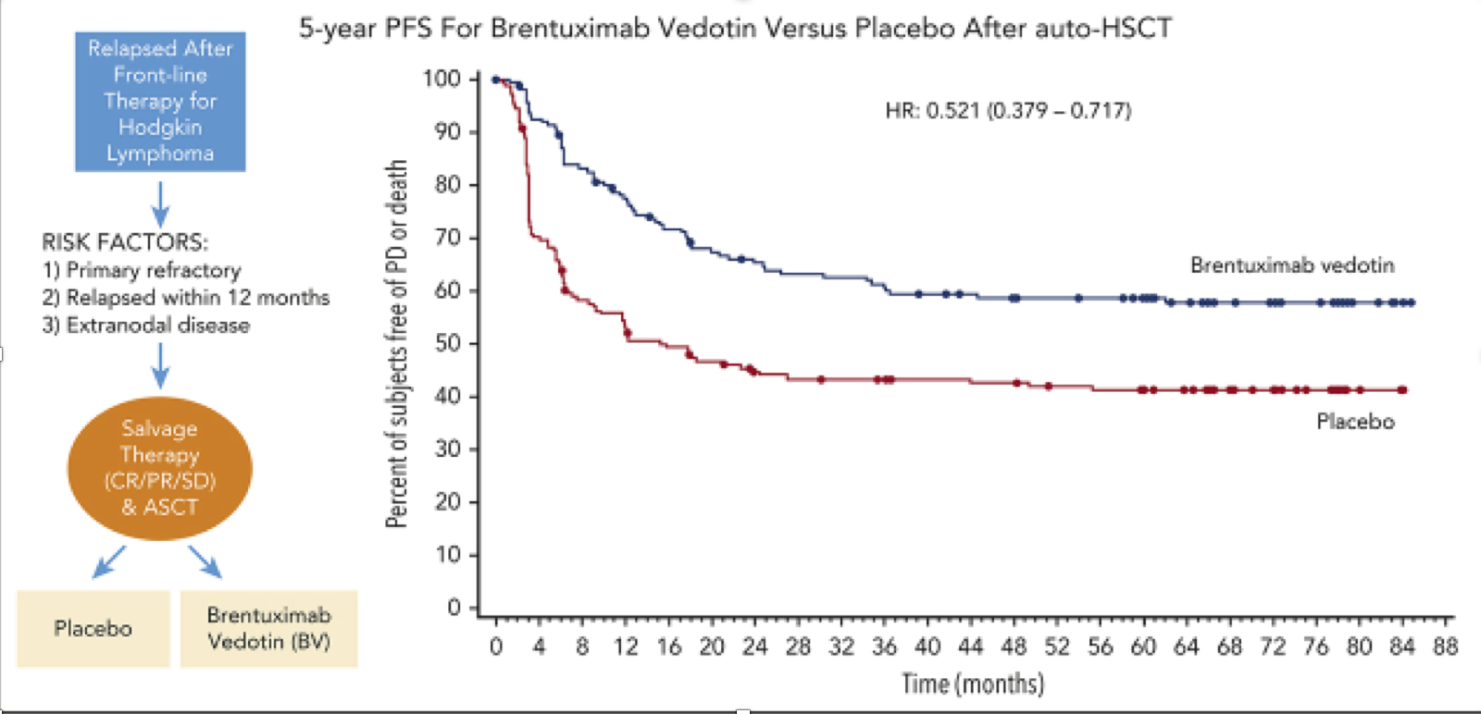
Strategic Thinking
In ECHELON-1 with 4 yr f/u,
mPFS is 82% (BV-AVD) vs 75% (ABVD)
If we treat 100 patients,
  75 will do well with either regimen
  18 will relapse regardless of regimen
  7 avoid 2nd line therapy
Using data from AETHERA trial:
  Of 25 post-ABVD relapses, 15 do well post ASCT + BV (AETHERA), so 10 “fail”, and overall success rate 90%
  Of 18 post-BV-AVD failures, what if BV resistant and their “salvage” rate is 40%, then 7 do well, and 11 “fail”, and overall success rate is 89%
Moskowitz et al. Blood 2018; 132:2639-42

Slide 46
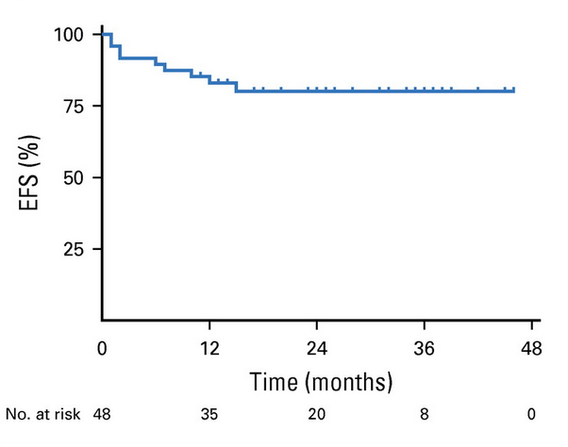
cHL in Patients ≥ 60 years
A(B)VD x 2: if PET2-, then A-VD x 4
PET2+ “individualized therapy”
GHSG reported bleo for 2 cycles tolerable in older patients [I do not give B in this age group]
BV
  single agent ORR 92%, CR 73%, but med PFS 11 months
  BV + Dacarbazine (N = 22, age ≥ 60) ORR 100%, CR 62%, med PFS 18 months
  BV-bendamustine toxic Friedberg, JW et al Blood 2017; ASCO 2018
BV-AVD
  Age ≥ 60
  BV x 2, A-VD x 4, BV x 4 [NOT CONCURRENT]
  EFS @ 2 yr 80% (95% CI 65-89%)
  OS @ 2 yr 93%
Evens, AM et al JCO 2018

Slide 47
FDA Approval of Brentixumab Vedotin (BV) in Combination with Chemotherapy for Adults with Previously Untreated Systemic Anaplastic Large Cell Lymphoma (sALCL) and CD30-Expressing Peripheral T-Cell Lymphomas
Press Release – November 16, 2018
The FDA has approved BV in combination with CHP chemotherapy (cyclophosphamide/doxorubicin/prednisone) for previously untreated sALCL or other
CD30-expressing peripheral T-cell lymphomas (PTCL), including angioimmunoblastic
T-cell lymphoma and PTCL not otherwise specified. This is the first FDA approval for previously untreated PTCL including sALCL.
Approval was based on ECHELON-2 (NCT01777152), a double-blind, multicenter trial that randomized 226 patients to BV plus CHP and 226 patients to cyclophosphamide, doxorubicin, vincristine, and prednisone (CHOP).
https://www.fda.gov/drugs/fda-approves-brentuximab-vedotin-previously-untreated-salcl-and-cd30-expressing-ptcl

Slide 48
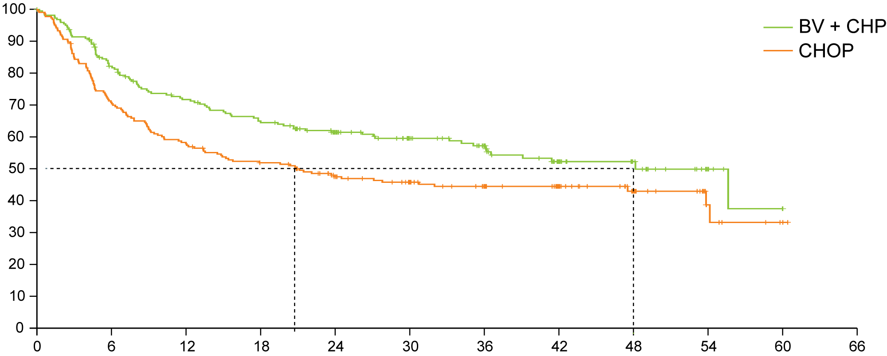
ECHELON-2: Brentuximab Vedotin (BV) with Chemotherapy for CD30-Positive Peripheral T-Cell Lymphoma
HR 0.71
p = 0.0110
Progression-free survival (%)
Median in CHOP
20.8 months
Median in BV + CHP
48.2 months
Time from randomization (months)
Horwitz S et al. Lancet 2019;393(10168):229-40

Slide 49
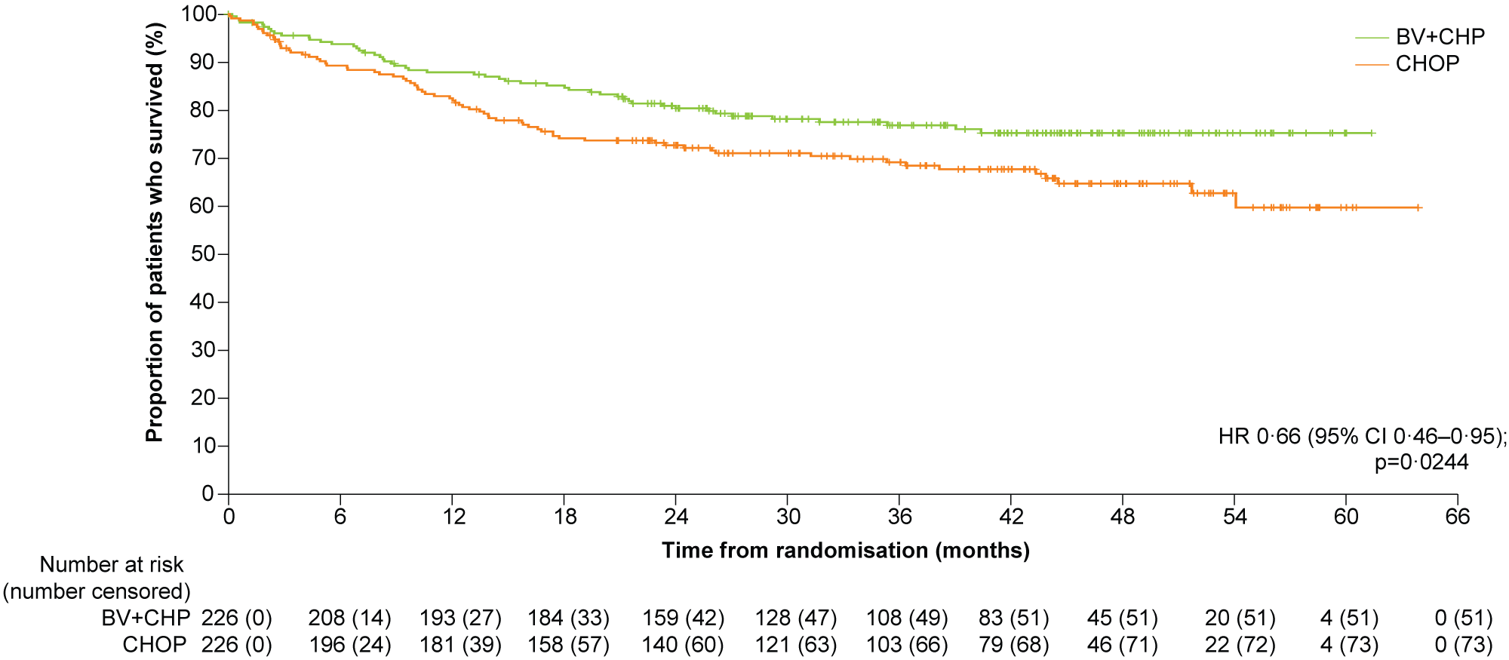
ECHELON-2: Overall Survival
Median OS was not reached in either subgroup, though it was numerically in favor of BV + CHP for key patient subgroups analyzed.
Horwitz S et al. Lancet 2019;393(10168):229-40

Slide 50
Immune Checkpoint Inhibitors in cHL
cHL depends on tumor microenvironment signals and T cell interactions
Often amplify 9p24.1 and express PD-L1
Very active in relapsed cHL:
  Nivolumab ORR 69%, DOR 17 months. Approved for R/R cHL after ASCT and BV
  Pembrolizumab ORR 65%. Approved for R/R cHL after 3 lines of therapy
  Combinations with ipilimumab, BV and all 3 studied
1st Line Combinations:
  CheckMate 205 Arm D in advanced stage HL: Nivo x 4 → N-AVD
    N = 51
    PET2- 71%, EOT PET- 75%
    mPFS at 2 years 80%
  Phase II NIVAHL trial: GHSG [ASH 2019] concurrent vs sequential Nivo-AVD in early unfavorable, all + RT = feasible
Current Intergroup Trial for advanced stage cHL:
Randomized Phase 3 of BV-AVD vs N-AVD

