Slide 1
Module 6: Acute Leukemias

Slide 2
 | Percent with Patients | Number of Patients (Median)
Follicular lymphoma | 96 | 5
Mantle cell lymphoma | 80 | 3
Hodgkin Lymphoma | 96 | 3
Relapsed/refractory diffuse large B-cell lymphoma | 80 | 3
Peripheral T-cell lymphoma | 48 | 2
Anaplastic large cell lymphoma | 32 | 1

Slide 3
Venetoclax combinations for AML in patients ineligible for intensive induction; FLT3 Inhibitors in AML
Alexander Perl, MD
Associate Professor of Medicine
Perelman School of Medicine at the University of Pennsylvania
Member, Leukemia Program
Abramson Cancer Center of the University of Pennsylvania
Philadelphia, Pennsylvania

Slide 4
Disclosures
Advisory Committee | AbbVie Inc, Actinium Pharmaceuticals Inc, Astellas, Daiichi Sankyo Inc, FORMA Therapeutics, Loxo Oncology Inc, a wholly owned subsidiary of Eli Lilly & Company, NewLink Genetics
Consulting Agreements | AbbVie Inc, Arog Pharmaceuticals Inc, Astellas, Daiichi Sankyo Inc
Contracted Research | AbbVie Inc, Astellas, Bayer HealthCare Pharmaceuticals, Daiichi Sankyo Inc, FUJIFILM Pharmaceuticals USA Inc
Data and Safety Monitoring Board/Committee | Leukemia & Lymphoma Society

Slide 5
Case
76 YO woman undergoes a R hip replacement for osteoarthritis
Postoperatively she does fine for two weeks then has progressive fatigue and becomes too tired to do any physical therapy. She spends most of the time in bed or on her couch until she sees the orthopedist 6 weeks post-op (ECOG PS=3).
Labs are drawn, showing a WBC=51K, 80% blasts, Hgb=7.5 and Plts=40. Her preoperative labs were normal. Transfusion of 2 units of PRBCs does not improve her fatigue

Slide 6
Case (continued)
Marrow biopsy confirms AML
normal female karyotype in 20 cells
Flow cytometry
CD34(-), CD13+, CD33+, HLA-DR+, MPO+
NGS testing:
NPM1+
FLT3-ITD+
IDH1 R132C

Slide 7
Is this patient an induction candidate?
Induction outcomes for age >75 and PS>2
30 day mortality rate 36%
60 day mortality rate 50%
1 year survival= 20%
If not induction, what are the alternatives?
HMA
LDAC
Venetoclax + HMA or LDAC
FLT3 inhibitor +/- HMA or LDAC
Ivosidenib
Gemtuzumab ozogamicin
Juliusson G, et al. Blood. 2009 Apr 30;113(18):4179-87

Slide 8
You choose to treat this patient with venetoclax and azacitidine. Which of the following is important to do prior to initiating this therapy?
Obtain a baseline echocardiogram
Start allopurinol and hydroxyurea
Secure central venous access
Perform an LP with prophylactic intrathecal therapy
Send HLA-typing of the patient and siblings
Notes:
Correct answer is B: cytoreduce the WBC to <25K with hydroxyurea and initiate allopurinol to reduce risk of tumor lysis syndrome at venetoclax initiation

Slide 9
Four weeks after initiating her venetoclax and azacitidine, you are reviewing labs on a Friday after clinic. Monday will be day 29 after starting this regimen, which has been well tolerated. The patient has improved her PS and is now doing PT exercises again. She has not required re-hospitalization for fever or other complications. However, yesterday’s CBC shows a WBC of 0.4 (ANC 50), hemoglobin 8.7, and platelets were 31. There are no circulating blasts on the differential.
Given the lack of count recovery, it is important to do which of the following?
Continue venetoclax and schedule cycle 2 of azacitidine to start Monday to ensure the patient remains on her treatment schedule
Continue venetoclax and change azacitidine to low dose cytarabine to start Monday, given inadequate response
Stop venetoclax and schedule cycle 2 of azacitidine alone to start Monday
Temporarily stop all chemotherapy and schedule a bone marrow biopsy to determine the cause of cytopenias
Permanently stop all chemotherapy and change to supportive care only

Slide 10
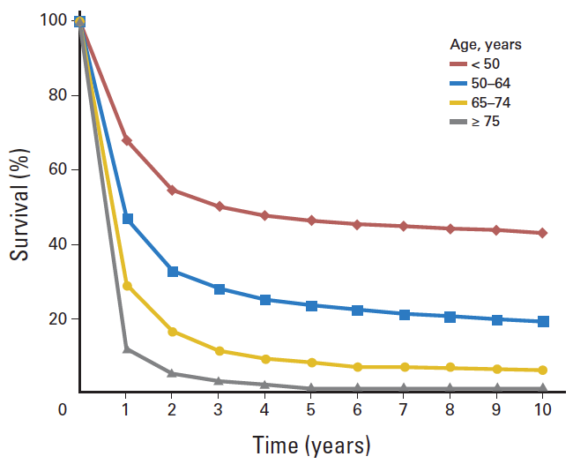
Intensive treatment of older patients: inferior survival, high early mortality
Induction mortality risk factors, age ≥70
Extremes of age (esp. over age 80)
ECOG PS of 2 or higher
Abnormal creatinine (>1.3)
Complex karyotype (e.g. TP53 mutation)
8 week mortality of >50% if 2 or more present
Klepin HD, et al. J Clin Oncol. 2014 Aug 20;32(24):2541-52
Kantarjian H, et al. Blood. 2010 Nov 25;116(22):4422-9.

Slide 11
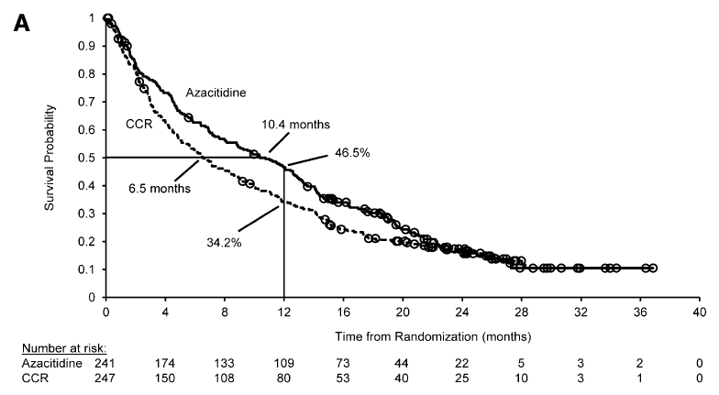
Age >65: to induce or not to induce?
CR/CRi rates:
Azacitidine: 28%
LDAC: 26%
Intensive chemo (IC): 48%
Dombret H, et al. Blood. 2015 Jul 16;126(3):291-9

Slide 12
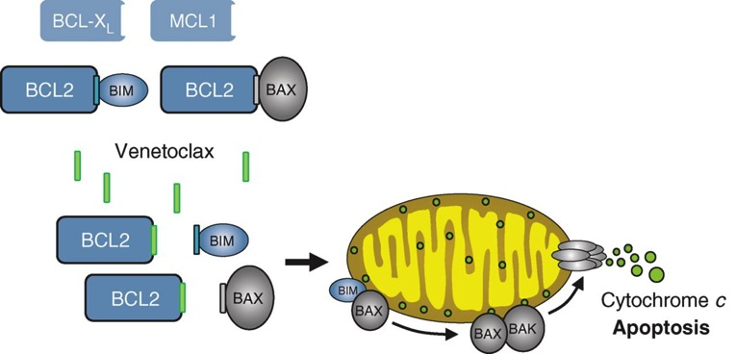
BCL2 in AML
BCL2 inhibits apoptosis in normal and malignant cells
BCL2 is overexpressed in AML cells
Early BCL2 inhibitors (navitoclax) also inhibited BCL_{XL}, which contributed to toxicity (thrombocytopenia)
Oral BCL-2 inhibitor venetoclax is a BH-3 mimetic without activity against BCL_{XL}
Single-agent venetoclax ph1 showed modest efficacy, enriched in mIDH+ patients
Konopleva M, et al. Cancer Discov 2016;6:1106-1117

Slide 13
Venetoclax doublets in unfit, newly diagnosed AML
Two multicenter, single arm studies performed
Venetoclax + HMA (azacitidine or decitabine), prohibited prior HMA for MDS
Venetoclax + low dose cytarabine (LDAC), prior HMA for MDS allowed
Inpatient hospitalization mandated
Ramp up venetoclax over 3-5 days
WBC <25K at initiation of regimen
TLS ppx/monitoring x 24h after target venetoclax dose
Ineligible for induction defined as:
Age >75
Age >65 with comorbidity (poor PS, prior anthracycline, renal dysfunction, etc.)
Primary endpoint: safety, efficacy (in ph2)
DiNardo CD, Blood. 2019 Jan 3;133(1):7-17
Wei et al. J Clin Oncol 2019, 37: 1277-84

Slide 14
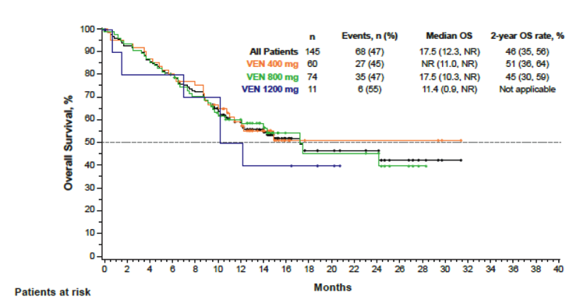
Venetoclax + HMA phase 2
Cohort | N (%) | CR + CRi | Median CR/CRi duration (95% CI) | Median OS (95% CI)
All patients | 145 | 67% | 11.3 mo. | 17.5 mo.
VEN 400/HMA | 44 (73) | 73% | 12.5 mo. | NR (11-NR)
Age 65-74 | 83 (57) | 69% | 12.9 mo. | 17.7 mo.
Age ≥75 | 62 (43) | 65% | 9.2 mo. | 11 mo.
De Novo AML | 109 (75) | 67% | 9.4 mo. | 12.5 mo.
Secondary AML | 36 (25) | 67% | NR (12.5, NR) | NR (14.6, NR)
Better outcomes with NPM1 or IDH1/2 mutation (71-91% CR/CRi, median OS NR)
TP53 mutation did worse (47% CR/CRi, 5.6 mo median OS)
3-5 day ramp up from 100 mg to target venetoclax dose (400-1200 mg)
Azacitidine 75 mg/m² SQ/IV days 1-7 or Decitabine 20 mg/m² IV days 1-5, repeat Q28 days
DiNardo CD, Blood. 2019 Jan 3;133(1):7-17

Slide 15
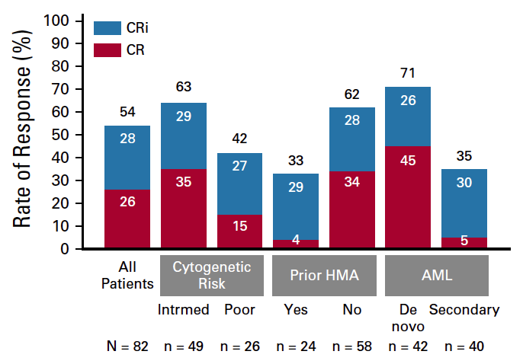
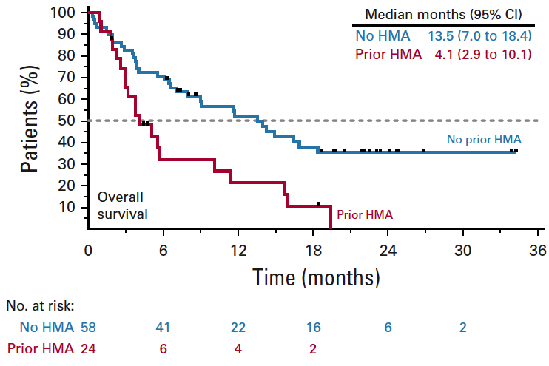
Venetoclax + LDAC
Median duration of response: 8.1 months
Median OS for all patients= 10.1 mo
3-5 day ramp up from 100 mg to target VEN dose (MTD = 600 mg/d)
LDAC 20 mg/m² SQ, once daily d1-10, repeat Q28 days
Wei et al. J Clin Oncol 2019, 37: 1277-84

Slide 16
Venetoclax doublets: toxicity
Watch for myelosuppression and infections
Perform marrow biopsy after 3-4 weeks of venetoclax—hold chemo for recovery
Patients not responding to two cycles are refractory
30 day mortality 3%, 60 day 8% (sepsis, pneumonia, AML)
Venetoclax dose reductions required for concurrent azole antifungals
200 mg if moderate CYP3A4 inhibitors (fluconazole, isavuconazole)
70-100 mg if strong CYP3A4 inhibitors (posaconazole, voriconazole)
TLS not seen on trials, does occur rarely in practice
label recommends inpatient hospitalization for initiation/ramp up
cytoreduction prior to initiation
allopurinol, oral or IV hydration
lab monitoring within hours of first dose and each increase
DiNardo CD, Blood. 2019 Jan 3;133(1):7-17
Jonas BA and Pollyea DA, Leukemia. 2019 Dec;33(12):2795-2804
DiNardo CD and Wei AH, Blood. 2020 Jan 9;135(2):85-96.

Slide 17
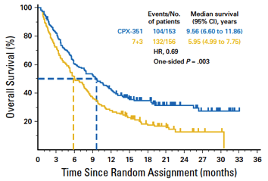
Age >65: to induce or not to induce?
Fit patients, age 60-75 with t-AML or AML-MRC
Unfit patients, age >65
CPX-351 vs. 7+3
Venetoclax+ HMA
Lancet J, et al. J Clin Oncol. 2018 Sep 10;36(26):2684-2692
DiNardo CD, Blood. 2019 Jan 3;133(1):7-17

Slide 18
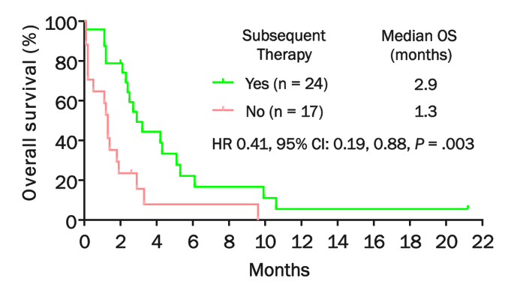
Survival after progression to venetoclax doublets
Maiti A, et al. ASH 2019. Abstract 738.

Slide 19
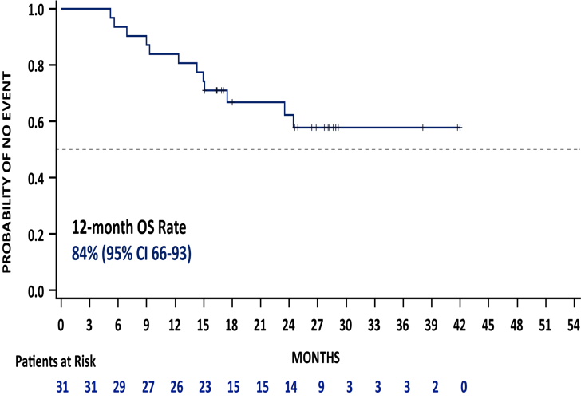
Transplant after frontline venetoclax regimens
10% (31/304 patients) received SCT
26/31 (84%) in CR/CRi
Median age 69 (63-76)
68% (21/31) remained alive at 12 months post-HSCT
55% (17/31) of all patients that had HSCT had post-transplant remission of ≥ 12 months
71% (12/17) of those patients remained in remission for ≥ 2 years
Pratz K, et al. ASH 2019. Abstract 264.

Slide 20
Conclusions
Venetoclax combinations are changing the field’s approach to manage patients ineligible for induction
Response rates are high and occur rapidly—different from HMA alone
Single arm OS data very promising--randomized data needed
Highly effective, tolerable outpatient therapy, but curability unknown
Sequencing of venetoclax, HMA, IDH, and FLT3 inhibitors (or new combinations?) TBD…

Slide 21
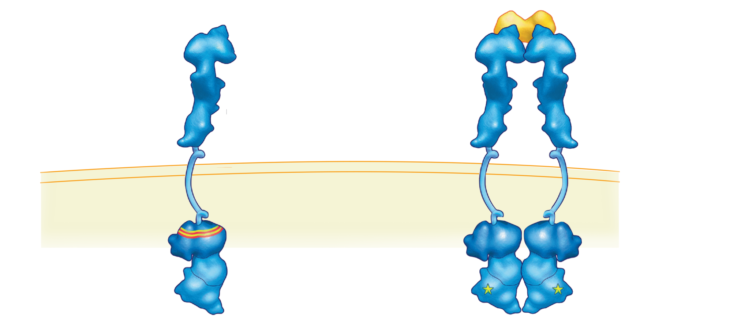
FLT3 Mutations (ITD and TKD) Occur in Approximately 30-35% of Patients with AML
Inactive conformation
Active conformation
FLT3 ligand
FLT3 receptor
Type I FLT3 inhibitors bind the FLT3 receptor in the active conformation, either near the activation loop or the ATP-binding pocket, and are active against ITD and TKD mutations.
Intracellular space
ITD Mutations
~25%
Type II inhibitors
JMD
Type I inhibitors
TKD Mutations
7-10%
Sorafenib Ponatinib Quizartinib*
TK1
TK2
Sunitinib Midostaurin Lestaurtinib Crenolanib* Gilteritinib*
Type II FLT3 inhibitors bind the FLT3 receptor in the inactive conformation in a region adjacent to the ATP-binding domain.
* Second-generation FLT3 inhibitors
Daver N et al. Leukemia 2019;33:299-312.

Slide 22
Characteristics of Select FLT3 Inhibitors
FLT3 Inhibitor | Inhibitory Type | FLT3 Kinase Inhibition IC50 (nmol/L) | Non-FLT3 Targets | FLT3-TKD mutation activity | Major Toxicities
Sorafenib 400 mg BID | II | 58 | c-KIT PDGFR RAF VEGFR | No | Rash Hemorrhage Myelosuppression
Midostaurin 50 mg BID | I | 6.3 | c-KIT PDGFR PKC VEGFR | Yes | GI toxicity Myelosuppression
Quizartinib 30 – 60 mg QD | II | 1.6 | c-KIT | No | QTc prolongation Myelosuppression
Gilteritinib 120 mg QD | I | 0.29 | AXL LTK ALK | Yes | Elevated transaminases Diarrhea
Kiyoi H et al. Cancer Science 2019;[Epub ahead of print];
Short NJ et al. Ther Adv Hematol 2019;10:2040620719827310.

Slide 23
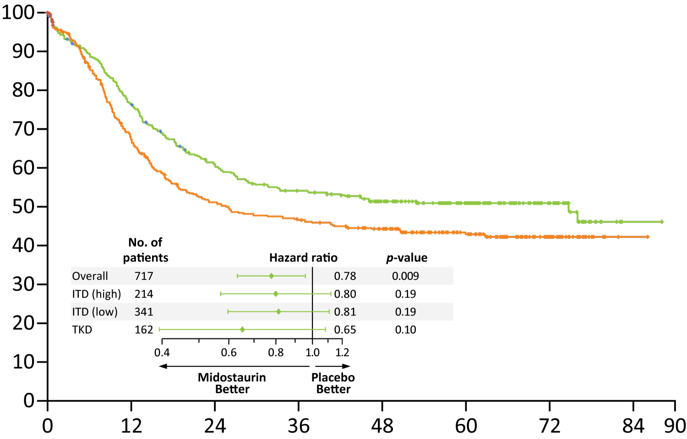
RATIFY: Overall Survival Analyses
Midostaurin 74.7 mo (n = 360)
Placebo 25.6 mo (n = 357)
HR: 0.78; p = 0.009
Probability of survival (%)
Midostaurin
Placebo
Months
Stone RM et al. N Engl J Med 2017;377:454-64.

Slide 24
FDA Approves Addition of Survival Data to Gilteritinib Label for Relapsed or Refractory AML with a FLT3 Mutation Press Release – May 29, 2019
“The Food and Drug Administration approved the addition of overall survival data in labeling for gilteritinib, indicated for adult patients who have relapsed or refractory AML with a FLT3 mutation as detected by an FDA-approved test.
Approval was based on the ADMIRAL trial (NCT02421939), which included 371 adult patients with relapsed or refractory AML having a FLT3 ITD, D835, or I836 mutation by the LeukoStrat CDx FLT3 Mutation Assay. Patients were randomized (2:1) to receive gilteritinib 120 mg once daily (n = 247) over continuous 28-day cycles or prespecified salvage chemotherapy (n = 124). Salvage chemotherapy included either intensive cytotoxic chemotherapy or a low-intensity regimen. For the analysis, overall survival (OS) was measured from the randomization date until death by any cause.”
https://www.fda.gov/drugs/resources-information-approved-drugs/fda-approves-addition-survival-data-gilteritinib-label-refractory-aml-flt3-mutation

Slide 25
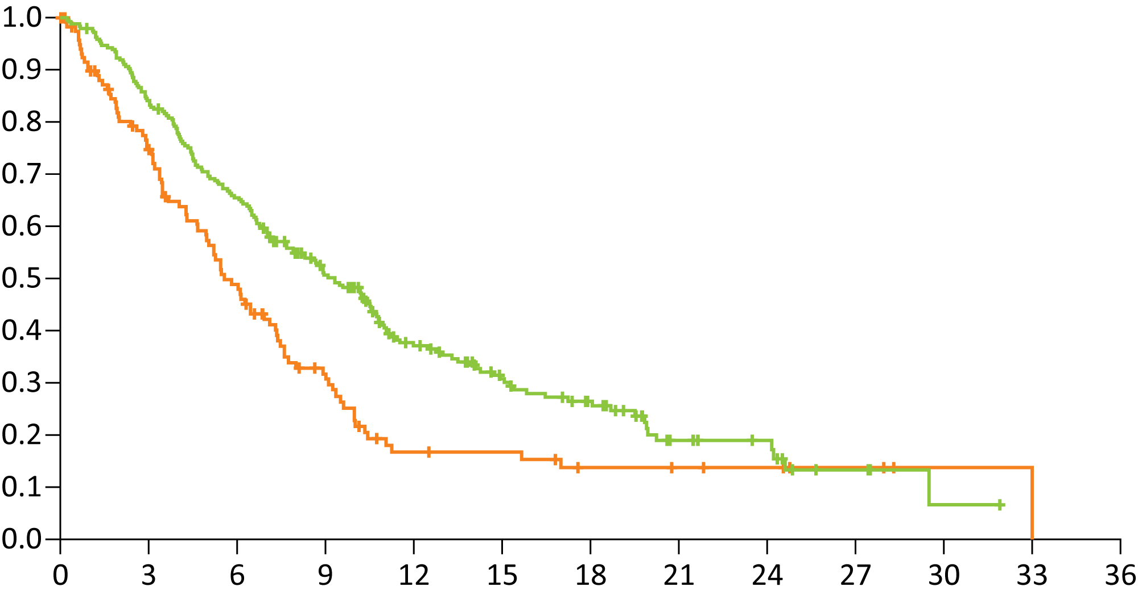
ADMIRAL: Overall Survival
Median OS | Gilteritinib (n = 247) | Salvage Chemo (n = 124) | HR | p-value
ITT | 9.3 mo | 5.6 mo | 0.64 | <0.01
High allelic ratio (n = 109, 60) | 7.1 mo | 4.3 mo | 0.49 | Not reported
Probability of Survival
Gilteritinib
Salvage chemotherapy
Months
Perl AE et al. N Engl J Med 2019;381:1728-40.

Slide 26
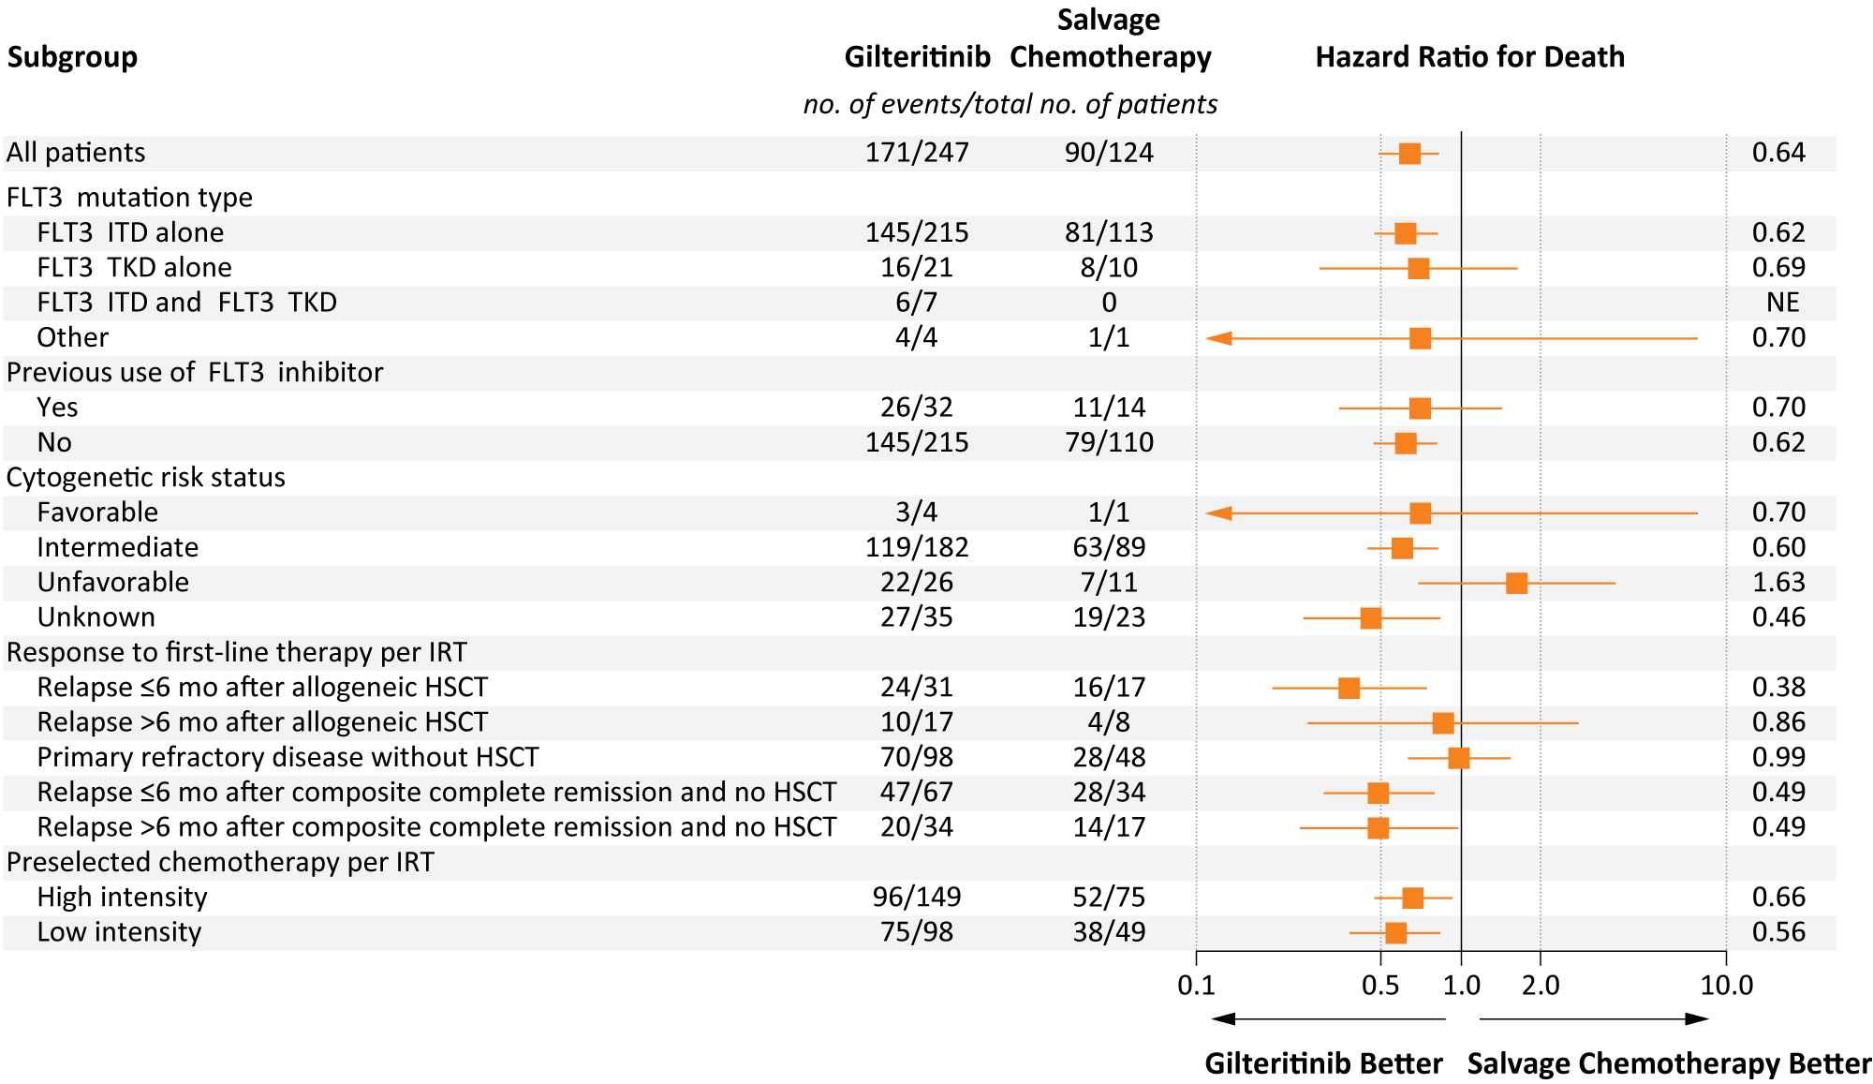
ADMIRAL: Subgroup Analysis of Overall Survival
Perl AE et al. N Engl J Med 2019;381:1728-40.

Slide 27
Select Ongoing Phase III Trials of FLT3 Inhibitors
Study | Target Accrual | Setting | Randomization
NCT01371981 | 1,641 | Newly diagnosed | Chemotherapy Chemotherapy + bortezomib Chemotherapy + bortezomib + sorafenib
NCT02997202 | 346 | Newly diagnosed/ Maintenance after transplant | Gilteritinib Placebo
HOVON 156 AML (NCT04027309) | 768 | Newly diagnosed | Induction/consolidation chemo + midostaurin → midostaurin Induction/consolidation chemo + gilteritinib → gilteritinib
QuANTUM-FIRST | 539 | Newly diagnosed | Induction/consolidation chemo + quizartinib → quizartinib Induction/consolidation chemo + placebo → placebo
www.clinicaltrials.gov. Accessed January 2020.

Slide 28
IDH Inhibitors in AML
Eytan M Stein, MD
Assistant Attending Physician
Director, Center for Drug Development in Leukemia
Leukemia Service, Department of Medicine
Memorial Sloan Kettering Cancer Center
New York, New York

Slide 29
Disclosures
Advisory Committee | Agios Pharmaceuticals Inc, Amgen Inc, Astellas, Celgene Corporation, Daiichi Sankyo Inc, Genentech, Menarini Group, Novartis, PTC Therapeutics, Seattle Genetics, Syros Pharmaceuticals Inc
Contracted Research | Agios Pharmaceuticals Inc, Amgen Inc, Bayer HealthCare Pharmaceuticals, Celgene Corporation, Syros Pharmaceuticals Inc
Data and Safety Monitoring Board/Committee | Cellectis, Epizyme
Ownership Interest | Auron Therapeutics

Slide 30
Patient Case – IDH Mutation
58 year old man diagnosed in January, 2017 with AML associated with and an isolated mutation in IDH2 (R140Q). Receives induction chemotherapy with 7+3 → no remission → FLAG-IDA → no remission.
The patient feels well. Physical examination is normal. Labs are notable for a WBC of 2.4 with 90% peripheral blasts, an ANC of 0.2, hgb of 7.1 and platelets of 13.
Repeat bone marrow biopsy shows 80% myeloblasts and confirms the continued presence of an IDH2 mutation. What should you do?

Slide 31
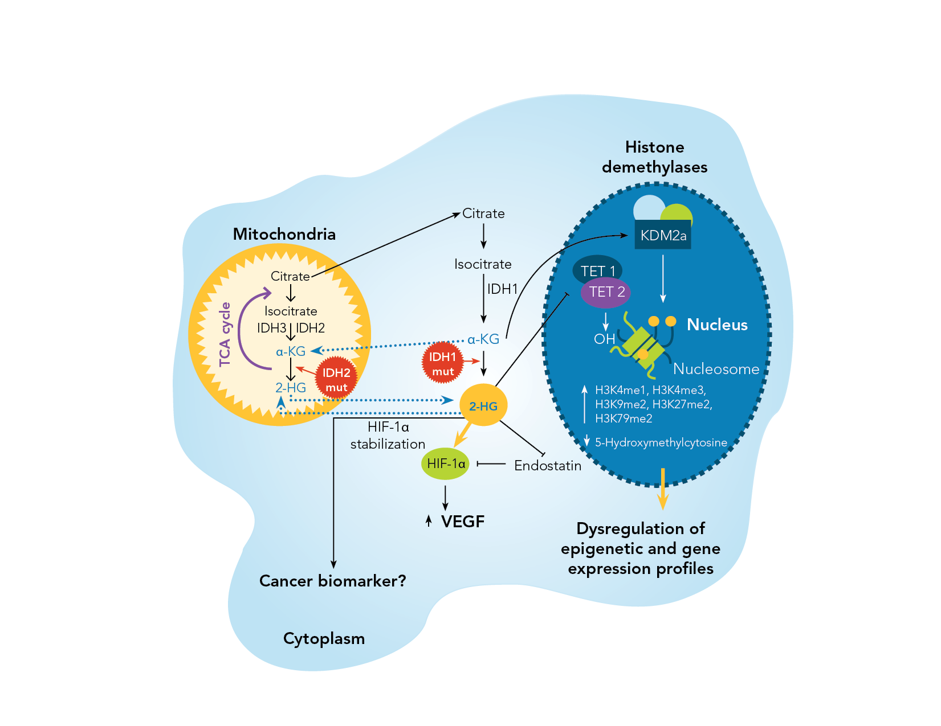
IDH in AML
IDH1 in cytoplasm and IDH2 in mitochondria
Cancer-associated IDHm produces 2-hydroxyglutarate (R-2-HG)
IDH1/IDH2 mutations induce BCL-2 dependence (Majeti, Nature Medicine, 2015)
R-2HG suppresses homologous recombination (Bindra, Science Translational Medicine, 2017)
Prensner and Chinnaiyan Nature, 2011

Slide 32
Approved IDH Inhibitors in AML
Enasidenib – IDH2 inhibitor. Approved for relapsed and refractory IDH2 mutant AML.
Oral, given once daily, continuous 28 day cycles
Indirect hyperbilirubinemia
Median OS of 8.8 months
Ivosidenib – IDH1 inhibitor. Approved for relapsed and refractory and newly diagnosed IDH1 mutant AML.
Oral, once daily, continuous 28 day cycles
QT prolongation
Median OS of 9.0 months
In R/R AML, complete remission rates with IDH inhibitors is about 21%

Slide 33
Enasidenib Plus Azacitidine Significantly Improves Complete Remission and Overall Response Compared with Azacitidine Alone in Patients with Newly Diagnosed Acute Myeloid Leukemia (AML) with Isocitrate Dehydrogenase 2 (IDH2) Mutations: Interim Phase II Results from an Ongoing, Randomized Study
ASH 2019
ABSTRACT 643
Courtney D. DiNardo¹, Andre C. Schuh², Eytan M. Stein^{3,4}, Pau Montesinos^{5,6}, Andrew Wei^{7,8}, Stephane de Botton⁹, Amer M. Zeidan¹⁰, Amir T. Fathi^{11,12}, Lynn Quek¹³, Hagop M. Kantarjian¹, Mark G. Frattini¹⁴, Frederik Lersch¹⁵, Jing Gong¹⁴, Aleksandra Franovic¹⁴, Kyle MacBeth¹⁴, Paresh Vyas¹² and Hartmut Döhner¹⁶
¹The University of Texas MD Anderson Cancer Center, Houston, TX; ²Princess Margaret Cancer Centre, Toronto, ON, Canada; ³Memorial Sloan Kettering Cancer Center, New York, NY; ⁴Weill Cornell Medical College, New York, NY; ⁵Hospital Universitario y Politécnico Le Fe, Valencia, Spain; ⁶CIBERONC, Instituto Carlos III, Madrid, Spain; ⁷The Alfred Hospital, Melbourne, Australia; ⁸Australian Centre for Blood Diseases, Monash University, Melbourne, Australia; ⁹Gustave Roussy, Villejuif Cedex, France; ¹⁰Yale University School of Medicine and Yale Cancer Center, New Haven, CT; ¹¹Harvard Medical School, Boston, MA; ¹²Massachusetts General Hospital, Cambridge, MA; ¹³MRC Molecular Haematology Unit and Oxford Biomedical Research Centre, University of Oxford and Oxford University Hospitals, Oxford, United Kingdom; ¹⁴Bristol-Myers Squibb, Summit, NJ; ¹⁵Celgene, A Bristol-Myers Squibb Company, Summit, NJ; ¹⁶Department of Internal Medicine III, University Hospital Ulm, Ulm, Germany

Slide 34
AG221-AML-005: Study design
KEY ELIGIBILITY CRITERIA
Phase Ib: Dose-finding (3+3) and IVO+ AZA Expansion
Randomized, Open-Label Phase II (N=101)
ND-AML
Age ≥18 years
Ineligible for intensive chemotherapy
Patients with antecedent hematologic disorders allowed
Prior HMA excluded
Dose-finding* + Expansion:
IVO 500 mg QD + AZA (n=23)
ENA 100 mg QD + AZA (n=68)
mIDH1
2
Randomization (2:1)
Follow-up
Follow-up
mIDH2
Dose-finding*:
ENA 100 mg QD + AZA (n=3) ENA 200 mg QD + AZA (n=3)
AZA Only (n=33)
1
SC AZA 75mg/m²/day x 7 days/ 28-day cycle (all study phases)
Primary Endpoint: ORR
Key Secondary Endpoints: CR rate, safety, overall survival (OS), event-free survival (EFS)
DiNardo CD et al. ASH 2019

Slide 35
Survival
Median follow-up was 14 months in both treatment arms
Median OS in the ENA + AZA group was 22.0 months, and in the AZA Only group was 22.3 months (HR 0.99 [95%CI 0.52, 1.87], P=0.9686)
Among pts in the ENA + AZA arm who achieved CR, median OS was not reached and estimated 1-year survival was over 90%
Median EFS was 17.2 months in the ENA + AZA group, vs. 10.8 months in the AZA Only group (HR 0.59 [95%CI 0.30, 1.17], P=0.1278)
In the AZA Only arm, 7 patients (21%) received subsequent treatment with enasidenib monotherapy
Overall survival
Event-free survival
ENA + AZA: 17.2 months
AZA Only:
10.8 months
DiNardo CD et al. ASH 2019

Slide 36
Study design
INDUCTION
(1–2 cycles)
CONSOLIDATION
MAINTENANCE
ivosidenib 500mg +
ARA-C (200mg/m²/d x 7d) +
DNR (60mg/m²/d x 3d)
ivosidenib
500mg +
ARA-C
(up to 4 cycles)
or mitoxantrone + etoposide (ME)
CR CRi CRp
mIDH1
ivosidenib 500mg +
ARA-C (200mg/m²/d x 7d) +
IDR (12mg/m²/d x 3d)
Single-agent ivosidenib or enasidenib daily until the end of studyª
CR
CRi
CRp
SCREENING
enasidenib 100mg +
ARA-C (200mg/m²/d x 7d) +
DNR (60mg/m²/d x 3d)
enasidenib 100mg +
ARA-C
(up to 4 cycles) or mitoxantrone + etoposide (ME)
CR CRi CRp
mIDH2
enasidenib 100mg +
ARA-C (200mg/m²/d x 7d) +
IDR (12mg/m²/d x 3d)
Ivosidenib and enasidenib are discontinued and not resumed in patients who proceed to transplant
ARA-C = cytarabine; DNR = daunorubicin; IDR = idarubicin
Stein EM et al. ASH 2018

Slide 37
Summary of best overall response in efficacy-evaluable patients
 | Ivosidenib (AG-120) + chemotherapy |  |  | Enasidenib (AG-221) + chemotherapy
Response,^{b} n (%) | All (n=49) | De novo (n=34) | sAML (n=15) | All (n=89) | De novo (n=56) | sAML (n=33)
CR+CRi/CRp | 39 (80) | 31 (91) | 8 (53) | 64 (72) | 43 (77) | 21 (64)
CR | 35 (71) | 27 (79) | 8 (53) | 50 (56) | 36 (64) | 14 (42)
CRi/CRp | 4 (8) | 4 (12) | - | 14 (16) | 7 (13) | 7 (21)
MLFS | 3 (6) | 1 (3) | 2 (13) | 11 (12) | 6 (11) | 5 (15)
PR | 1 (2) | - | 1 (7) | 1 (1) | - | 1 (3)
Treatment failure | 6 (12) | 2 (6) | 4 (27) | 13 (15) | 7 (13) | 6 (18)
ªPatients who have at least one post-baseline response assessment on or after Induction Day 21 or who discontinued treatment before having a response assessment
^{b}Best response from any time on study is shown
Stein EM et al. ASH 2018
Data cut 01AUG2018

Slide 38
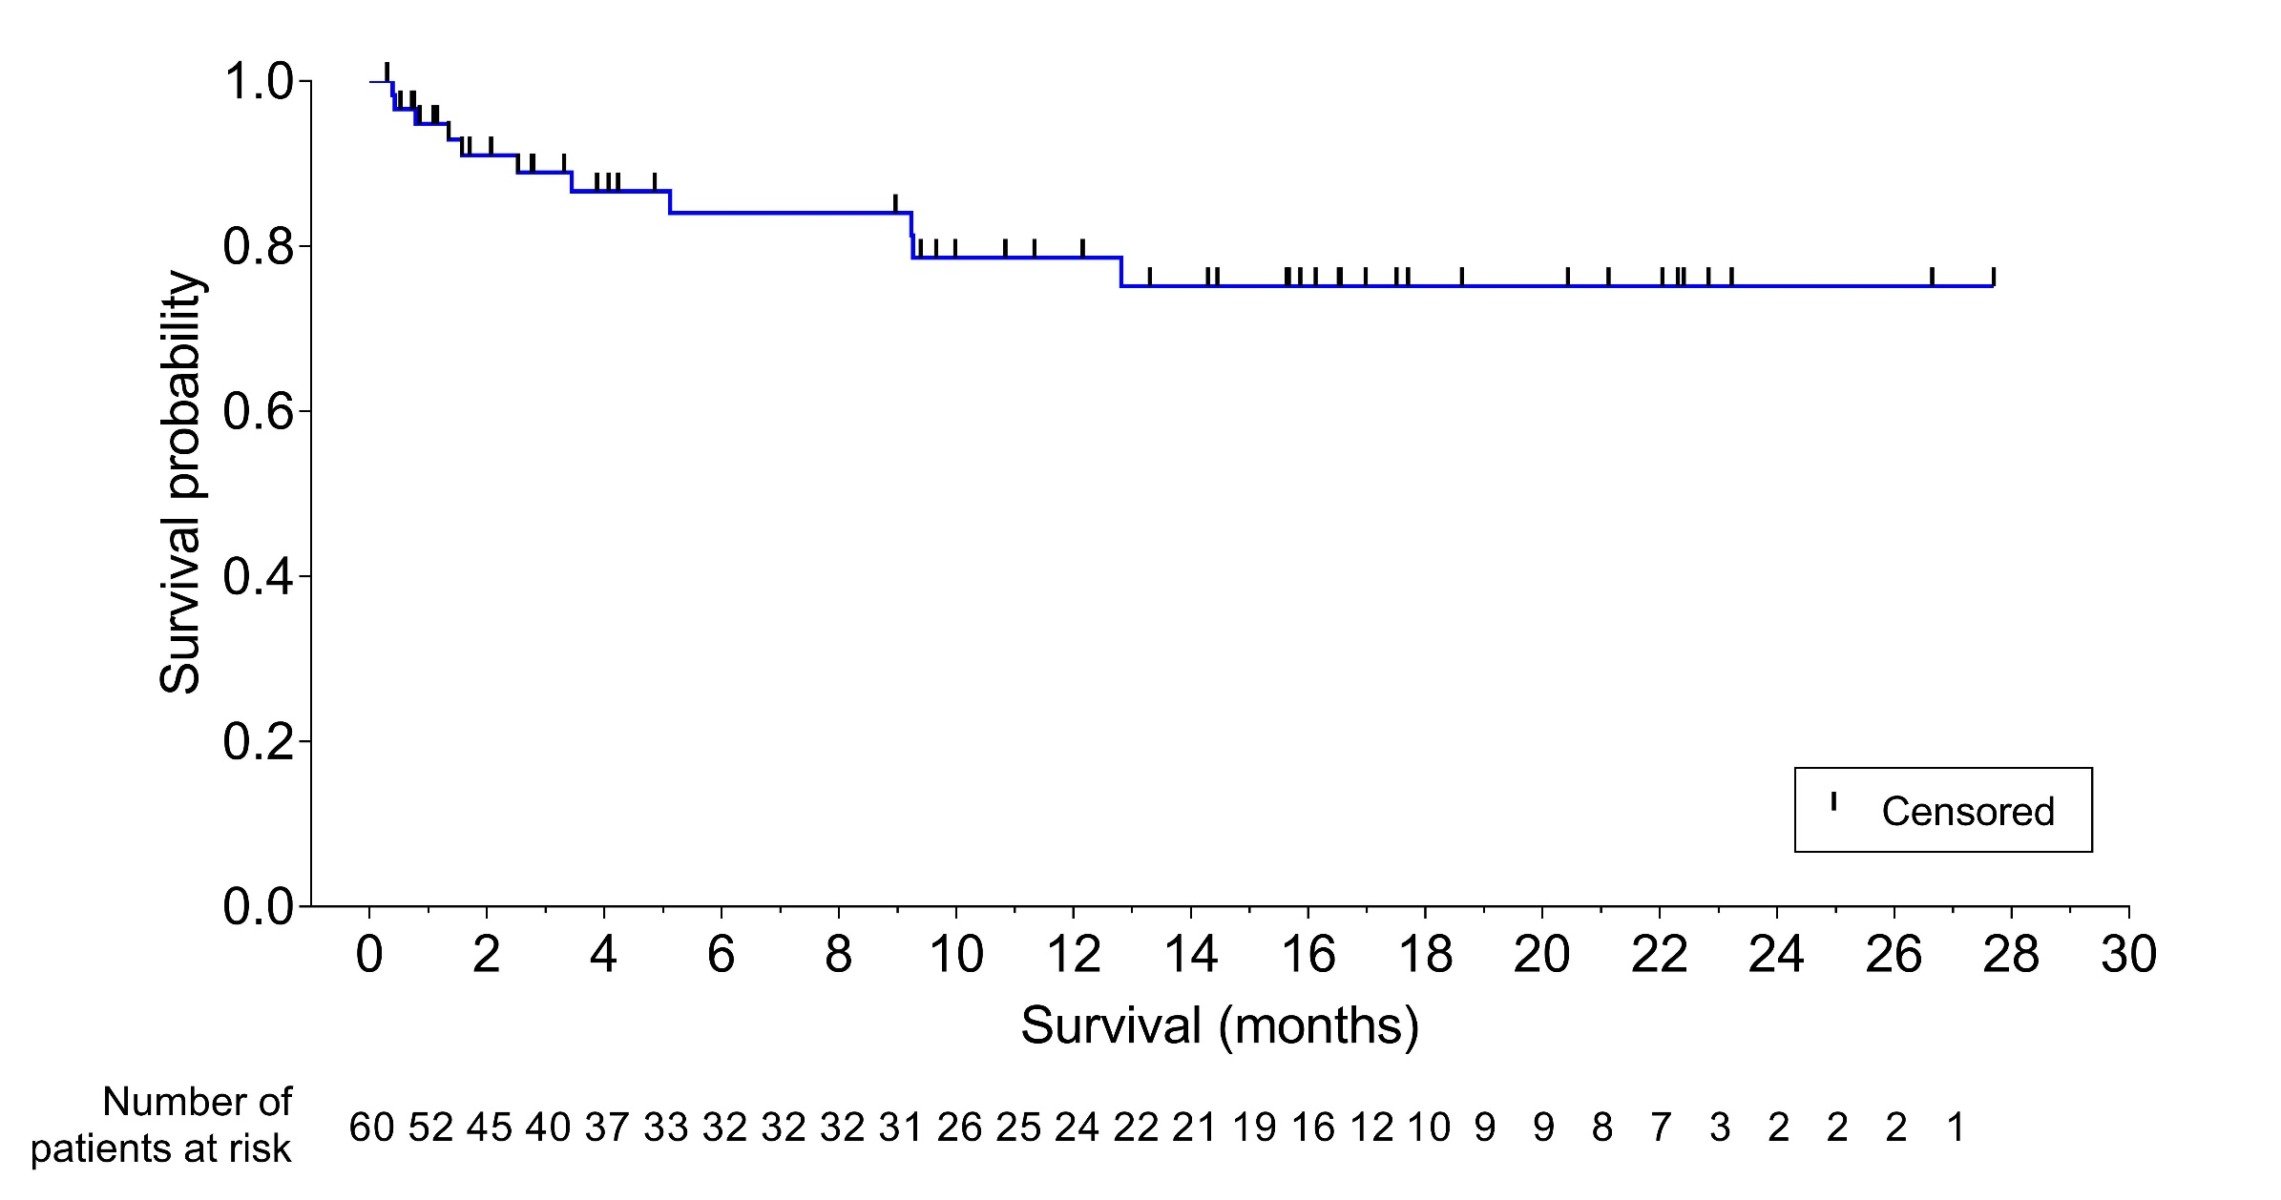
Overall survival in ivosidenib-treated patients
79% probability of being alive at 1 year after Induction Day 1
Median overall survival not yet estimable
Stein EM et al. ASH 2018

Slide 39
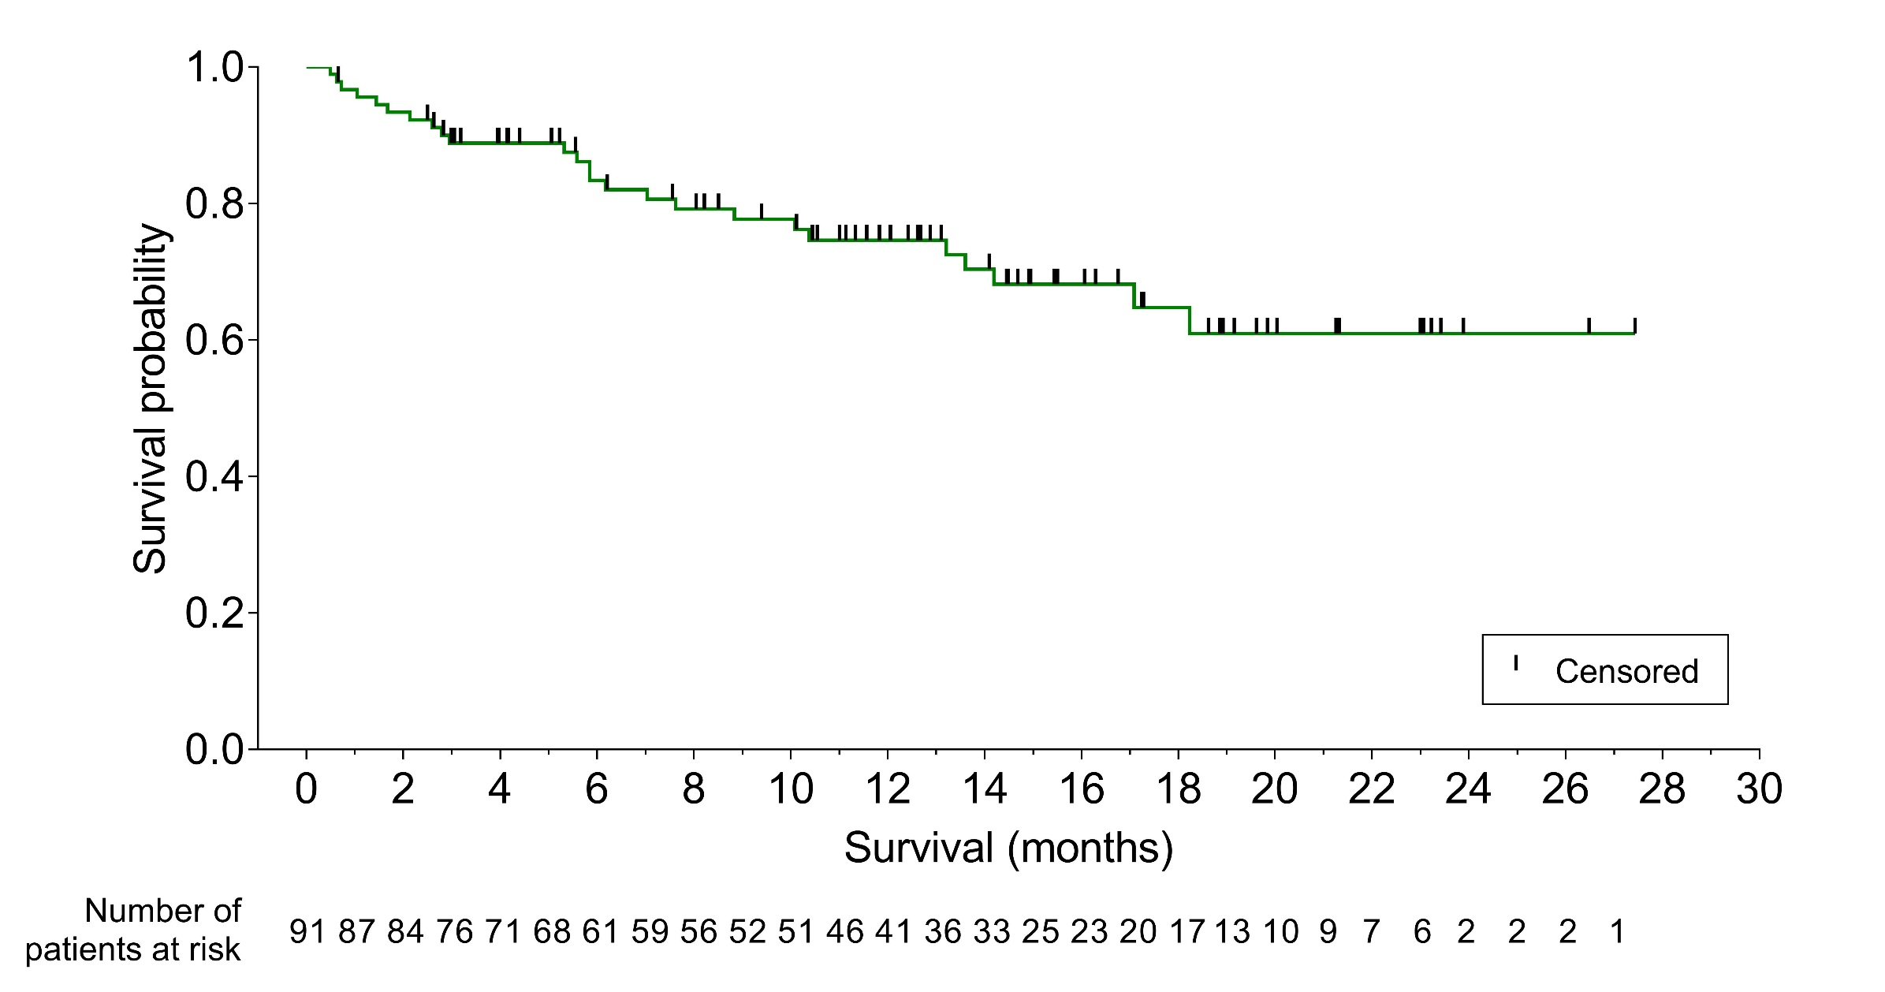
Overall survival in enasidenib-treated patients
75% probability of being alive at 1 year after Induction Day 1
Median overall survival not yet estimable
Stein EM et al. ASH 2018

Slide 40
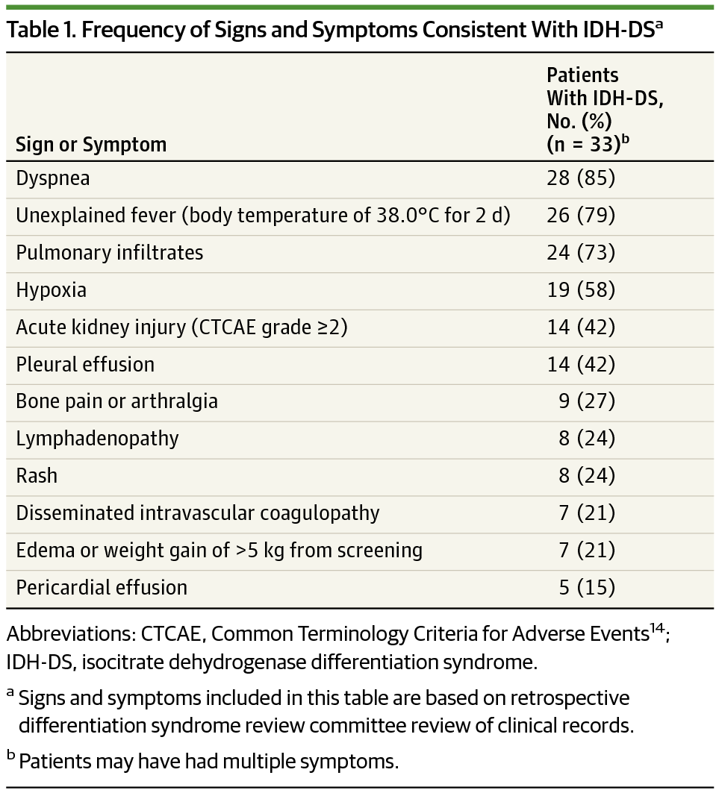
Differentiation Syndrome
Fathi A et al. JAMA Oncology 2018

Slide 41
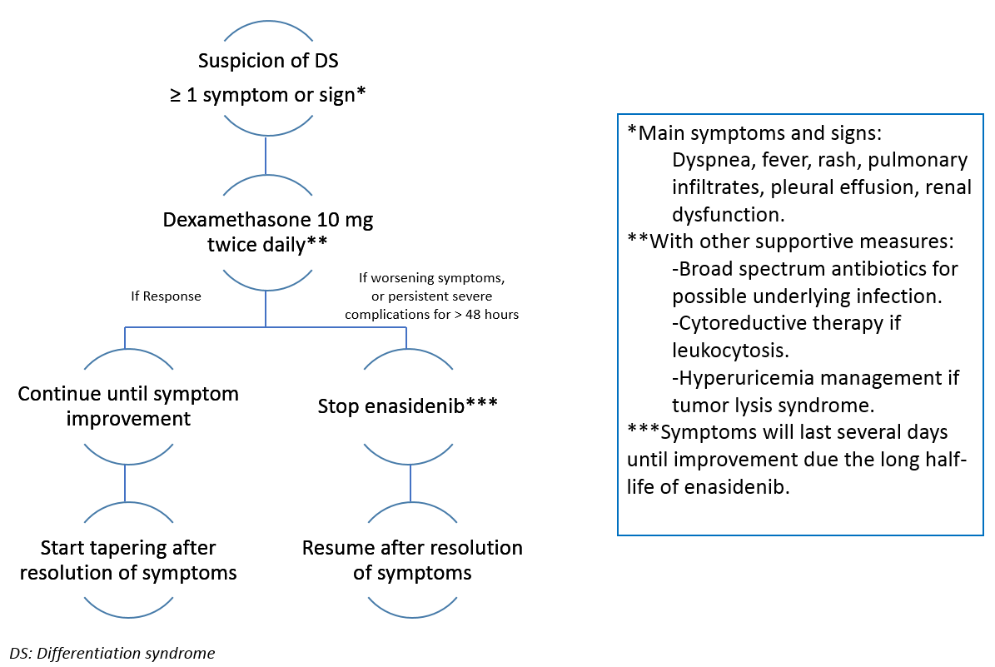
Management of IDH-DS
Abou Dalle I et al. Ther Adv Heme 2018

Slide 42
Role of Blinatumomab and CAR T-Cell Therapy in ALL

Slide 43
In ALL, It’s all About T Cells - Blinatumomab
Kantarjian H et al. NEJM 2017

Slide 44
Blinatumomab for minimal residual disease in adults with B-cell precursor acute lymphoblastic leukemia
Adults with B-cell precursor ALL in hematologic complete remission with MRD (≥ 10⁻³) received blinatumomab 15 𝜇g/m² per day by continuous IV infusion for up to 4 cycles
Primary endpoint: Complete MRD response after 1 cycle of blinatumomab: 88/113 (78%)
 | All patients | MRD responders | MRD nonresponders
Overall survival Patients with events Median OS | 48/110 36.5 mo | 31/85 38.9 mo | 14/22 12.5 mo
Hematologic RFS Patients with events Median Hem RFS | 62/110 18.9 mo | 40/85 23.6 mo | 12/15 5.7 mo
Gokbuget N et al. Blood 2018;131(14):1522-31.

Slide 45
COG AALL1331: Blinatumomab vs Chemo as Post-Reinduction Therapy for Children and Young Adults with Relapsed B-ALL
DFS
OS
1.0
1.0
0.8
0.8
0.6
0.6
DFS
OS
0.4
0.4
0.2
Chemotherapy Blinatumomab
41.0% at 2yr (n = 103) 59.3% at 2yr (n = 105)
0.2
Chemotherapy Blinatumomab
59.2% at 2yr (n = 103) 79.4 % at 2yr (n = 105)
0
P = 0.050
0
P = 0.005
0
0.5
1.0
1.5
2.0
2.5
3.0
3.5
4.0
4.5
0
0.5
1.0
1.5
2.0
2.5
3.0
3.5
4.0
4.5
Yrs
Yrs
Brown PA et al. Proc ASH 2019;LBA-1.

Slide 46
ECOG-E1910: Ongoing Phase III Trial Design
Estimated Enrollment (N = 488)
Newly diagnosed B-lineage ALL BCR-ABL-negative disease No concurrent active cancer No history of recent myocardial infarction (within 3 months) ECOG PS 0-3
Chemotherapy
R
Blinatumomab + chemotherapy
Primary endpoint: Overall survival
www.clinicaltrials.gov (NCT02003222). Accessed February 2020.

Slide 47
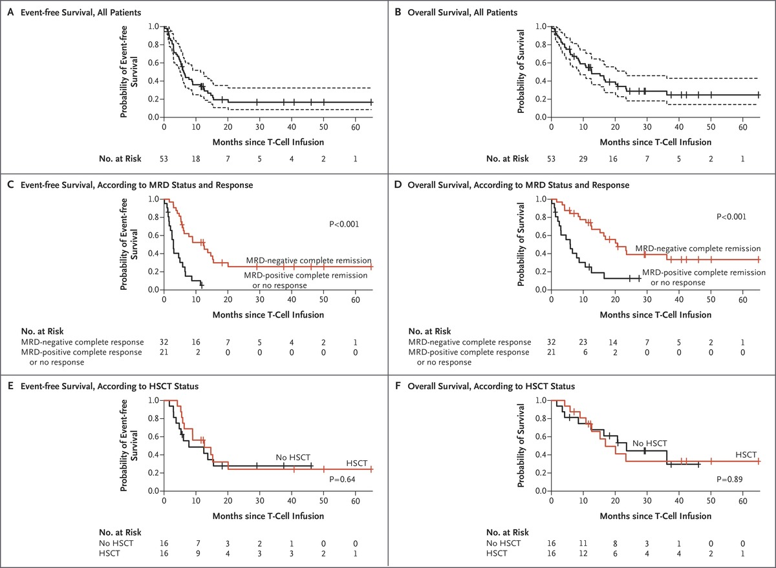
In ALL, It’s all About T Cells – CAR T
Park JH et al. NEJM 2018

Slide 48
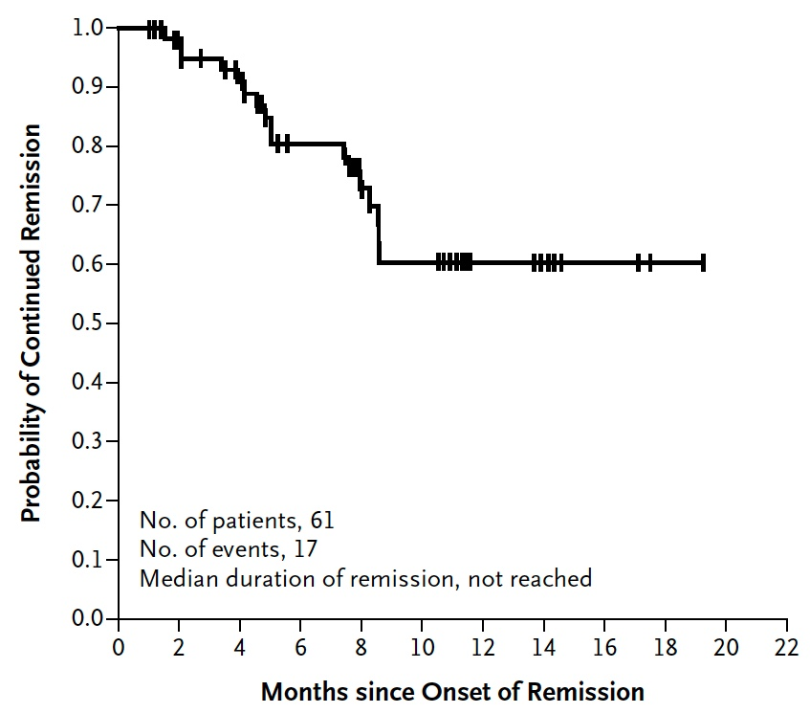
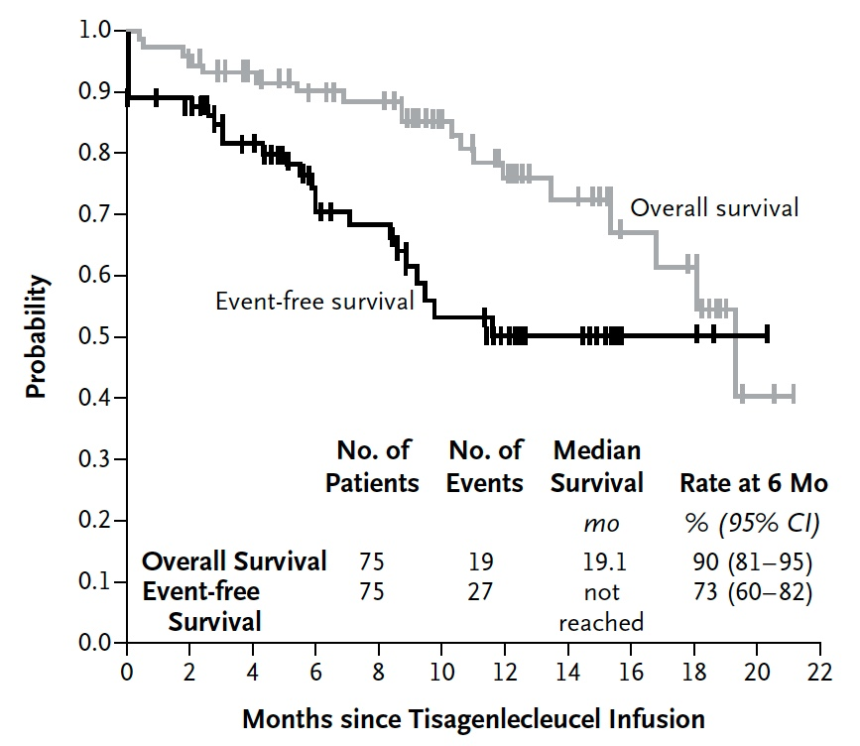
Tisagenlecleucel in Children and Young Adults with B-Cell Lymphoblastic Leukemia
Duration of Remission
Event-Free and Overall Survival
Maude SL et al. N Engl J Med 2018;378:439-48.

