Slide 1
Module 13:
Multiple Myeloma

Slide 2
 | Percent with Patients | Number of Patients (Median)
Multiple Myeloma | 100 | 10
Waldenström Macroglobulinemia | 84 | 4
Smoldering myeloma | 96 | 3

Slide 3


The Evolving Role of Novel and Next Generation Therapy in the Management of Multiple Myeloma: Focus on Selected Agents in RR MM
Paul G Richardson, MD
Clinical Program Leader
Director of Clinical Research
Jerome Lipper Multiple Myeloma Center
Department of Medical Oncology
Dana-Farber Cancer Institute
RJ Corman Professor of Medicine
Harvard Medical School
Boston, Massachusetts
          2020

Slide 4
DISCLOSURES
Advisory Boards
  Celgene Corporation, Novartis, Takeda, Oncopeptides, Amgem
Consultant
  None
Honoraria
  None
Research Funding
  Celgene, Takeda, Oncopeptides, Bristol-Myers Squibb

Slide 5
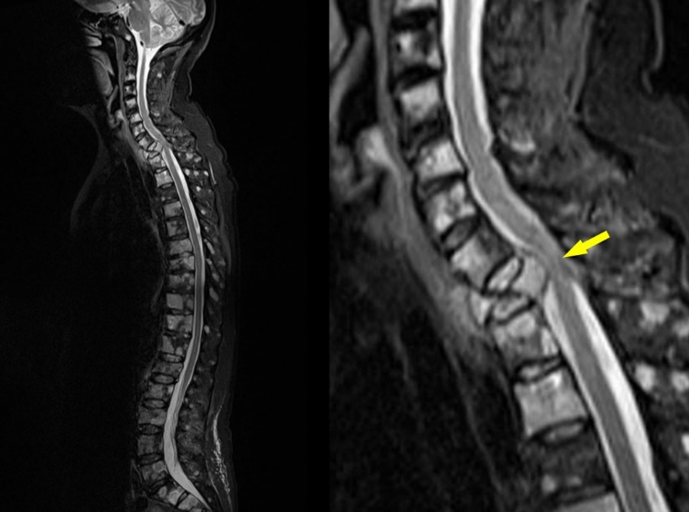
Mary worked as a 64 year-old librarian
And was working full time in 2016 when she:
  Developed severe back pain with associated fatigue and malaise
  Plain Films revealed T1 compression fracture
  Multiple lytic lesions found on skeletal survey affecting both the right femur and T6-8
  MRI demonstrated early SCC in the thoracic spine
  Creatinine was elevated (and normal one year before)
  Admitted emergently for further evaluation and
  treatment
  Dex administered, IVF and bisphosphonate IV
  (pamidronate + IV NS)
  Urgent Radiation therapy and Neurosurgery
  Consult

Slide 6
Case
Myeloma Workup
  Peripheral blood:
    Calcium: 10.2 mg/dL (ULN 10.6 mg/dL)
    Albumin: 3.3 mMol/L (LLN 3.5 mMol/L)
    B₂M: 5.3 mg/dL (ULN 2.64 mg/dL)
    LDH: 150 U/mL (ULN 250 U/mL)
    Creatinine: 2.1 mg/dL (ULN 1.3 mg/dL)
– GFR (calculated): 24 mL/min/1.73m²
    Hgb: 10.8 g/dL
    κ : 1832.0 g/dL (normal range 3.3-19.4 g/dL)
    κ/λ-light-chain ratio: 122 (ULN: 1.65)
  Bone marrow biopsy:
    60% + kappa- restricted PC
    Cytogenetics: t (11,14), 1q amplification
  PET CT:
    Lytic lesions: arms, ribs, spine, skull, femur
Diagnosis: Active myeloma R-ISS Stage II; DSS 3b

Slide 7
Case
PMH
  Type II diabetes
  DVT (RLE in 2014)
  MI (2015)
  Atrial fibrillation
  Obese
  Hypertension
  Hyperlipidemia
Medications:
  Metformin
  Glipizide
  Amlodipine
  Aspirin
  Atorvastatin

Slide 8
Case
Health related factors
  Renal impairment noted
  Thrombosis history
  Cardiac issues
  Diabetes
Impact on treatment decisions and options?
RVd vs. KRd vs. IXA Rd vs. CyBORd
…..and now emerging role of Mabs
(e.g. RVD dara, KRD dara)

Slide 9
Systemic Treatment
RVD + pamidronate X 8 cycles to achieve sCR, followed by len/bort maintenance (Lenalidomide 15 mgs d1-21 every 28 days, Bortezomib every 2 weeks, pamidronate monthly for two years and then every 3 months) – lenalidomide rash resolved with dose reduction and supportive care ~ tolerance of treatment otherwise good (mild to moderate PN, non-painful, and some fatigue)
SCH performed in 2016 and early SCT deferred
Relapsed from CR early 2020 after 4 year PFI, heralded by recurrent chest infections and suppression of uninvolved immunoglobulins; restaging confirmed BM plasmacytosis in addition to a marked rise in KLC, modest decline in renal function (creat 1.9 mg/dl) and progressive bone disease; FISH (t11,14; 1q amplification; 13q deletion)
Salvage options now under consideration

Slide 10
Case: best RRMM treatment options include
Return to RVD at full dose and schedule with monthly pamidronate No
Pomalidomide, dexamethasone and daratumumab and renally adjusted zoledronic acid every 4 weeks Maybe
Carfilzomib and venetoclax with dexamethasone, with venetoclax dosed at 800 mgs/day No
Bortezomib and venetoclax with dexamethasone, venetoclax dosed at 200-400 mgs /day according to tolerance, and monthly concurrent IVIG plus denosumab s/c Yes

Slide 11
Treating Multiple Myeloma
Is a Marathon, Not a Sprint
Asymptomatic
Symptomatic
Relapsing
Refractory
100
Induction Remission +/- ASCT
2nd RELAPSE
1st RELAPSE
M protein (g/L)
50
MGUS or smoldering myeloma
20
Plateau
remission
First-line therapy
Second line
Third line
Adapted from Borrello I. Leuk Res. 2012;36:S3.

Slide 12
Key Targets in MM 2020
Genomic abnormalities:
Target and overcome mutations
Critical Role of Combination and Continuous Therapy
Evolving Position and Timing of ASCT
Excess Protein Production:
Target Protein Degradation
Immune Suppression:
Restore anti-MM immunity

Slide 13
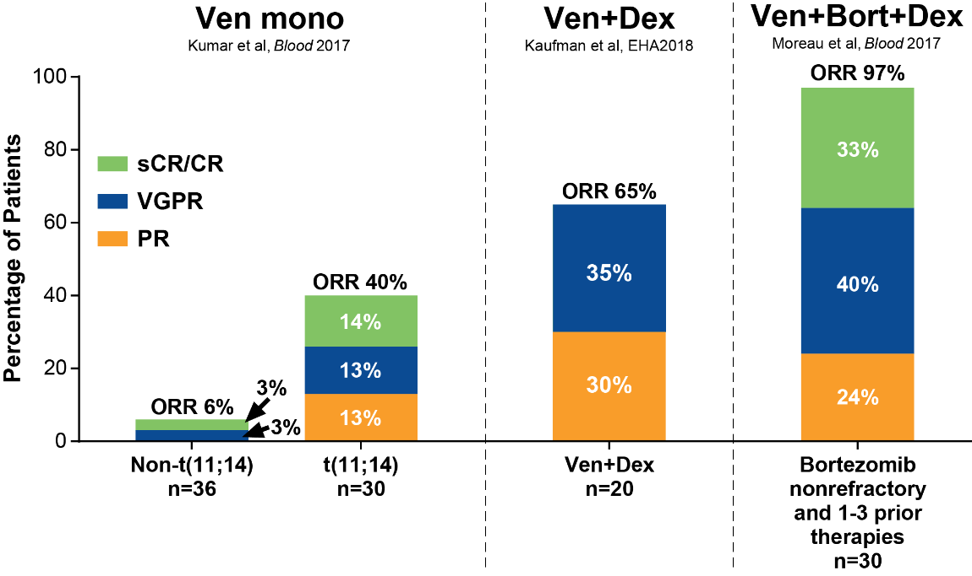
Venetoclax Targets BCL-2 and Induces Apoptosis in
MM Cells
Venetoclax
(Ven)
Dexamethasone
(Dex)
Proteasome inhibitor (PI)
NOXA
BCL-2
MCL-1
BCL-X_{L}
Apoptosis
t(11;14)
n=20
Ven had encouraging clinical efficacy in t(11;14) MM as monotherapy and in a broader patient population in combination with Bd, with a tolerable safety profile in phase 1 studies
CR, complete response; mono, monotherapy; ORR, objective response rate; PI, proteasome inhibitor; PR, partial response; sCR, stringent CR; VGPR, very good partial response.

Slide 14
BELLINI Study Design
n=194
Ven (800 mg QD) +
Bortezomib (B) + Dexamethasone (d)
PD
Randomization
N=291
Key eligibility:
RRMM
1-3 prior lines of therapy
PI nonrefractory
Primary Endpoint:
PFS (per IRC)
Key Secondary Endpoints:
ORR
≥VGPR
OS
QoL/PRO parameters
2:1
Placebo (Pbo) +
Bortezomib (B) + Dexamethasone (d)
PD
n=97
Cycles 1-8: 21-day, bortezomib 1.3 mg/m² days 1, 4, 8, 11 and dexamethasone 20 mg days 1, 2, 4, 5, 8, 9, 11, 12
Cycles 9+: 35-day, bortezomib 1.3 mg/m² days 1, 8, 15, 22 and dexamethasone 20 mg days 1, 2, 8, 9, 15, 16, 22, 23
Stratification factors | Bortezomib sensitive vs naïve Prior lines of therapy: 1 vs 2–3
Nonranked secondary endpoints | PFS in BCL-2^{high} (IHC), DOR, TTP, MRD negativity rate, other PROs (GHS, fatigue)
Key subgroup analyses | t(11;14), high/standard-risk cytogenetics, and BCL2 gene expression
DOR, duration of response; GHS, global health status; IHC, immunohistochemistry; MRD, minimal residual disease; ORR, objective response rate; OS, overall survival; PD, progressive disease; PFS, progression-free survival; PI, proteasome inhibitor; PRO, patient reported outcome; QD, daily; QoL, quality of life; RRMM, relapsed/refractory multiple myeloma; TTP, time to progression; VGPR, very good partial response.

Slide 15
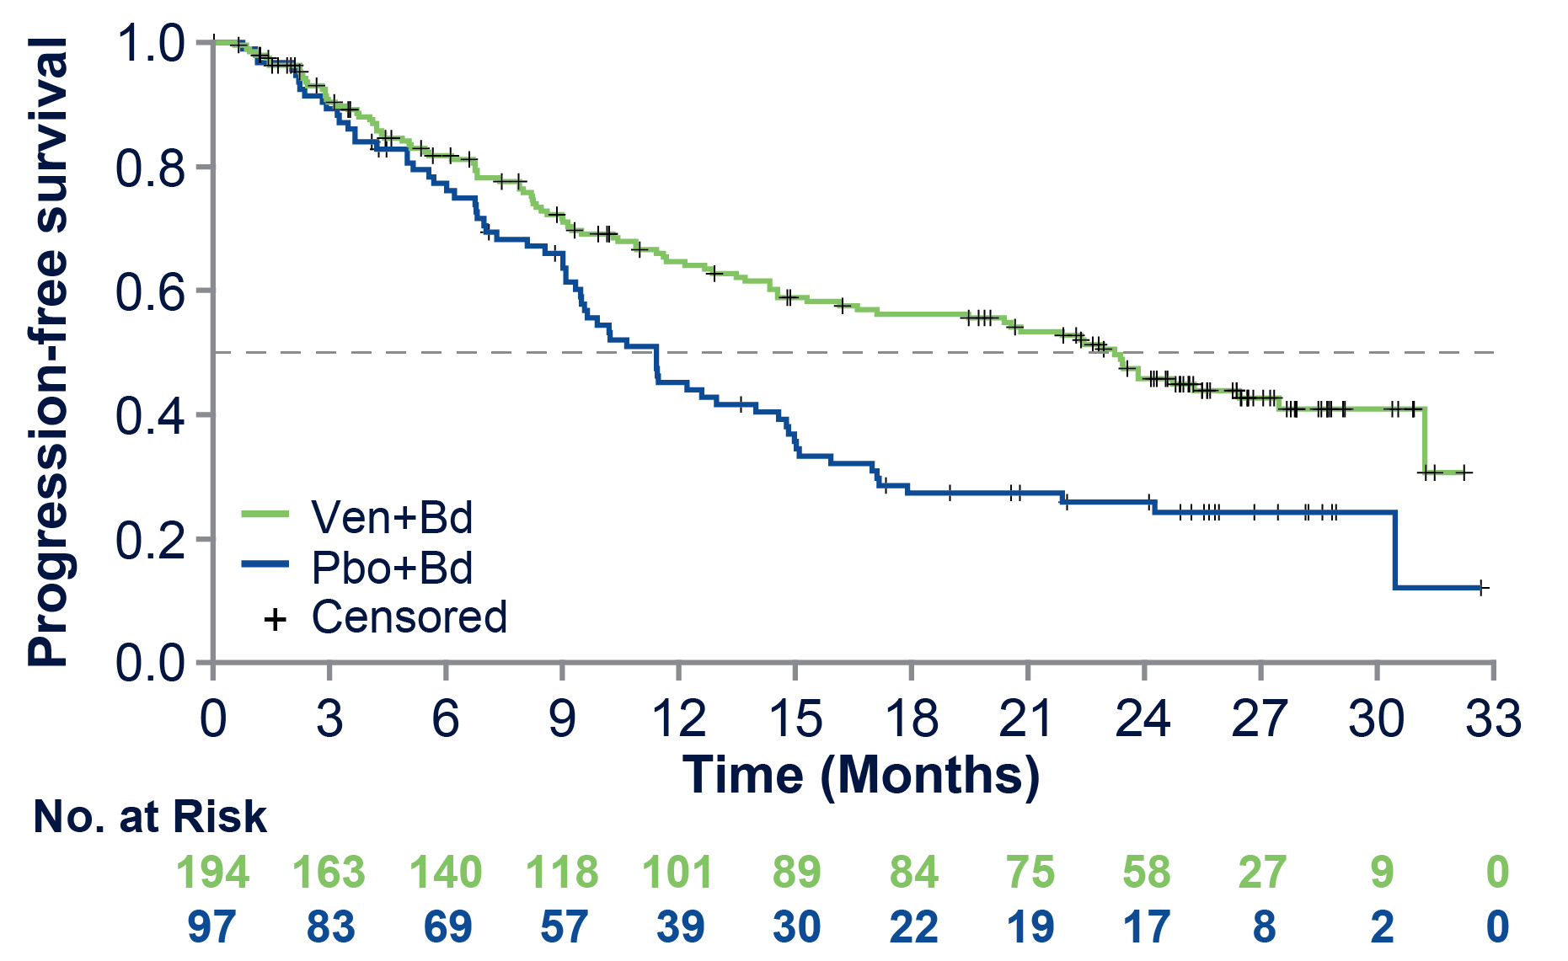
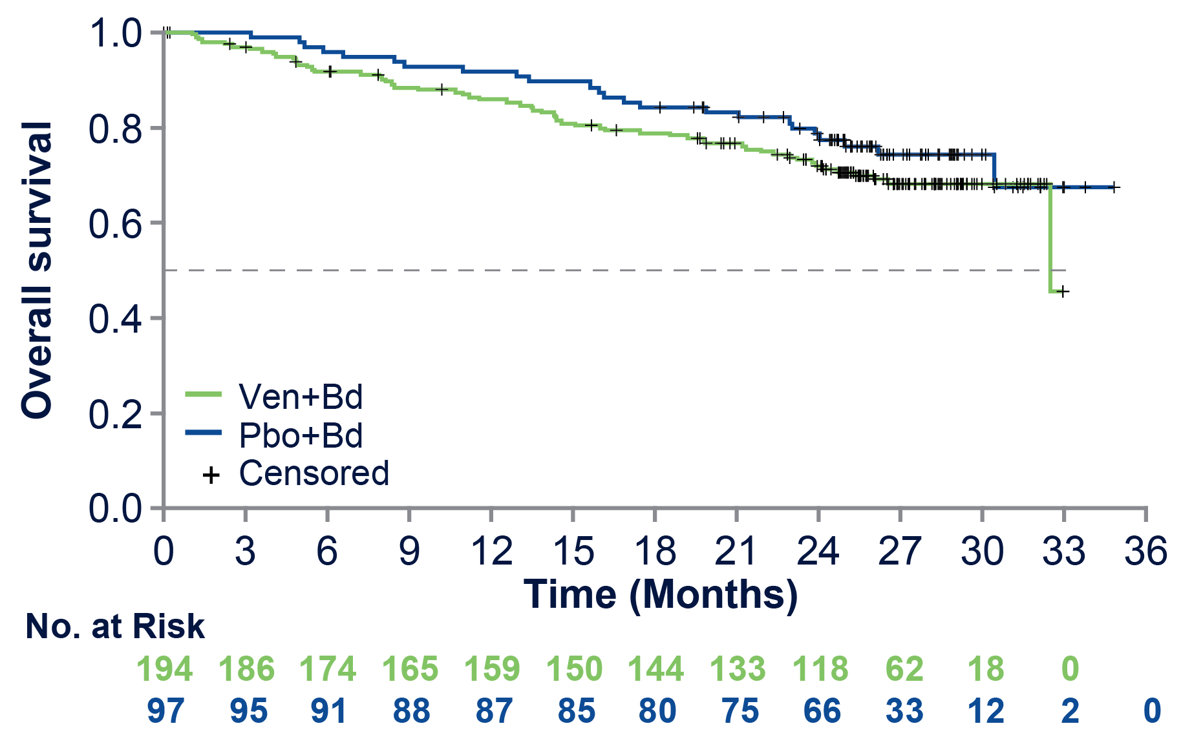
PFS and OS in All Patients (ITT)
Clinical Data Cutoff: 15 Jul 2019
Investigator-Assessed PFS
OS
PFS | Ven+Bd | Pbo+Bd
Median, months | 23.2 | 11.4
HR (95% CI) | 0.60 (0.44, 0.83)
P value | 0.001
OS | Ven+Bd | Pbo+Bd
Median, months | 32.5ª | Not reached
HR (95% CI) | 1.32 (0.82, 2.12)
P value | 0.256
ªBecause of a large number of patients who were censored before reaching the median, the estimated median could change when longer follow-up data are available.

Slide 16
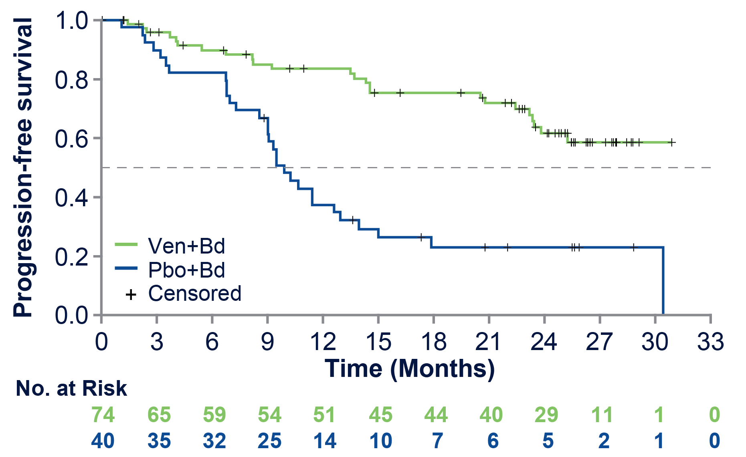
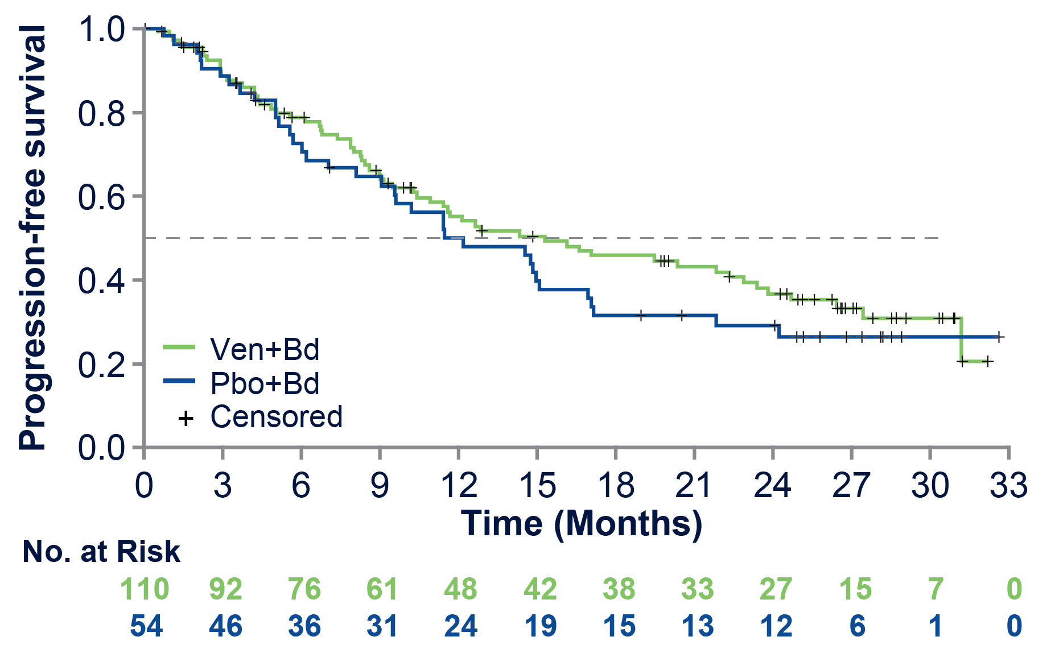
PFS is Significantly Prolonged with Venetoclax in Patients With t(11;14) or BCL2^{high}, but not in Patients With Non-t(11;14), BCL2^{low} MM
t(11;14) or BCL2^{high}
Non-t(11;14) BCL2^{low}
PFS | Ven+Bd | Pbo+Bd
Median, months | Not reached | 9.9
HR (95% CI) | 0.30 (0.17, 0.53)
P value | <0.001
PFS | Ven+Bd | Pbo+Bd
Median, months | 15.3 | 11.5
HR (95% CI) | 0.85 (0.56, 1.30)
P value | 0.451
High BCL2 gene expression was determined by qPCR.

Slide 17
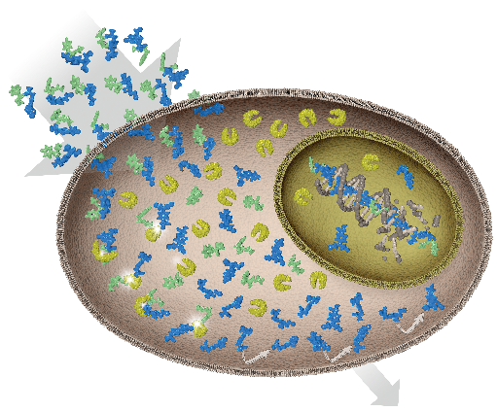
Melflufen Is a Lipophilic Peptide-Conjugated Alkylator
That Rapidly Delivers a Highly Cytotoxic Payload Into Myeloma Cells
Peptidase-enhanced activity in multiple myeloma cells
Peptidases are expressed in several cancers, including multiple myeloma¹⁻³
Melflufen is rapidly taken up by myeloma cells due to its high lipophilicity^{4,5}
Melflufen rapidly induces irreversible DNA damage, leading to apoptosis of myeloma cells^{4,8}
Melflufen
Once inside the myeloma cell, melflufen is immediately cleaved by peptidases⁵⁻⁷
pFPhe (carrier)
Peptidase
The hydrophilic alkylator payloads are entrapped⁵⁻⁷
Alkylator payload
Melflufen is 50-fold more potent than melphalan in myeloma cells in vitro due to increased intracellular alkylator activity^{4,5}
1. Hitzerd SM, et al. Amino Acids. 2014;46:793-808. 2. Moore HE, et al. Mol Cancer Ther. 2009;8:762-770. 3. Wickström M, et al. Cancer Sci. 2011;102:501-508.
4. Chauhan D, et al. Clin Cancer Res. 2013;19:3019-3031. 5. Wickström M, et al. Oncotarget. 2017;8:66641-66655. 6. Wickström M, et al. Biochem Pharmacol. 2010;79:1281-1290. 7. Gullbo J, et al. J Drug Target. 2003;11:355-363. 8. Ray A, et al. Br J Haematol. 2016;174:397-409.

Slide 18
HORIZON: Study Design
Melflufen + dexamethasone
Phase 2, Single-Arm, Open-Label, Multicenter Study
Primary endpoint
ORR
Inclusion Criteria
Pts with RR MM refractory to pom or dara or both
≥2 prior lines of therapy including an IMiD and a PI
ECOG PS ≤2
28-Day Cycle
Secondary endpoints
PFS
DOR
OS
CBR
TTR
TTP
Safety
N=121
Day 1
40 mg melflufen
40ª mg dex
Days 8, 15 and 22
40ª mg dex
All 121 pts (100%) received prior PIs + IMiDs
IMiDs: lenalidomide, thalidomide, and pomalidomide
PIs: bortezomib, carfilzomib, and ixazomib
mAbs included daratumumab, elotuzumab, isatuximab
Follow-up for PFS and OS
for up to 24 months
EoT
Follow-up
With a median follow-up of 10.8 months, 29% of pts are on ongoing treatment (data cutoff 06 May 2019)

Slide 19
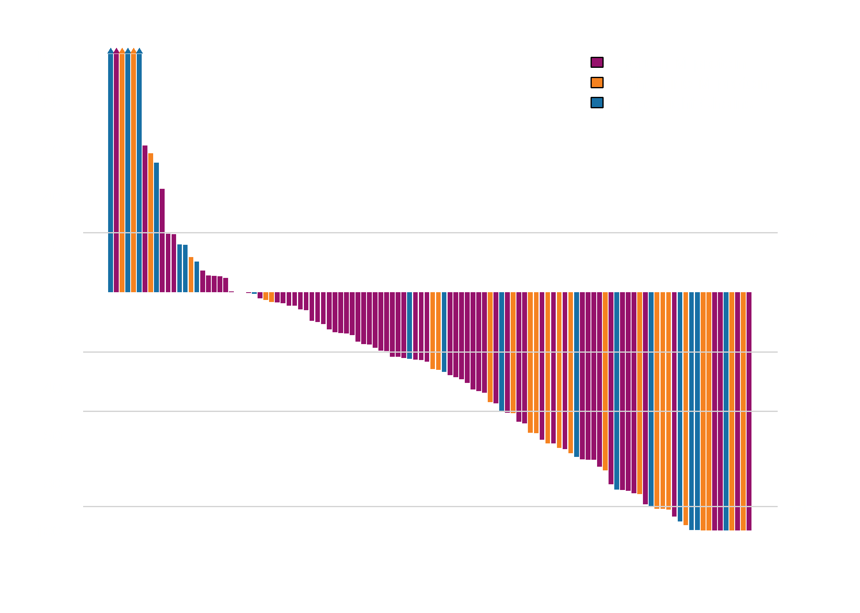
Best M-Protein Change (n=112)ª
Best Change in M-Protein
From Baseline (%)
ªM-protein data for 9 pts missing at time of data cut-off.
Disease stabilization rate/disease control rate [DCR] (≥SD) was 86%
Data cutoff 06 May 2019.

Slide 20
Best Response
Best Response (%)
CBR
40%
ORR
55%
ORR
22%
CBR
33%
CBR
32%
ORR
28%
ORR
20%
Median time to response 1.2 months
13 of ongoing pts have follow-up time of 4 weeks
sCR was confirmed MRD negative (10⁻⁶ sensitivity) with current ongoing progression-free period of 13.6 months.
ª8, 1, 7 and 6 pts, respectively, did not have any available response data or end of treatment data. At time of data cutoff 1 VGPR, 2 PRs and 4 MRs were unconfirmed. ^{b}Not anti-CD38 refractory.
Data cutoff 06 May 2019.

Slide 21
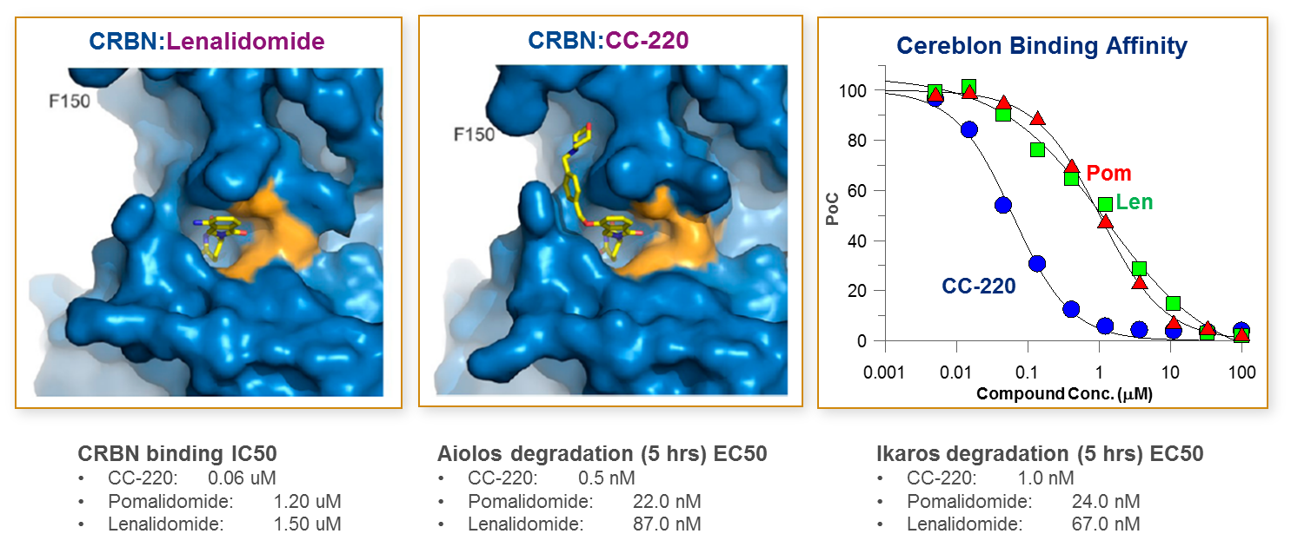
Lonial et al , ASCO 2019
IBERDOMIDE Mechanism of Action
IBER enhances in vitro immune stimulatory activity versus LEN and POM¹
LEN²
IBER²
IL-2 Secretion by Treated PBMCs¹
MM Cell Survival in
Co-Culture With Treated PBMCs¹
1,500
120
LEN
POM
IBER
100
1,000
80
Secreted IL-2 (ng/mL)
Live Cells (% DSMO)
500
60
EC₅₀, nM² | Ikaros | Aiolos
LEN | 67 | 87
POM | 24 | 22
IBER | 1 | 0.5
40
LEN
POM
IBER
0
20
0
0.1
1
10
100
1,000
0
0.1
1
10
100
1,000
100,000
100,000
Compound Concentration (nM)
Compound Concentration (nM)
  DSMO, dimethylsulfoxide; EC₅₀, half maximal effective concentration; IL, interleukin; NK, natural killer; PBMC, peripheral blood mononuclear cell.
1. Bjorklund CC, et al. Unpublished data. 2. Adapted with permission from
Matyskiela ME, et al. J Med Chem. 2018;61:535-542 © 2018 American Chemical Society.

Slide 22
Iberdomide MM-001 Phase 1b/2a trial: Study Design
Phase 1
RRMM
Prior LEN or POM
Prior proteasome inhibitor
Documented PD during or within 60 days of last antimyeloma therapy
Phase 2
Cohort A:
IBER
Cohort C:
IBER (RP2D)
Cohort B:
IBER + DEXª
Cohort D:
IBER (RP2D) + DEXª
Cohort E:
IBER + DARA + DEX
Study objective: Determine the MTD / RP2D and efficacy of IBER in RRMM
3 triplet cohorts
Cohort F:
IBER + BORT + DEX
Cohort G:^{b}
IBER + CFZ + DEX
ª DEX given at a dose of 40 mg (20 mg in patients aged > 75 years) on Days 1, 8, 15, and 22 of each 28-day cycle. ^{b} CFZ dosed once weekly (Cohort G1) or twice weekly (Cohort G2).
CFZ, carfilzomib; DEX, dexamethasone; MTD, maximum tolerated dose; PD, progressive disease; RP2D, recommended phase 2 dose; RRMM, relapsed/refractory multiple myeloma.

Slide 23
Response
ORR 32.2%
ORR 35.3%
ORR 29.6%
2 (3.4)
1 (2.0)
1 (3.7)
CBR
49.2%
17 (28.8)
17 (33.3)
7 (25.9)
10 (16.9)
DCR
84.7%
4 (14.8)
9 (17.7)
10 (37.0)
21 (35.6)
17 (33.3)
9 (15.3)
7 (13.7)
5 (18.5)
Evaluable patients include patients who have received ≥ 1 dose of IBER, had measurable disease at baseline, and ≥ 1 post-baseline response assessment.
ª Includes LEN and POM.
CBR, clinical benefit rate; DCR, disease control rate; MR, minimal response; ORR, overall response rate; PR, partial response; SD, stable disease; VGPR, very good partial response.

Slide 24
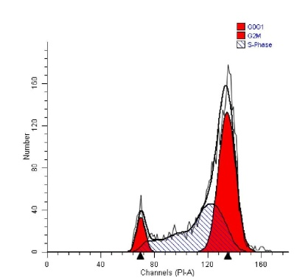


Antibody Drug Conjugates (ADC) –
BCMA Auristatin Immunotoxin Induces Strong Anti-MM Effects
Macrophage (Mφ )
Apoptotic
MM cells
ADPC
ADCC
MMAF released at
lysosome to
induce G₂/M arrest
followed by apoptosis
Apoptosis
FcRII
NK,
Monocyte
FcRII
Mφ engulfing MM
MM
MM
NFκB
GSK2857916
Inhibition of NFκB signaling
MM cell lysis
APRIL
BAFF
Bone Marrow Stromal Cell
BCMA
GSK2857916
Tai et al, Blood. 2014

Slide 25
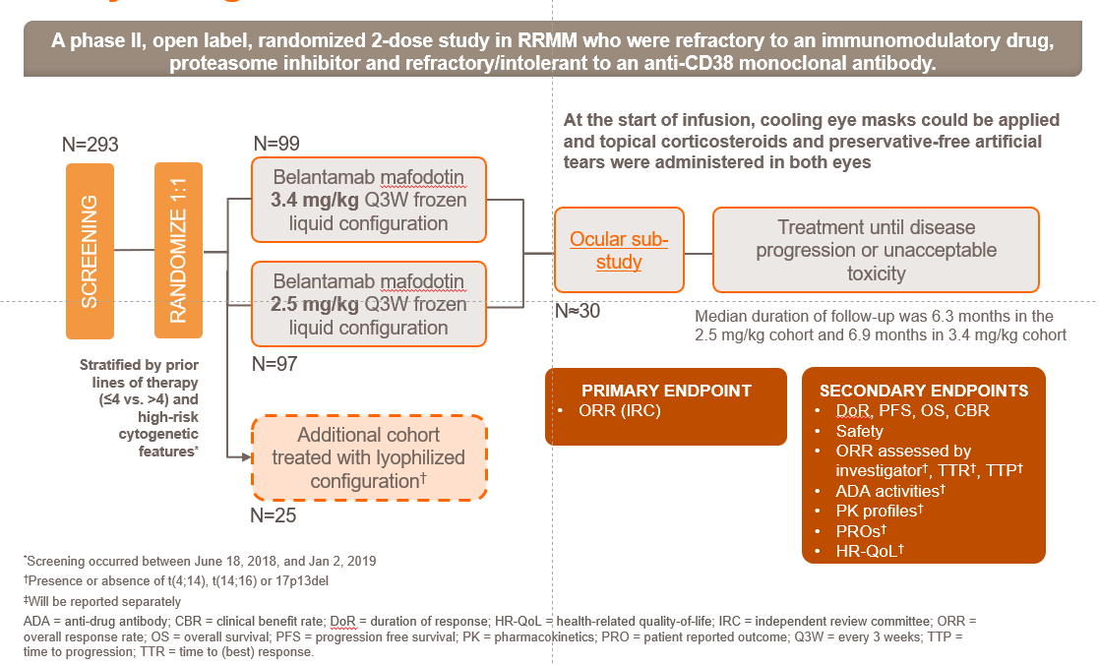
DREAMM-2 Study Design
Lonial S, Lee HC, Badros A, et al. Belantamab mafodotin for relapsed or refractory multiple myeloma (DREAMM-2): a two-arm, randomized, open-label, phase 2 study. Lancet Oncol. 2019. Epub ahead of print. https://doi.org/10.1016/S1470-2045(19)30788-0.
ClinicalTrials.gov Identifier NCT03525678. Available at https://clinicaltrials.gov/ct2/show/NCT03525678

Slide 26
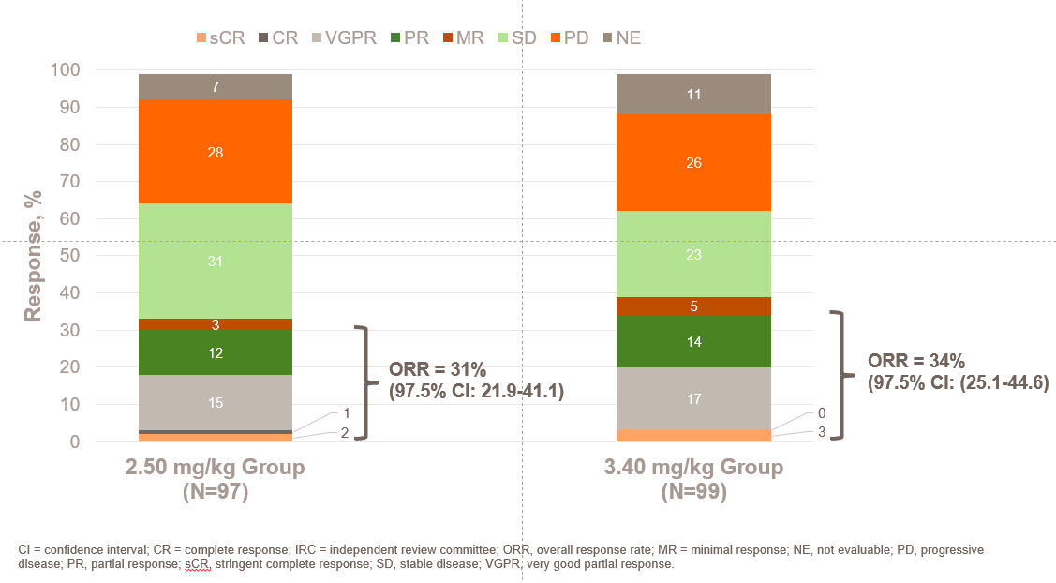
Efficacy Data: Overall Response Rate (IRC)
As of data cut-off (June 21, 2019)
Lonial S, Lee HC, Badros A, et al. Belantamab mafodotin for relapsed or refractory multiple myeloma (DREAMM-2): a two-arm, randomized, open-label, phase 2 study. Lancet Oncol. 2019. Epub ahead of print. https://doi.org/10.1016/S1470-2045(19)30788-0.

Slide 27
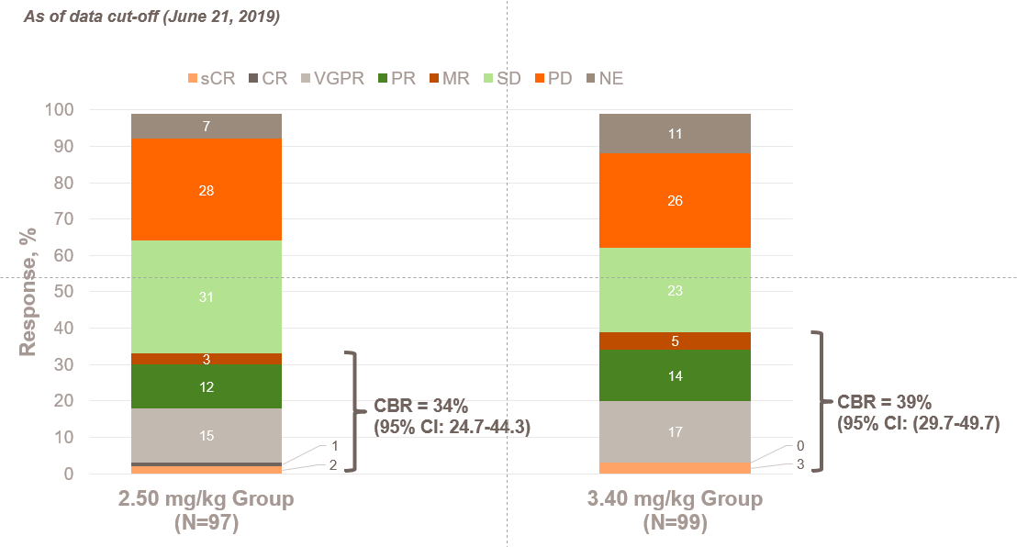
Efficacy Data: Clinical Benefit Rate
CBR = clinical benefit rate; CI = confidence interval; CR = complete response; IRC = independent review committee; ORR, overall response rate; MR = minimal response; NE, not evaluable; PD, progressive disease; PR, partial response; sCR, stringent complete response; SD, stable disease; VGPR, very good partial response.
Lonial S, Lee HC, Badros A, et al. Belantamab mafodotin for relapsed or refractory multiple myeloma (DREAMM-2): a two-arm, randomized, open-label, phase 2 study. Lancet Oncol. 2019. Epub ahead of print. https://doi.org/10.1016/S1470-2045(19)30788-0.

Slide 28
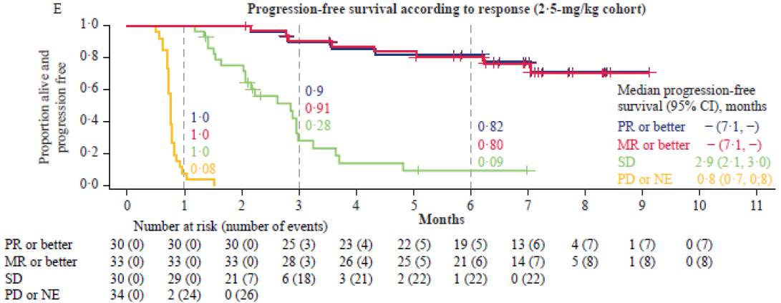
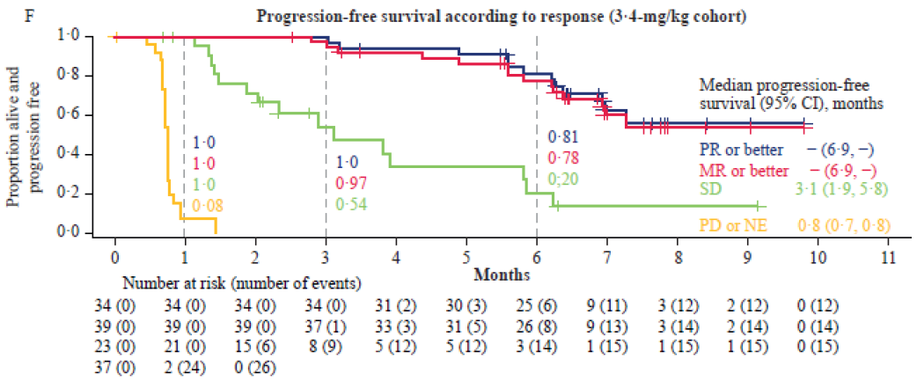
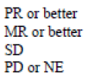
Efficacy Data: Progression-Free Survival by Response
The median PFS was not reached in patients with a partial response or better
CI = confidence interval; IQR = interquartile range; MR = minimal response; NE = not evaluable; PD = progressive disease; PFS = progression-free survival; PR = partial response; SD = stable disease
Lonial S, Lee HC, Badros A, et al. Belantamab mafodotin for relapsed or refractory multiple myeloma (DREAMM-2): a two-arm, randomized, open-label, phase 2 study. Lancet Oncol. 2019. Epub ahead of print. https://doi.org/10.1016/S1470-2045(19)30788-0.

Slide 29
Safety Data: Treatment Discontinuation, Dose Reductions, Dose Interruptions/Delays and Adverse Events of Special Interest
As of data cut-off (June 21, 2019)
Median dose intensity was
2.47 mg/kg (IQR: 1.56–2.50) in the 2.5 mg/kg cohort
2.95 mg/kg (IQR: 1.85–3.40) in the 3.4 mg/kg cohort
However, because of the higher incidence of dose modifications, the dose intensity was lower than the intended dose for the 3·4 mg/kg dose group
Events | Belantamab Mafodotin 2.5-mg/kg Cohort (N=95) | Belantamab Mafodotin 3.4-mg/kg Cohort (N=99)
 | Percentage of patients
Adverse events leading to treatment discontinuation | 8 | 10
Adverse events leading to dose reduction | 29 | 41
Adverse events leading to dose interruption/delay | 54 | 62
Keratopathy was the most common reason for permanent treatment discontinuation in both the 2.5 mg/kg and 3.4 mg/kg cohorts (1% and 3%, respectively)
Events reported based on Common Terminology Criteria for Adverse Events criteria v4.0314 in the safety population (including all patients who received at least one dose of trial treatment)
Thrombocytopenia includes the preferred terms thrombocytopenia, decreased platelet count, and cerebral hemorrhage. Infusion-related reactions includes preferred terms infusion-related reaction, pyrexia, chills, diarrhea, nausea, vomiting if occurring within 24 hours.
Adverse Event of Special Interest | Belantamab Mafodotin 2.5-mg/kg Cohort (N=95) | Belantamab Mafodotin 3.4-mg/kg Cohort (N=99) | Belantamab Mafodotin 3.4-mg/kg Cohort (N=99)
 | Percentage of patients
Thrombocytopenia | 35 |  | 59
Infusion-related reactions | 21 |  | 16
Keratopathy | 71 |  | 75
IQR = interquartile range
Lonial S, Lee HC, Badros A, et al. Belantamab mafodotin for relapsed or refractory multiple myeloma (DREAMM-2): a two-arm, randomized, open-label, phase 2 study. Lancet Oncol. 2019. Epub ahead of print. https://doi.org/10.1016/S1470-2045(19)30788-0.

Slide 30
Conclusions – Continued Integration and Impact of Novel Agents in ND MM and
RR MM, including Immune Therapies:
Innovations (PIs, IMiDs, MoAbs, HDACs) to date have produced significant improvements in PFS and OS; recent approvals will augment this
10 Novel Drugs and > 26 new FDA-approved drugs/combos/indications in last 18 yrs
Next wave of immune therapies: crucially, are they agnostic to mutational thrust?
Baseline immune function is a key barrier to success and appears to be targetable
mAbs (including ADCs, BiTEs) represent true new novel mechanisms, as well as other immuno-therapeutics (e.g. CAR –T, cellular therapies, vaccines)
New insights to mechanisms of drug action are further expanding treatment/immuno-therapeutic opportunities with combinations
Next generation small molecules also show great promise – e.g. VENETOCLAX, SELINEXOR, MELFLUFEN, CeLMoDS
Further refinement of prognostics, immune profiling, and MRD will guide therapy

Slide 31

CART Therapy in MM
Sagar Lonial, MD
Chair and Professor
Department of Hematology and Medical Oncology
Chief Medical Officer
Winship Cancer Institute
Emory University
Atlanta, Georgia

Slide 32
Disclosures
Consulting Agreements | Amgen Inc, Bristol-Myers Squibb Company, Celgene Corporation, GlaxoSmithKline, Janssen Biotech Inc, Novartis, Takeda Oncology
Contracted Research | Celgene Corporation, Janssen Biotech Inc, Takeda Oncology

Slide 33
Case
45 year old female, presented with RISS 2 ISS 3 MM. Received initial induction with RVD followed by Mel 200 auto and based on standard risk genetics, received len maintenance alone.
Did well for 14 months, then had progression with anemia and bone lesions
Pom/Dara/Dex, PR lasted for 6 months
Car/Cyclo/Dex, PR lasted for 4 months

Slide 34
Options
1. DCEP/VDCEP
2. New IMID phase 2 trial
3. Allo transplant
4. CART trial
5. Hospice

Slide 35
Story
She received VDCEP as salvage therapy, but rapidly progressed within 60 days
Underwent T cell collection, no bridging, and CART infusion on study
Complicated by grade 3 CRS that responded to Toci, No neurotoxicity
Achieved CR by day 100, MRD negative by 6 months
Remains in CR 14 months out from CART infusion

Slide 36
Optimal Target for CART in MM
CD38?
SLAMF7?
CD19?
BCMA
Others?

Slide 37
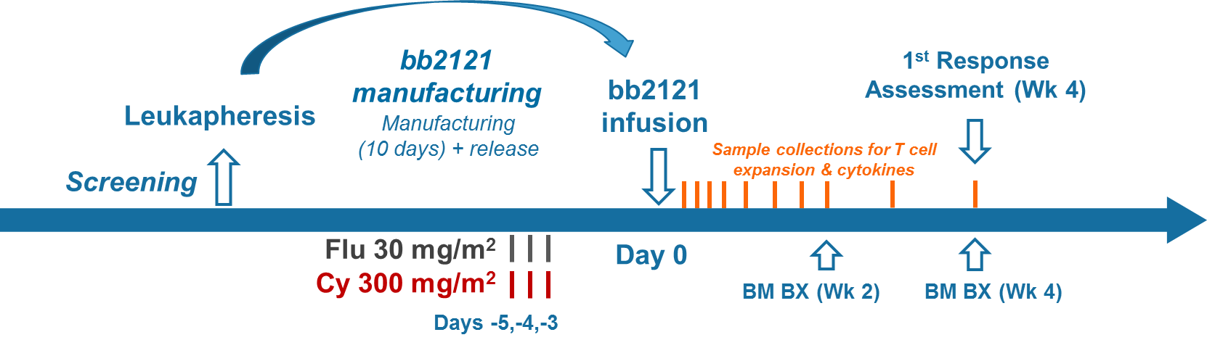
bb2121 Anti-BCMA CAR T-Cell Therapy in Patients With Relapsed/Refractory Multiple Myeloma:
Updated Results From a Multicenter Phase 1 Study CRB-401
Flu 30 m/m²
Cy 300 mg/m²
Dose Escalation (N = 21) |  | Dose Expansion (N = 22)
≥ 50% BCMA expression
50 × 10⁶
150 × 10⁶
450 × 10⁶
800 × 10⁶
Raje N, et al. N Engl J Med. 2019;380:1726-1737.

Slide 38
Treatment History
Parameter | Escalation (N = 21) | Expansion (N = 12)
Prior regimens, median (min, max) | 7 (3, 14) | 8 (3, 23)
Prior autologous SCT, n (%) | 21 (100) | 11 (92)
Parameter | Escalation (N = 21) |  | Expansion (N = 12)
 | Exposed | Refractory | Exposed | Refractory
Prior therapies, n (%)
Bortezomib | 21 (100) | 13 (62) | 12 (100) | 7 (58)
Carfilzomib | 19 (90) | 12 (57) | 11 (92) | 7 (58)
Lenalidomide | 21 (100) | 17 (81) | 12 (100) | 7 (58)
Pomalidomide | 19 (90) | 14 (67) | 12 (100) | 12 (100)
Daratumumab | 15 (71) | 9 (43) | 12 (100) | 9 (75)
Raje N, et al. N Engl J Med. 2019;380:1726-1737.

Slide 39
Response to bb2121 Infusion
ORR: 85%
CR/sCR: 45%
Raje N, et al. N Engl J Med. 2019;380:1726-1737.

Slide 40
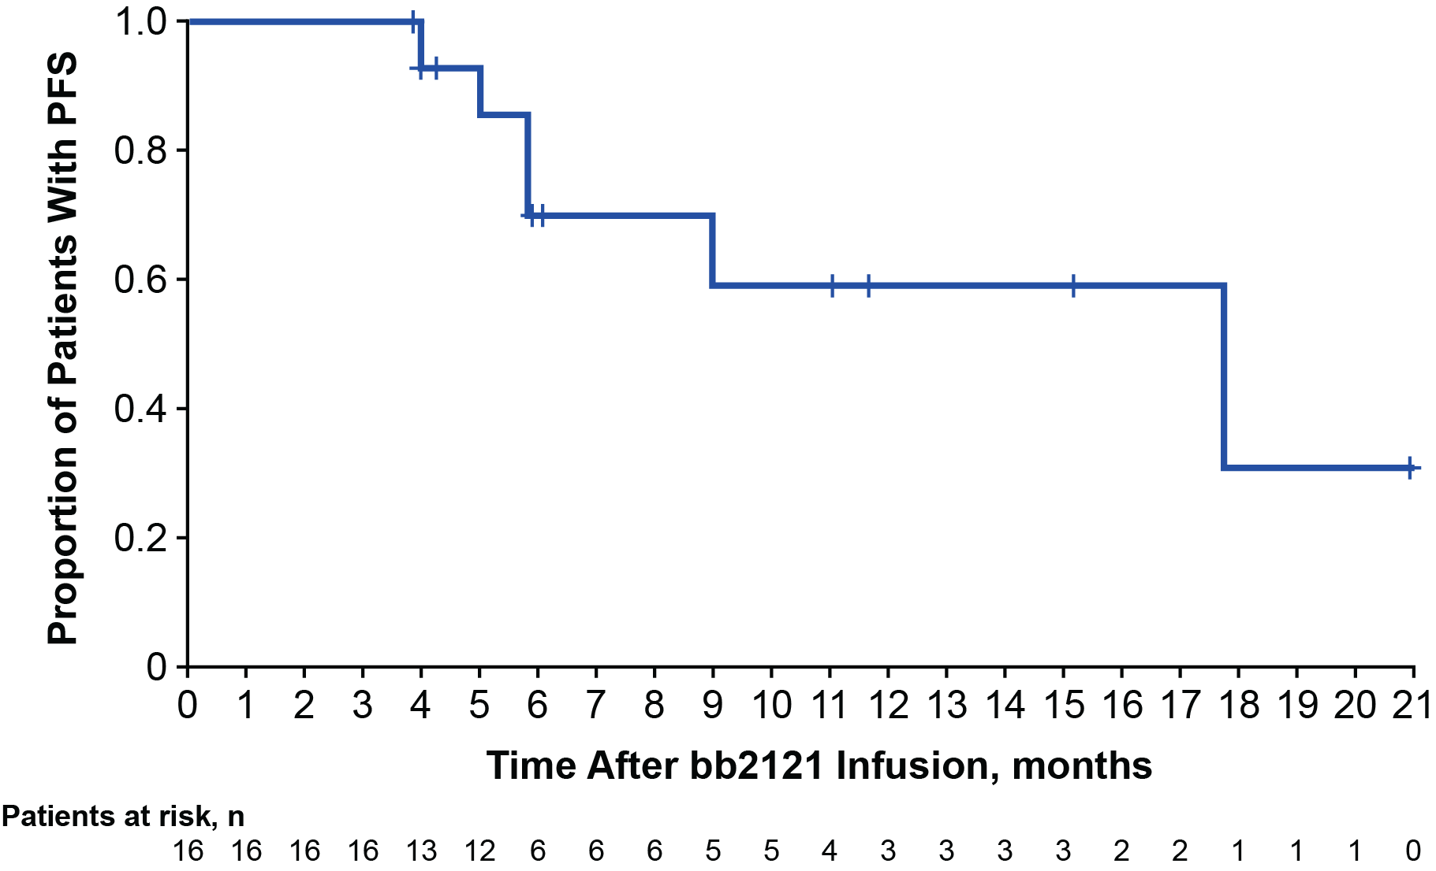
Progression-Free Survival
PFS¹
PFS in MRD-Negative Patients²
mPFS = 17.7 mo (n = 16)
1. Raje N, et al. N Engl J Med. 2019;380:1726-1737. 2. Raje NS, et al. ASCO 2018. Abstract 8007.

Slide 41
bb2121: Safety
Treatment-Emergent AEs, n (%) | All Patients (N = 33)
 | Any Grade | Grade ≥ 3
CRS | 25 (76) | 2 (6)
Neurotoxicity | 14 (42) | 1 (3)
Neutropenia | 28 (85) | 28 (85)
Leukopenia | 20 (61) | 19 (58)
Anemia | 19 (58) | 15 (45)
Thrombocytopenia | 19 (58) | 15 (45)
Lymphopenia | 6 (18) | 6 (18)
Raje N, et al. N Engl J Med. 2019;380:1726-1737.

Slide 42
Pivotal Phase II KarMMa Study of bb2121 (Ide-cel) for Relapsed/Refractory MM Meets Primary and Key Secondary Endpoints
Press Release – December 6, 2019
“On 6th December 2019, it was announced that the phase II KarMMA study met its primary endpoint of overall response rate (ORR) and key secondary endpoint of complete response (CR) rate. The KarMMA study is investigating idecabtagene vicleucel (ide-cel, also known as bb2121), in patients with relapsed/refractory multiple myeloma (RRMM). Ide-cel is a chimeric antigen receptor (CAR) T-cell therapy targeting B-cell maturation antigen (BCMA).”
CAR T-cell dose | 150 x 10⁶ | 300 x 10⁶ | 450 x 10⁶ | 150 – 450 x 10⁶
N | 4 | 70 | 54 | 128
ORR | 50% | 68.6% | 81.5% | 73.4%
CR/stringent CR | 25% | 28.6% | 35.2% | 31.3%
Median DoR | — | 9.9 mo | 11.3 mo | 10.6 mo
Median PFS | — | 5.8 mo | 11.3 mo | 8.6 mo
https://multiplemyelomahub.com/medical-information/update-from-the-karmma-study-of-car-t-cell-product-bb2121-ide-cel

Slide 43
CARTITUDE-1 Trial of JNJ-4528
Study Design
Primary Objectives:
Phase 1b: Characterize safety and confirm phase 2 dose as informed by the LEGEND-2 study
Phase 2: Evaluate efficacy of JNJ-4528
Screening (28 days)
Apheresis
Key Eligibility Criteria:
Progressive MM per IMWG criteria
ECOG PS ≤ 1
Measurable disease
Received ≥ 3 prior therapies or double refractory
Prior PI, IMiD, anti-CD38 therapy
Bridging Therapy (as needed)
Cy (300 mg/m²) + Flu (30 mg/m²)
Day -5
to -3
JNJ-4528 Infusion
Target: 0.75x10⁵ (0.5 - 1.0x10⁵) CAR+ viable T cells/kg
Day 1
Median administered dose = 0.73 x 10⁶
(0.52) – (0.89) x 10⁶ CAR+ viable T cells/kg
Median follow-up at data cutoff = 6 mo (3, 14)
Post-Infusion Assessments
Safety, Efficacy, PK, PD, Biomarker
Follow-Up
Madduri D, et al. ASH 2019. Abstract 577.

Slide 44
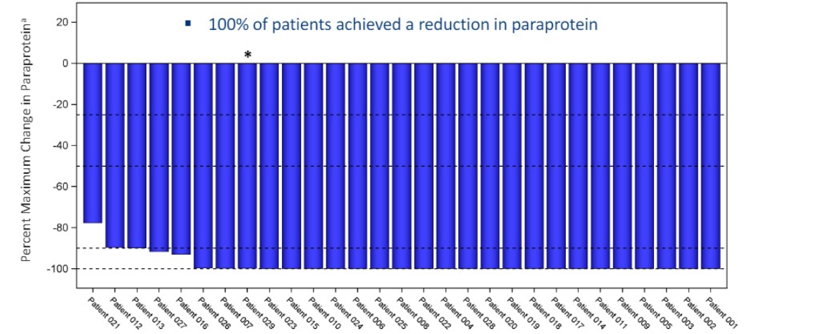
CARTITUDE-1 Trial of JNJ-4528
Reduction in Tumor Burden
  100% of 17 evaluable patients were MRD-negative at day 28
    9 patients
    MRD-negative
    at 10⁻⁶
    5 patients
    MRD-negative
    at 10⁻⁵
    3 patients
    MRD-negative
    at 10⁻⁴
  5 patients without identifiable clone at baseline
Madduri D, et al. ASH 2019. Abstract 577.

Slide 45
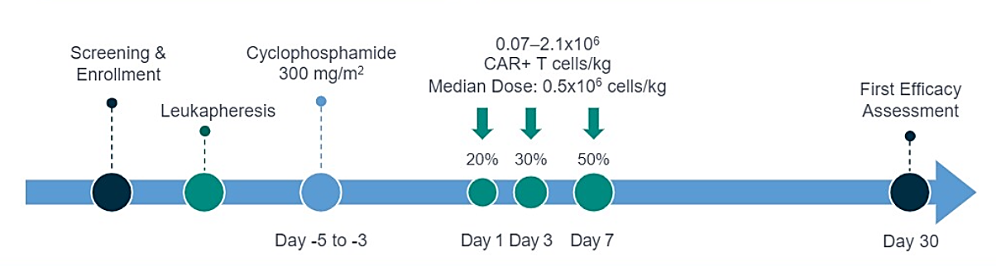
LCAR-B38M
LEGEND-2 Study Design
Key Inclusion Criteria:
Active MM defined by IMWG criteria
Relapsed on prior regimens
Key Objectives:
Primary: safety of LCAR-B38M CAR T cells
Secondary: antimyeloma activity based on IMWG response criteria
Wang BY, et al. ASH 2019. Abstract 579.

Slide 46
LCAR-B38M
Conclusions
  LCAR-B38M displayed a safety profile consistent with other safety reports of BCMA-targeting CAR T-cell therapy
  High ORR and deep responses were achieved with low CAR-positive T-cell doses (median dose = 0.5 x 10⁶ cells/kg)
  With a median follow-up of 25 mo
    mPFS for all patients was 19.9 mo (28.2 mo for CR patients)
    mOS for all patients was 36.1 mo (NE for CR patients)
  A phase 2 confirmatory study with LCAR-B38M is ongoing in China (CARTIFAN-1, NCT03758417)
  3 studies are ongoing in the United States with JNJ-4528, using an identical construct
    Phase 1b/2 registration study (CARTITUDE-1, NCT03548207)
    Phase 2 multi-cohort study (CARTITUDE-2, NCT04133636) evaluating different populations of patients with MM
Wang BY, et al. ASH 2019. Abstract 579.

